Slide 1
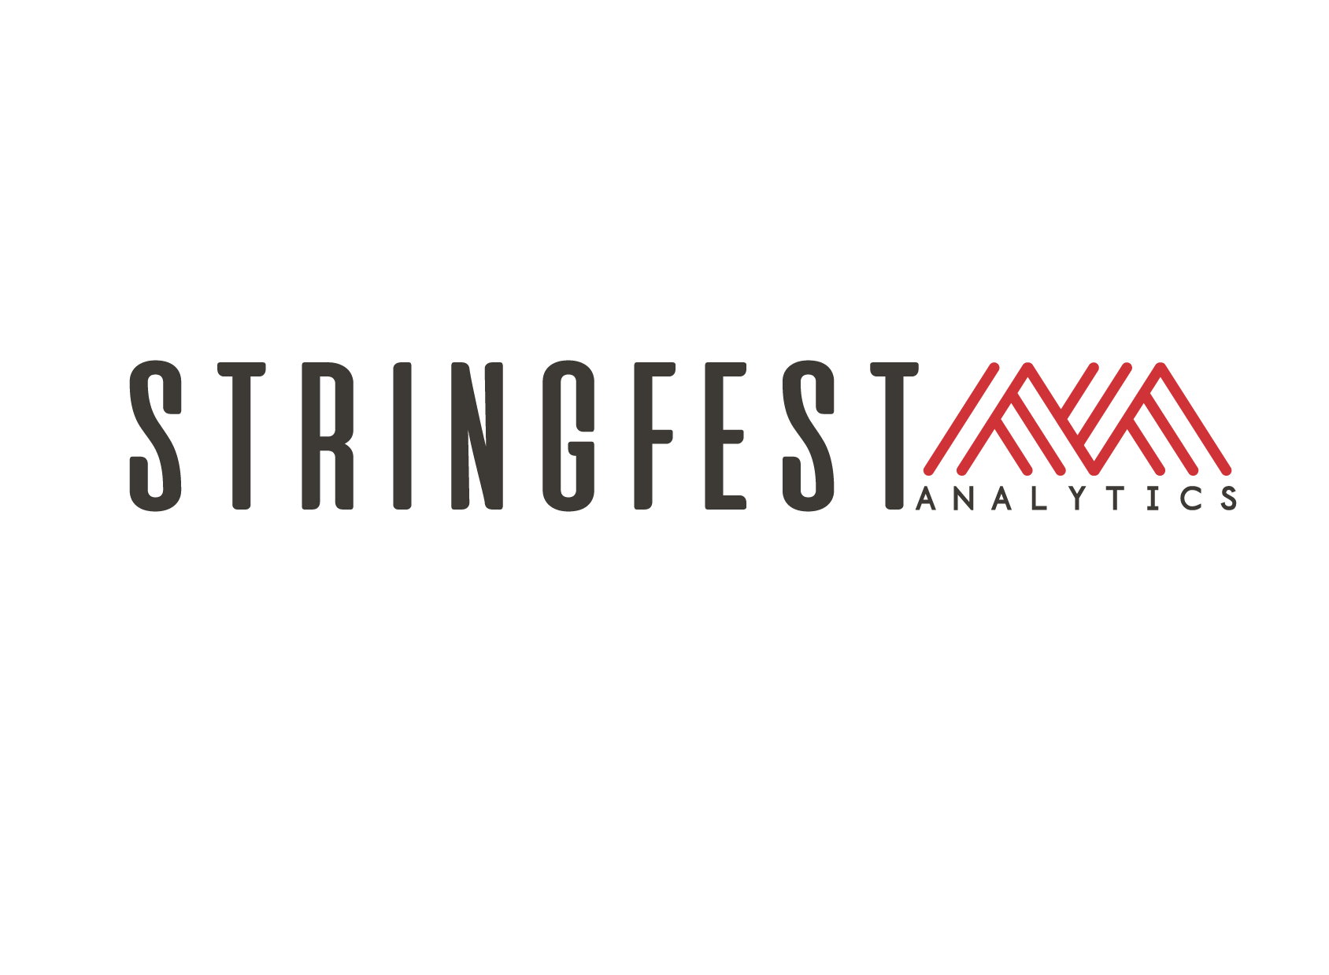

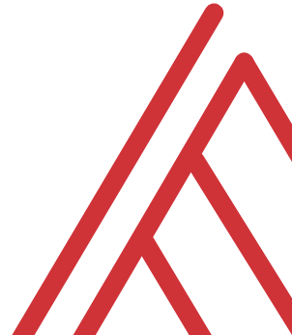
Advancing into Analytics: From Excel to R and Python

Slide 2
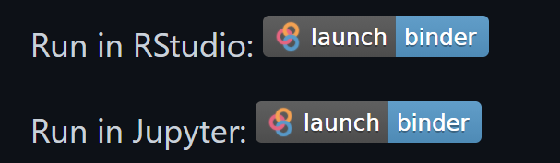
Follow along
Download resources: https://github.com/stringfestdata/lagos-meetup
Click through these links now to interact later:
(this could take some time so feel free to ask questions now)…
Notes:
If you’d like to follow along with the presentation, all resources are available at this link.
I also wanted to give a shout-out to Alan Turing, born on this day in 1912.

Slide 3
Learning objectives
Situate Excel in the data analytics stack
Chart a clear learning path from Excel to R and Python

Slide 4
Unofficial learning objectives
Having fun with data & computers
Maybe winning a book….
Wait for the next slide to answer…

Slide 5

For a book…
Name another city in Ohio
https://kids.britannica.com/students/assembly/view/54743

Slide 6
Preferred topics? (Vote here)
Foundations of Analytics in Excel
From Excel to R
From Excel to Python

Slide 7
What is the data analytics stack?

Slide 8
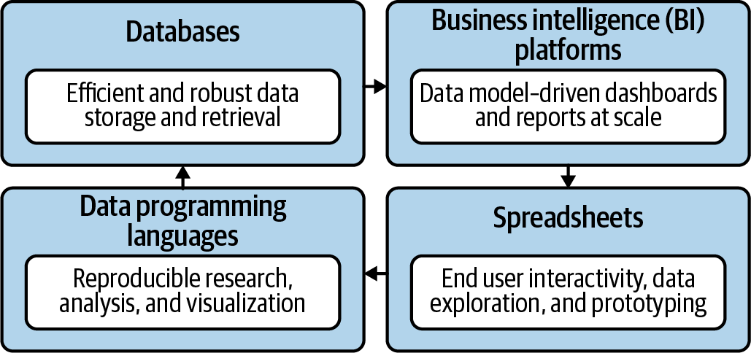
Spare no tools…
Mount, George. Advancing into Analytics: From Excel to Python and R. O’Reilly Media, 2021
Notes:
Now this figure comes from my book and it’s a very broad conceptualization of the various slices of the stack. You know we hear engineers or web developers talk about being “full stack” all the time but it’s not so common an expression as it could be.

Slide 9

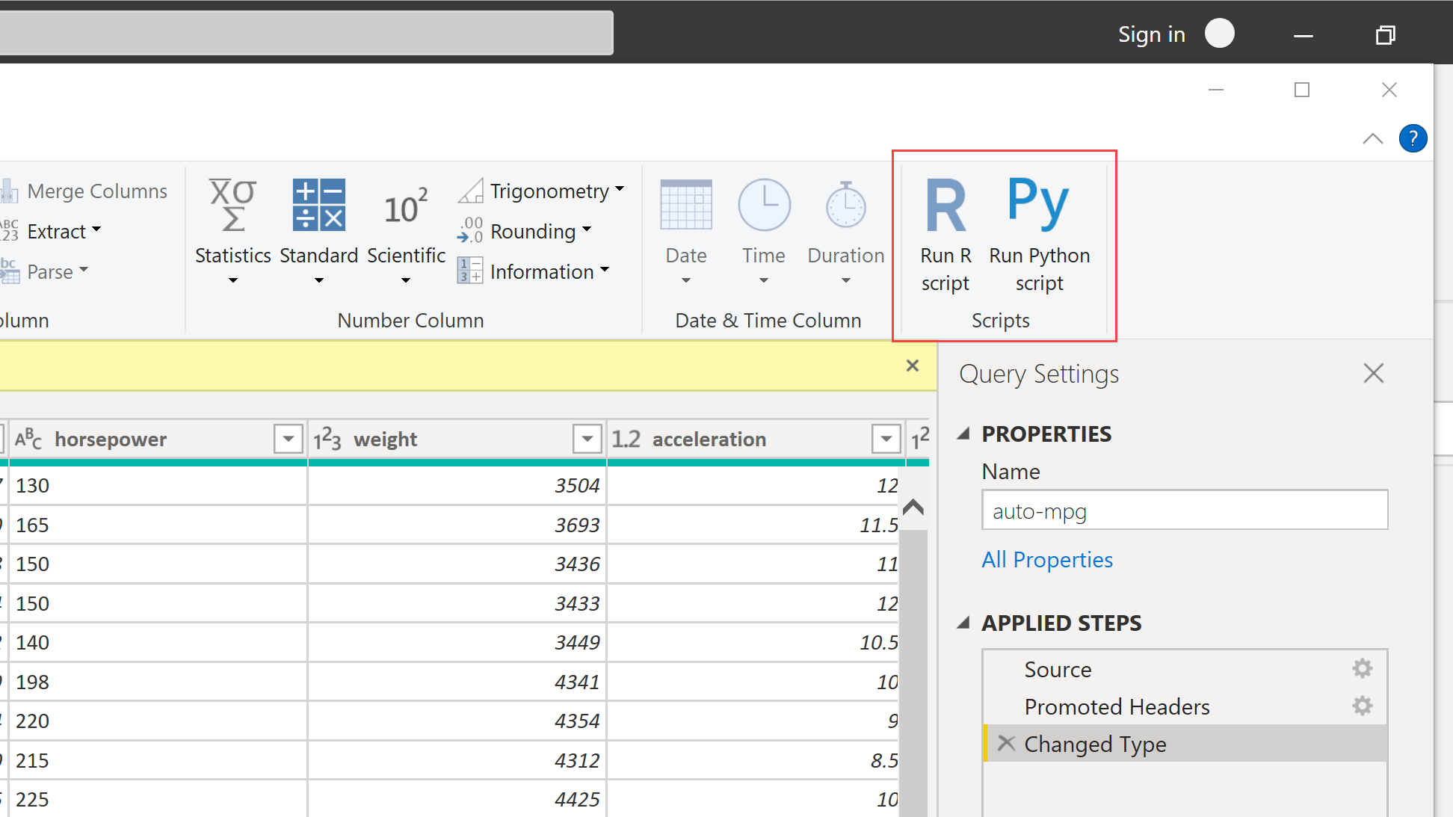
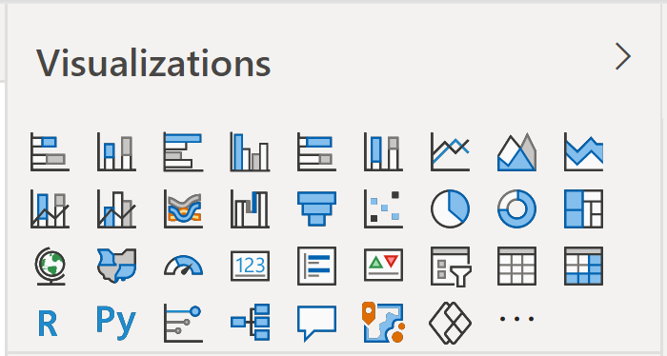
Don’t take my word for it…
Free to
Use
Build on
Repurpose
Redistribute
https://docs.microsoft.com/en-us/archive/blogs/wikininjas/tnwiki-article-spotlight-consuming-azure-storages-python-sdk-using-ptvs
Notes:
Now, it may seem superfluous to learn a statistical programming language when Microsoft keeps rolling out new features to help with data analysis. And this has been a huge change at how Microsoft itself looks at open source languages. They are now seen as allies.

Slide 10
The dialects of data
Column-wise operations (Adding, dropping, calculating fields)
Row-wise operations (Sorting, filtering)
Aggregations (Grouping by, summarizing by)
Joining and merging
Re-shaping (pivoting and unpivoting)
Notes:
The interesting thing is that regardless of these tools used we’re often really speaking the same language when it comes to data analysis. Whether you’re doing it in a spreadsheet or a statistical programming languages, these sorts of operations are the same.
So what I want to help you do is take that mental model of working with data that you’ve so finely honed and show you how to transfer that knowledge into working with these other tools.

Slide 11
Foundations of Data Analytics in Excel

Slide 12
Exploratory & Confirmatory
File: datasets/computers.xlsx
Is there a difference in sale price of computers with and without a CD-ROM?
Dated data… same analysis
Download the Analysis ToolPak: https://support.microsoft.com/en-us/office/load-the-analysis-toolpak-in-excel-6a63e598-cd6d-42e3-9317-6b40ba1a66b4

Slide 13
Welcome to the R Project for Statistical Computing
Notes:
OK, first let’s start with R, and yes its full name is the R Project for Statistical Computing.

Slide 14


The R project for…
Notes:
So R was really built by statisticians, for statisticians.
Add a slide here who uses it and so forth.

Slide 15


R + RStudio
The code base
The interface
Notes:
Now like I mentioned when something is open source that means anyone is welcome to build on the code base however they like. RStudio is a very popular integrated development environment which is used to interact with the code base.
In Excel we are used to the code base and interface all being wrapped up in one package so this is something that could take some getting used to for you.

Slide 16
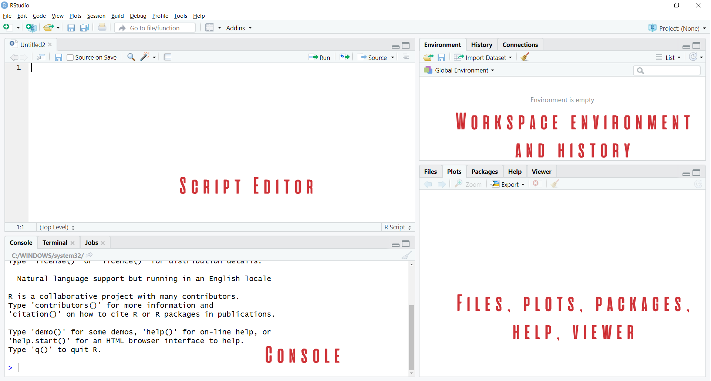

Demo
Navigate RStudio, beginning with 1+1
https://github.com/stringfestdata/london-excel
Notes:
OK so now it’s time for a demo. I want this meetup to be as interactive as possible. You will see in the repo there is a button that says Run in Rstudio. This is going to launch Rstudio right in your browser window. And when you get there you are going to see these four screens.
So what I want to do now is just show you what Rstudio looks like. We aren’t going to get too into depth about all the object types and so forth, just a little tour here.

Slide 17

Packages: “There’s an App for that!”
Install the package (usually from CRAN)
Open the package
Notes:
Now another thing unique to open source programs is this idea of packages. You can kind of think of this as like add-ins for Excel – the analogy I like to use is as apps on a phone.

Slide 18
Demo
Speaking the language of data with the tidyverse
Load and explore diamonds dataset
Write a “sentence” in dplyr:
“Get me the average price for each cut, sorted from high to low.”
How would you pseudo-code this?
Group by cut
Find average for each group
Sort the results
File: diamonds.r
Notes:
OK so what we are going to do here is go back to your session or open a new one. Go to the diamonds.r dataset. And let’s actually conduct the analysis that was hinted at earlier.

Slide 19
Questions?
Notes:
Any questions so far about using R?
Again I just want to show you how easy it is to get up and running there as an Excel user and what to expect when working with open source programs.
Now I guess one of the questions I might have in your shoes is what’s the big deal, we can do the same kind of stuff with Power Query. So I want to acknowledge that.

Slide 20
Prancing into Python
Notes:
Well this is the name of the section just because I couldn’t think of anything else that started with a P….
Anyway let’s situate Python here for a sec. If you are wondering about the difference between R and Python – like I mentioned earlier R is best known for its statistical capabilities, it was born and raised to be a statistical language.
On the other hand Python was built primarily as a computer scripting language, sort of like VBA. So they were built for somewhat different needs which means they both have their strengths and weaknesses. For example, Python does not include a built-in data structure for a tabular data source, so we’ll need to rely on open source packages to implement it.

Slide 21



Python+ Anaconda + Jupyter
The (open) source code
The distribution of code & apps
The browser-based app
Notes:
OK now remember that being open source means anyone is free to repackage and redistribute code. In the case of Python the official source code lives with the Python foundation and can be found there. It’s more common however to download from the Anaconda _distribution_ of that code. One of the reasons why is Anaconda comes with some goodies that don’t come with the raw Pyhon installation. One of those is the Jupyter notebook, which is a browser-based app we’ll be using to work with Python.

Slide 22

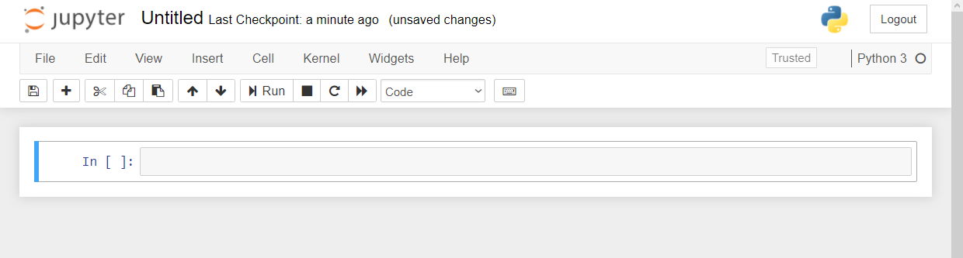
Demo
Navigate Jupyter, starting with 1 + 1
File: Open a new .ipynb notebook
https://github.com/stringfestdata/london-excel
Menu bar
Toolbar
Code cell
Notes:
OK again, what I want to do here is just show you the basics of working with Jupyter. You will see in the repo there is an option to launch an interactive session, so do that and let’s navigate the four sections of Jupyter and get comfortable working there.
Possibly come up with some demo notes for this

Slide 23
Demo
Python for data analysis
Working with modules (packages) in Python
Working with tabular data in Python with pandas
Reading and writing Excel <> Python data
File: python-for-data-analysis.ipynb
Notes:
OK so if you want to head back to that file on your browser what we’ll do here is export and format a dataset from Python to Excel. We’ll need to use some modules, what you know as packages, to do this.

Slide 24
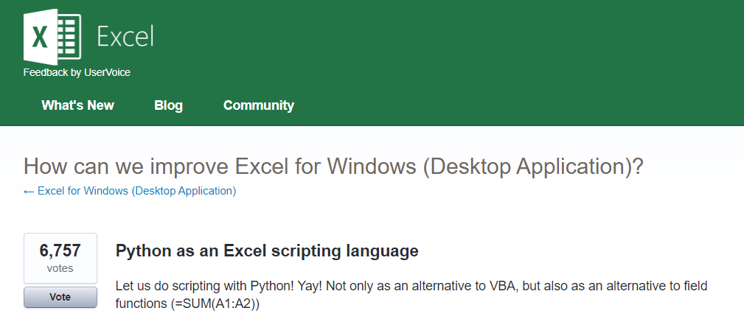



Python for Excel
More: http://www.python-excel.org
https://excel.uservoice.com/forums/304921-excel-for-windows-desktop-application/suggestions/10549005-python-as-an-excel-scripting-language
Notes:
OK so let’s talk about Python. In particular as an Excel user something to be aware of is the growing interest in integrating it with Python. Now I’ve linked to the infamous UserVoice survey above asking for this feature. I won’t press Alan or any of our MVPs on the matter but something is happening there…
There are also some popular packages over here but there are even more. So in this demo I am going to share a really brief example for “Python-Powered Excel.”

Slide 25
Demo
pandas + xlsxwriter =
Python-Powered Excel
Add custom cell formats
Re-size column widths
Add charts (from Excel or Python)
File: python-powered-excel.ipynb
Notes:
OK, in this demo you will look a bit more into using Python as an automation tool for Excel. You already saw that Python makes for pretty intuitive data analysis. I don’t know that this package is as intuitive, but I don’t know it’s any worse than VBA, and the nice thing is that it layers so many Python features into it as well. So go back to the repo and the Python-Powered Excel worksheet.

Slide 26
Questions?
Notes:
Any questions about Python?

Slide 27
The data world is your oyster shell
Notes:
OK now for one last demo. I want to show you an example of “remixing” some of these different tools and really using each resource to its full potential. And the pun here is “shell” as in a programming shell.

Slide 28
Demo
Export an R regression to Excel
Jupyte”R”
“R-powered Excel” with openxlsx
The magic of ggplot2 visualizations
File: r-powered-excel.ipynb
Notes:
OK so now you will see R’s equivalent to some of those features you saw with Python. I think that for different reasons Python seems to be taking the lead on Excel automation, but R has some pretty robust features and in some ways are richer than Python’s.

Slide 29
Questions?

Slide 30
Pre-reading homework

Slide 31
Excel: The analysis toolPak
Windows
File > Add-ins > Go
Check Analysis ToolPak
OK
Mac
Tools > Excel Add-ins
Check Analysis ToolPak
OK
Analysis ToolPak – VBA not needed
More installation notes
Notes:
OK now remember that being open source means anyone is free to repackage and redistribute code. In the case of Python the official source code lives with the Python foundation and can be found there. It’s more common however to download from the Anaconda _distribution_ of that code. One of the reasons why is Anaconda comes with some goodies that don’t come with the raw Pyhon installation. One of those is the Jupyter notebook, which is a browser-based app we’ll be using to work with Python.

Slide 32
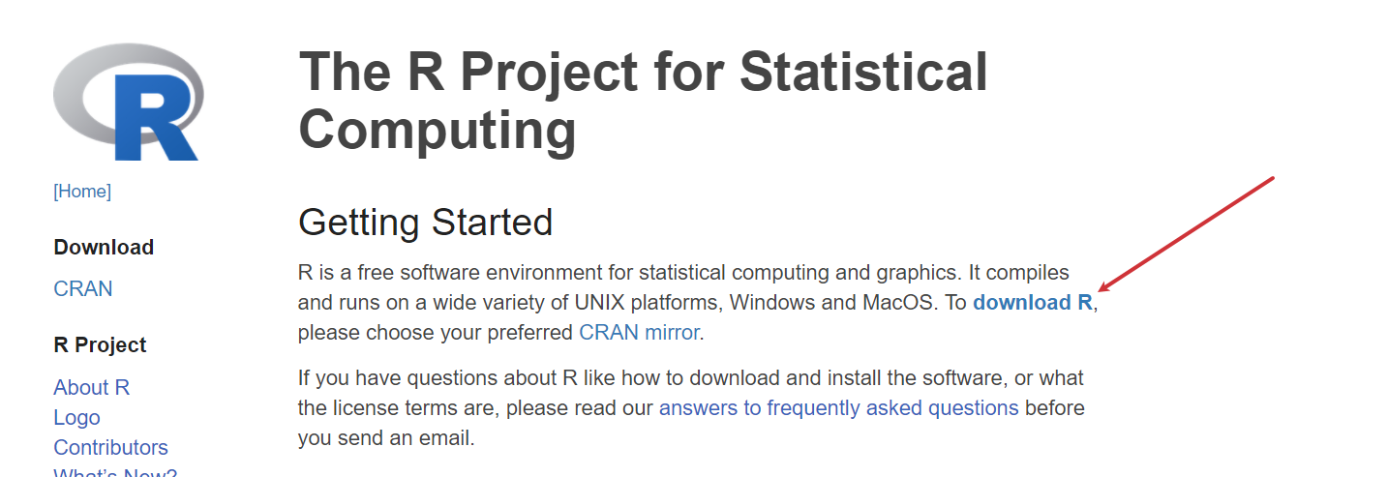
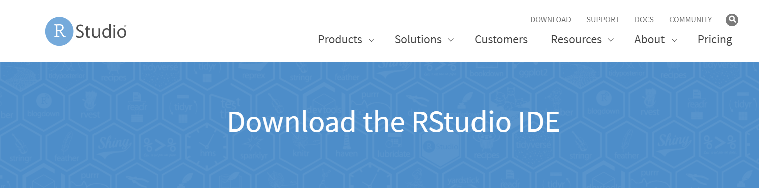
R: R + Rstudio
https://www.r-project.org
Choose a mirror near you
https://www.rstudio.com/products/rstudio/download/
Choose RStudio desktop (free)
Notes:
OK now remember that being open source means anyone is free to repackage and redistribute code. In the case of Python the official source code lives with the Python foundation and can be found there. It’s more common however to download from the Anaconda _distribution_ of that code. One of the reasons why is Anaconda comes with some goodies that don’t come with the raw Pyhon installation. One of those is the Jupyter notebook, which is a browser-based app we’ll be using to work with Python.

Slide 33
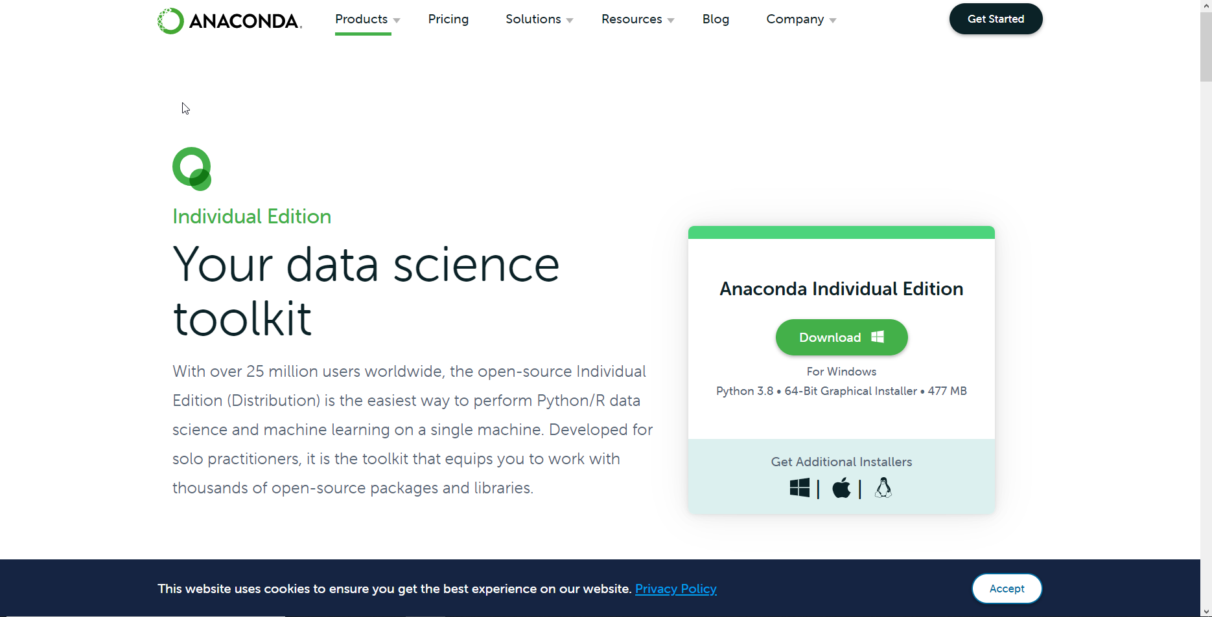
Python: Anaconda individual
https://www.anaconda.com/products/individual
Mac: Terminal > jupyter notebook
Windows: Anaconda Prompt > jupyter notebook
Notes:
OK now remember that being open source means anyone is free to repackage and redistribute code. In the case of Python the official source code lives with the Python foundation and can be found there. It’s more common however to download from the Anaconda _distribution_ of that code. One of the reasons why is Anaconda comes with some goodies that don’t come with the raw Pyhon installation. One of those is the Jupyter notebook, which is a browser-based app we’ll be using to work with Python.

Slide 34
Conclusion/Resources

Slide 35
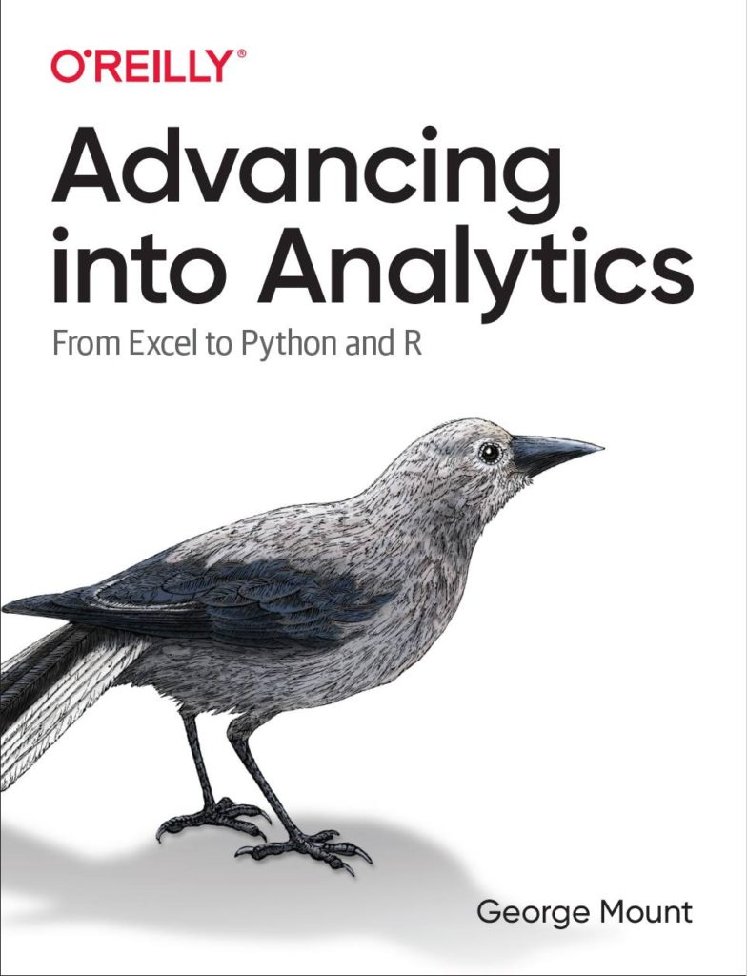
Get started
Advancing into Analytics by George Mount
Stringfestanalytics.com/book
Notes:
By the end of this book, you should be able to conduct exploratory data analysis and
hypothesis testing using a programming language.

Slide 36
Survey, please
https://forms.office.com/r/dkZ6RKSk0G

Slide 37
Questions?
Who wants to win a book?

