Slide 1


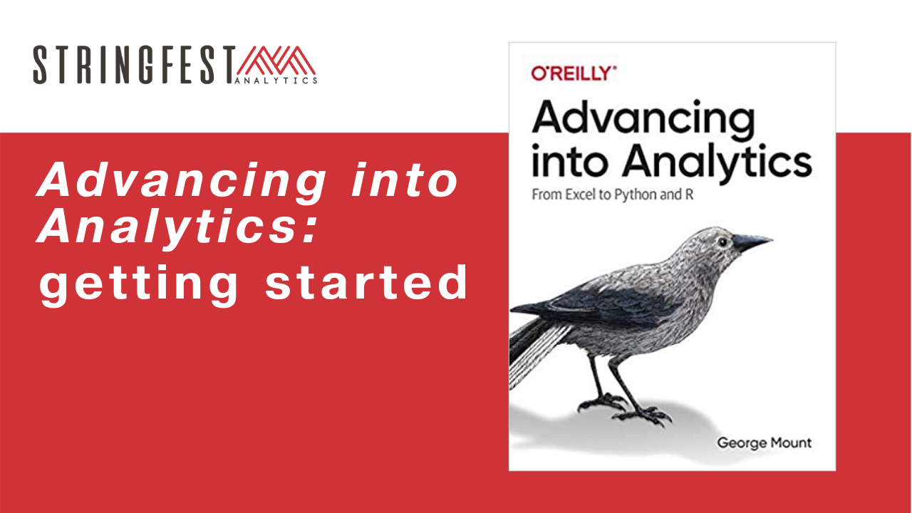
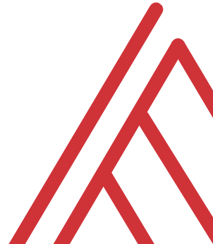
Advancing into Analytics: From Excel to R and Python

Slide 2
Follow along
Download resources: https://github.com/stringfestdata/lagos-meetup
Notes:
If you’d like to follow along with the presentation, all resources are available at this link.
I also wanted to give a shout-out to Alan Turing, born on this day in 1912.

Slide 3
Learning objectives
Situate Excel, R and Python in the data analytics stack
Prepare a Windows computer to work in all three
Run summary statistics on a dataset in all three

Slide 4
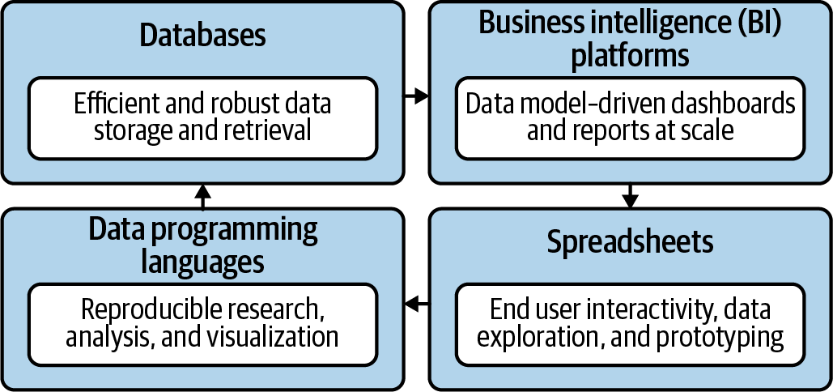
Spare no tools…
Mount, George. Advancing into Analytics: From Excel to Python and R. O’Reilly Media, 2021
Notes:
Now this figure comes from my book and it’s a very broad conceptualization of the various slices of the stack. You know we hear engineers or web developers talk about being “full stack” all the time but it’s not so common an expression as it could be.

Slide 5

Demos
Downloads and summary statistics in Excel, R, Python
Follow along with demo notes
Let’s get situated…
Notes:
OK so now you will see R’s equivalent to some of those features you saw with Python. I think that for different reasons Python seems to be taking the lead on Excel automation, but R has some pretty robust features and in some ways are richer than Python’s.

Slide 6
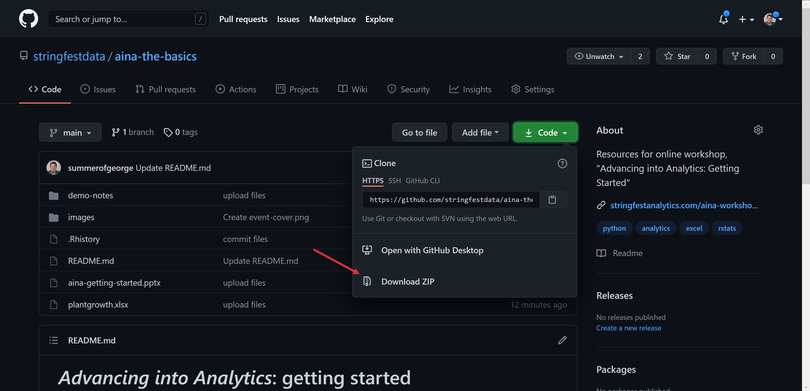
Download and extract files

Slide 7
Questions?
On to the demos…

Slide 8
Questions?

Slide 9
Conclusion/Resources

Slide 10
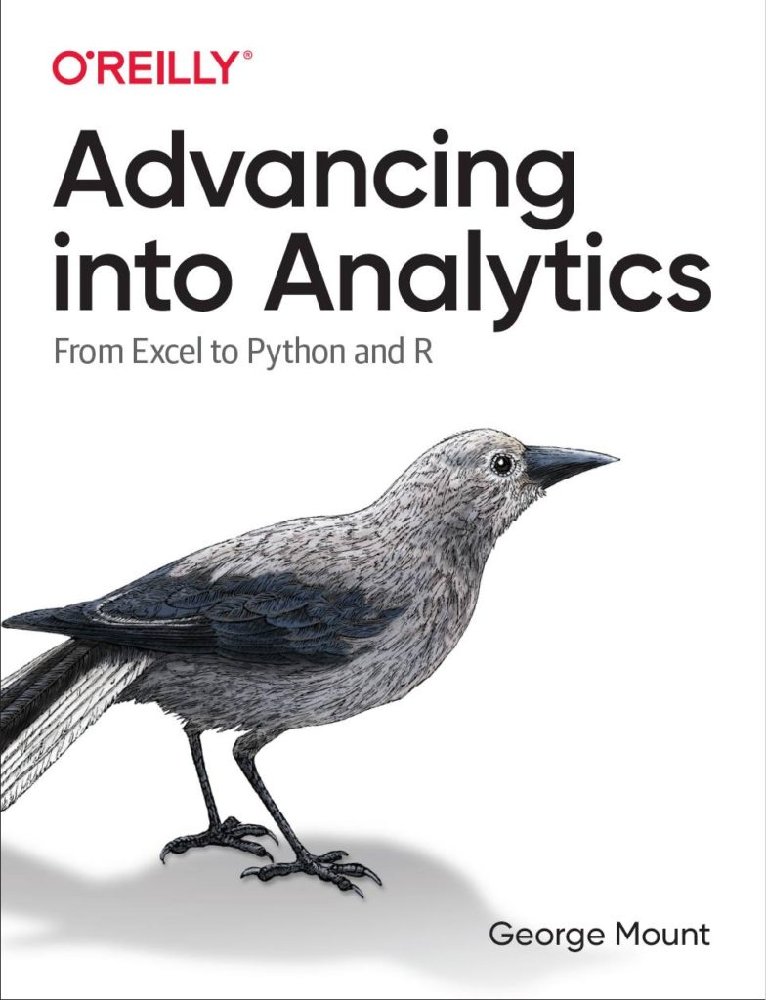
Keep going
Advancing into Analytics by George Mount
Stringfestanalytics.com/book
Notes:
By the end of this book, you should be able to conduct exploratory data analysis and
hypothesis testing using a programming language.

Slide 11
Questions?
Event survey: https://forms.office.com/r/0ZnD0LxpZy

Slide 12
THANK YOU
george@stringfestanalytics.com
linkedin.com/in/gjmount
stringfestanalytics.com/contact

