Slide 1
✓ Microphone off?
✓ Camera off?
✓ Fun on?

Slide 2
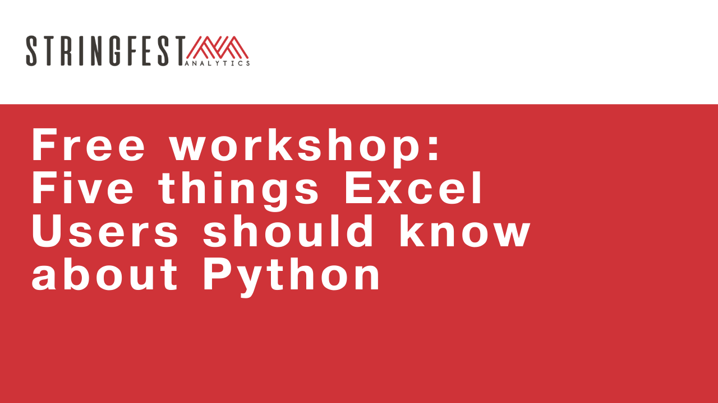

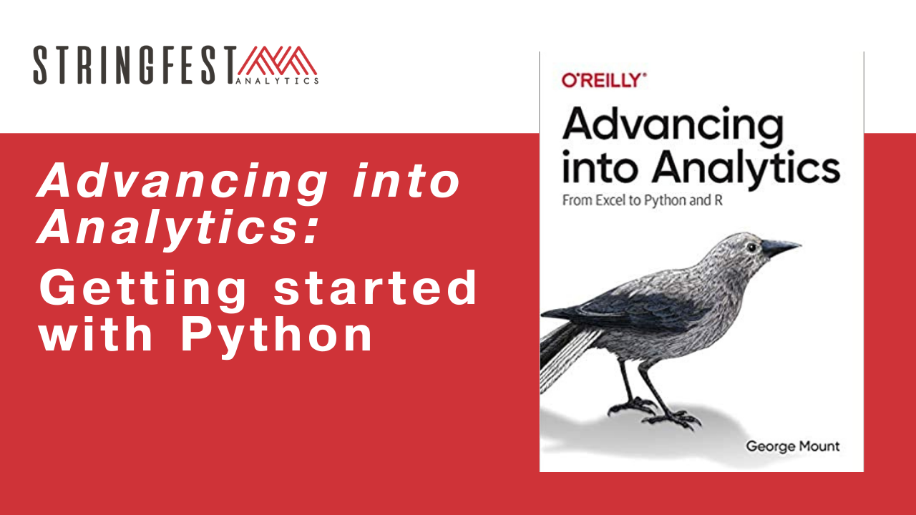
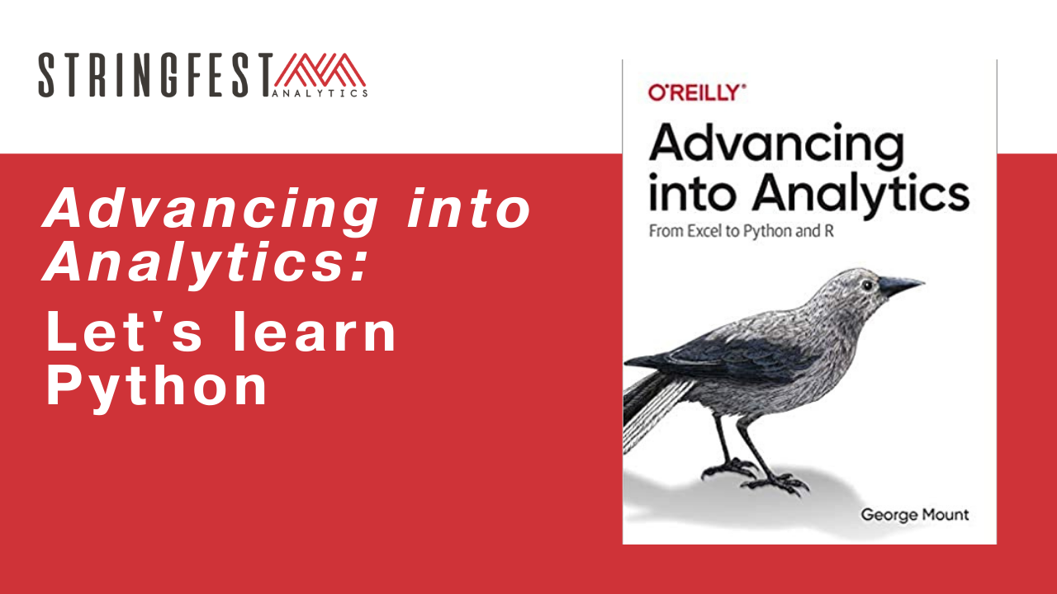
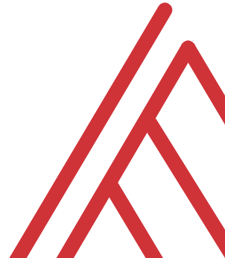
Follow along
Download resources: https://github.com/stringfestdata/ms-excel-toronto-python

Slide 3
Warm-up
Which code will return the absolute value of -100 in Python? (Choose all that apply)
Abs(-100)
abs(-10*10)
abs(-100)
ABS(-100)

Slide 4
Warm-up
Which code will return the absolute value of -100 in Python? (Choose all that apply)
Abs(-100)
abs(-10*10)
abs(-100)
ABS(-100)
Case sensitive

Slide 5
Chat me up…
What interests you about learning Python?
What tasks would you like to use it for?
What questions about Python do you have from the book? In general?
Notes:
By the end of this book, you should be able to conduct exploratory data analysis and
hypothesis testing using a programming language.

Slide 6
Warm-up
What happens when you run this?
import this

Slide 7
Warm-up
What happens when you run this?
import this
Python Easter eggs and jokes

Slide 8
Follow along
Download and unzip resources: https://github.com/stringfestdata/aina-lets-learn-python
Code > Download ZIP

Slide 9

Questions?
Notes:
Any questions so far about using R?
Again I just want to show you how easy it is to get up and running there as an Excel user and what to expect when working with open source programs.
Now I guess one of the questions I might have in your shoes is what’s the big deal, we can do the same kind of stuff with Power Query. So I want to acknowledge that.

Slide 10
There’s a package for that!

Slide 11

The package two-step…
Install the package if needed
conda install packagename
pip install packagename
Open the package
import packagename
More: https://stringfestanalytics.com/sourcing-python-packages/
Notes:
Now another thing unique to open source programs is this idea of packages. You can kind of think of this as like add-ins for Excel – the analogy I like to use is as apps on a phone.

Slide 12
You won’t get far without these…
Package | Description
numpy | Designed for numerical computing
pandas | Designed to work with panel data and other tabular data structures (think rows and columns. This package leverages code from numpy.
matplotlib | a popular package for data visualization
seaborn | another package for data visualization, built on top of matplotlib and designed to work well with pandas.

Slide 13

Demo
File: working-with-modules.ipynb
Import from the Standard Library
Practice working with modules and functions
Notes:
OK again, what I want to do here is just show you the basics of working with Jupyter. You will see in the repo there is an option to launch an interactive session, so do that and let’s navigate the four sections of Jupyter and get comfortable working there.
Possibly come up with some demo notes for this

Slide 14
Drill
Match the data to the data type…
Package | Description
String | 2
Float | True
Integer | 2.26
Boolean | ‘Hello’

Slide 15
Python… finnicky, or just logical?

Slide 16
Demo
File: feeling-finnicky.ipynb
How does Python handle
Counting?
Whitespace?
Multiplying lists?

Slide 17
Questions?
Notes:
Any questions so far about using R?
Again I just want to show you how easy it is to get up and running there as an Excel user and what to expect when working with open source programs.
Now I guess one of the questions I might have in your shoes is what’s the big deal, we can do the same kind of stuff with Power Query. So I want to acknowledge that.

Slide 18
Numpy we’re getting somewhere…
Match the data to the data type…
Package | Description
Countplot() | Countplot/bar chart
Displot() | Histogram
Boxplot() | Box plot
Scatterplot | Scatterplot

Slide 19
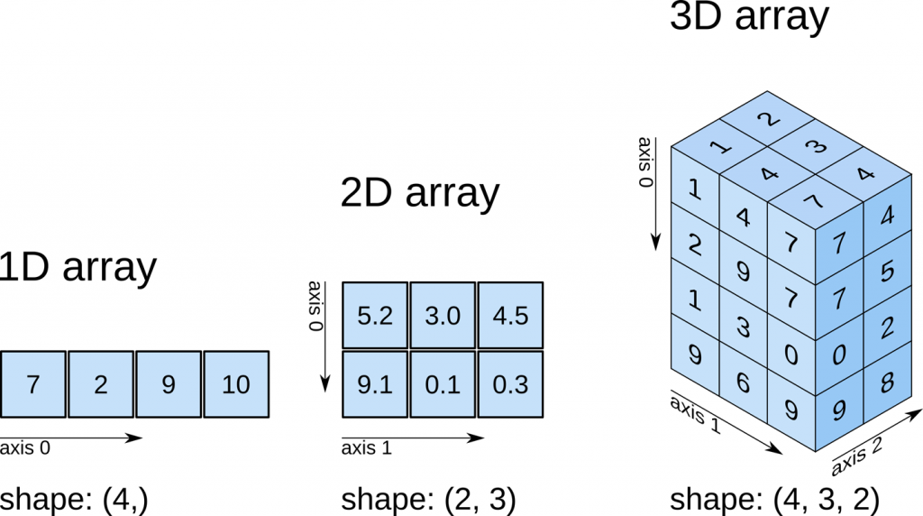
Numpy we’re getting somewhere…
All elements must be of same time (numeric, string, etc)
No labels (column names, etc)
Range Worksheet Workbook of worksheets
https://predictivehacks.com/tips-about-numpy-arrays/

Slide 20
Aliasing.. Give your code a nickname
I’m numpy, but for this session you can call me np…
import numpy as np
import pandas as pd
my_array = np.array([[1,2,3], [4,5,6]])
df = pd.DataFrame(my_array, columns = ['Column_A','Column_B','Column_C'])
df

Slide 21
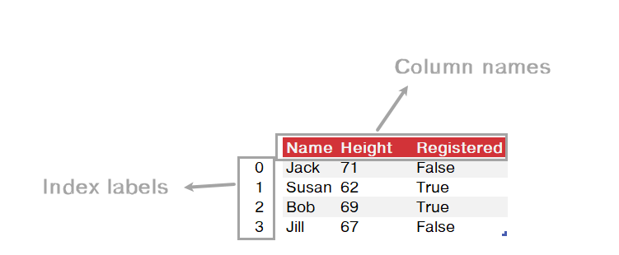
Pandas… this looks familiar

Slide 22
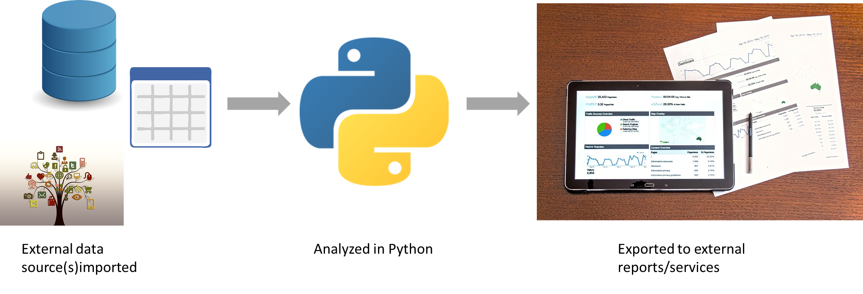
Demo
File: pandas-data.ipynb
Where does data come from?
Exploring a DataFrame
Importing and exporting to Excel
Notes:
OK again, what I want to do here is just show you the basics of working with Jupyter. You will see in the repo there is an option to launch an interactive session, so do that and let’s navigate the four sections of Jupyter and get comfortable working there.
Possibly come up with some demo notes for this

Slide 23
Data manipulation

Slide 24
You know the drill…
Task | Operation
Countplot() | Countplot/bar chart
Displot() | Histogram
Boxplot() | Box plot
Scatterplot | Scatterplot

Slide 25
Data visualization

Slide 26
What seaborn wants…
Argument | Description
X | What variable goes on x-axis (usually independent variable)
Y | What variable goes on x-axis (usually independent variable)
data | What DataFrame includes them

Slide 27
Seaborn plot types
Match the data to the data type…
Package | Description
Countplot() | Countplot/bar chart
Displot() | Histogram
Boxplot() | Boxplot
Scatterplot | Scatterplot
Pairplot() | Plot all pairwise relationship
Regplot() | Scatterplot with fit regression line

Slide 28
Exploratory data analysis

Slide 29
You’ve been doing it!
Summarize variables with descriptive statistics and other tables
Visualize variables using plots
Classify variables as continuous, categorical, etc.
Notes:
By the end of this book, you should be able to conduct exploratory data analysis and
hypothesis testing using a programming language.

Slide 30
Confirmatory data analysis

Slide 31


Imagine a world…
SOLD: $200,000
SOLD: $200,000
α = .05
If the null were true (i.e. no real difference in means), we would find a significant difference in 5% of our samples due to random error.
Notes:
Let’s take an example from the housing prices dataset in the book. Let’s say that our null is there is no difference in sales prices for homes with our without air conditioning. If we did indeed live in this world, and we tested for significance at the 95% confidence level, then we would still find a significant difference in sales prices in 5% of our samples, due to random error.
That’s a 1 in 20 chance of finding a significant difference when there is none! So if we do a bunch of tests, the higher our chances that we will hit a significant finding due to random chance. This is called experimentwise error.

Slide 32
Demo
File: housing-prices.ipynb
Is there likely a significant difference in the average price of homes with and without air conditioning?
Notes:
OK again, what I want to do here is just show you the basics of working with Jupyter. You will see in the repo there is an option to launch an interactive session, so do that and let’s navigate the four sections of Jupyter and get comfortable working there.
Possibly come up with some demo notes for this

Slide 33
Capstone

Slide 34
Demo
File: housing-prices.ipynb
Is there likely a significant difference in the average price of homes with and without air conditioning?
Notes:
OK again, what I want to do here is just show you the basics of working with Jupyter. You will see in the repo there is an option to launch an interactive session, so do that and let’s navigate the four sections of Jupyter and get comfortable working there.
Possibly come up with some demo notes for this

Slide 35
Take-home activity
Folder: take-home
Summarize and visualize a dataset in Python “fill in the blank:” five-things-take-home.ipynb
Solution notebook available: five-things-take-home-solution.ipynb
Read the white paper, “Five Things Excel Users Should Know About Python” (included in downloads)
Notes:
By the end of this book, you should be able to conduct exploratory data analysis and
hypothesis testing using a programming language.

Slide 36
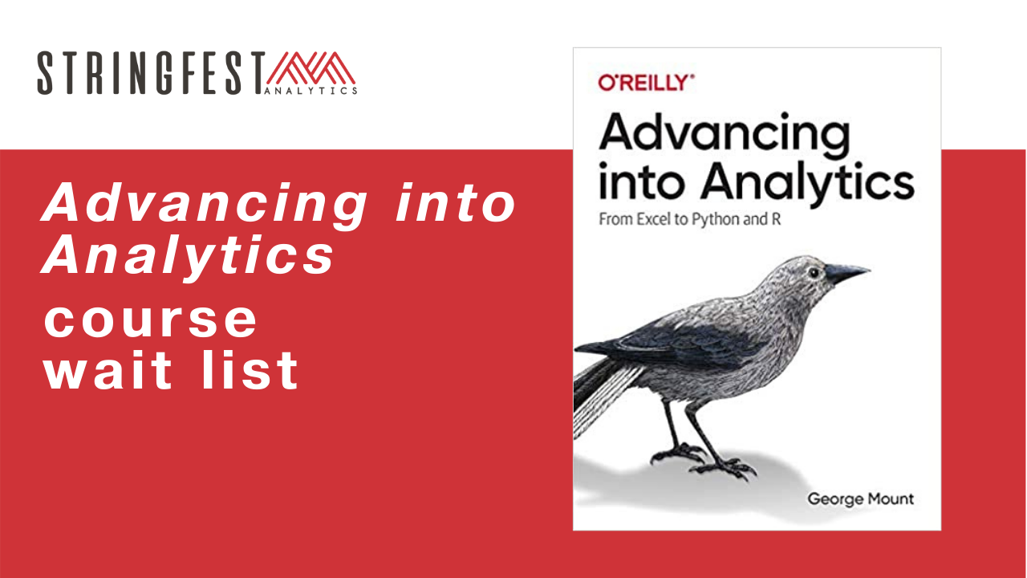
Want more?
Sign up for course waiting list: https://stringfestanalytics.com/aina-waiting/
Notes:
By the end of this book, you should be able to conduct exploratory data analysis and
hypothesis testing using a programming language.

Slide 37
Event survey: https://forms.office.com/r/0ZnD0LxpZy

Slide 38
THANK YOU
george@stringfestanalytics.com
linkedin.com/in/gjmount
stringfestanalytics.com/contact

Slide 39
4. It can augment and automate Excel

Slide 40
So many choices, so many use cases…
Package | Pros | Cons
xlsxwriter | Write almost anything from Excel from Python (data, formats, workbook settings, etc.) | Writes to Excel only/no reading
xlwings | Feature-rich: write data/UDFs, call VBA procedures, robust debugging tools | Local Python/Excel downloads needed
openpyxl | Read and write .xlsx, .xlsm Excel files | Limited ability to edit files
pyxlsb | Read and write .xlsb files | Limited features
xlrd, xlwt, xlutils | Can work with .xls files | Limited features
Notes:
Now another thing unique to open source programs is this idea of packages. You can kind of think of this as like add-ins for Excel – the analogy I like to use is as apps on a phone.

Slide 41
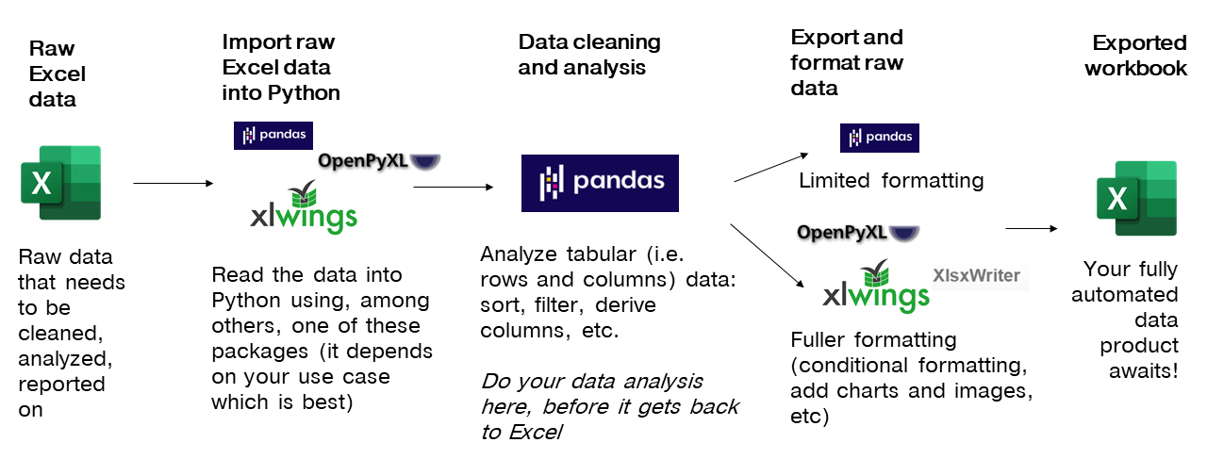
Notes:
Now another thing unique to open source programs is this idea of packages. You can kind of think of this as like add-ins for Excel – the analogy I like to use is as apps on a phone.

Slide 42
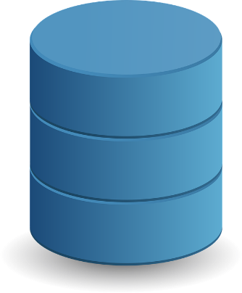




External data source(s)imported
Analyzed in Python
Exported to external reports/services
Notes:
Now another thing unique to open source programs is this idea of packages. You can kind of think of this as like add-ins for Excel – the analogy I like to use is as apps on a phone.

Slide 43
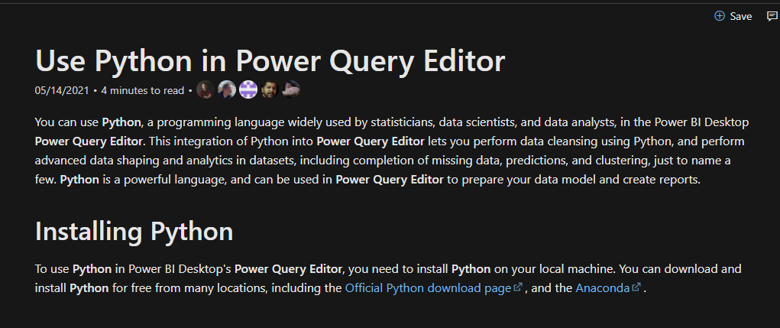
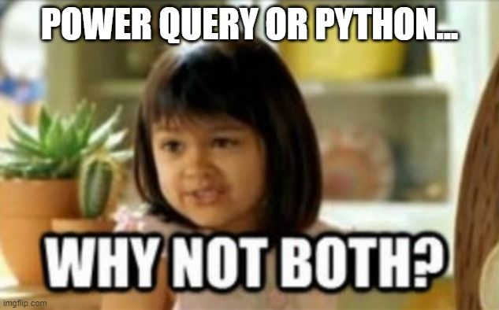
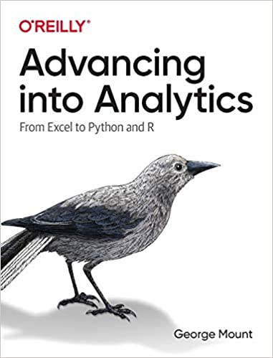
You’re not leaving the stack…
Notes:
One of the things that people get confused about is why learn Python if you’re getting into Power Query… or which to focus on.
You’re not leaving Microsoft’s stack. I have some documentation and a great book here. Now of course these are more about PowerBI but there’s every indication there’s more to come with Excel.

Slide 44
5. It’s not worth panicking over
Notes:
Now this is scary, it’s literally learning another language!

Slide 45
Demo
File: thing-5.ipynb
Some ways to get help from right inside Jupyter…
Notes:
OK again, what I want to do here is just show you the basics of working with Jupyter. You will see in the repo there is an option to launch an interactive session, so do that and let’s navigate the four sections of Jupyter and get comfortable working there.
Possibly come up with some demo notes for this

