Slide 1
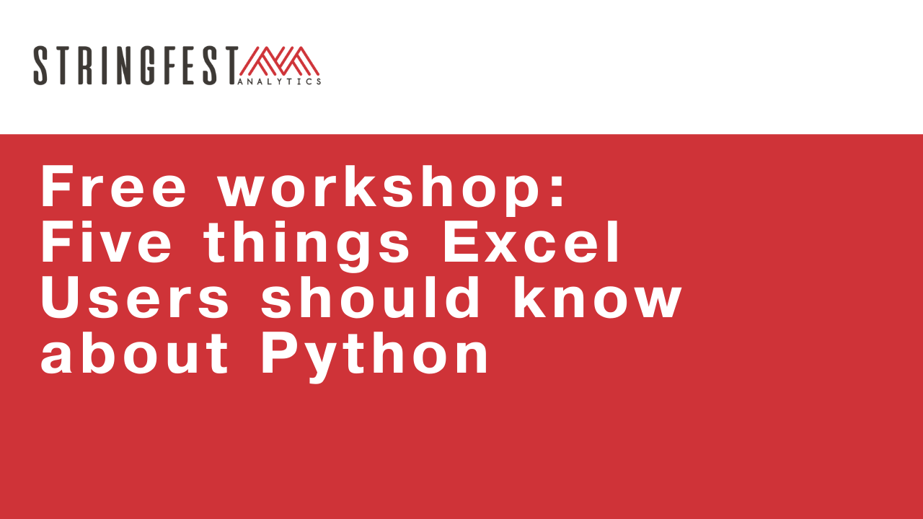

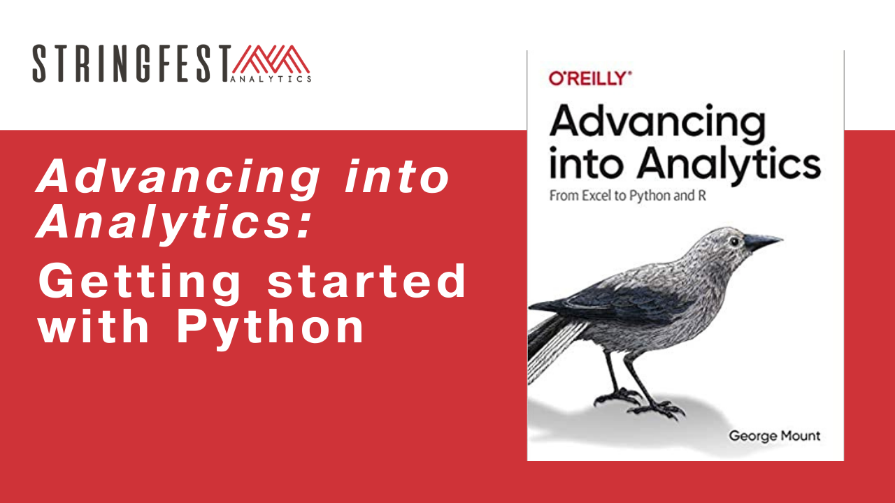
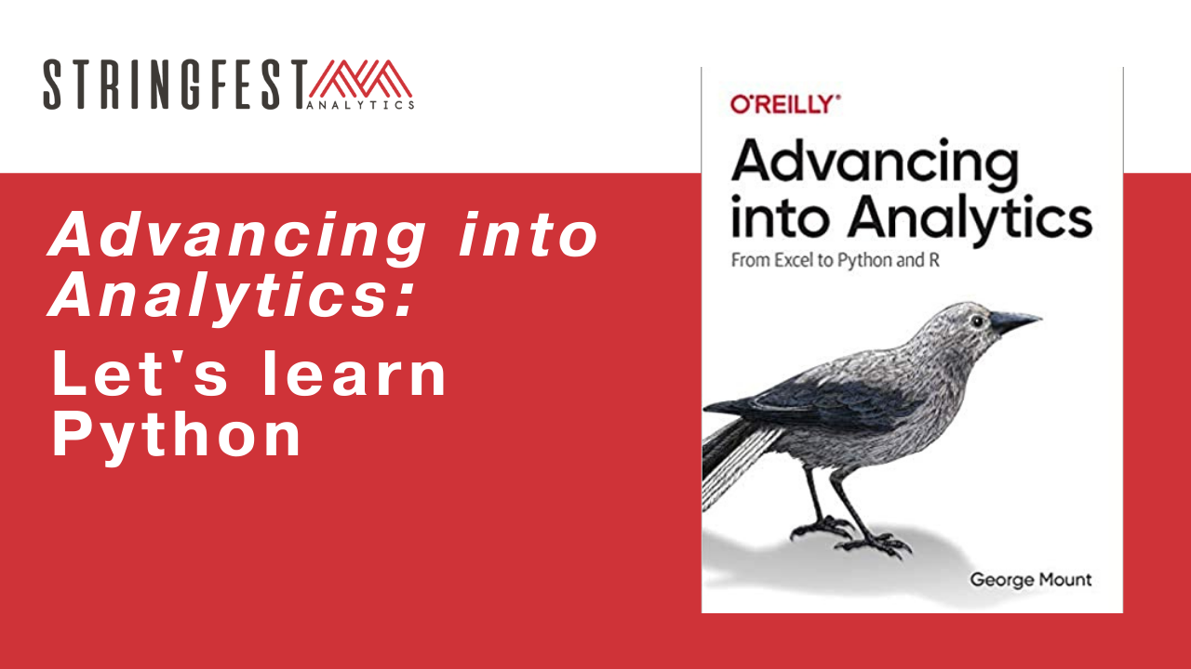
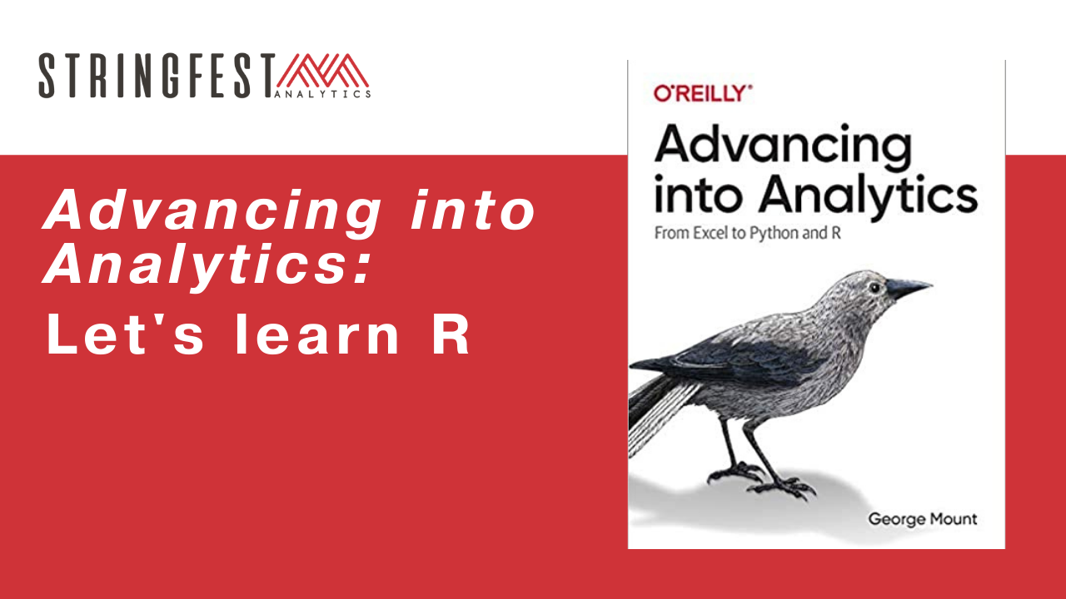
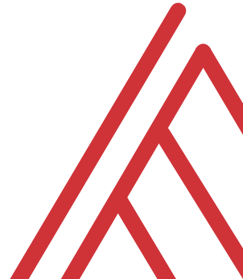
Follow along
Download resources: https://github.com/stringfestdata/ms-excel-toronto-python

Slide 2
Warm-up
Which code will return the absolute value of -100 in R? (Choose all that apply)
Abs(-100)
abs(-10*10)
abs(-100)
ABS(-100)

Slide 3
Warm-up
Which code will return the absolute value of -100 in Python? (Choose all that apply)
Abs(-100)
abs(-10*10)
abs(-100)
ABS(-100)
Case sensitive
Notes:
Let’s do this even before I show you the resources. These are just pure warmups.

Slide 4
Chat me up…
What interests you about learning R?
What tasks would you like to use it for?
What questions about Python do you have from the book? In general?
Notes:
By the end of this book, you should be able to conduct exploratory data analysis and
hypothesis testing using a programming language.

Slide 5
Warm-up
What happens when you run this in the console?
????""

Slide 6
Follow along
Download and unzip resources: https://github.com/stringfestdata/aina-lets-learn-r
Code > Download ZIP

Slide 7

Questions?
Notes:
Any questions so far about using R?
Again I just want to show you how easy it is to get up and running there as an Excel user and what to expect when working with open source programs.
Now I guess one of the questions I might have in your shoes is what’s the big deal, we can do the same kind of stuff with Power Query. So I want to acknowledge that.

Slide 8
6. First Steps with R for Excel Users

Slide 9

The package two-step…
Install the package from CRAN
install.packages(' packagename')
Open the package
library(packagename)
Notes:
Now another thing unique to open source programs is this idea of packages. You can kind of think of this as like add-ins for Excel – the analogy I like to use is as apps on a phone.

Slide 10

Drill
Drills: ch-6-drills.r
Installing packages
Download the reticulate package
Call the package
Pull its help documentation with ?
Solutions: ch-6-solutions.r

Slide 11
Drill
Match the data to the data type…
Package | Description
String | 2
Float | True
Integer | 2.26
Boolean | ‘Hello’

Slide 12
Demo
File: ch-6-demos.ipynb
Assigning data to objects
What to watch for in R
Notes:
OK again, what I want to do here is just show you the basics of working with Jupyter. You will see in the repo there is an option to launch an interactive session, so do that and let’s navigate the four sections of Jupyter and get comfortable working there.
Possibly come up with some demo notes for this

Slide 13
Questions about Chapter 6?

Slide 14
7. Data structures in R

Slide 15
Demo
File: ch-7-demos.ipynb
c() is for combine
Working with vectors
1.15
1.76
1.03
1.98
1.98
'A'
'E'
'I'
'O'
TRUE
FALSE
TRUE
Notes:
OK again, what I want to do here is just show you the basics of working with Jupyter. You will see in the repo there is an option to launch an interactive session, so do that and let’s navigate the four sections of Jupyter and get comfortable working there.
Possibly come up with some demo notes for this

Slide 16
Drill
File: ch-7-drills.r
Create a character vector of five elements, and then access the first and fourth elements of this vector.
Create two vectors x and y of length 4, one containing numeric and the other logical values. Multiply them and pass the result to z. What is the result?
Solution: ch-7-solutions.r
Notes:
OK again, what I want to do here is just show you the basics of working with Jupyter. You will see in the repo there is an option to launch an interactive session, so do that and let’s navigate the four sections of Jupyter and get comfortable working there.
Possibly come up with some demo notes for this

Slide 17
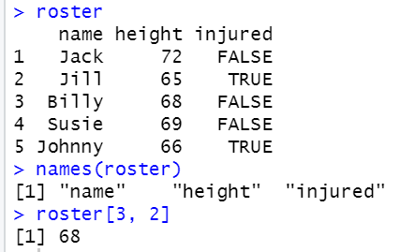
Excel tables: The missing link to R

Slide 18
Demo
File: ch-7-demos.r
Building and working with data frames
Where to source data frames
Notes:
OK again, what I want to do here is just show you the basics of working with Jupyter. You will see in the repo there is an option to launch an interactive session, so do that and let’s navigate the four sections of Jupyter and get comfortable working there.
Possibly come up with some demo notes for this

Slide 19
Demo
How to locate and import a file?
File: output/import.ipynb
import os
os.path.isfile('filename')
Notes:
This is a new file

Slide 20
Drill
File: ch-11-drills.ipynb
Install vega_datasets from pip
Import the movies dataset:
import pandas as pd
from vega_datasets import data
movies = data.movies()
Generate descriptive statistics
Write first five rows to Excel
Solution: ch-11-solutions.ipynb
Notes:
OK again, what I want to do here is just show you the basics of working with Jupyter. You will see in the repo there is an option to launch an interactive session, so do that and let’s navigate the four sections of Jupyter and get comfortable working there.
Possibly come up with some demo notes for this

Slide 21
Questions about Chapter 7?
Notes:
Any questions so far about using R?
Again I just want to show you how easy it is to get up and running there as an Excel user and what to expect when working with open source programs.
Now I guess one of the questions I might have in your shoes is what’s the big deal, we can do the same kind of stuff with Power Query. So I want to acknowledge that.

Slide 22
8. Data manipulation and visualization in R

Slide 23
Data manipulation

Slide 24
Working with columns in dplyr
Function What it does
mutate() | Creates new columns based on exsiting columns
select() | Selects selected columns
rename() | Renames selected columns
arrange() | Reorders rows
filter() | Selects rows based on condition
group_by() | Groups records by selected columns
summarise() | Aggregates values for each group
%>% | Connect multiple verbs into a “pipeline”

Slide 25
Demo
File: ch-8-demos.r
Working with columns
Selecting and dropping
Calculating and renaming
Notes:
OK again, what I want to do here is just show you the basics of working with Jupyter. You will see in the repo there is an option to launch an interactive session, so do that and let’s navigate the four sections of Jupyter and get comfortable working there.
Possibly come up with some demo notes for this

Slide 26
Demo
File: ch-12-demos.ipynb
Working with rows
Sorting
Filtering

Slide 27
Working with rows
Task | Operation
Sorting rows | df.sort_values(by=['col'], ascending=[False])
Filtering rows | df[df['col'] == 'x']

Slide 28
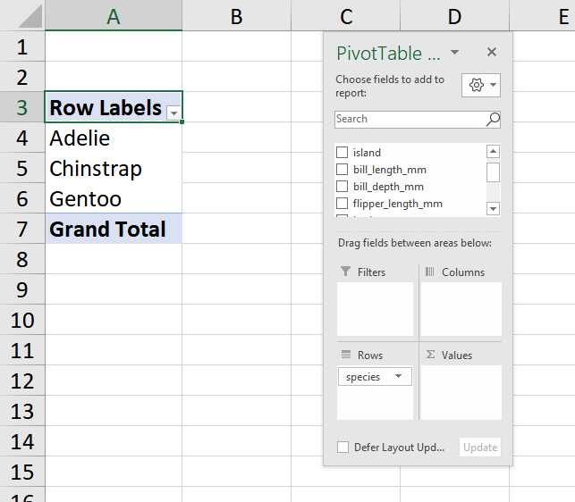
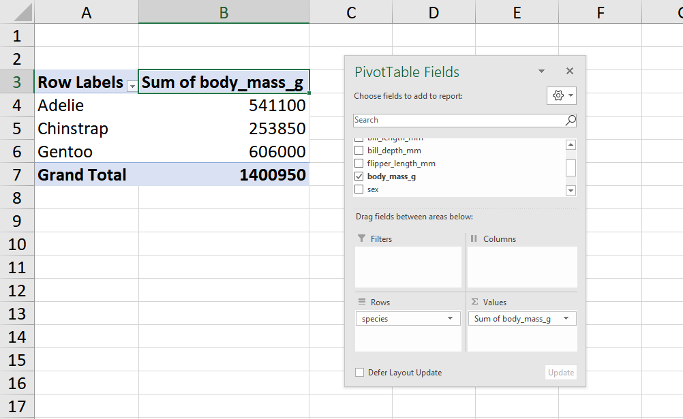
Aggregating
df_grouped = df.groupby('col')
df_grouped[['other_col']].sum()

Slide 29
Demo
File: ch-12-demos.ipynb
Grouping by
Summarizing

Slide 30
Merging
VLOOKUP(): duct tape
Left outer join: welder
left_join() in dplyr

Slide 31
Demo
File: ch-12-demos.ipynb
Datasets:
data/people.csv
data/hof.csv
How does pandas handle merges?

Slide 32
Drill
File: ch-12-drills.ipynb
Dataset: mpg (from seaborn)
Drop the name column
Create a weight_kg column (weight * .454)
Sort by mpg, descending
Keep only the records with cylinder of more than 4
Get the average mpg for each origin
Solutions: ch-12-solutions.ipynb

Slide 33
Questions about data manipulation?

Slide 34
Data visualization

Slide 35
What ggplot2 wants
Argument | What it does
data | What dataset to use
x | What variable goes on x axis?
y | What variable goes on y axis?
color, bins, etc. | Other ways to customize the plot

Slide 36
Demo
File: ch-12-demo.ipynb
Univariate visualizations
Bivariate visualizations
Pairplots
Adding labels and titles

Slide 37
Dataviz summary
Type of plot | Function
Countplot/bar chart | sns.countplot()
Histogram | sns.displot()
Boxplot | sns.boxplot()
Scatterplot | sns.boxplot()
Pairplot | sns.pairplot()
Type of label | Function
X axis | plt.xlabel()
Y axis | plt.ylabel()
Title | plt.title()

Slide 38
Drill
File: ch-12-demo.ipynb
Pick a seaborn dataset or two... and make some visualizations!
Include at least two univariate and two bivariate plots.
Label your axes and titles on at least one of them.
Get a list of available datasets:
import seaborn as sns
sns.get_dataset_names()
Solutions: We’ll do them now ☺

Slide 39
Questions about Chapter 8?
Notes:
Any questions so far about using R?
Again I just want to show you how easy it is to get up and running there as an Excel user and what to expect when working with open source programs.
Now I guess one of the questions I might have in your shoes is what’s the big deal, we can do the same kind of stuff with Power Query. So I want to acknowledge that.

Slide 40
9. Capstone: R for Data Analytics

Slide 41
Exploratory data analysis

Slide 42

Checking up the data that we have…
Classify them
Summarize them
Visualize them (we’ve done this)
Check assumptions before using them

Slide 43
Demo
File: ch-13-demos.ipynb
Why is visualization a non-negotiable part of exploratory data analysis?

Slide 44
Variable, variable on the column…
Variable
Categorical
Binary
Nominal
Quantitative
Discrete
Ordinal
Continuous
Purchased? Yes/no
State/Country
Size
Count frequencies
Number of children
Area
Sales
Descriptive statistics

Slide 45
Demo
File: ch-13-demos.ipynb
Frequencies
Descriptive statistics
Pairplots (more dataviz!)

Slide 46
Confirmatory data analysis

Slide 47
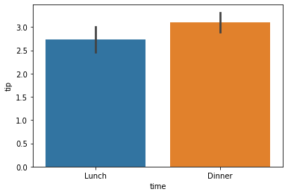
Independent samples t-test
Can we expect to find this average difference across the population?
(Not just what we see here in the samples)

Slide 48
Demo
File: ch-13-demos.ipynb
Is the difference in tip sizes that we see in these samples likely to be found in the population?
from scipy import stats
P < .05… not likely a fluke

Slide 49
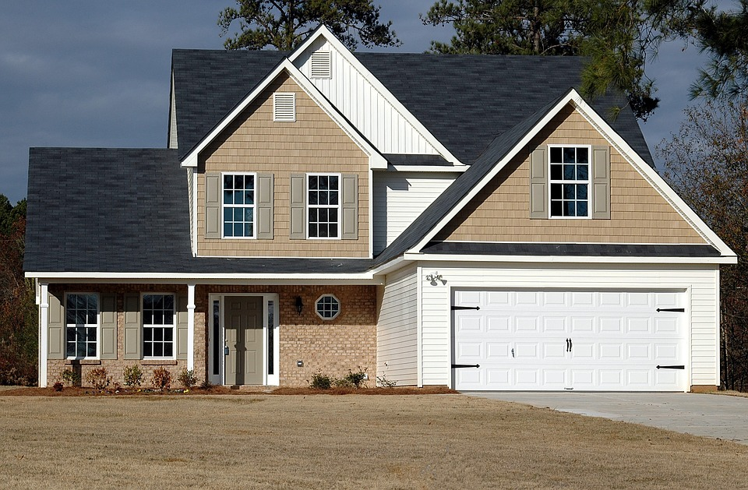

Imagine a world…
SOLD: $200,000
SOLD: $200,000
α = .05
If the null were true (i.e. no real difference in means), we would find a significant difference in 5% of our samples due to random error.
Notes:
Let’s take an example from the housing prices dataset in the book. Let’s say that our null is there is no difference in sales prices for homes with our without air conditioning. If we did indeed live in this world, and we tested for significance at the 95% confidence level, then we would still find a significant difference in sales prices in 5% of our samples, due to random error.
That’s a 1 in 20 chance of finding a significant difference when there is none! So if we do a bunch of tests, the higher our chances that we will hit a significant finding due to random chance. This is called experimentwise error.

Slide 50
Drill
File: ch-13-drills.ipynb
Dataset: mpg from seaborn
Is there a difference between the average mileage of American and European cars?
Hint: get unique values in origin: mpg['origin'].unique()

Slide 51
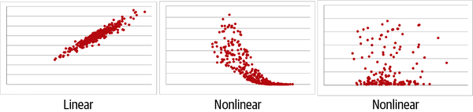
Does a line run through it?
Linear correlation
Correlation coefficient | Interpretation
–1.0 | Perfect negative linear relationship
–0.5 | Moderate negative relationship
0 | No linear relationship
+0.5 | Moderate positive relationship
+1.0 | Perfect positive linear relationship

Slide 52
Demo
File: ch-13-demos.ipynb
What are the correlations between variables?
Are they linear to begin with?

Slide 53
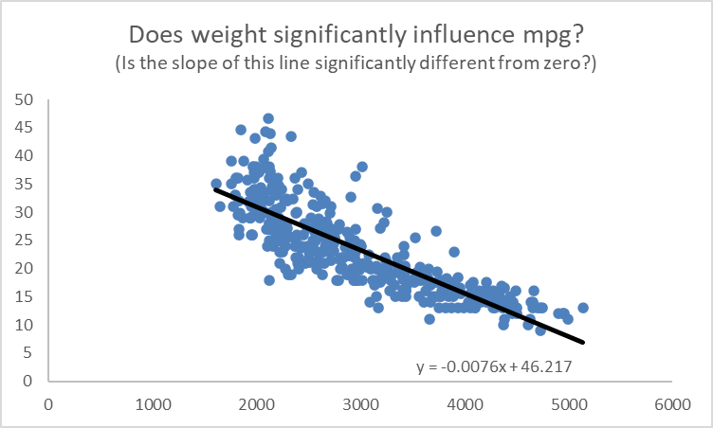
What is that line’s slope and intercept?

Slide 54
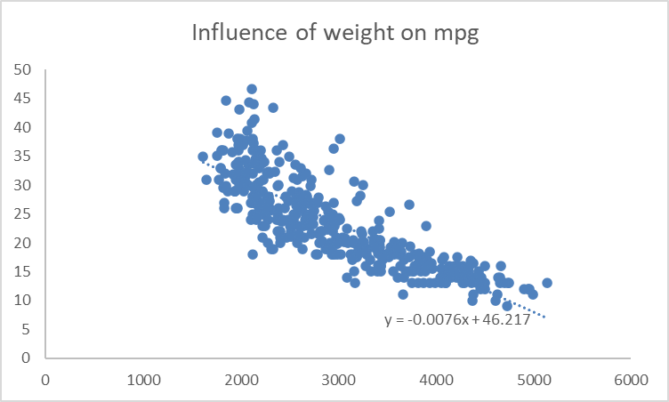
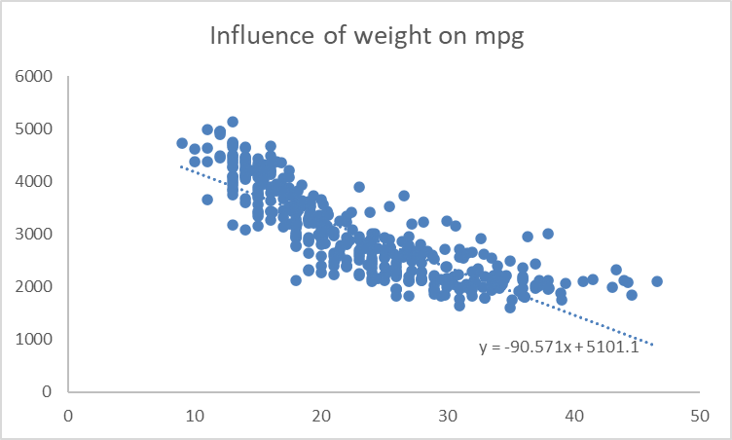
What does when?
Independent vs dependent variables
Correlation vs causation

Slide 55
Demo
File: ch-13-demos.ipynb
Linear regression with scipy.stats
Split data into x’s and y’s

Slide 56
Drills
File: ch-13-drills.ipynb
Dataset: tips from seaborn
Between total_bill and tip, which is the independent and dependent variable?
Is the relationship linear?
If so, what is the influence of the independent on the linear variable?
Solutions: ch-13-solutions.ipynb

Slide 57
Train/test split

Slide 58
Advancing into machine learning
“Machine learning (ML) is the study of computer algorithms that can improve automatically through experience and by the use of data….
Machine learning algorithms build a model based on sample data, known as training data, in order to make predictions or decisions without being explicitly programmed to do so.”
https://en.wikipedia.org/wiki/Machine_learning

Slide 59
Advancing into machine learning
from sklearn import linear_model
from sklearn import model_selection
from sklearn import metrics
X_train, X_test, y_train, y_test =
model_selection.train_test_split(df[['x']], mpg[['y']], random_state=1234)

Slide 60
Demo
File: ch-13-demos.ipynb
Train the regression model
Evaluate results on testing set
R-square: How much of the variability in Y is explained by X on our testing data?

Slide 61
Drill
File: ch-13-drills.ipynb
Apply a train/test split to the tips model you developed earlier.
What is the R-square on the test data?
Solutions: ch-13-solutions.ipynb

Slide 62
Questions about Chapter 9?
Notes:
Any questions so far about using R?
Again I just want to show you how easy it is to get up and running there as an Excel user and what to expect when working with open source programs.
Now I guess one of the questions I might have in your shoes is what’s the big deal, we can do the same kind of stuff with Power Query. So I want to acknowledge that.

Slide 63
Conclusion/next steps

Slide 64
Getting unblocked

Slide 65
Demo
Five ways to get help in R
File: conclusion-get-help-in-r.r
You can’t know everything
But you can have a plan for getting unblocked!
Notes:
\

Slide 66
Get your swag!
More practice sets: stringfestdata.gumroad.com/l/aina-practice
Video walkthroughs of book exercises: stringfestdata.gumroad.com/l/aina-solution-demos
Download for free with promocode CLARKS

Slide 67
Event survey: https://forms.office.com/r/0ZnD0LxpZy

Slide 68
THANK YOU
george@stringfestanalytics.com
linkedin.com/in/gjmount
stringfestanalytics.com/contact

