Slide 1
✓ Microphone off?
✓ Camera off?
✓ Fun on?

Slide 2


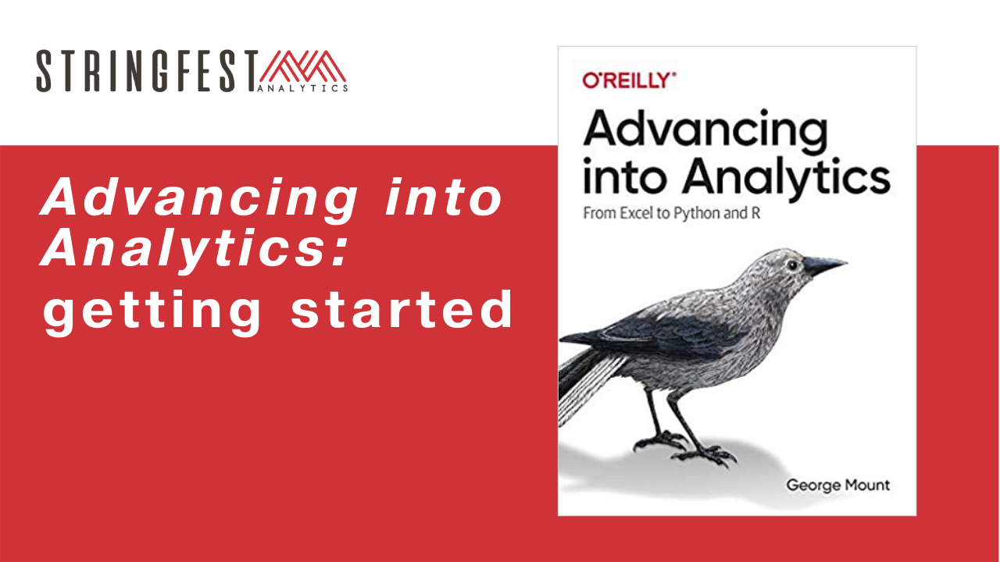
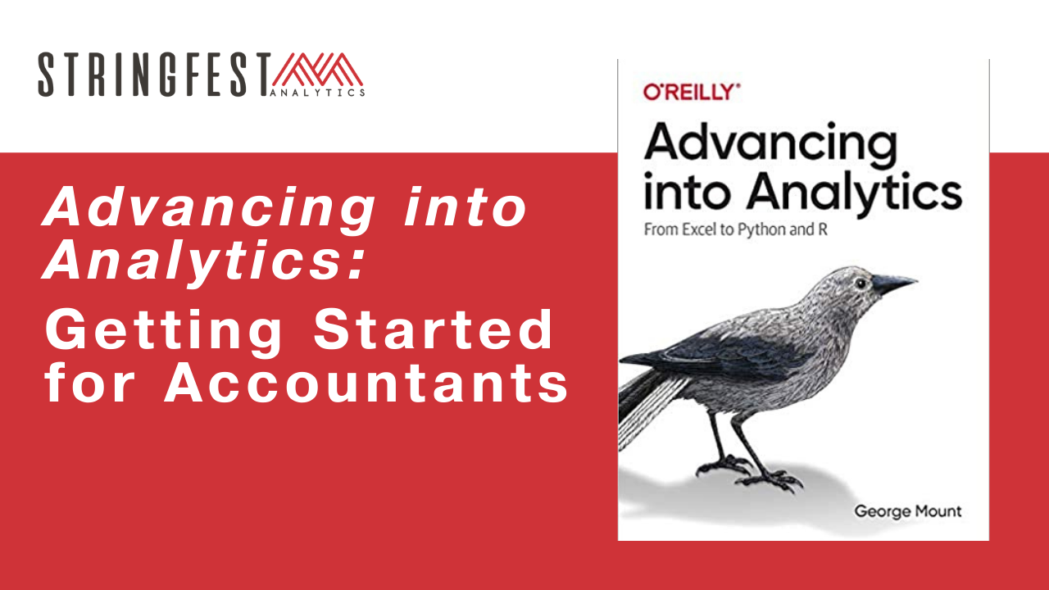

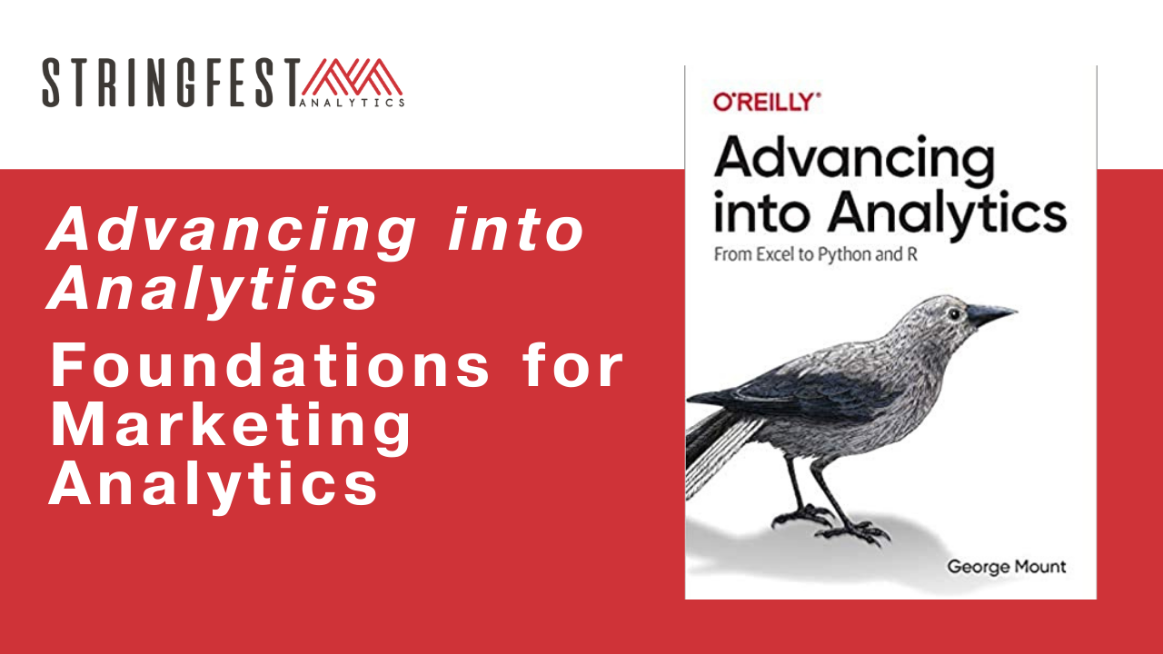
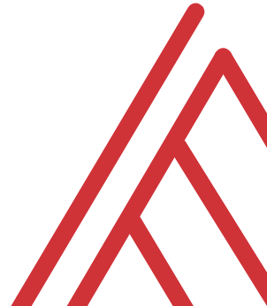
Advancing into Analytics: From Excel to R and Python

Slide 3
Chat me up…
What excites you about these topics? What scares you?
What marketing areas are you coming from? (Poll)
What use cases are you interested in?
Notes:
Product
Social media
Email
Other

Slide 4
Learning objectives
Situate Excel, R and Python in the data analytics stack
Prepare a Windows computer to work in both
Analyze data in them all

Slide 5
Follow along
Download resources: https://github.com/stringfestdata/aina-marketing-foundations
Code > Download ZIP
Notes:
\

Slide 6
Questions?

Slide 7
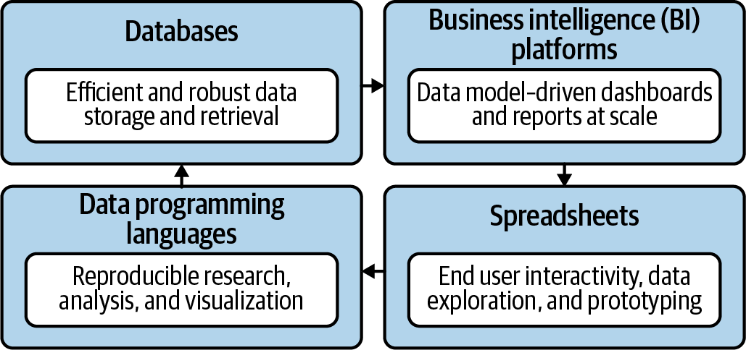
Become a full-stack marketing analyst
Mount, George. Advancing into Analytics: From Excel to Python and R. O’Reilly Media, 2021
Notes:
Now this figure comes from my book and it’s a very broad conceptualization of the various slices of the stack. You know we hear engineers or web developers talk about being “full stack” all the time but it’s not so common an expression as it could be.

Slide 8

Demos
Analyze A/B test results in Excel
Confirm them in R
Model a linear regression in Python

Slide 9
Questions?

Slide 10
Demos
Analyze A/B test results in Excel
Confirm them in R
Model a linear regression in Python

Slide 11
Demo
Data analytics in Excel
Is there a difference in AOV between legacy and prototype stores?
Data: retail.xlsx
Demo notes: excel-demo.docx

Slide 12
Questions?

Slide 13
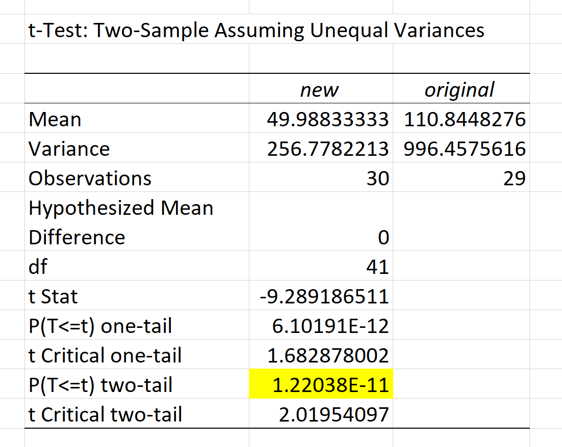


Imagine a world…
AOV: $50
AOV: $50
α = .05
If the null were true (i.e. no real difference in means), we would find a significant difference in 5% of our samples due to random error.
Notes:
Let’s take an example from the housing prices dataset in the book. Let’s say that our null is there is no difference in sales prices for homes with our without air conditioning. If we did indeed live in this world, and we tested for significance at the 95% confidence level, then we would still find a significant difference in sales prices in 5% of our samples, due to random error.
That’s a 1 in 20 chance of finding a significant difference when there is none! So if we do a bunch of tests, the higher our chances that we will hit a significant finding due to random chance. This is called experimentwise error.

Slide 14

Demo
Data analytics in R
How likely will this difference generalize to larger population of stores?
Script: retail.r

Slide 15

The package two-step…
Install the “app” (This has been done for you for Python)
Open it to run
Notes:
Let’s take an example from the housing prices dataset in the book. Let’s say that our null is there is no difference in sales prices for homes with our without air conditioning. If we did indeed live in this world, and we tested for significance at the 95% confidence level, then we would still find a significant difference in sales prices in 5% of our samples, due to random error.
That’s a 1 in 20 chance of finding a significant difference when there is none! So if we do a bunch of tests, the higher our chances that we will hit a significant finding due to random chance. This is called experimentwise error.

Slide 16
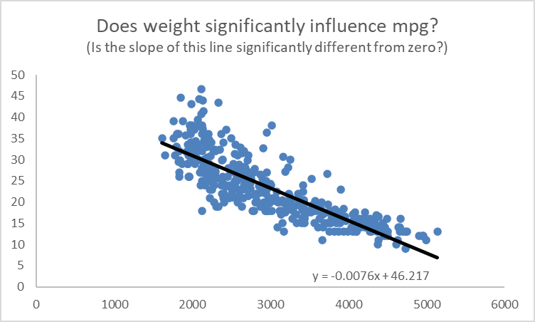
Does a line run through it?
(And what is the slope and intercept?)

Slide 17

Demo
Data analytics in Python
Does a vehicle’s weight significantly impact its mileage?
Script: mpg.ipynb

Slide 18
Questions?

Slide 19
Conclusion/Next steps

Slide 20
Cracking the book
The underlying math & philosophy of analytics
Data cleaning in R & Python
Further data visualizations

Slide 21
Event survey: https://forms.office.com/r/0ZnD0LxpZy

Slide 22
THANK YOU
Happy reading 📚
george@stringfestanalytics.com
linkedin.com/in/gjmount
stringfestanalytics.com/contact

