Slide 1
✓ Microphone off?
✓ Camera off?
✓ Fun on?

Slide 2


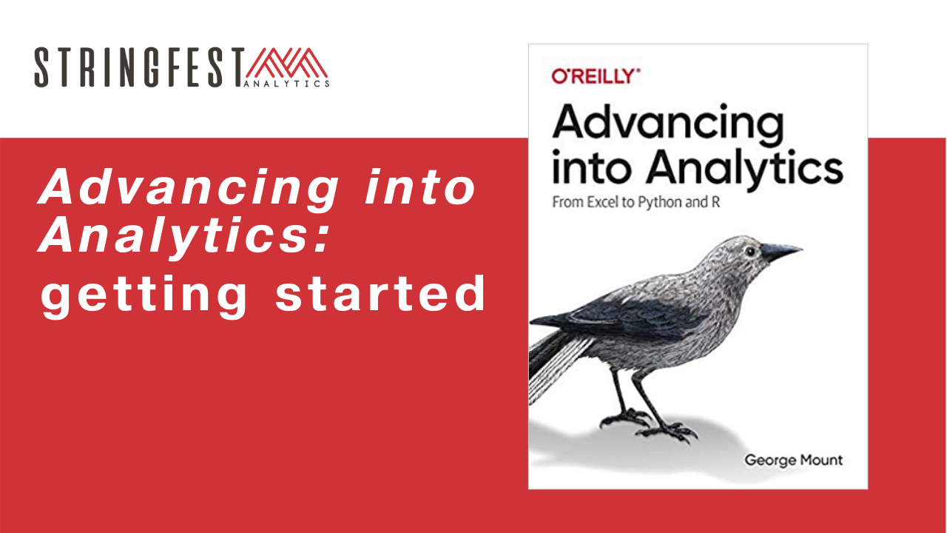
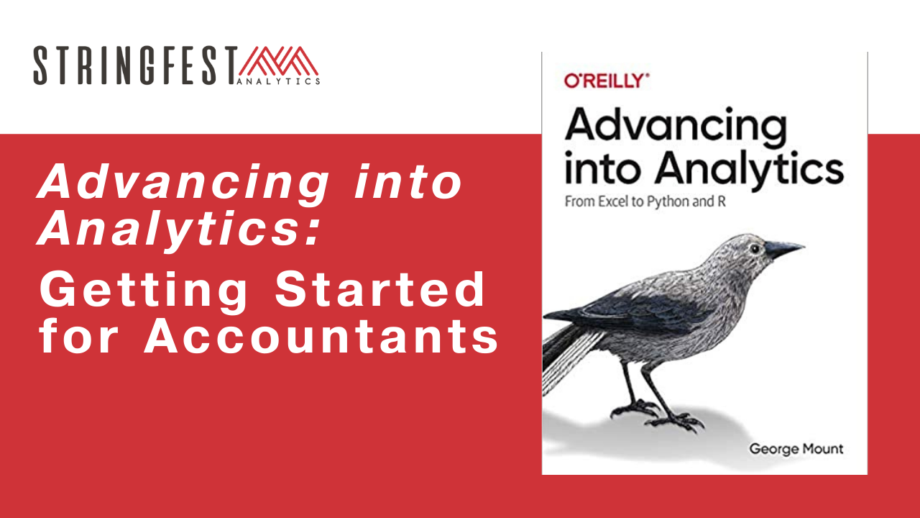

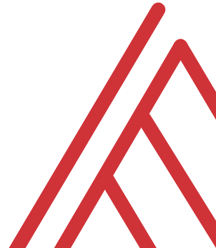
Advancing into Analytics: From Excel to R and Python

Slide 3
Chat me up…
What excites you about these topics? What scares you?
What research areas are you coming from? (Poll)
What use cases are you interested in?
Notes:
Healthcare
Agriculture
Academia

Slide 4
Learning objectives
Situate R and Python in the data analytics stack
Prepare a Windows computer to work in both
Summarize and visualize data in both

Slide 5
Follow along
Download resources: https://github.com/stringfestdata/aina-getting-started-for-researchers
Code > Download ZIP
Notes:
\

Slide 6
Questions?

Slide 7
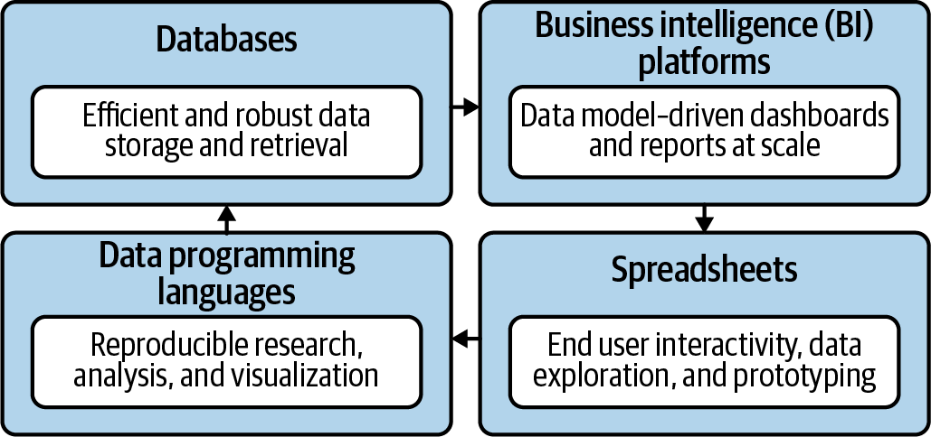
Become a full-stack analyst
Mount, George. Advancing into Analytics: From Excel to Python and R. O’Reilly Media, 2021
Notes:
Now this figure comes from my book and it’s a very broad conceptualization of the various slices of the stack. You know we hear engineers or web developers talk about being “full stack” all the time but it’s not so common an expression as it could be.

Slide 8

Demos
Download, summarize and visualize data:
R
Python
Follow along with demo notes for both
Let’s get situated…
File to summarize: ispy.xlsx
Notes:
OK so now you will see R’s equivalent to some of those features you saw with Python. I think that for different reasons Python seems to be taking the lead on Excel automation, but R has some pretty robust features and in some ways are richer than Python’s.

Slide 9
Questions?

Slide 10
Conclusion/Next steps

Slide 11
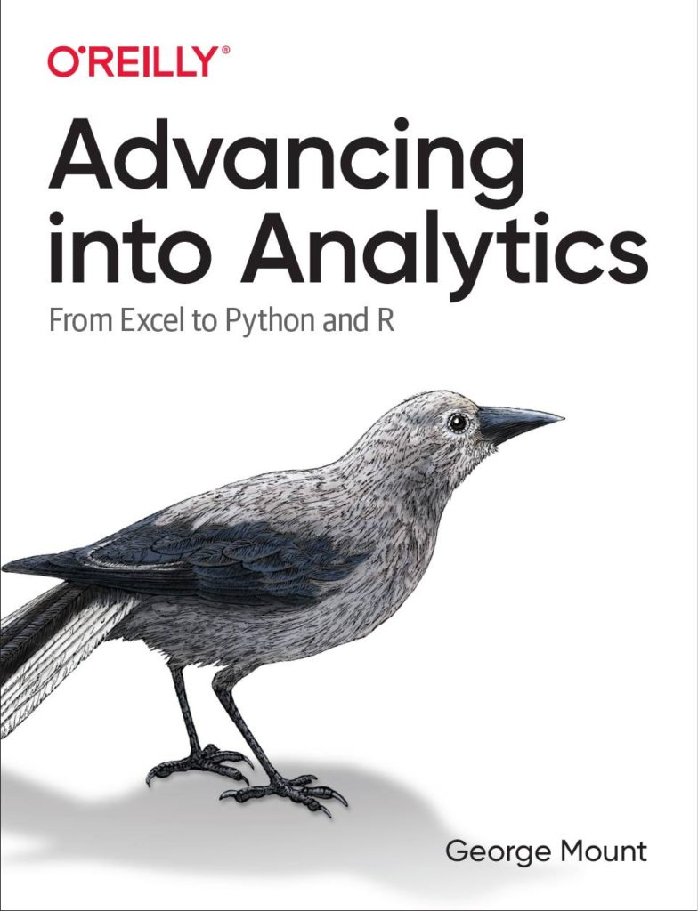
Read the book
http://stringfestanalytics.com/book/
Read for free on O’Reilly’s website (30 day trial, or check your library)
Desk copies for interested educators

Slide 12

Get the swag
Resource library
Memes galore
Discounts to upcoming courses
https://stringfestanalytics.com/subscribe/

Slide 13
Event survey: https://forms.office.com/r/0ZnD0LxpZy

Slide 14
Questions?

Slide 15
THANK YOU
george@stringfestanalytics.com
linkedin.com/in/gjmount
stringfestanalytics.com/contact

