Slide 1


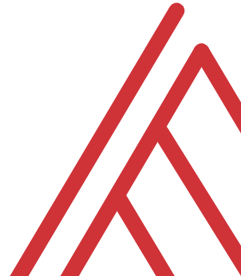
Advancing into Analytics: From Excel to R and Python

Slide 2
Why are you here?
Tell me about yourself…

Slide 3
Why am I here?
Founder, Stringfest Analytics
Author, Advancing into Analytics (O’Reilly)
Full-time analytics solopreneur since 2018

Slide 4

Learning objectives
What is the basic strategy of analytics solopreneurship?
What are possible tactics?
Notes:
So there’s some linear plan I can give you, right? That’s probably what you want?

Slide 5

INDIVIDUAL RESULTS MAY VARY

Slide 6
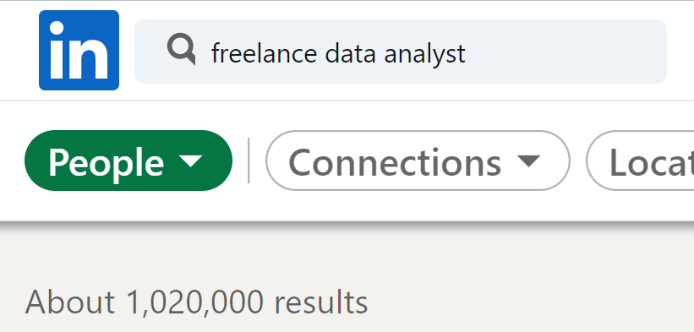
Why are there so few of us?
Do you think it will change?
Notes:
You’re data people you can probably figure it out

Slide 7
Themes

Slide 8

What’s in a dataset?
Variables… vary
Observations… are observed

Slide 9
What’s in an eda?
Interview the data:
What sorts of stories are possible?
What types of variables are there?
How can we “summarize” them (frequencies, descriptive statistics, etc.)?
How can we depict them visually?

Slide 10
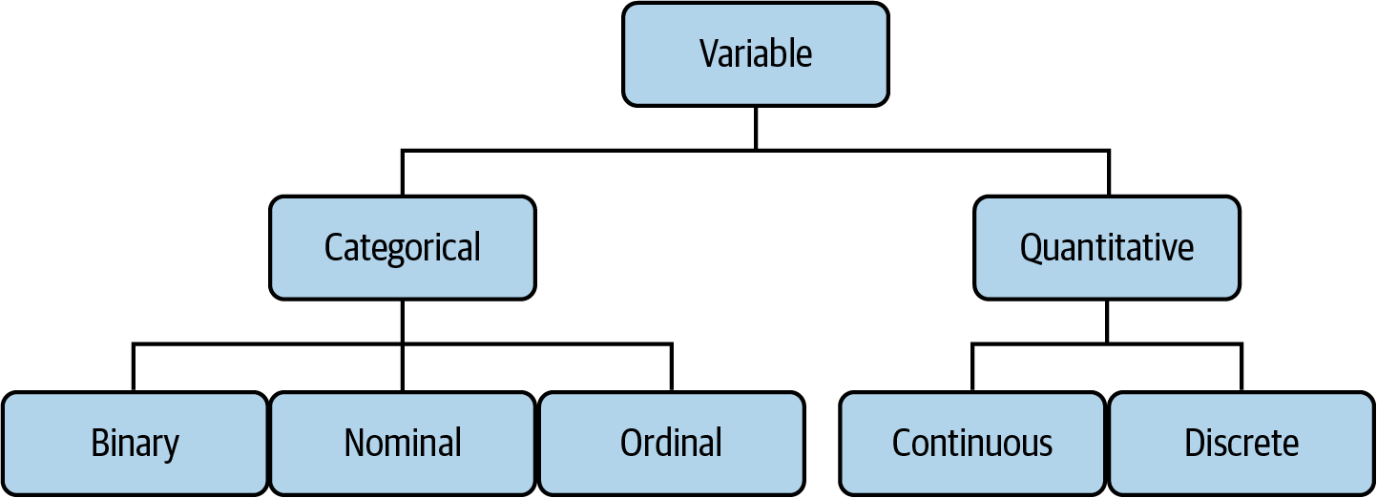
The tree of data
Mount, George. Advancing into Analytics: From Excel to Python and R. O’Reilly Media, 2021
Notes:
Now this figure comes from my book and it’s a very broad conceptualization of the various slices of the stack. You know we hear engineers or web developers talk about being “full stack” all the time but it’s not so common an expression as it could be.

Slide 11
“How much?”
Made purchase?
Yes or No
ZIP code
44134, 90210, etc.
Beverage size:
Small, medium, large… extra large?
Notes:
Now this figure comes from my book and it’s a very broad conceptualization of the various slices of the stack. You know we hear engineers or web developers talk about being “full stack” all the time but it’s not so common an expression as it could be.

Slide 12
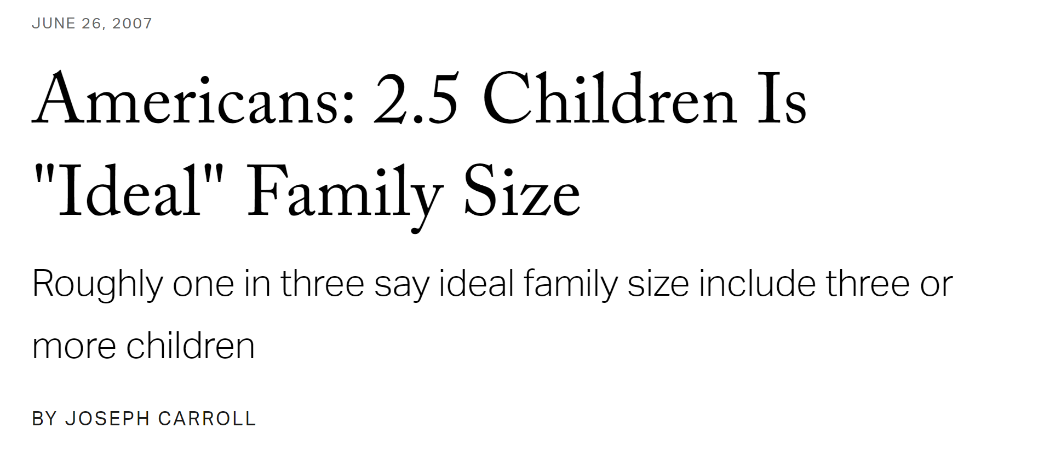
“How much/how many?”
🤔
pH level
Height
Number of children
Units sold
Notes:
Now this figure comes from my book and it’s a very broad conceptualization of the various slices of the stack. You know we hear engineers or web developers talk about being “full stack” all the time but it’s not so common an expression as it could be.

Slide 13
Questions?

Slide 14

Drill
File: titanic.xlsx
Variable descriptions: https://web.stanford.edu/class/archive/cs/cs109/cs109.1166/problem12.html
Categorize each variable
Add an index column and convert to table!
Solutions: solutions/titanic-solutions.xlsx
Notes:
OK so now you will see R’s equivalent to some of those features you saw with Python. I think that for different reasons Python seems to be taking the lead on Excel automation, but R has some pretty robust features and in some ways are richer than Python’s.

Slide 15
Summarizing continuous variables
Central tendency: what value is the variable centered around?
Mean: “average”
Median: “middle”
Mode: “most common”

Slide 16
You are consulting for a non-profit on fundraising strategies
Donation data is shown below
Which measure of central tendency (mean/median/mode) should be tracked?
Drill
Donation
10
10
20
30
100
Notes:
OK so now you will see R’s equivalent to some of those features you saw with Python. I think that for different reasons Python seems to be taking the lead on Excel automation, but R has some pretty robust features and in some ways are richer than Python’s.

Slide 17
No one statistic rules them all…
Drill
Donation
10
10
20
30
100
Statistic | Value
Mean | $34
Median | $20
Mode | $10
Notes:
OK so now you will see R’s equivalent to some of those features you saw with Python. I think that for different reasons Python seems to be taking the lead on Excel automation, but R has some pretty robust features and in some ways are richer than Python’s.

Slide 18
Demo
Summarizing categorical variables
How many of each category?
PivotTables
Bar charts
Dataset: housing.xlsx
Complete file: solutions/housing-complete.xlsx
Demo notes: demo-notes.xlsx
Notes:
OK so now you will see R’s equivalent to some of those features you saw with Python. I think that for different reasons Python seems to be taking the lead on Excel automation, but R has some pretty robust features and in some ways are richer than Python’s.

Slide 19
Summarizing continuous variables
Variability: how spread is the variable from the center?
Range: What are the min/max?
Variance: Relative to the mean, how far away does the data fall?
Standard deviation: Square root of the variance

Slide 20
Questions?

Slide 21
Do you have the the Analysis ToolPak?
https://bit.ly/3jZaw9X

Slide 22
Demo
File: housing.xlsx
Summarize price with the Analysis ToolPak
Notes:
OK so now you will see R’s equivalent to some of those features you saw with Python. I think that for different reasons Python seems to be taking the lead on Excel automation, but R has some pretty robust features and in some ways are richer than Python’s.

Slide 23
Drill
File: housing.xlsx
Summarize lotsize with the Analysis ToolPak
Notes:
OK so now you will see R’s equivalent to some of those features you saw with Python. I think that for different reasons Python seems to be taking the lead on Excel automation, but R has some pretty robust features and in some ways are richer than Python’s.

Slide 24
Questions?

Slide 25
Visualizing continuous variables
Histogram
What does the data’s distribution “look like?”
How many data points lie with each bin?

Slide 26
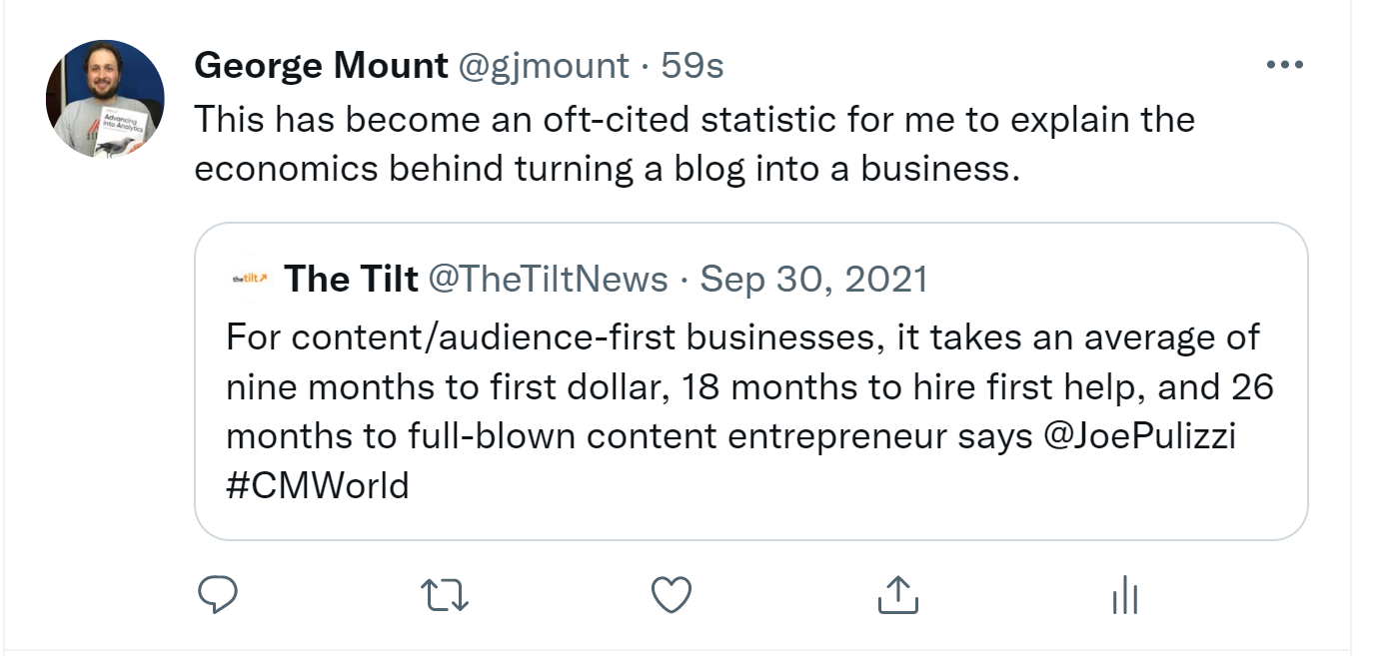
It’s a long haul

Slide 27
Demo
File: housing.xlsx
Visualize price with a histogram
Notes:
OK so now you will see R’s equivalent to some of those features you saw with Python. I think that for different reasons Python seems to be taking the lead on Excel automation, but R has some pretty robust features and in some ways are richer than Python’s.

Slide 28
Drill
File: housing.xlsx
Visualize lotsize with a histogram
Notes:
OK so now you will see R’s equivalent to some of those features you saw with Python. I think that for different reasons Python seems to be taking the lead on Excel automation, but R has some pretty robust features and in some ways are richer than Python’s.

Slide 29
Demo
File: housing.xlsx
Summarizing and visualizing two categories: price by AC
Notes:
OK so now you will see R’s equivalent to some of those features you saw with Python. I think that for different reasons Python seems to be taking the lead on Excel automation, but R has some pretty robust features and in some ways are richer than Python’s.

Slide 30
Demo
File: housing.xlsx
Summarizing and visualizing two categories: lotsize by AC
Notes:
OK so now you will see R’s equivalent to some of those features you saw with Python. I think that for different reasons Python seems to be taking the lead on Excel automation, but R has some pretty robust features and in some ways are richer than Python’s.

Slide 31
Questions about EDA?
Next… CDA (but before that, probability!)

Slide 32
Timeline

Slide 33

Month 0
Pick a topic
Blog the daylights out of it

Slide 34
Months 1-3
Get moving on social media

Slide 35
Months 4-6
Pick up a safety-net gig
Consider bailing full-time gig
Keep blogging the daylights out of it

Slide 36
Months 7-12
Try selling a product on your own
Continue the safety-net (full-time, part-time, whatever works)

Slide 37
Years 1-2
Rinse and repeat
Pivot topics, media, etc.
Build the “portfolio of small bets”

Slide 38
Years 2-3
Is this a hobby or a business?
Or a little of both?
Notes:
By then you should know this.

Slide 39
Conclusion/Next steps

Slide 40
Questions?

Slide 41
Need a hand?
Booking five initial consults – first X people get one

Slide 42
Event survey: https://forms.office.com/r/0ZnD0LxpZy
Notes:
A surprise awaits those of you who do it…

Slide 43
THANK YOU
george@stringfestanalytics.com
linkedin.com/in/gjmount
stringfestanalytics.com/contact

