Slide 1

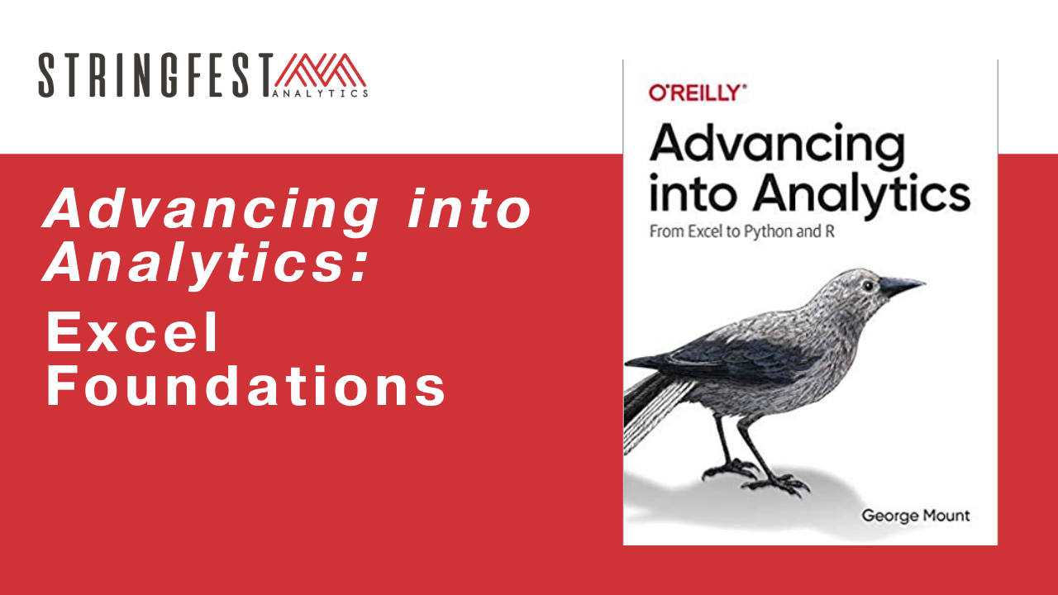
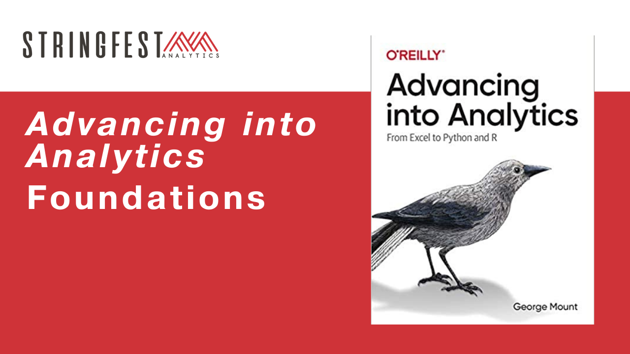
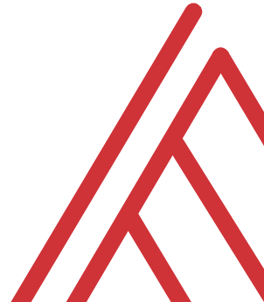
Advancing into Analytics: From Excel to R and Python

Slide 2
Questions about the book?
Tell me about yourself…

Slide 3
Learning objectives
Chapter 1:
Establish aims of exploratory data analysis (EDA)
Perform basic EDA in Excel
What is the data analytics stack? How does this book help?

Slide 4

What’s in a dataset?
Variables… vary
Observations… are observed

Slide 5
What’s in an eda?
Interview the data:
What sorts of stories are possible?
What types of variables are there?
How can we “summarize” them (frequencies, descriptive statistics, etc.)?
How can we depict them visually?

Slide 6
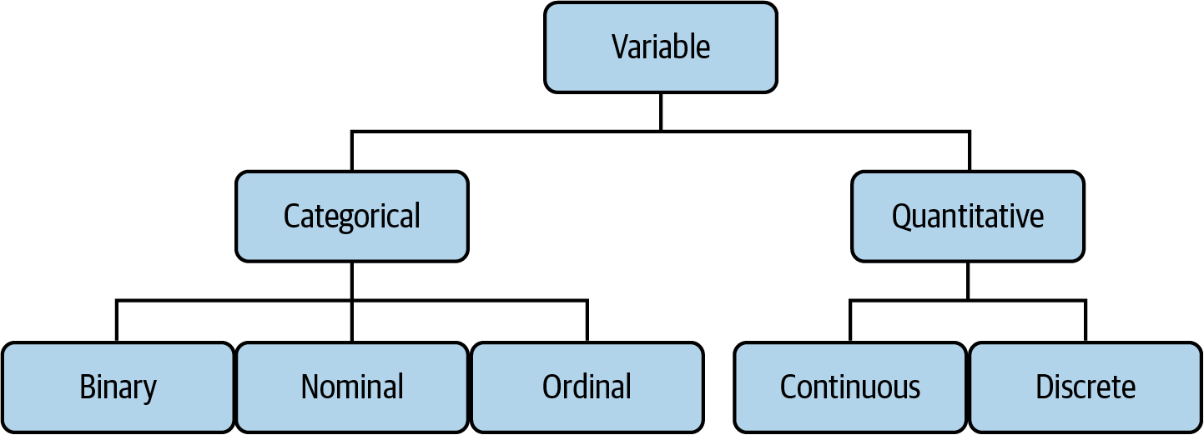
The tree of data
Mount, George. Advancing into Analytics: From Excel to Python and R. O’Reilly Media, 2021
Notes:
Now this figure comes from my book and it’s a very broad conceptualization of the various slices of the stack. You know we hear engineers or web developers talk about being “full stack” all the time but it’s not so common an expression as it could be.

Slide 7
“How much?”
Made purchase?
Yes or No
ZIP code
44134, 90210, etc.
Beverage size:
Small, medium, large… extra large?
Notes:
Now this figure comes from my book and it’s a very broad conceptualization of the various slices of the stack. You know we hear engineers or web developers talk about being “full stack” all the time but it’s not so common an expression as it could be.

Slide 8
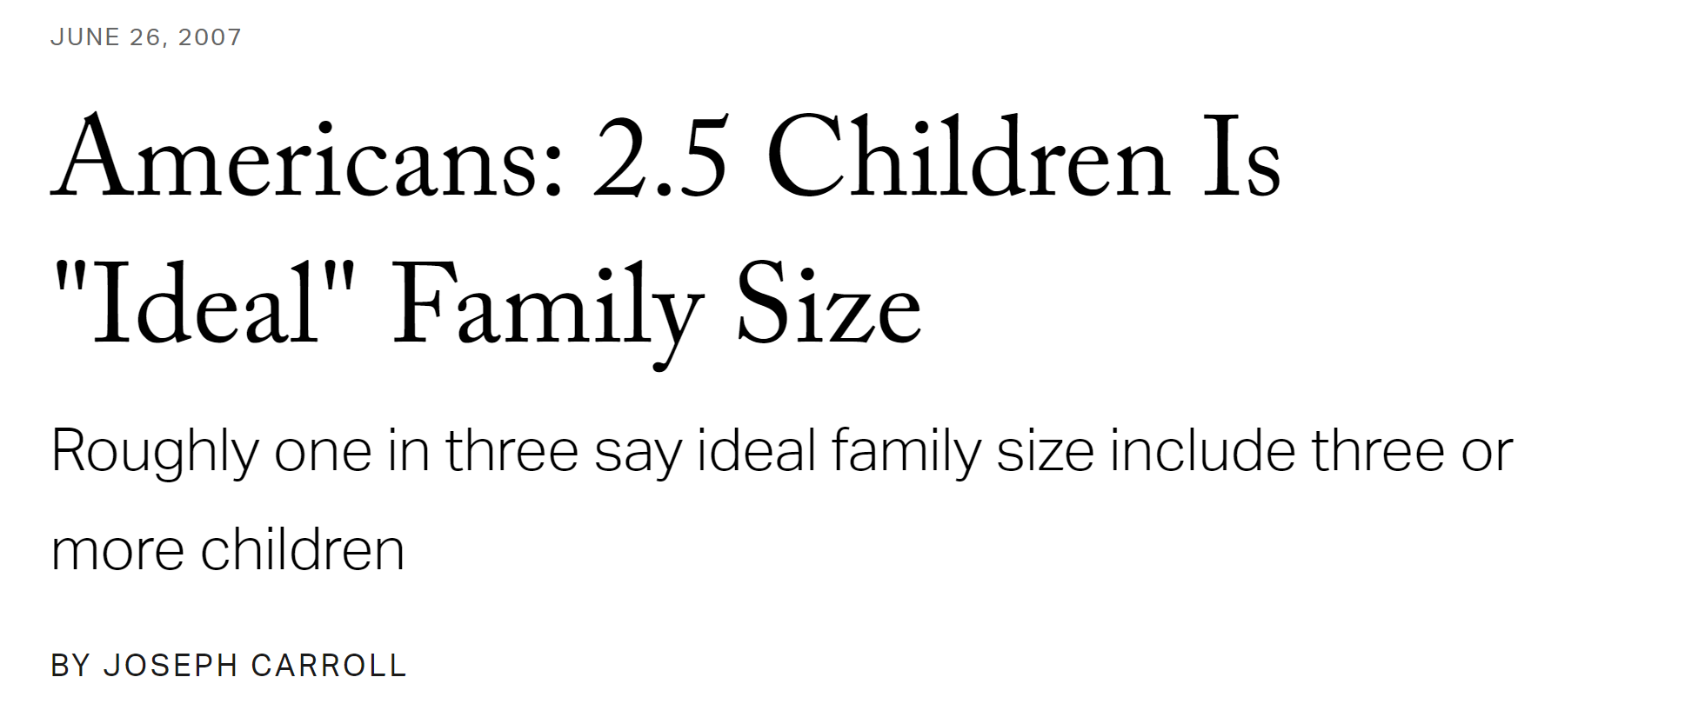
“How much/how many?”
🤔
pH level
Height
Number of children
Units sold
Notes:
Now this figure comes from my book and it’s a very broad conceptualization of the various slices of the stack. You know we hear engineers or web developers talk about being “full stack” all the time but it’s not so common an expression as it could be.

Slide 9
Questions?

Slide 10

Drill
File: titanic.xlsx
Variable descriptions: https://web.stanford.edu/class/archive/cs/cs109/cs109.1166/problem12.html
Categorize each variable
Add an index column and convert to table!
Solutions: solutions/titanic-solutions.xlsx
Notes:
OK so now you will see R’s equivalent to some of those features you saw with Python. I think that for different reasons Python seems to be taking the lead on Excel automation, but R has some pretty robust features and in some ways are richer than Python’s.

Slide 11
Summarizing continuous variables
Central tendency: what value is the variable centered around?
Mean: “average”
Median: “middle”
Mode: “most common”

Slide 12
You are consulting for a non-profit on fundraising strategies
Donation data is shown below
Which measure of central tendency (mean/median/mode) should be tracked?
Drill
Donation
10
10
20
30
100
Notes:
OK so now you will see R’s equivalent to some of those features you saw with Python. I think that for different reasons Python seems to be taking the lead on Excel automation, but R has some pretty robust features and in some ways are richer than Python’s.

Slide 13
No one statistic rules them all…
Drill
Donation
10
10
20
30
100
Statistic | Value
Mean | $34
Median | $20
Mode | $10
Notes:
OK so now you will see R’s equivalent to some of those features you saw with Python. I think that for different reasons Python seems to be taking the lead on Excel automation, but R has some pretty robust features and in some ways are richer than Python’s.

Slide 14
Demo
Summarizing categorical variables
How many of each category?
PivotTables
Bar charts
Dataset: housing.xlsx
Complete file: solutions/housing-complete.xlsx
Demo notes: demo-notes.xlsx
Notes:
OK so now you will see R’s equivalent to some of those features you saw with Python. I think that for different reasons Python seems to be taking the lead on Excel automation, but R has some pretty robust features and in some ways are richer than Python’s.

Slide 15
Summarizing continuous variables
Variability: how spread is the variable from the center?
Range: What are the min/max?
Variance: Relative to the mean, how far away does the data fall?
Standard deviation: Square root of the variance

Slide 16
Questions?

Slide 17
Do you have the the Analysis ToolPak?
https://bit.ly/3jZaw9X

Slide 18
Demo
File: housing.xlsx
Summarize price with the Analysis ToolPak
Notes:
OK so now you will see R’s equivalent to some of those features you saw with Python. I think that for different reasons Python seems to be taking the lead on Excel automation, but R has some pretty robust features and in some ways are richer than Python’s.

Slide 19
Drill
File: housing.xlsx
Summarize lotsize with the Analysis ToolPak
Notes:
OK so now you will see R’s equivalent to some of those features you saw with Python. I think that for different reasons Python seems to be taking the lead on Excel automation, but R has some pretty robust features and in some ways are richer than Python’s.

Slide 20
Questions?

Slide 21
Visualizing continuous variables
Histogram
What does the data’s distribution “look like?”
How many data points lie with each bin?

Slide 22
Demo
File: housing.xlsx
Visualize price with a histogram
Notes:
OK so now you will see R’s equivalent to some of those features you saw with Python. I think that for different reasons Python seems to be taking the lead on Excel automation, but R has some pretty robust features and in some ways are richer than Python’s.

Slide 23
Drill
File: housing.xlsx
Visualize lotsize with a histogram
Notes:
OK so now you will see R’s equivalent to some of those features you saw with Python. I think that for different reasons Python seems to be taking the lead on Excel automation, but R has some pretty robust features and in some ways are richer than Python’s.

Slide 24
Demo
File: housing.xlsx
Summarizing and visualizing two categories: price by AC
Notes:
OK so now you will see R’s equivalent to some of those features you saw with Python. I think that for different reasons Python seems to be taking the lead on Excel automation, but R has some pretty robust features and in some ways are richer than Python’s.

Slide 25
Demo
File: housing.xlsx
Summarizing and visualizing two categories: lotsize by AC
Notes:
OK so now you will see R’s equivalent to some of those features you saw with Python. I think that for different reasons Python seems to be taking the lead on Excel automation, but R has some pretty robust features and in some ways are richer than Python’s.

Slide 26
Questions about EDA?
Next… CDA (but before that, probability!)

Slide 27
The data analytics stack

Slide 28
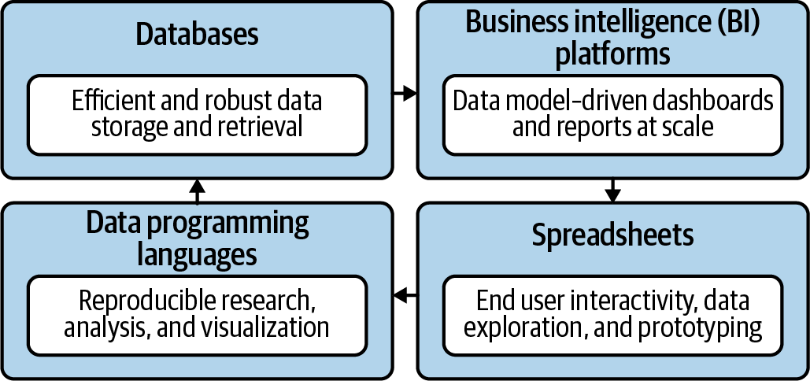
Become a full-stack analyst
Mount, George. Advancing into Analytics: From Excel to Python and R. O’Reilly Media, 2021
Notes:
Now this figure comes from my book and it’s a very broad conceptualization of the various slices of the stack. You know we hear engineers or web developers talk about being “full stack” all the time but it’s not so common an expression as it could be.

Slide 29
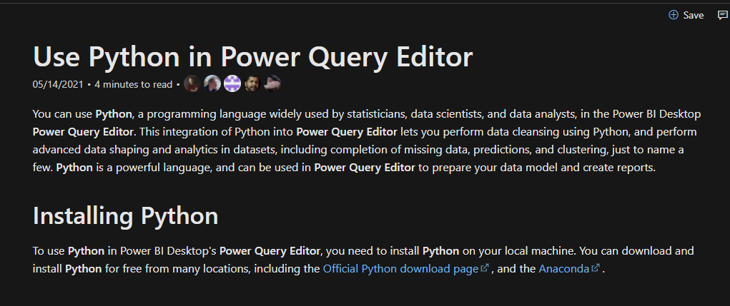

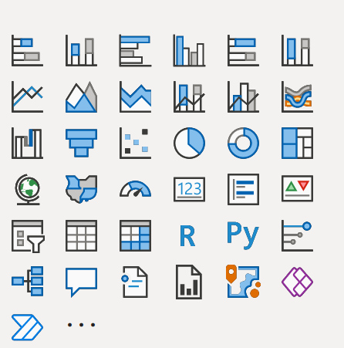
You’re not leaving the stack…
Notes:
One of the things that people get confused about is why learn Python if you’re getting into Power Query… or which to focus on.
You’re not leaving Microsoft’s stack. I have some documentation and a great book here. Now of course these are more about PowerBI but there’s every indication there’s more to come with Excel.

Slide 30
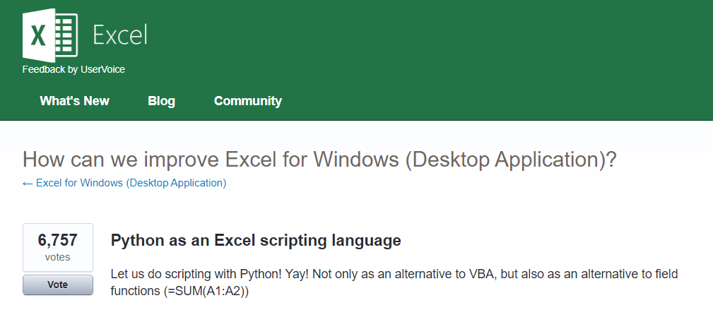



Python for Excel
More: http://www.python-excel.org
https://excel.uservoice.com/forums/304921-excel-for-windows-desktop-application/suggestions/10549005-python-as-an-excel-scripting-language
Notes:
OK so let’s talk about Python. In particular as an Excel user something to be aware of is the growing interest in integrating it with Python. Now I’ve linked to the infamous UserVoice survey above asking for this feature. I won’t press Alan or any of our MVPs on the matter but something is happening there…
There are also some popular packages over here but there are even more. So in this demo I am going to share a really brief example for “Python-Powered Excel.”

Slide 31
Conclusion/Next steps

Slide 32
Next steps?
Start reading!

Slide 33
Event survey: https://forms.office.com/r/0ZnD0LxpZy

Slide 34
Questions?

Slide 35
THANK YOU
george@stringfestanalytics.com
linkedin.com/in/gjmount
stringfestanalytics.com/contact

