Slide 1


Analyzing data with Python in Excel

Slide 2
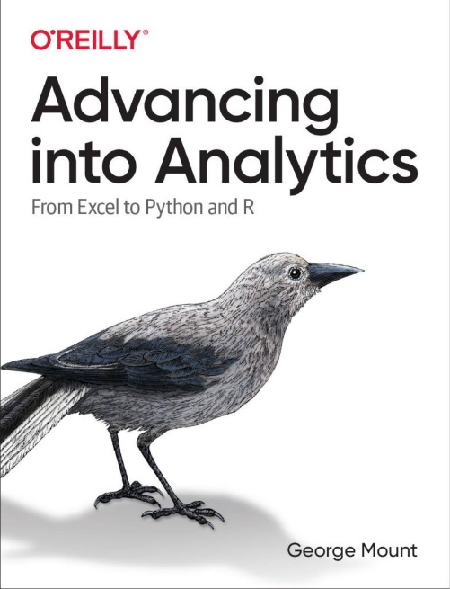
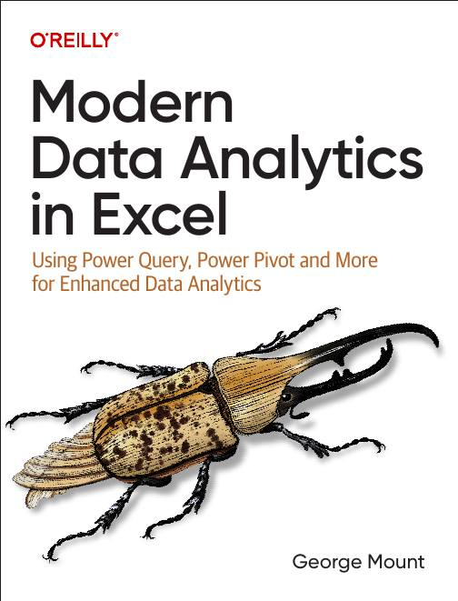




Hi, I’m George

Slide 3

Objectives for this session
Understanding Python basics for data wrangling
Profiling and handling missing values more efficiently than Excel
Leveraging Python for advanced time series analysis
Creating summaries and visualizations that extend Excel’s capabilities within the workbook environment
Bonus: Creating advanced analyses with Python using Copilot for seamless automation and insights

Slide 4
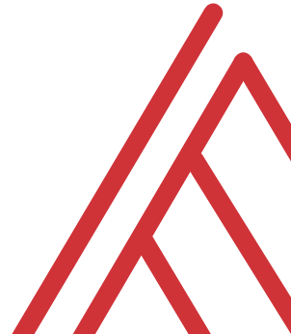
Questions?

Slide 5
Thank you

