Slide 1



Advancing into Analytics: From Excel to R and Python
Notes:
Welcome everyone to the presentation, I am looking forward to it.

Slide 2
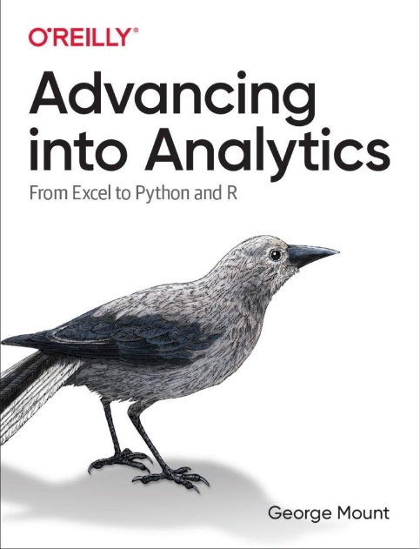




Hi, I’m George

Slide 3
Learning objectives
Create an end-to-end Excel automation in Python
Situate pandas versus openpyxl versus Power Query

Slide 4
Follow along
Resources: https://github.com/stringfestdata/automating-excel-with-python-webinar

Slide 5
Terms of engagement
Feel free to share the download link with latecomers ☺
Participation is welcome via the chat/unmute
Demos work best with 365 + Anaconda 3 for Windows
Recording goes out later today and is up for one week
I will do my best to answer your questions

Slide 6
What can Python do that VBA cannot?
Version control
Git/GitHub have limited features for Excel workbooks
View contributions, revert to previous versions, and so forth
Unit testing
Automated checks for software working as intended
Quality check for users of various technical backgrounds
Cross-platform interoperability
The “glue” of modern software development
Seamlessly compatible with the cloud
Package development
Thousands of free packages for nearly any use case
Easier to maintain source codes than copy-and-pasted VBA modules

Slide 7

Demo
File: automating-excel.ipynb
pandas for data manipulation
openpyxl for Excel automation
seaborn for data visualization

Slide 8
Conclusion/Resources

Slide 9
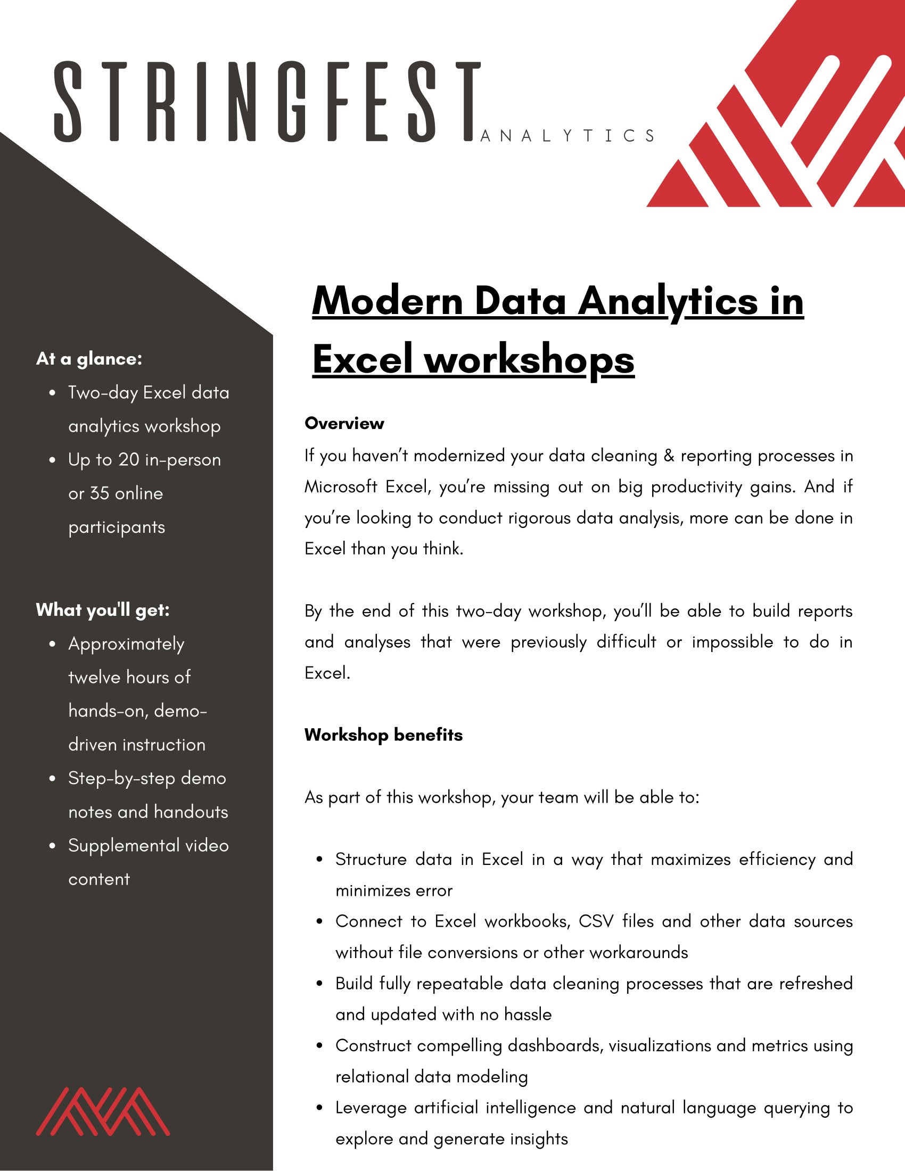
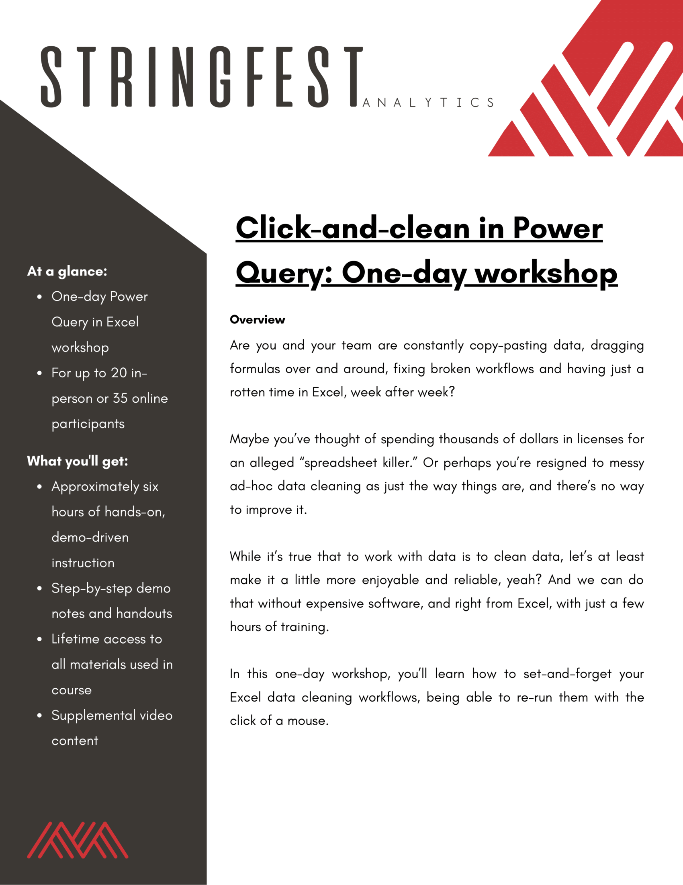
Modern Analytics in Excel workshops
Learn more and connect at https://stringfestanalytics.com/modern-data-analytics-in-excel-workshops/
Human Centered Design • MDLS 2020
Notes:
If you are looking to individually take a Power Query class I have a surprise here at the end…

Slide 10
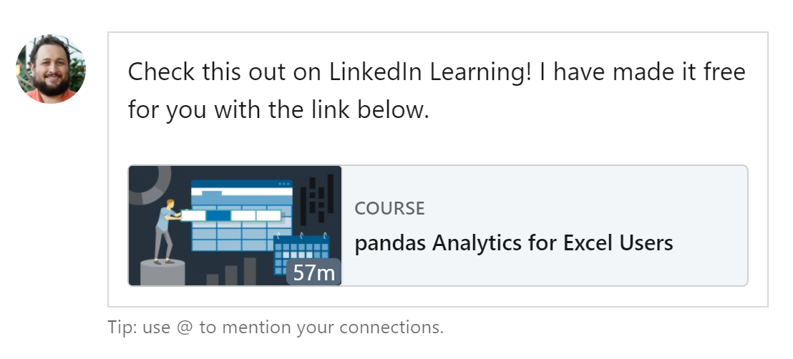
Pandas analytics for Excel users
View 24 hrs for free at https://www.linkedin.com/learning/pandas-analytics-for-excel-users/python-and-excel-for-analytics?u=50815393
Human Centered Design • MDLS 2020
Notes:
If you are looking to individually take a Power Query class I have a surprise here at the end…

Slide 11
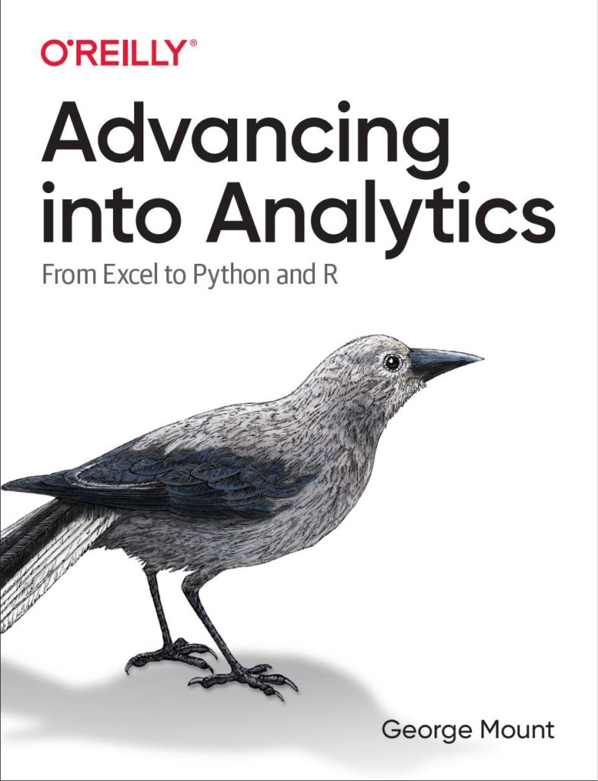
Advancing into Analytics
Learn more and where to get it: stringfestanalytics.com/book
Human Centered Design • MDLS 2020
Notes:
If you are looking to individually take a Power Query class I have a surprise here at the end…

Slide 12
Get in touch
george@stringfestanalytics.com
stringfestanalytics.com/book
linkedin.com/in/gjmount

Slide 13
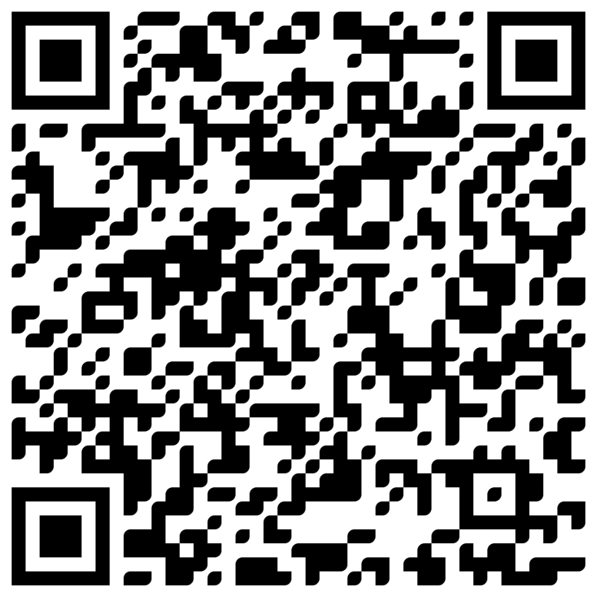

TAKE THE SURVEY
How did I do today? Testimonials or other data welcome.
https://social.stringfestanalytics.com/event-feedback
Notes:
I’m a data analyst give me data on how I did
Testimonials also VERY helpful.

Slide 14
FINAL QUESTIONS?
Thanks for joining!
A recap email with recording, survey and more will be coming…
The recording stays up for seven days.
I appreciate your reviews & referrals.
Notes:
Any questions on descriptive statistics?

Slide 15
Questions?

