Slide 1

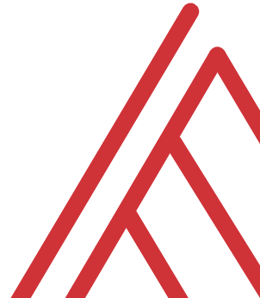

Data Visualization with Python in Excel

Slide 2
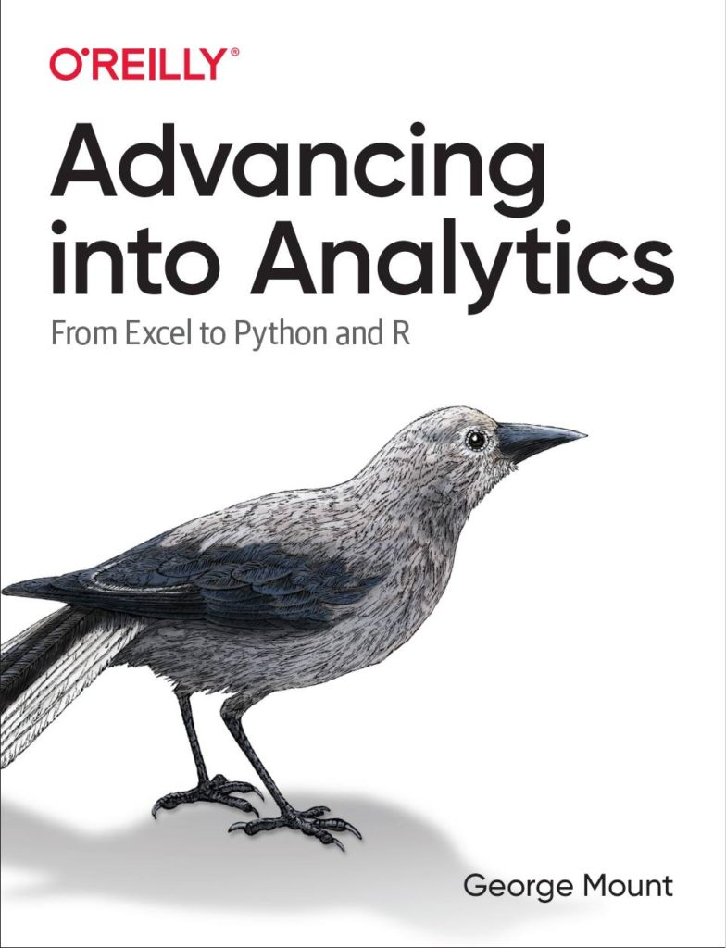

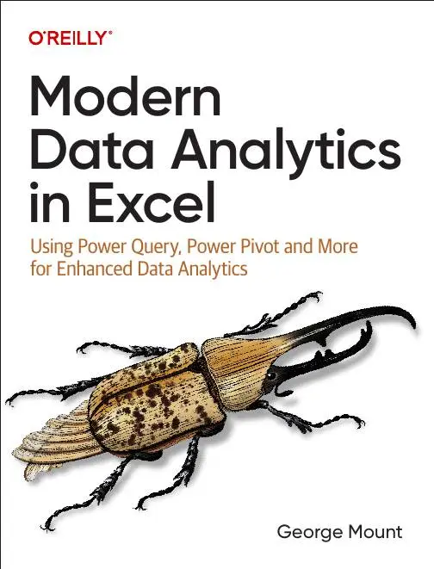


Hi, I’m George

Slide 3

Objectives for this session
Understand Python integration with Excel for data visualization.
Create and customize Python-generated plots within Excel workbooks.
Utilize Matplotlib, Seaborn, and Plotnine libraries for sophisticated visuals.
Implement dynamic and interactive measures using Python in Excel.
Leverage AI tools such as Copilot to enhance and refine Python visualizations.

Slide 4
1. Getting started with Python visualizations in Excel

Slide 5
Getting started with Python in Excel data viz
Learning the rules of the road for Python data viz
Execute Python plots in Excel
Resize and position plots
Pros and cons of Python-powered vs native Excel plots
File: first-python-plot.xlsx
Notes:
False!
Function, Formula, Function
Argument

Slide 6
Getting started with Python in Excel data viz CHALLENGE
Load rainfall data into Python within Excel
Create a line chart using `plt.plot()` from matplotlib
Assign months to the X-axis and rainfall (inches) to the Y-axis
Add a descriptive title to the chart
Adjust plot dimensions for clearer X-axis labels
Enhance visualization and troubleshoot as needed
File: first-plot-challenge.xlsx
Notes:
False!
Function, Formula, Function
Argument

Slide 7
Questions?

Slide 8
2. Matplotlib: The foundation of Python visualizations

Slide 9
Understanding Matplotlib basics
Matplotlib as foundational data viz library for Python
Create and customize basic plots
Explore creation of subplots for multi-chart analyses
Integrate Pandas DataFrames with Matplotlib for streamlined plotting
File: understand-matplotlib.xlsx
Notes:
False!
Function, Formula, Function
Argument

Slide 10
Building custom plots with Matplotlib
Create more advanced and specialized plots with Matplotlib
Gantt
Waterfall
Dumbbell
Integrate Python programming concepts such as loops and conditional statements with data visualization
File: matplotlib-custom-plots.xlsx
Notes:
False!
Function, Formula, Function
Argument

Slide 11
Building custom plots with Matplotlib CHALLENGE
Create a two-panel plot
Index subplots as [0] and [1]
Subplot 1: Precipitation Line Chart
Plot precipitation by date using Matplotlib basics
Subplot 2: Dumbbell Chart
Use the plot_temperature_range function from cell B14
Provide subplot location (e.g., ax[1])
Specify the relevant dataframe for the chart
File: matplotlib-challenge.xlsx
Notes:
False!
Function, Formula, Function
Argument

Slide 12
Questions?

Slide 13
3. Seaborn: Statistical visualization made simple

Slide 14
Intro to Seaborn and its advantages
Seaborn as data visualization library for statistical plotting that builds upon Matplotlib
Create plots such as scatter plots, KDE plots, violin plots, and customized bar charts
Showcase Seaborn’s simplified syntax and integration with pandas DataFrames to customize and streamline the visualization process
File: intro-to-seaborn.xlsx
Notes:
False!
Function, Formula, Function
Argument

Slide 15
Creating statistical plots with Seaborn
Pairplots to visualize relationships and distributions across multiple variables
Jitterplots to prevent data point overlap in categorical and quantitative variable plots
Jointplots to analyze relationships and distributions of paired variables using hexbin plots
Heatmaps to visualize correlation matrices and understand variable correlations effectively
File: seaborn-statistical-plots.xlsx
Notes:
False!
Function, Formula, Function
Argument

Slide 16
Seaborn CHALLENGE
Viz 1: Scatterplot
flipper_length_mm vs body_mass_g, colored by species
Viz 2: Distribution plot
Choose between KDE plot or violinplot
Show body_mass_g variation across species
Viz 3: Pairplot
Examine relationships among bill_length_mm, bill_depth_mm, flipper_length_mm, body_mass_g
Add hue='species' to differentiate species
Viz 4: Jointplot
Analyze relationship between two features (e.g., bill_length_mm and bill_depth_mm)
Experiment with kind parameter ('hex', 'scatter', 'kde')
File: seaborn-challenge.xlsx
Notes:
False!
Function, Formula, Function
Argument

Slide 17
Questions?

Slide 18
3. Plotnine: Harnessing the grammar of graphics

Slide 19
Getting to know Plotnine
Plotnine as Grammar of Graphics-based library
Building plots incrementally using Plotnine’s ggplot() function and layering components
Create diverse visualizations, including scatter plots, density plots, and bar charts
Emphasize Plotnine’s flexibility and ability to create complex, customizable charts that surpass Excel’s native capabilities
File: getting-to-know-plotnine.xlsx
Notes:
False!
Function, Formula, Function
Argument

Slide 20
Creating layered and faceted visuals with Plotnine
Create layered plots by combining multiple geometric objects, such as scatterplots with regression lines
Develop faceted charts (small multiples) to effectively compare categories side by side
Combine different plot types, like histograms and density plots, to provide comprehensive views of data distributions
File: plotnine-layered-plots.xlsx
Notes:
False!
Function, Formula, Function
Argument

Slide 21
Plotnine CHALLENGE
Bar Chart
Count survivors by class
X-axis: survived, Fill: class
Add title, labels, apply classic theme
Scatter Plot
Age vs. Fare
Color by pclass
Add regression line, title, labels, classic theme
Density Plot
Age distribution by survival
Fill: survived, Facet by sex
Add title, labels, rename legend, classic theme
File: getting-to-know-plotnine.xlsx
Notes:
False!
Function, Formula, Function
Argument

Slide 22
THANK YOU

Slide 23
5. Practical use cases for Python in Excel

Slide 24
Building a moving average chart
Develop an interactive moving average chart using Python within an Excel workbook
Combine Python backend processing with Excel frontend capabilities to build user-driven data analyses
File: moving-average.xlsx
Notes:
False!
Function, Formula, Function
Argument

Slide 25
Dynamic measures
Create dynamic measures a la Power BI/Tableau
Integrate Python backend processing with Excel’s visualization capabilities to build responsive and customizable bar charts
Utilize Python’s getattr() function to dynamically handle user-driven inputs for flexible data aggregation
File: dynamic-measures.xlsx
Notes:
False!
Function, Formula, Function
Argument

Slide 26
Practical use cases CHALLENGE
Create user inputs for start date, end date, and cumulative type (sum or mean)
Use the expanding() method
Build line chart of cumulative total over filtered date range
Don’t forget about getattr()!
File: combine-use-cases-challenge.xlsx
Notes:
False!
Function, Formula, Function
Argument

Slide 27
Questions?

Slide 28
5. AI-powered Python data visualization with Copilot

Slide 29
Python data viz through Copilot
Utilize Copilot and generative AI to streamline Python-based data visualization within Excel
Define clear visualization goals to enhance collaboration with Copilot for personalized adjustments
File: copilot-for-data-viz.xlsx
Notes:
False!
Function, Formula, Function
Argument

Slide 30
Python data viz through Copilot CHALLENGE
KDE Plot: Flipper lengths by species
Scatterplot with Regression: Body mass vs. flipper length, grouped by species
Small Multiples: Organized by island, scatterplots with regression lines by species
Pairplot: All numeric variables, colored by species
Tips:
Use detailed prompts
Adapt and iterate your visualizations
File: copilot-challenge.xlsx
Notes:
False!
Function, Formula, Function
Argument

Slide 31
Questions?

Slide 32
THANK YOU

