Slide 1




Introducing Excel dynamic array functions

Slide 2
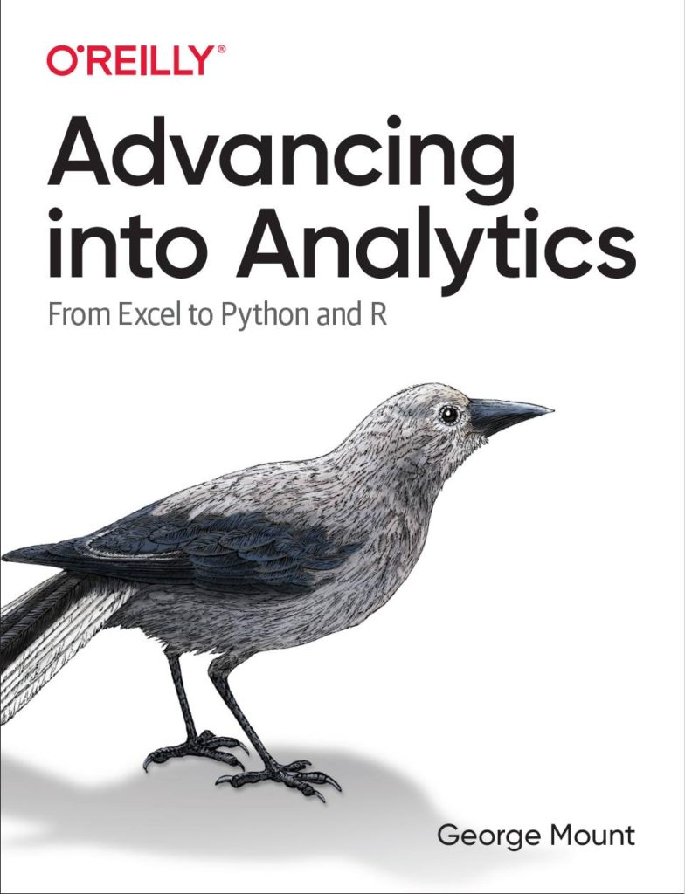



Hi, I’m George

Slide 3

Objectives for this session
Prepare, profile and analyze data in Excel workbooks
Hack PivotTables and PivotCharts for compelling analysis
Discover point-and-click analytics with the Analysis ToolPak

Slide 4
Download the files:
https://swiy.co/FW5w
Feel free to share to latecomers
Downloads & recording will move to Patreon after 48 hrs

Slide 5
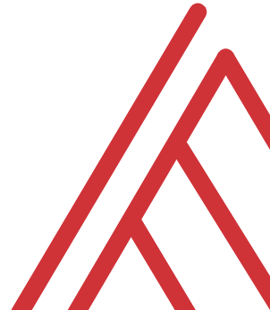
Terms of engagement
Feel free to share the download link with latecomers ☺
Participation is welcome via the chat/unmute
Demos work best with 365 for PC
Recording goes out later today, moves to Patreon after 2 days
I will do my best to answer your questions

Slide 6
Demo
import-export.ipynb
Python is not a place to store data
Import and export Excel files
View the documentation
Notes:
These work a lot like functions..

Slide 7
Demo
data-profiling.ipynb
Data profiling with pandas-profiling
Installing and identifying packages for your needs
Notes:
https://pypi.org/project/pandas-profiling/
https://github.com/vinta/awesome-python

Slide 8
Demo
easy-analysis.ipynb
What are some things that are difficult to do in Excel and easy in Pandas?
Metadata management
Regular expressions
Window functions
Notes:
https://pypi.org/project/pandas-profiling/
https://github.com/vinta/awesome-python

Slide 9

Questions?

Slide 10
Find me
stringfestanalytics.com
Linkedin.com/in/gjmount
Twitter.com/gjmount

Slide 11
Join my Patreon
https://social.stringfestanalytics.com/patreon
Get lifetime access to all past webinar recordings & downloads

Slide 12
Advancing into Analytics: From Excel to Python and R
Learn more: where to buy:
https://stringfestanalytics.com/book/

Slide 13



TAKE THE SURVEY
How did I do today? Testimonials or other data welcome.
https://social.stringfestanalytics.com/event-feedback
Notes:
I’m a data analyst give me data on how I did
Testimonials also VERY helpful.

Slide 14
FINAL QUESTIONS?
Thanks for joining!
A recap email with recording, survey and more will be coming…
The recording stays up for 48 hours, then moves to my Patreon
I appreciate your reviews & referrals.
Notes:
Any questions on descriptive statistics?

Slide 15
Thank you

