Slide 1


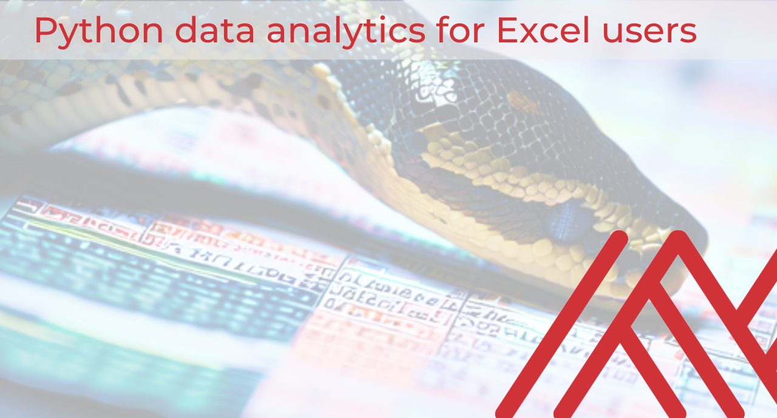

Introducing Excel dynamic array functions

Slide 2
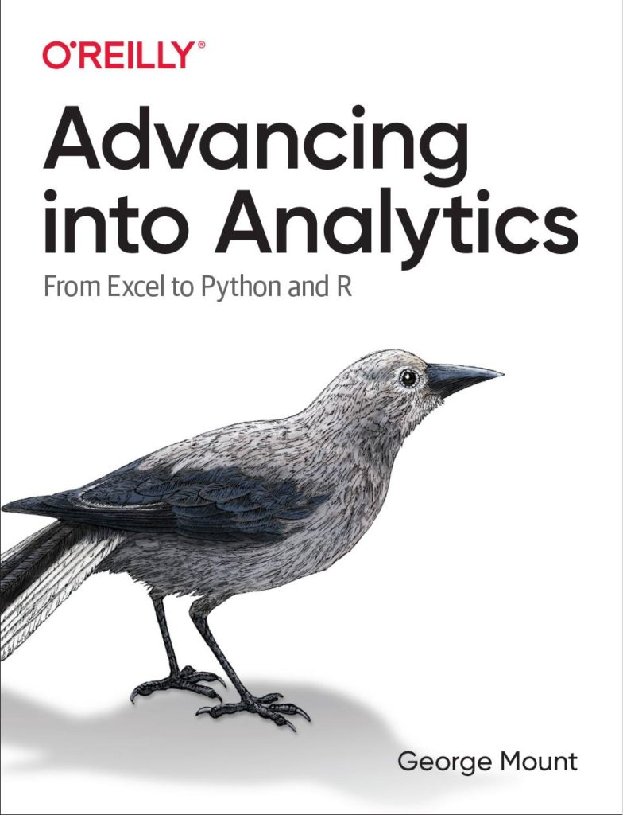



Hi, I’m George

Slide 3

Objectives for this session
Deriving summary statistics and exploring data with pandas
Building and iterating on plots with seaborn
Creating a linear regression model in statsmodels & scikit-learn

Slide 4
Download the files:
https://swiy.co/ptdl
Feel free to share to latecomers
Downloads & recording will move to Patreon after 48 hrs

Slide 5
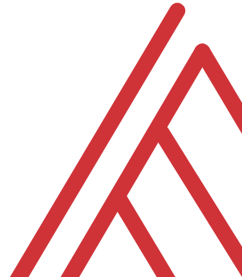
Terms of engagement
Feel free to share the download link with latecomers ☺
Participation is welcome via the chat/unmute
Demos work best with 365 for PC
Recording goes out later today, moves to Patreon after 2 days
I will do my best to answer your questions

Slide 6
Demo
Script: python-analytics-for-excel-users-demo.ipynb
Visualize, explore and model the mpg dataset from seaborn

Slide 7
Questions?

Slide 8
Find me
stringfestanalytics.com
Linkedin.com/in/gjmount
Twitter.com/gjmount

Slide 9
Join my Patreon
https://social.stringfestanalytics.com/patreon
Get lifetime access to all past webinar recordings & downloads

Slide 10
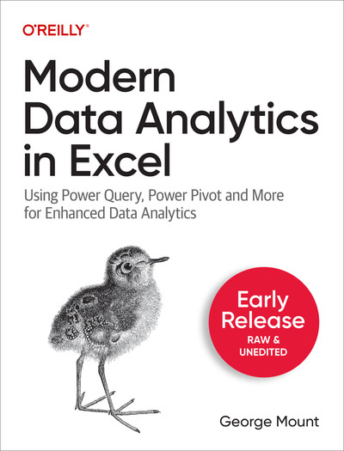
Modern Data Analytics in Excel
Available in early release: https://stringfestanalytics.com/maxl/

Slide 11



TAKE THE SURVEY
How did I do today? Testimonials or other data welcome.
https://social.stringfestanalytics.com/event-feedback
Notes:
I’m a data analyst give me data on how I did
Testimonials also VERY helpful.

Slide 12
FINAL QUESTIONS?
Thanks for joining!
A recap email with recording, survey and more will be coming…
The recording stays up for 48 hours, then moves to my Patreon
I appreciate your reviews & referrals.
Notes:
Any questions on descriptive statistics?

Slide 13
Thank you

