Slide 1

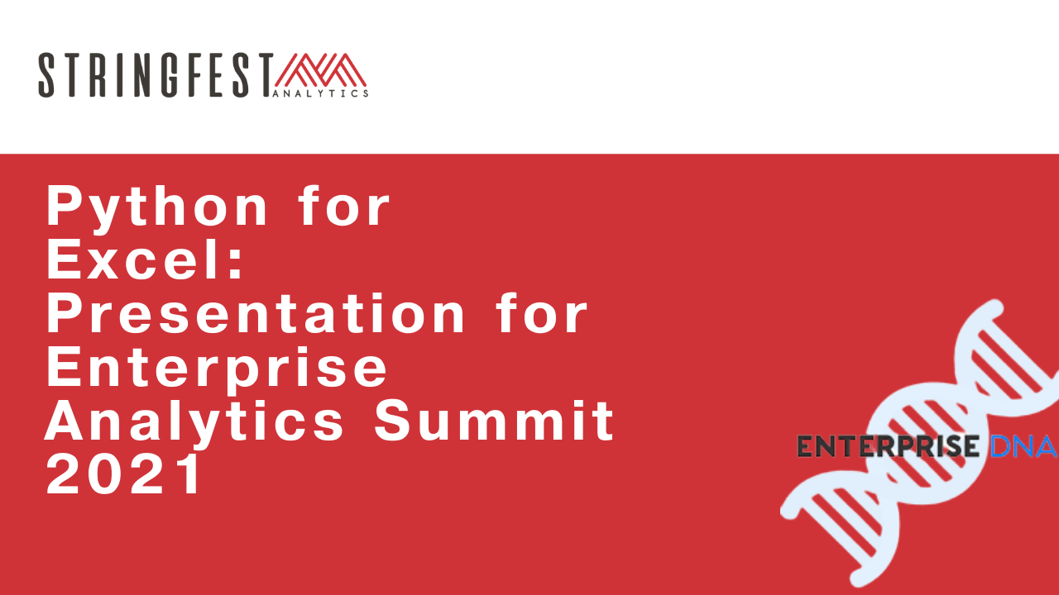
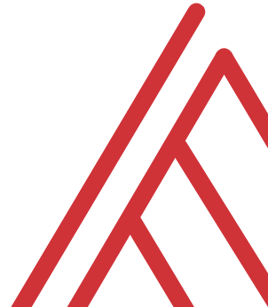
Advancing into Analytics: From Excel to R and Python

Slide 2
Follow along
Download resources: https://github.com/stringfestdata/edna-ess-nov-2021
Code > Download ZIP

Slide 3
Learning objectives
Situate Excel in the data analytics stack
Chart a clear learning path from Excel to R and Python
Demonstrate tangible use cases for combining these tools
Notes:
So what do we want to do today – well this is an Excel meetup, so this would be a weird meetup for me to be trashing Excel as an inherently inferior tool. I love Excel and it’s my home base for working with data, and I’ve found for some tasks that R and Python are just better fits. I want to contextualize R and Python as complementary resources.
So if you are interested in learning these tools as an Excel user, I want to give you a clear learning path and provide you an overview here. Now it probably seems really intimidating to go anywhere near R or Python but by the end of this hour you’ll have a good lay of the land – I’ll have some demos here where you can use the industry standard software for these languages without having to download anything.
I also want to go a bit further than I necessarily do in the book and show some tangible demos for combining these two tools – again I want to show that you should think of these tools as complements and not substitutes.
So those are the official learning objectives.

Slide 4
Unofficial learning objective
Having fun with data & computers
Win a book… maybe?
Notes:
The unofficial objective is to have fun with data and computers, if you are in this group you are probably a geek, so you can take this meetup as an opportunity to geek out with other geeks and learn something new.

Slide 5
Excel and the analytics stack
Notes:
Now I’ll start out here just with a conceptual overview of how Excel fits in with other tools you might use for analytics, and when I say analytics I mean using data to make recommendations about what to do given what’s happened. You’ll learn a bit about open source tools and how to think about how they related to Microsoft’s own stack.

Slide 6
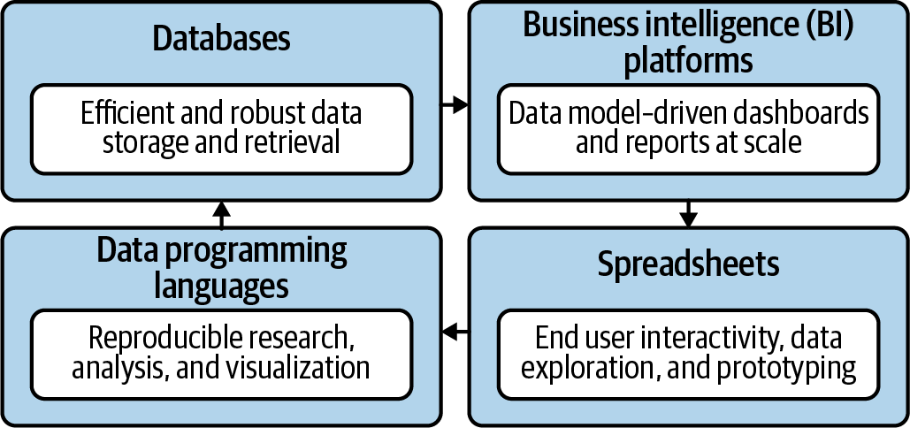
Spare no tools…
Mount, George. Advancing into Analytics: From Excel to Python and R. O’Reilly Media, 2021
Notes:
Now this figure comes from my book and it’s a very broad conceptualization of the various slices of the stack. You know we hear engineers or web developers talk about being “full stack” all the time but it’s not so common an expression as it could be.

Slide 7
What is Excel good for?
Good at…
Visual calculations
End-user interactivity
Rapid prototyping
Not so much…
Storing data
Mobilizing data
Implementing advanced analytics
Notes:
So this seems patronizing
How about add a slide defining what analytics is.

Slide 8

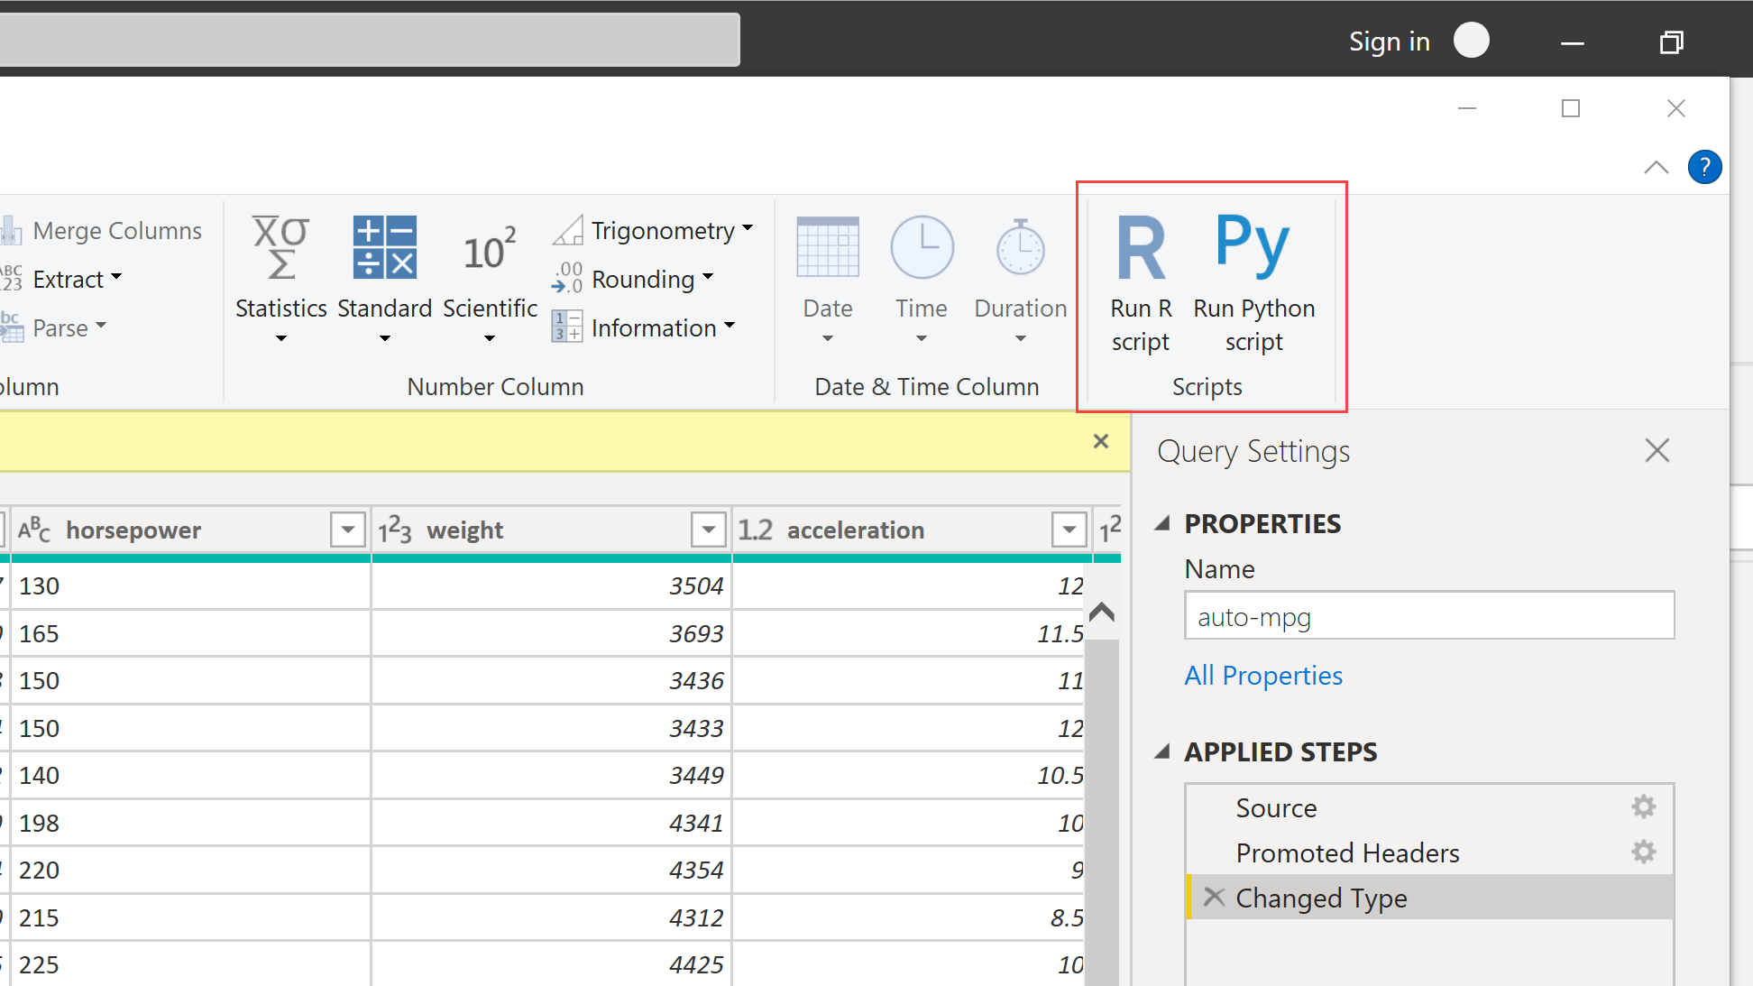
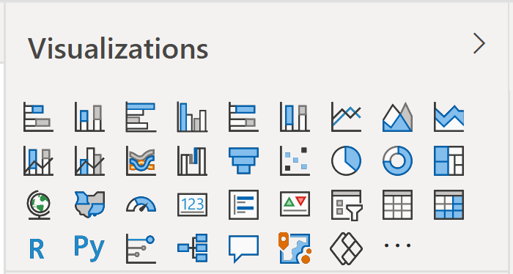
Don’t take my word for it…
Free to
Use
Build on
Repurpose
Redistribute
https://docs.microsoft.com/en-us/archive/blogs/wikininjas/tnwiki-article-spotlight-consuming-azure-storages-python-sdk-using-ptvs
Notes:
Now, it may seem superfluous to learn a statistical programming language when Microsoft keeps rolling out new features to help with data analysis. And this has been a huge change at how Microsoft itself looks at open source languages. They are now seen as allies.

Slide 9
The dialects of data
Column-wise operations (Adding, dropping, calculating fields)
Row-wise operations (Sorting, filtering)
Aggregations (Grouping by, summarizing by)
Joining and merging
Re-shaping (pivoting and unpivoting)
Notes:
The interesting thing is that regardless of these tools used we’re often really speaking the same language when it comes to data analysis. Whether you’re doing it in a spreadsheet or a statistical programming languages, these sorts of operations are the same.
So what I want to help you do is take that mental model of working with data that you’ve so finely honed and show you how to transfer that knowledge into working with these other tools.

Slide 10
Welcome to the R Project for Statistical Computing
Notes:
OK, first let’s start with R, and yes its full name is the R Project for Statistical Computing.

Slide 11


The R project for…
Notes:
So R was really built by statisticians, for statisticians.
Add a slide here who uses it and so forth.

Slide 12


R + RStudio
The code base
The interface
Notes:
Now like I mentioned when something is open source that means anyone is welcome to build on the code base however they like. RStudio is a very popular integrated development environment which is used to interact with the code base.
In Excel we are used to the code base and interface all being wrapped up in one package so this is something that could take some getting used to for you.

Slide 13
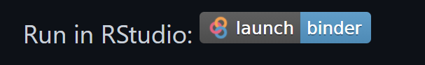
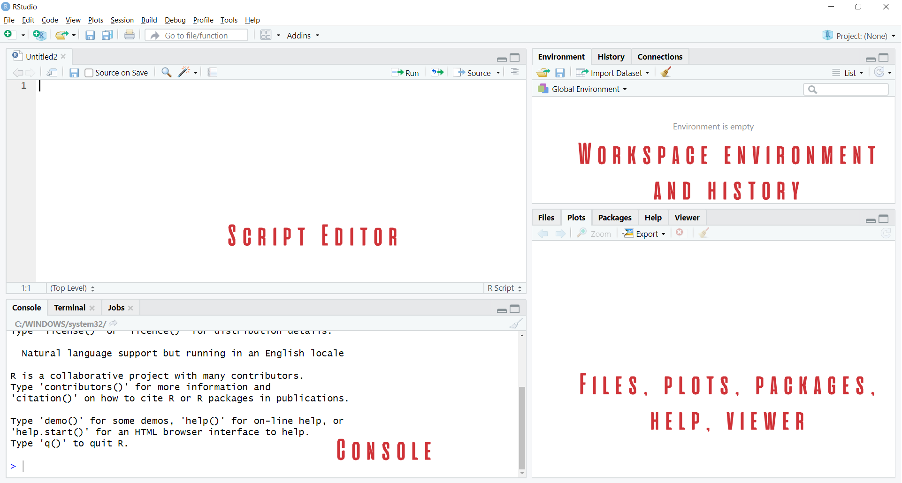

Demo
Navigate RStudio, beginning with 1+1
https://github.com/stringfestdata/london-excel
Notes:
OK so now it’s time for a demo. I want this meetup to be as interactive as possible. You will see in the repo there is a button that says Run in Rstudio. This is going to launch Rstudio right in your browser window. And when you get there you are going to see these four screens.
So what I want to do now is just show you what Rstudio looks like. We aren’t going to get too into depth about all the object types and so forth, just a little tour here.

Slide 14

Packages: “There’s an App for that!”
Install the package (usually from CRAN)
Open the package
Notes:
Now another thing unique to open source programs is this idea of packages. You can kind of think of this as like add-ins for Excel – the analogy I like to use is as apps on a phone.

Slide 15
Demo
Speaking the language of data with the tidyverse
Load and explore diamonds dataset
Write a “sentence” in dplyr:
“Get me the average price for each cut, sorted from high to low.”
How would you pseudo-code this?
Group by cut
Find average for each group
Sort the results
File: diamonds.r
Notes:
OK so what we are going to do here is go back to your session or open a new one. Go to the diamonds.r dataset. And let’s actually conduct the analysis that was hinted at earlier.

Slide 16
Questions?
Notes:
Any questions so far about using R?
Again I just want to show you how easy it is to get up and running there as an Excel user and what to expect when working with open source programs.
Now I guess one of the questions I might have in your shoes is what’s the big deal, we can do the same kind of stuff with Power Query. So I want to acknowledge that.

Slide 17
Prancing into Python
Notes:
Well this is the name of the section just because I couldn’t think of anything else that started with a P….
Anyway let’s situate Python here for a sec. If you are wondering about the difference between R and Python – like I mentioned earlier R is best known for its statistical capabilities, it was born and raised to be a statistical language.
On the other hand Python was built primarily as a computer scripting language, sort of like VBA. So they were built for somewhat different needs which means they both have their strengths and weaknesses. For example, Python does not include a built-in data structure for a tabular data source, so we’ll need to rely on open source packages to implement it.

Slide 18



Python+ Anaconda + Jupyter
The (open) source code
The distribution of code & apps
The browser-based app
Notes:
OK now remember that being open source means anyone is free to repackage and redistribute code. In the case of Python the official source code lives with the Python foundation and can be found there. It’s more common however to download from the Anaconda _distribution_ of that code. One of the reasons why is Anaconda comes with some goodies that don’t come with the raw Pyhon installation. One of those is the Jupyter notebook, which is a browser-based app we’ll be using to work with Python.

Slide 19

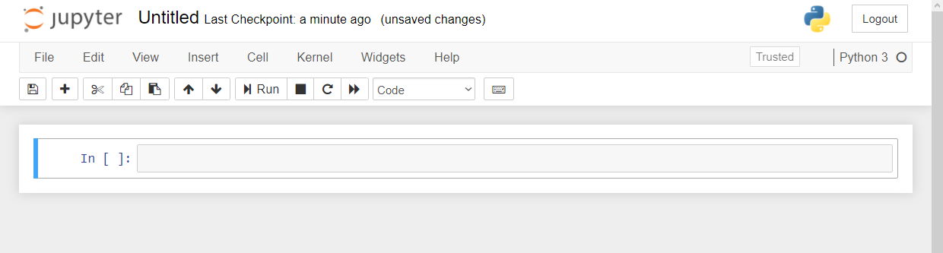
Demo
Navigate Jupyter, starting with 1 + 1
File: Open a new .ipynb notebook
https://github.com/stringfestdata/london-excel
Menu bar
Toolbar
Code cell
Notes:
OK again, what I want to do here is just show you the basics of working with Jupyter. You will see in the repo there is an option to launch an interactive session, so do that and let’s navigate the four sections of Jupyter and get comfortable working there.
Possibly come up with some demo notes for this

Slide 20
Demo
Python for data analysis
Working with modules (packages) in Python
Working with tabular data in Python with pandas
Reading and writing Excel <> Python data
File: python-for-data-analysis.ipynb
Notes:
OK so if you want to head back to that file on your browser what we’ll do here is export and format a dataset from Python to Excel. We’ll need to use some modules, what you know as packages, to do this.

Slide 21
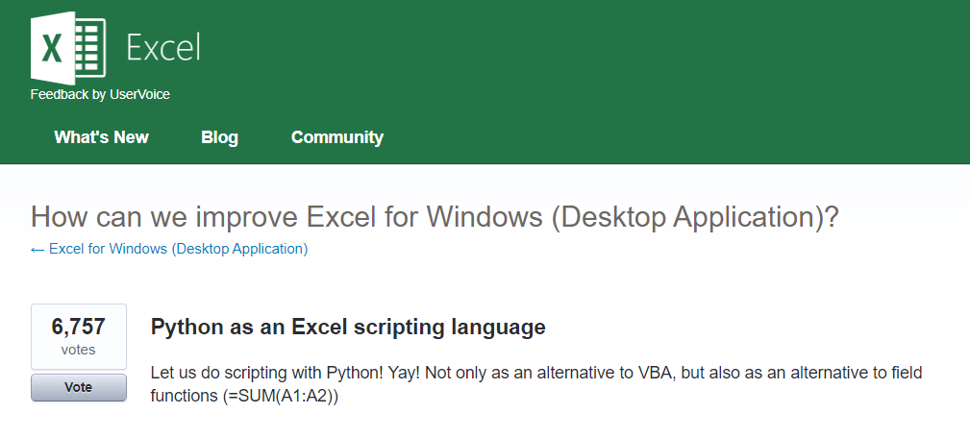



Python for Excel
More: http://www.python-excel.org
https://excel.uservoice.com/forums/304921-excel-for-windows-desktop-application/suggestions/10549005-python-as-an-excel-scripting-language
Notes:
OK so let’s talk about Python. In particular as an Excel user something to be aware of is the growing interest in integrating it with Python. Now I’ve linked to the infamous UserVoice survey above asking for this feature. I won’t press Alan or any of our MVPs on the matter but something is happening there…
There are also some popular packages over here but there are even more. So in this demo I am going to share a really brief example for “Python-Powered Excel.”

Slide 22
Demo
pandas + xlsxwriter =
Python-Powered Excel
Add custom cell formats
Re-size column widths
Add charts (from Excel or Python)
File: python-powered-excel.ipynb
Notes:
OK, in this demo you will look a bit more into using Python as an automation tool for Excel. You already saw that Python makes for pretty intuitive data analysis. I don’t know that this package is as intuitive, but I don’t know it’s any worse than VBA, and the nice thing is that it layers so many Python features into it as well. So go back to the repo and the Python-Powered Excel worksheet.

Slide 23
Questions?
Notes:
Any questions about Python?

Slide 24
The data world is your oyster shell
Notes:
OK now for one last demo. I want to show you an example of “remixing” some of these different tools and really using each resource to its full potential. And the pun here is “shell” as in a programming shell.

Slide 25
Demo
Export an R regression to Excel
Jupyte”R”
“R-powered Excel” with openxlsx
The magic of ggplot2 visualizations
File: r-powered-excel.ipynb
Notes:
OK so now you will see R’s equivalent to some of those features you saw with Python. I think that for different reasons Python seems to be taking the lead on Excel automation, but R has some pretty robust features and in some ways are richer than Python’s.

Slide 26
Questions?

Slide 27
Conclusion/Resources

Slide 28
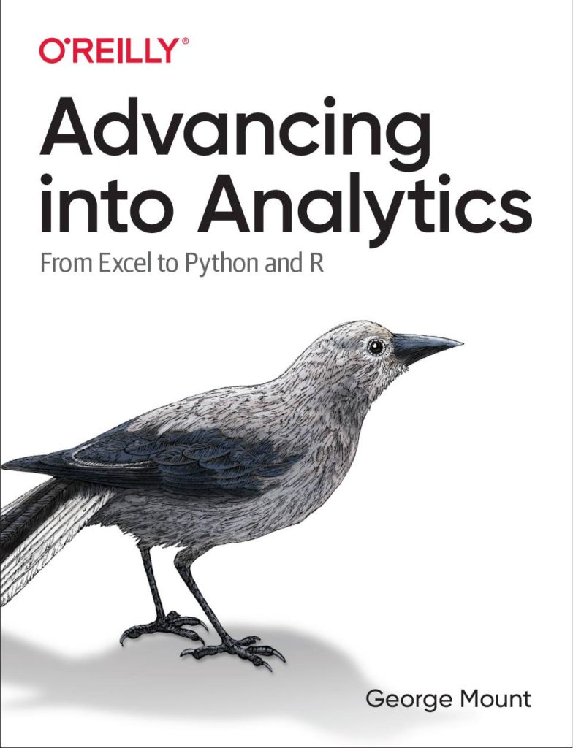
Recommended reading
Advancing into Analytics by George Mount
georgejmount.com/book
By the end of this book, you should be able to conduct exploratory data analysis and
hypothesis testing using a programming language.
Notes:
By the end of this book, you should be able to conduct exploratory data analysis and
hypothesis testing using a programming language.

Slide 29
After that…
R for Data Science by Hadley Wickham and Garrett Grolemund
Python for Data Analysis, 2nd Edition by Wes McKinney
Python for Excel by Felix Zumstein

Slide 30
Get in touch
george@stringfestanalytics.com
stringfestanalytics.com/book
linkedin.com/in/gjmount

Slide 31
Questions?
Who wants to win a book?

Slide 32
So many choices, so many use cases…
Package | Pros | Cons
xlsxwriter | Write almost anything from Excel from Python (data, formats, workbook settings, etc.) | Writes to Excel only/no reading
xlwings | Feature-rich: write data/UDFs, call VBA procedures, robust debugging tools | Local Python/Excel downloads needed
openpyxl | Read and write .xlsx, .xlsm Excel files | Limited ability to edit files
pyxlsb | Read and write .xlsb files | Limited features
xlrd, xlwt, xlutils | Can work with .xls files | Limited features
Notes:
Now another thing unique to open source programs is this idea of packages. You can kind of think of this as like add-ins for Excel – the analogy I like to use is as apps on a phone.

Slide 33
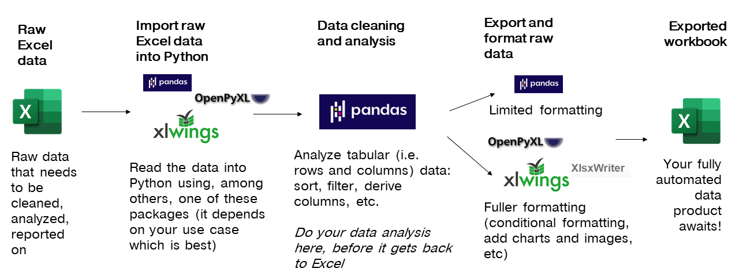
Notes:
Now another thing unique to open source programs is this idea of packages. You can kind of think of this as like add-ins for Excel – the analogy I like to use is as apps on a phone.

Slide 34
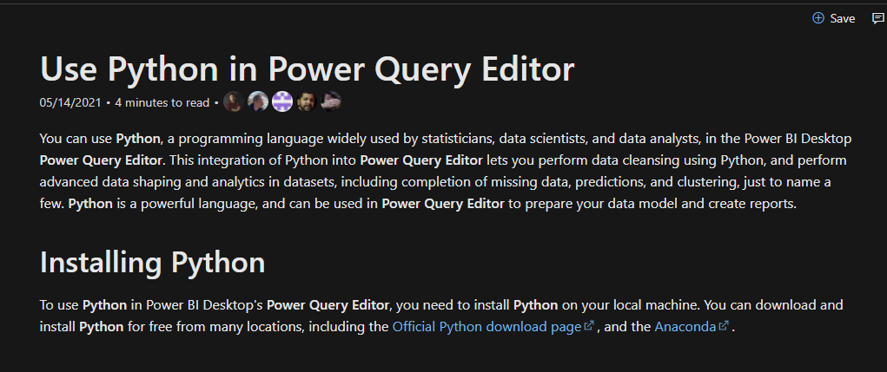
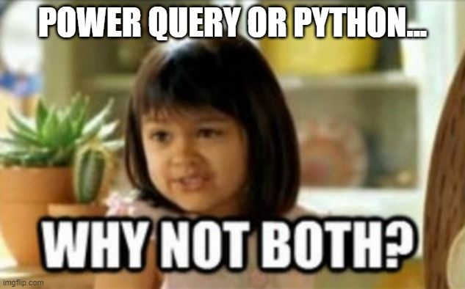
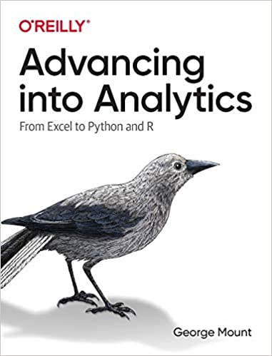
You’re not leaving the stack…
Notes:
One of the things that people get confused about is why learn Python if you’re getting into Power Query… or which to focus on.
You’re not leaving Microsoft’s stack. I have some documentation and a great book here. Now of course these are more about PowerBI but there’s every indication there’s more to come with Excel.

