Slide 1

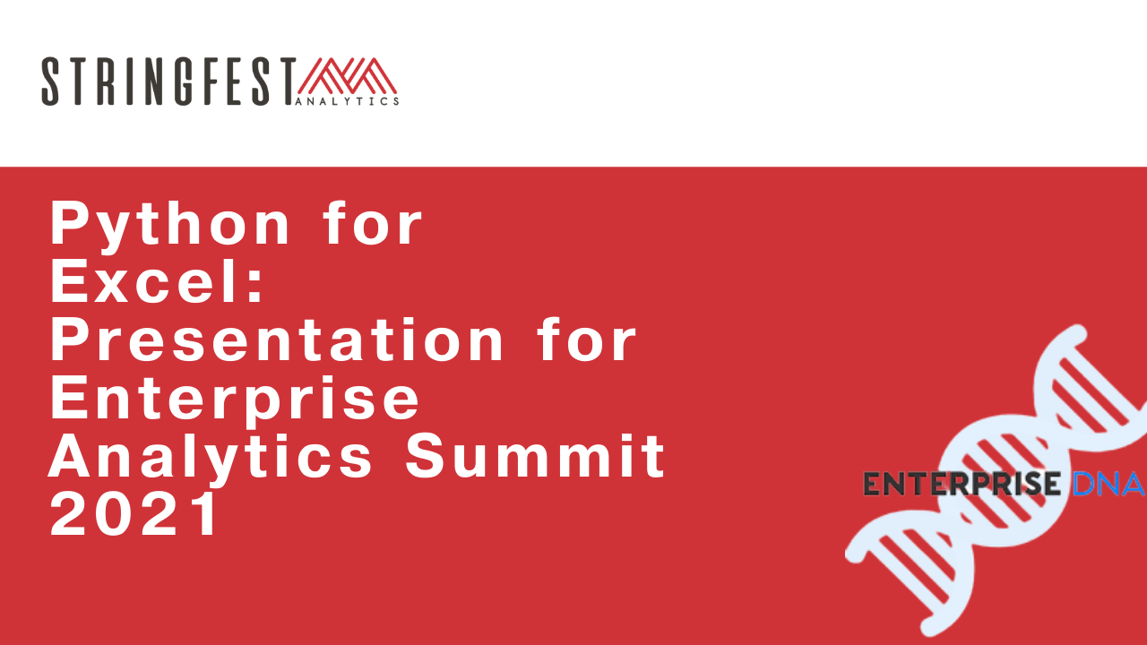
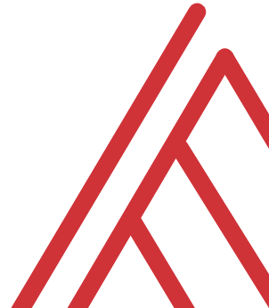
Advancing into Analytics: From Excel to R and Python

Slide 2
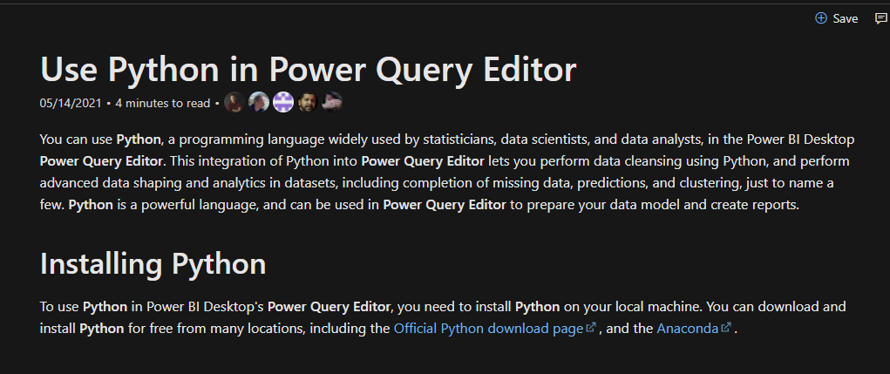
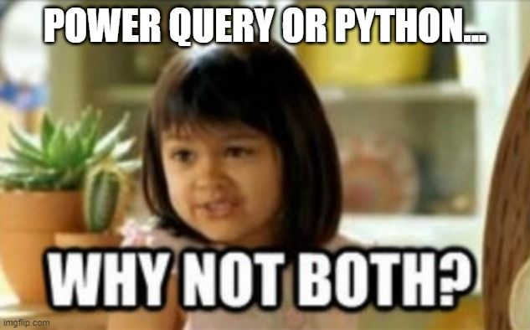
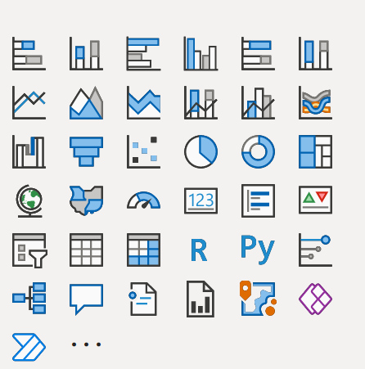
You’re not leaving the stack…
Notes:
One of the things that people get confused about is why learn Python if you’re getting into Power Query… or which to focus on.
You’re not leaving Microsoft’s stack. I have some documentation and a great book here. Now of course these are more about PowerBI but there’s every indication there’s more to come with Excel.

Slide 3
Learning objectives
How can Python augment and automate Excel?
What pandas can and can’t do
Prior knowledge
Familiarity with Python principles: functions, objects, modules
Prior knowledge of pandas a plus

Slide 4
Follow along
Download resources: https://github.com/stringfestdata/edna-ess-nov-2021
Code > Download ZIP

Slide 5

Demo
Python for data analysis
Working with tabular data in Python with pandas
Reading and writing Excel <> Python data
File: python-for-data-analysis.ipynb
What is the limitation?
Notes:
OK so if you want to head back to that file on your browser what we’ll do here is export and format a dataset from Python to Excel. We’ll need to use some modules, what you know as packages, to do this.

Slide 6
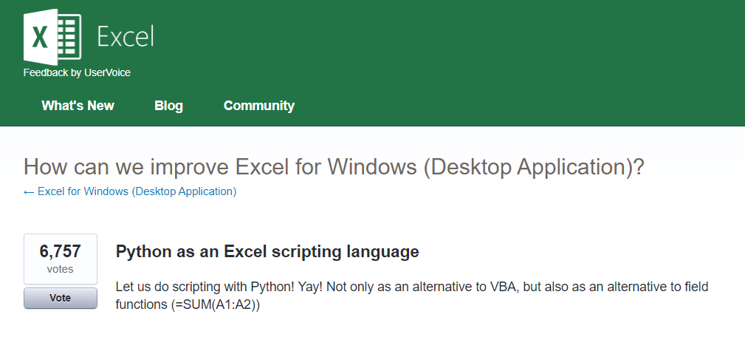



Python for Excel
More: http://www.python-excel.org
https://excel.uservoice.com/forums/304921-excel-for-windows-desktop-application/suggestions/10549005-python-as-an-excel-scripting-language
Notes:
OK so let’s talk about Python. In particular as an Excel user something to be aware of is the growing interest in integrating it with Python. Now I’ve linked to the infamous UserVoice survey above asking for this feature. I won’t press Alan or any of our MVPs on the matter but something is happening there…
There are also some popular packages over here but there are even more. So in this demo I am going to share a really brief example for “Python-Powered Excel.”

Slide 7
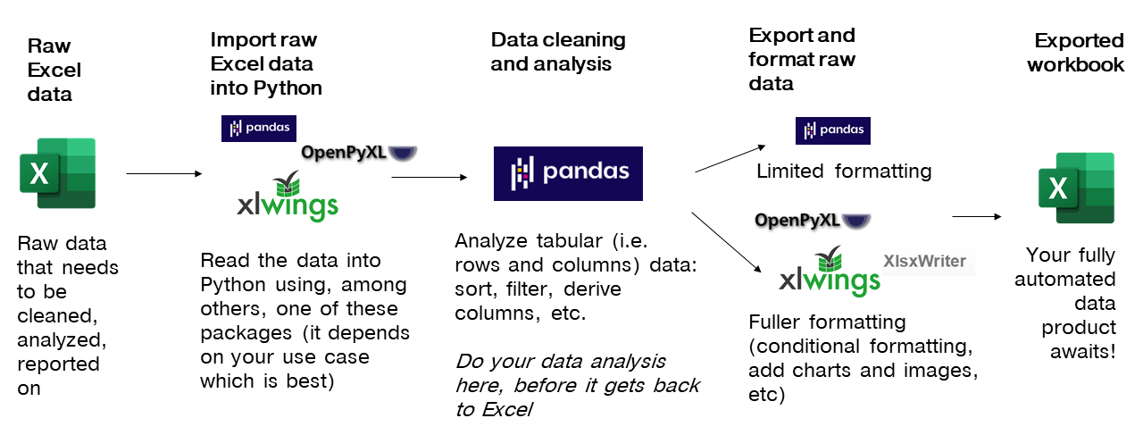
The Python <> Excel workflow
Notes:
Now another thing unique to open source programs is this idea of packages. You can kind of think of this as like add-ins for Excel – the analogy I like to use is as apps on a phone.

Slide 8
Demo
pandas + xlsxwriter =
Python-Powered Excel
Add custom cell formats
Re-size column widths
Add charts (from Excel or Python)
File: python-powered-excel.ipynb
Notes:
OK, in this demo you will look a bit more into using Python as an automation tool for Excel. You already saw that Python makes for pretty intuitive data analysis. I don’t know that this package is as intuitive, but I don’t know it’s any worse than VBA, and the nice thing is that it layers so many Python features into it as well. So go back to the repo and the Python-Powered Excel worksheet.

Slide 9
Questions?
Notes:
Any questions about Python?

Slide 10
Conclusion/Resources

Slide 11
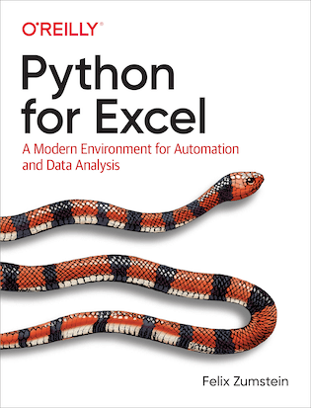
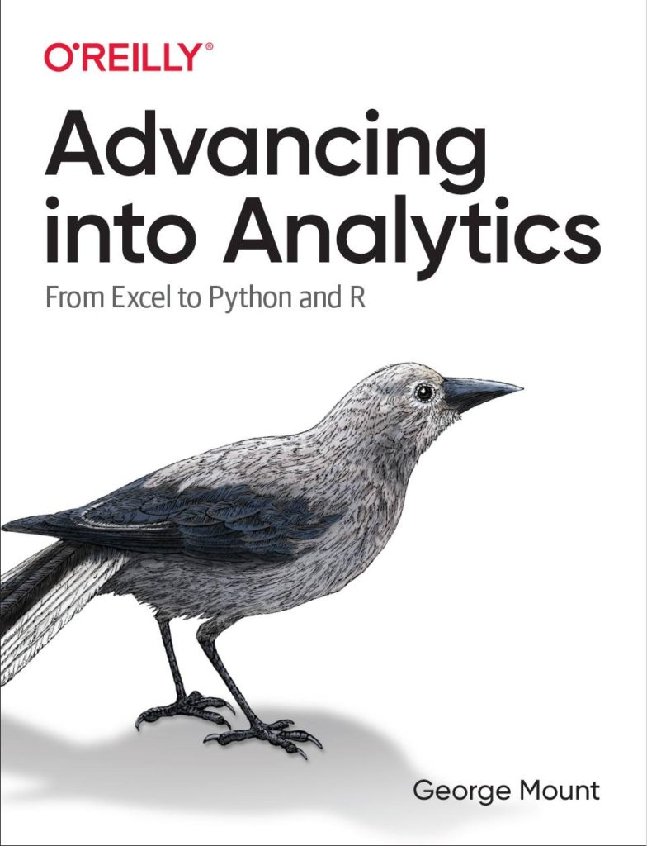
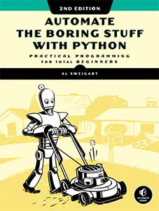
Recommended reading
https://www.xlwings.org/book
http://stringfestanalytics.com/book/
https://automatetheboringstuff.com

Slide 12
After that…
R for Data Science by Hadley Wickham and Garrett Grolemund
Python for Data Analysis, 2nd Edition by Wes McKinney
Python for Excel by Felix Zumstein

Slide 13
Get in touch
george@stringfestanalytics.com
stringfestanalytics.com/book
linkedin.com/in/gjmount

Slide 14
Questions?

Slide 15
So many choices, so many use cases…
Package | Pros | Cons
xlsxwriter | Write almost anything from Excel from Python (data, formats, workbook settings, etc.) | Writes to Excel only/no reading
xlwings | Feature-rich: write data/UDFs, call VBA procedures, robust debugging tools | Local Python/Excel downloads needed
openpyxl | Read and write .xlsx, .xlsm Excel files | Limited ability to edit files
pyxlsb | Read and write .xlsb files | Limited features
xlrd, xlwt, xlutils | Can work with .xls files | Limited features
Notes:
Now another thing unique to open source programs is this idea of packages. You can kind of think of this as like add-ins for Excel – the analogy I like to use is as apps on a phone.

Slide 16
Notes:
Now another thing unique to open source programs is this idea of packages. You can kind of think of this as like add-ins for Excel – the analogy I like to use is as apps on a phone.

Slide 17



Python+ Anaconda + Jupyter
The (open) source code
The distribution of code & apps
The browser-based app
Notes:
OK now remember that being open source means anyone is free to repackage and redistribute code. In the case of Python the official source code lives with the Python foundation and can be found there. It’s more common however to download from the Anaconda _distribution_ of that code. One of the reasons why is Anaconda comes with some goodies that don’t come with the raw Pyhon installation. One of those is the Jupyter notebook, which is a browser-based app we’ll be using to work with Python.

