Slide 1

INTRO TO ggplot2
Notes:
At this point I’ll just jump right to Power BI

Slide 2
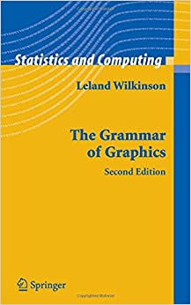
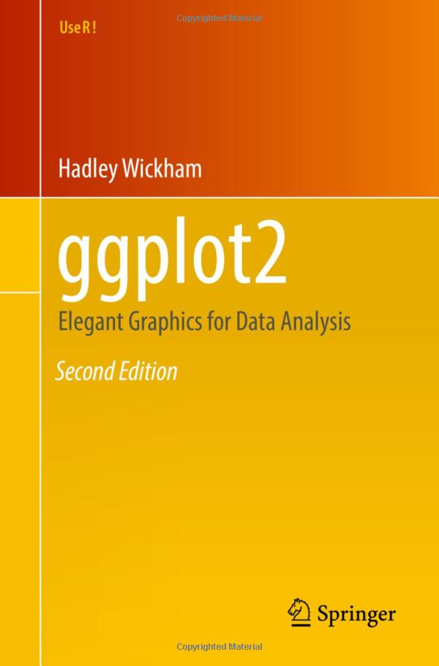
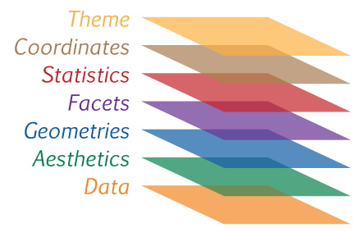



THE GRAMMAR OF GRAPHICS
https://www.science-craft.com/2014/07/08/introducing-the-grammar-of-graphics-plotting-concept/

Slide 3
THE GRAMMAR OF GRAPHICS
Element What it does
data | The source data
aes | Aesthetic mappings from data to visual properties (axes, color, size, etc.)
geom | Type of geometric object observed in plot (lines, bars, dots, etc.)
Source: Mount, George. Advancing into Analytics. O’Reilly Media, 2021.

Slide 4


DEMO
Intro to ggplot2
Loading ggplot2
Creating a univariate plot
Start: blank R script
Finish: ggplot2-intro.r
Notes:
Barplot, histogram, boxplot

Slide 5
PLOTTING ggplot2 with esquisse
Notes:
At this point I’ll just jump right to Power BI

Slide 6
DEMO
Getting help with esquisse
Loading a dataset to esquisse
Start esquisse: esquisser(df)
Creating a visualization
Pasting the results
Start: blank R script
Data: housing.xlsx
Finish: esquisse.r

Slide 7
BIVARIATE VISUALIZATIONS
Notes:
At this point I’ll just jump right to Power BI

Slide 8
DEMO
Bivariate visualizations
Visualizing distributions by group
Visualizing correlations
Visualizing pairwise relationships
Start: blank R script
Finish: bivariate.r
Notes:
We’ll focus on boxplots and histograms as Power BI can handle barplots

Slide 9
LABELS, COLORS AND THEMES
Notes:
At this point I’ll just jump right to Power BI

Slide 10
DEMO
Labels, colors and themes
Adding custom labels
Changing plot colors
Changing plot themes
Start: blank R script
Finish: labels-colors-themes.r

Slide 11
INTERACTIVE R VISUALIZATIONS IN POWER BI
Notes:
At this point I’ll just jump right to Power BI

Slide 12
INTERACTIVE R VISUALIZATIONS
Forecasting
Clustering
Scatterplot line fit
Read more: https://swiy.io/6Jsc

Slide 13
DEMO
Interactive R visualizations in Power BI
Clustering (data: iris.csv)
Forecasting (data: shampoo.csv)
Start: interactive-r-start.pbix
Finish: interactive-r-finish.pbix

