Slide 1


USING R IN POWER BI
AN EXPLORATION
START NOW

Slide 2



SESSION OBJECTIVES
Situate R & Power BI in the analytics & BI stack
Locate the three places where R can work with Power BI

Slide 3


COMPANION REPO
Download course materials: https://github.com/stringfestdata/edna-r-pbi-exploration
Download: Code > Download ZIP
Run on the cloud: Click “launch Binder”

Slide 4

WHY R? WHAT IS R?

Slide 5
INTRODUCING R
R is a programming language and free software environment for statistical computing and graphics supported by the R Core Team and the R Foundation for Statistical Computing.
It is widely used among statisticians and data miners for developing statistical software and data analysis.
- Source: Wikipedia

Slide 6
… AND IT’S FREE!
Technically, open source... broad rights to work with code base:
See
Modify
Distribute
Notes:
So that’s a plus

Slide 7



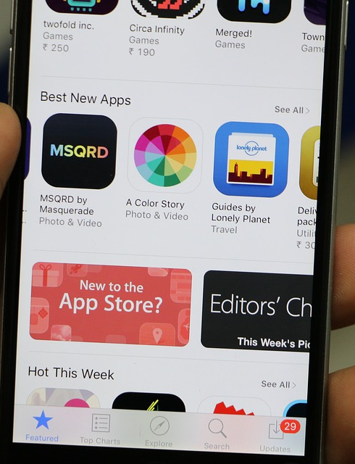
“THERE’S A PACKAGE FOR THAT”
Install package from “app store:” install.packages()
Open it before use: library()
https://unsplash.com/photos/XdTXyr8_2LE
Notes:
Packages can be built on top of other packages… it can get kind of confusing.

Slide 8
WHY R IN POWER BI? HOW?

Slide 9
IT’S AVAILABLE IN POWER BI FOR A REASON
Statistical analysis
Data visualizations
Large/unusual datasets
Text
Machine learning

Slide 10
R IN POWER BI: CONFIGURATION
Download R (the code base)
Download RStudio (the interface)
Connect R to Power BI (Options menu)
Try it later: configuring-r-and-power-bi.pdf

Slide 11
THE WAYS R TALKS TO POWER BI
Data import
Power Query steps
Data visualizations
Try it later: how-r-talks-with-power-bi.docx

Slide 12



QUESTIONS?

Slide 13

Let’s build the start of an R-enhanced Power BI report
Influence of lot size on housing price
Build model in RStudio
Load .rds dataset to Power BI
Visualize and combine with Power BI elements
Files:
housing.xlsx
housing-script.r
housing-report.pbix
r-pbi-exploration-notes.docx
DEMO:LINEAR REGRESSION IN R
Notes:
We’ll start from scratch with all this stuff, and most of the time we’ll be spending is in RStudio, but then we’ll move it all over to Power BI eventually.

Slide 14
QUESTIONS?

Slide 15
WHAT NEXT?

Slide 16
NEXT STEPS IN R FOR POWER BI
Take R for Power BI Users course on Enterprise DNA
Read Advancing into Analytics
Read R for Data Science
Notes:
There are also some pretty interesting R/Python for Power BI books, I would say learn the fundamentals of R first before getting into them however.

Slide 17
THANK YOU

