Slide 1


Slide 2
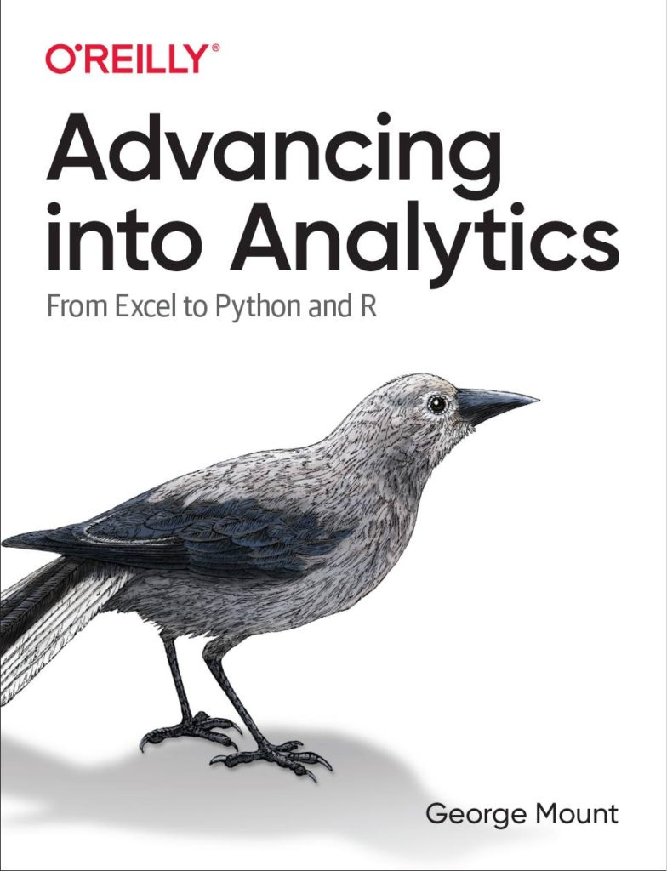

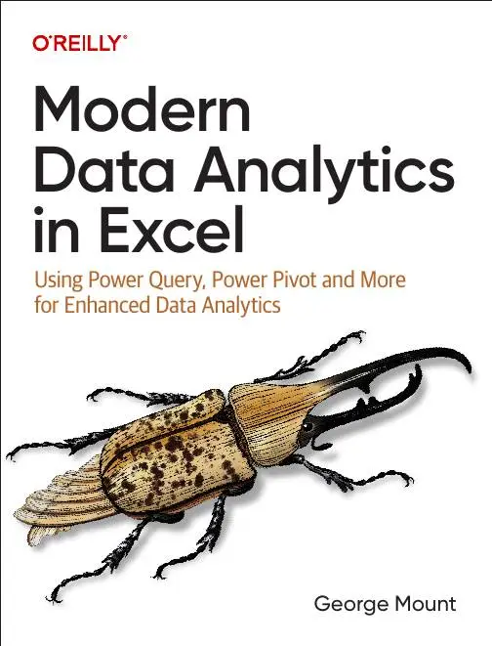


Hi, I’m George

Slide 3

Objectives for this session
Classify AI tools in Excel for data analysis
Use Power Query to prepare datasets for AI
Construct effective AI prompts for Excel tasks
Distinguish AI from traditional Excel functions
Integrate AI workflows for better efficiency

Slide 4
Following along
Download the resources: https://github.com/stringfestdata/enhancing-excel-free-generative-ai-tools/archive/refs/heads/main.zip

Slide 5
1. Preparing Data for AI with Power Query and Markdown

Slide 6
Reshaping data for AI with Power Query
What makes this dataset not AI-suitable?
How can we prepare it with Power Query?
File: reshape-with-power-query.xlsx
Notes:
False!
Function, Formula, Function
Argument

Slide 7
Structuring prompts with Markdown
What is Markdown and how can it structure our data for better AI?
Getting data in and out of Markdown with free tools
File: structuring-with-markdown.xlsx
Notes:
False!
Function, Formula, Function
Argument

Slide 8
Data prep for AI CHALLENGE
Unpivot this data for AI
Formulate some analysis questions for ChatGPT
Paste Markdown-converted dataset into ChatGPT via Dropbox Paper
Paste Markdown-formatted results into Google Docs
File: data-prep-for-ai-challenge.xlsx
Notes:
False!
Function, Formula, Function
Argument

Slide 9

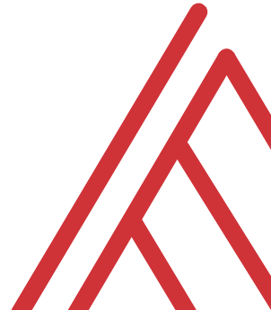

Questions?

Slide 10
2. Analyzing data with generative AI

Slide 11
Selecting AI tools for data analysis
Which FREE AI tool is the best for which Excel-related task?
Notes:
False!
Function, Formula, Function
Argument

Slide 12
1. Analyze Data in Excel
Great for quick, data-specific answers
Limited in providing nuanced, conceptual insights
External tools offer deeper analysis and broader recommendations…
Notes:
False!
Function, Formula, Function
Argument

Slide 13
2. ChatGPT: Your Excel Tactician
Generate complex formulas and calculations
Explain tricky concepts like INDEX/MATCH or VLOOKUP
Suggest approaches for tackling Excel tasks
Notes:
False!
Function, Formula, Function
Argument

Slide 14
3. Microsoft Copilot: Hands-On AI for Excel
Free web-based tool for formulas and features
Uses simulated examples, no data uploads needed
Ideal for improving skills with public datasets or dashboards
Great for hands-on practice with AI, even without full Excel integration
Notes:
False!
Function, Formula, Function
Argument

Slide 15
4. Claude AI: Strategic Insights and Context
Excels at workflow improvements and analytical strategies
Offers contextual explanations for trends and patterns
Great for exploring public data like unemployment or retail sales
Ideal for strategic advice over specific formula assistance
Notes:
False!
Function, Formula, Function
Argument

Slide 16
Tool | Strengths | Weaknesses | Use Cases
Excel Built-In AI | Integrated directly into Excel, offering seamless and familiar user experience | Limited to Excel’s built-in functionalities, limited generative AI capabilities | Automatically identify trends, patterns, and correlations with Analyze Data, gain insights quickly
ChatGPT | Excellent at generating text-based content, offering theoretical guidance, and explaining concepts | Cannot upload Excel workbooks in the free version, requires careful handling of sensitive data | Creating complex formulas, explaining Excel features, and offering tips on Excel best practices
Microsoft Copilot | Provides assistance with formulas and feature explanations through theoretical examples | Free version lacks direct data upload and customization with personal documents | Suggesting improvements to public datasets, content generation, explaining insights using public data
Claude AI | Sophisticated conversational AI, excels in offering high-level analytical strategies | Requires careful crafting of prompts to get the best results, cannot handle data uploads directly | Explaining data insights, communicating complex ideas to non-technical audiences, providing contextual explanations

Slide 17
Framing analytics problems with Claude
Generate and prioritize key factors influencing the analytics problem
Frame the problem using the SMART goal framework
Identify and gather relevant datasets based on prioritized factors
Structure and conduct analysis with Claude's guidance on key methodologies
Interpret results and determine actionable insights aligned with business objectives
Notes:
False!
Function, Formula, Function
Argument

Slide 18
Prompting for data viz with ChatGPT
Create prompts for simple data visualizations
Enhance visuals in Excel by adding trendlines, titles, or adjusting axis labels
Select chart types that best highlight key data insights.
File: prompt-ai-for-data-viz.md
Notes:
False!
Function, Formula, Function
Argument

Slide 19
Generate synthetic datasets with Copilot
Create a basic dataset with Copilot
Ask for a complex dataset with multiple columns to get a Python script
Use specific prompts for Python and Faker to generate detailed synthetic datasets
Use random seeds for consistent data in quality control
Notes:
False!
Function, Formula, Function
Argument

Slide 20
Analyzing data with generative AI CHALLENGE
Scenario: As a data analyst at a retail company, analyze sales trends to identify revenue opportunities without actual data due to confidentiality constraints.
Tasks:
Use Microsoft Copilot to generate a dataset with 1,000 records including Transaction ID, Purchase Date, Product Category, Sales Amount, Store Type, and Customer Age Group, ensuring realistic data distribution.
If provided by Copilot, execute the Python script with Faker, setting random seeds for consistency.
Consult ChatGPT to plan and determine effective visualization strategies and chart types.
Use Claude AI to identify and prioritize sales influencing factors and set a SMART goal.
Notes:
False!
Function, Formula, Function
Argument

Slide 21
Questions?

Slide 22
3. Advanced AI applications & troubleshooting

Slide 23
Debugging complex Excel formulas with ChatGPT
Paste broken formulas into ChatGPT to explain the problem for assistance
Apply fixes suggested by ChatGPT to the formula
If unsatisfied, ask ChatGPT for new formula options or further debugging advice.
File: debug-formulas.xlsx
Notes:
False!
Function, Formula, Function
Argument

Slide 24
Integrating AI into Excel with Analyze Data
Structure the dataset correctly for AI analysis
Utilize natural language querying to explore data
Validate AI-generated insights for accuracy
File: analyze-data.xlsx
Notes:
False!
Function, Formula, Function
Argument

Slide 25
Advanced AI apps & troubleshooting EXERCISE
Confirm or correct the existing formula used to calculate total sales
Leverage AI to develop or refine a formula for March 2024 total sales.
Analyze sales data by visualizing monthly sales, assessing average discount rates by category, or breaking down sales by category…. or more!!!
File: advanced-apps-analysis-challenge.xlsx
Notes:
False!
Function, Formula, Function
Argument

Slide 26
Questions?

Slide 27
THANK YOU

