Slide 1


Slide 2
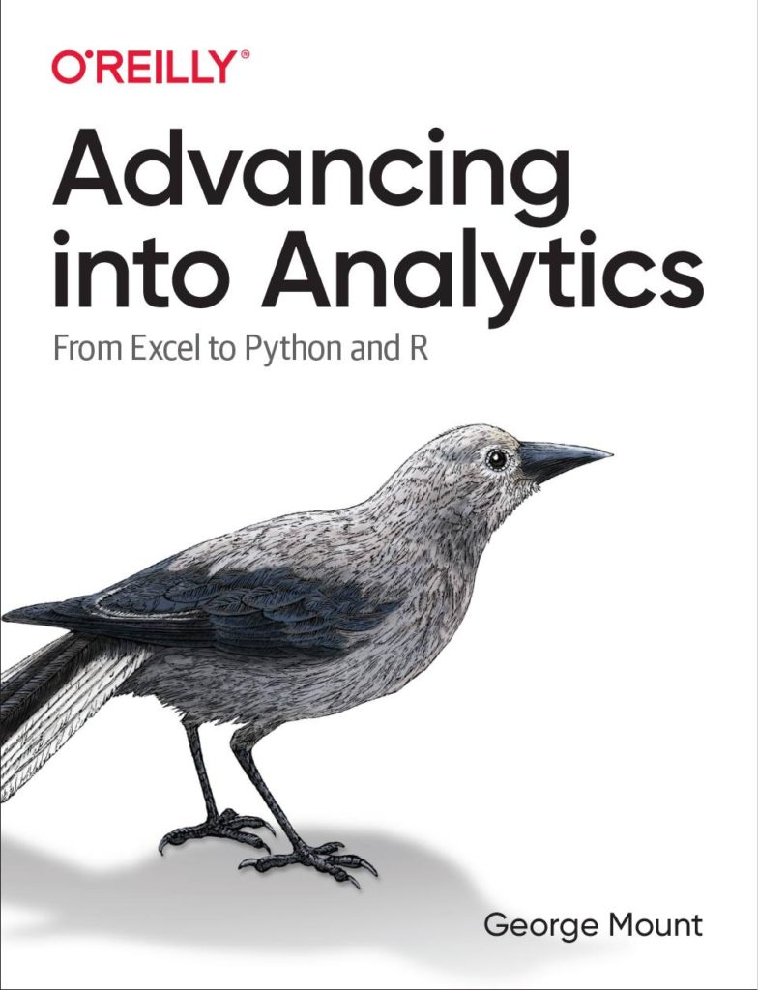

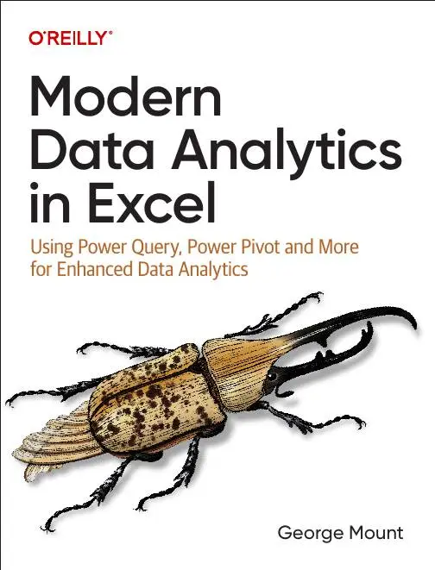


Hi, I’m George

Slide 3

Objectives for this session
Classify AI tools in Excel for data analysis
Use Power Query to prepare datasets for AI
Construct effective AI prompts for Excel tasks
Distinguish AI from traditional Excel functions
Integrate AI workflows for better efficiency

Slide 4
Following along
Download the resources: https://github.com/stringfestdata/enhancing-excel-free-generative-ai-tools/archive/refs/heads/main.zip

Slide 5
1. Preparing Data for AI with Power Query and Markdown

Slide 6
Reshaping data for AI with Power Query
What makes this dataset not AI-suitable?
How can we prepare it with Power Query?
File: reshape-with-power-query.xlsx
Notes:
False!
Function, Formula, Function
Argument

Slide 7
Structuring prompts with Markdown
What is Markdown and how can it structure our data for better AI?
Getting data in and out of Markdown with free tools
File: structuring-with-markdown.xlsx
Notes:
False!
Function, Formula, Function
Argument

Slide 8
Data prep for AI CHALLENGE
Unpivot this data for AI
Formulate some analysis questions for ChatGPT
Paste Markdown-converted dataset into ChatGPT via Dropbox Paper
Paste Markdown-formatted results into Google Docs
File: data-prep-for-ai-challenge.xlsx
Notes:
False!
Function, Formula, Function
Argument

Slide 9

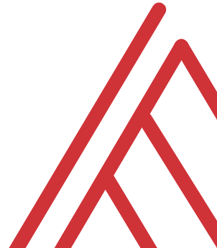

Questions?

Slide 10
2. Analyzing data with generative AI

Slide 11
Data management with Copilot
Working with formulas and functions
Data profiling
Sorting and filtering
File: copilot-data-management.xlsx
Notes:
False!
Function, Formula, Function
Argument

Slide 12
Data management with Copilot EXERCISE
Add total_sales column: price * quantity
Hide price and quantity columns
Count the number of products in each category
Arrange dataset by total_sales, descending
File: copilot-data-management-challenge.xlsx
Notes:
False!
Function, Formula, Function
Argument

Slide 13
Questions?

Slide 14
3. Advanced AI applications & troubleshooting

Slide 15
Debugging complex Excel formulas with AI
Conditional formatting
Data analysis
Data visualization
File: copilot-analysis-visualization.xlsx
Notes:
False!
Function, Formula, Function
Argument

Slide 16
Integrating AI into Excel with Analyze Data
Conditional formatting
Data analysis
Data visualization
File: copilot-analysis-visualization.xlsx
Notes:
False!
Function, Formula, Function
Argument

Slide 17
Advanced AI apps & troubleshooting EXERCISE
Add data bar conditional format to avg_review column
Visualize relationship between avg_review and return_percentage
Chart total revenue over time
Find the leading product category based on revenue
File: advanced-apps-analysis-challenge.xlsx
Notes:
False!
Function, Formula, Function
Argument

Slide 18
Questions?

Slide 19
THANK YOU

