Slide 1
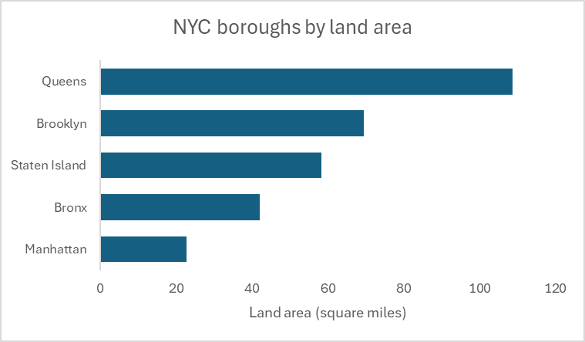
Method 1: Pasting chart as image

Slide 2
Method 2: Link to Excel workbook

Slide 3
Method 3: Embed in PowerPoint deck

