Slide 1
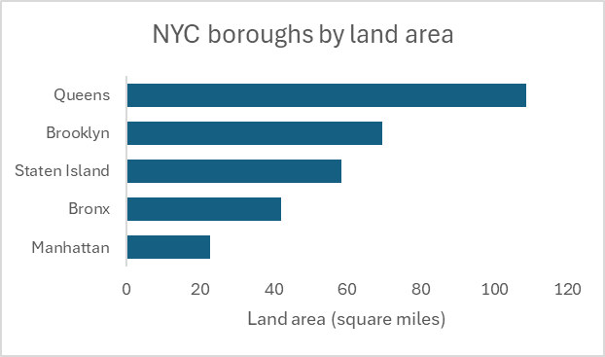
Method 1: Pasting chart as image

