Slide 1


Excel tables and PivotTables for analytics & AI

Slide 2
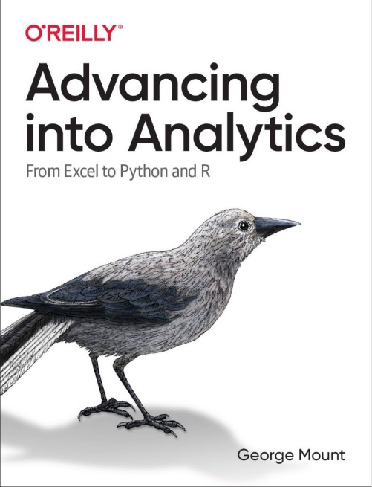
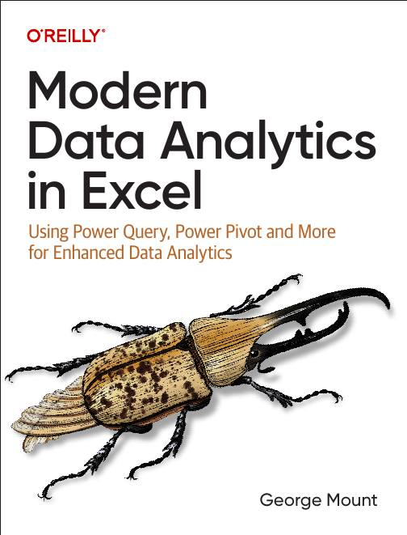




Hi, I’m George

Slide 3

Objectives for this session
Basics of creating, formatting, and operating on tables
Using Recommended Charts & Recommended PivotTables
Natural language querying with Analyze Data
Basic data cleanup for AI with Power Query

Slide 4
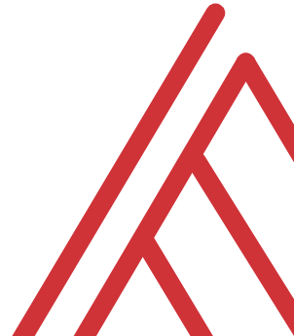
Questions?

Slide 5
THANK YOU
Linkedin.com/in/gjmount
george@stringfestanalytics.com

