Slide 1



Introducing Excel dynamic array functions

Slide 2




Hi, I’m George

Slide 3

Objectives for this session
H﻿ow to structure your data to get the most from PivotTables
H﻿ow to create and maintain your first PivotTable connection
How to build compelling tables and reports using PivotTable basics

Slide 4
Download the files:
https://swiy.co/ptdl
Feel free to share to latecomers
Downloads & recording will move to Patreon after 48 hrs

Slide 5

Terms of engagement
Feel free to share the download link with latecomers ☺
Participation is welcome via the chat/unmute
Demos work best with 365 for PC
Recording goes out later today, moves to Patreon after 2 days
I will do my best to answer your questions

Slide 6
PivotTables: The WD-40 of Excel

Slide 7

Every PivotTable operation is one of these…
Slice and dice
Drill down/roll up
Pivot/Unpivot
Notes:
Don’t worry too much about the building blocks right now – I have this in here to gauge everyone’s interest

Slide 8
Demo
File: pivot-tables-wd-40-start.xlsx
Using the tips worksheet:
Get the total bill by day, then time
Get the total bill for smokers only on Saturday and Sunday
Get average tips by day for each group size
Notes:
This would be rolling up and drilling down
This is slicing and dicing
This is unpivoting and pivoting

Slide 9
Demo
Using wholesale-customers worksheet:
Get the total sum of sales by Region, then Channel
Notes:
Doesn’t work so well, right?

Slide 10
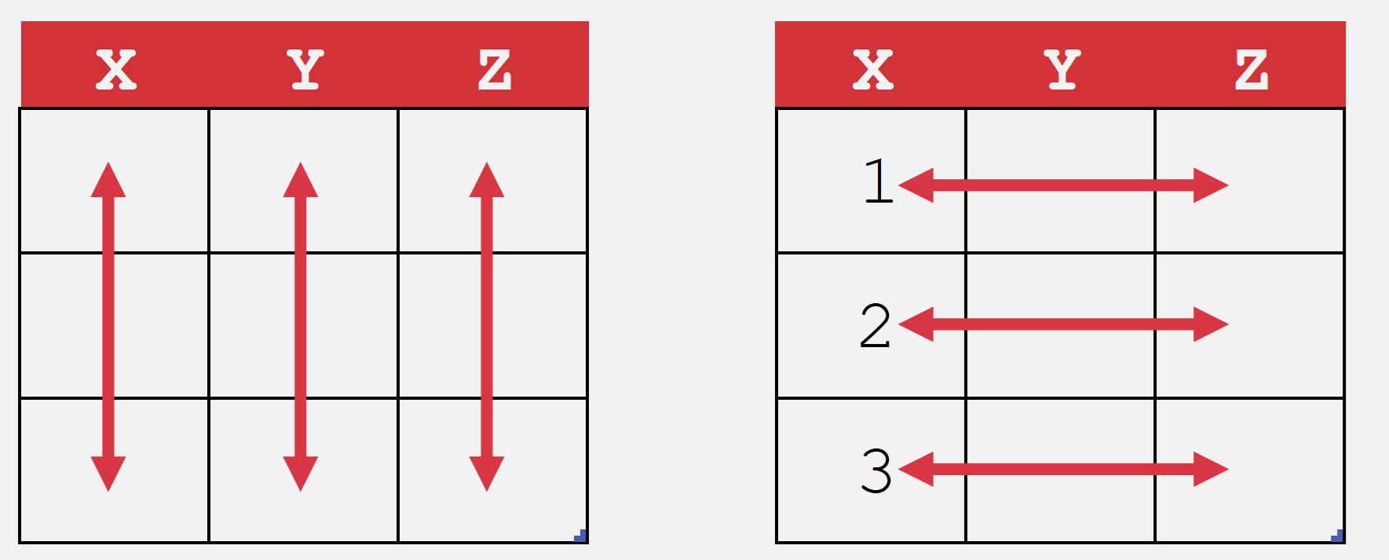
What makes data “Pivot”-ready?
Each variable is in its own column
Each observation is in its own row
Every cell is an observation-variable intersection
Notes:
The Power Query course will be good to actually shape this data. /

Slide 11
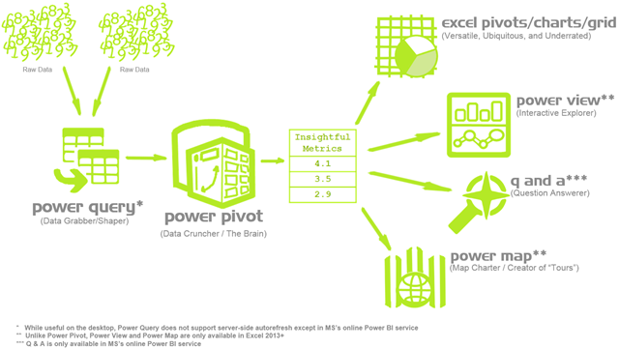
Heavy cleaning is a job for Power Query
https://p3adaptive.com/2014/09/what-is-power-bi/
Notes:
Don’t worry too much about the building blocks right now – I have this in here to gauge everyone’s interest

Slide 12
Demo
sales worksheet:
Create, configure, reformat PivotTables
Update, refresh, maintain data sources
Create calculated columns
Notes:
Doesn’t work so well, right?

Slide 13
Exercises
housing worksheet:
Find the average sale price for each sale condition.
Count the number of homes with each roof type for each neighborhood. Hint: Count the number of homes as the count of record ID’s.
Find the average number of above grade bathrooms for each year built. Hint: Calculate the total number of bathrooms as the number of full baths + 1/2 * the number of half baths.
Find the maximum lot area for each combination of street type and building type.
Count the total number of homes with an alley for each neighborhood.
Find the average sale price for homes with each type of garage, along with the number of cars the garage can hold.
Solutions: housing-pivot-table-solutions.xlsx
Notes:
Doesn’t work so well, right?

Slide 14
Questions?

Slide 15
Find me
stringfestanalytics.com
Linkedin.com/in/gjmount
Twitter.com/gjmount

Slide 16
Join my Patreon
https://social.stringfestanalytics.com/patreon
Get lifetime access to all past webinar recordings & downloads

Slide 17

Modern Data Analytics in Excel
Available in early release: https://stringfestanalytics.com/maxl/

Slide 18



TAKE THE SURVEY
How did I do today? Testimonials or other data welcome.
https://social.stringfestanalytics.com/event-feedback
Notes:
I’m a data analyst give me data on how I did
Testimonials also VERY helpful.

Slide 19
FINAL QUESTIONS?
Thanks for joining!
A recap email with recording, survey and more will be coming…
The recording stays up for 48 hours, then moves to my Patreon
I appreciate your reviews & referrals.
Notes:
Any questions on descriptive statistics?

Slide 20
Thank you

