Slide 1


First steps with Power BI for Excel users

Slide 2
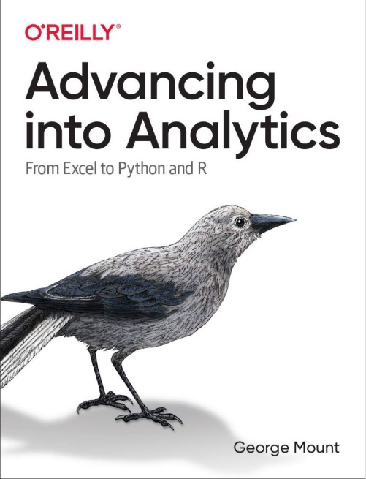
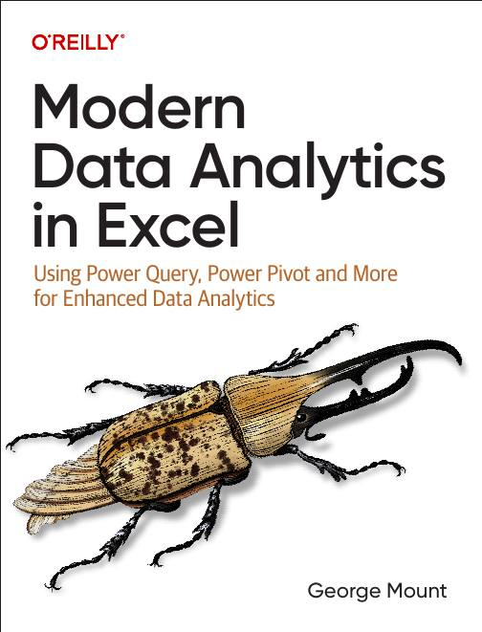



Hi, I’m George

Slide 3

Objectives for this session
Load and transform data in Power BI via Power Query
Create a relational data model with DAX measures
Fundamentals of building interactive reports and dashboards in Power BI

Slide 4
Loading, profiling and transforming data
Using Power Query in Power BI:
Read in workbook data
Profile, explore and transform the data via
Dataset: penguins.xlsx
Power BI report: penguins.pbix
Notes:
False!
Function, Formula, Function
Argument

Slide 5
Creating relational models and measures
Define relationships across multiple tables
Calculated columns versus measures for ad hoc analysis
Dataset: lahman.xlsx
Power BI report: lahman.pbix
Notes:
False!
Function, Formula, Function
Argument

Slide 6
Creating interactive dashboards and reports
Continue with the previous example
Creating interactive reports with Power BI
Slicers/Timelines
Cross filter functionality
Additional plot functionality vs Excel
Notes:
False!
Function, Formula, Function
Argument

Slide 7
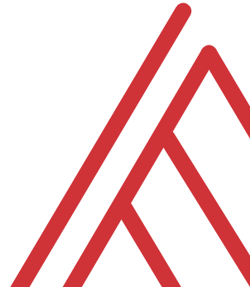
Questions?

Slide 8
Thank you

