Slide 1


First steps with VBA for Excel users

Slide 2
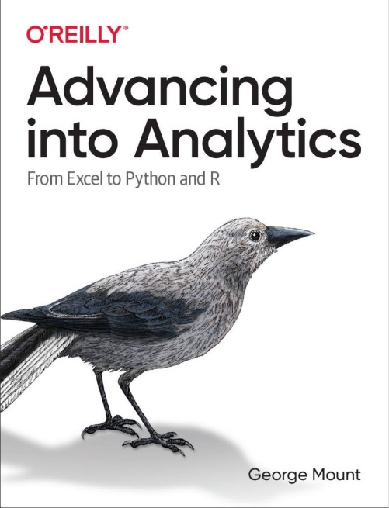
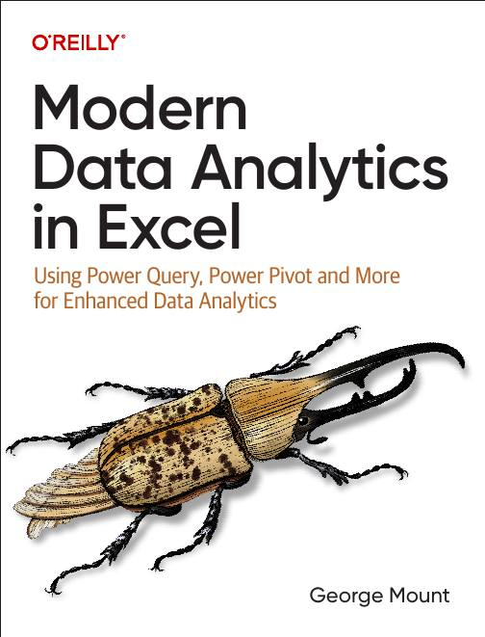




Hi, I’m George

Slide 3

Objectives for this session
Understand how automation can streamline tasks in Excel.
Learn to use the macro recorder to capture and replay repetitive actions.
Create and run simple scripts to process data efficiently.
Apply automation for data validation and cleanup in spreadsheets.

Slide 4
First flow with Power Automate
Use Power Automate templates for Excel
Create clock in/clock out workflow
File: first-flow.xlsx
Notes:
False!
Function, Formula, Function
Argument

Slide 5
Customizing outputs with Power Fx
Continue with the previous example
How can we improve appearance of outputs in Excel?
Resource: https://stringfestanalytics.com/power-automate-for-excel-how-to-understand-the-power-fx-programming-language/
Notes:
False!
Function, Formula, Function
Argument

Slide 6
Building flows with Copilot
Get AI assistance to build a flow
Create a monthly email/post to Teams based on data in a workbook
File: power-automate-copilot.xlsx
Resource: https://stringfestanalytics.com/power-automate-for-excel-how-to-build-flows-with-copilot/
Notes:
False!
Function, Formula, Function
Argument

Slide 7
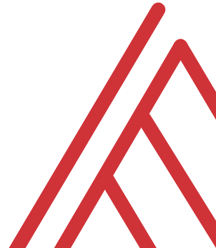
Questions?

Slide 8
Feedback:
https://stringfestanalytics.com/event-feedback/

Slide 9
Future events:
https://social.stringfestanalytics.com/eventbrite/

Slide 10
Thank you

