Slide 1



My top
Week 1 Bootcamp

Slide 2
Follow along with today
Download resources: ____
Follow along: demo-notes.docx

Slide 3
Learning objectives
Identify and alleviate pain points of virtual Excel instruction
Share tips for teaching Excel online

Slide 4

Chat me up…
What do you find most difficult about live virtual training? Virtual Excel training?
What is most difficult about leading it?
Notes:
OK so now you will see R’s equivalent to some of those features you saw with Python. I think that for different reasons Python seems to be taking the lead on Excel automation, but R has some pretty robust features and in some ways are richer than Python’s.

Slide 5

1. Draw attention to the spreadsheet
Demo: Zoom in/out of workbook
Set font of formula bar
Highlight with Logitech Spotlight

Slide 6
2. Get help with your functions
Demo: The Insert Function menu
Generating qualitative data with CHOOSE() and conditional counting with COUNTIF()

Slide 7
3. Show off your formulas
Demo: Combining IFERROR() with FORMULATEXT() for dynamically visible references

Slide 8
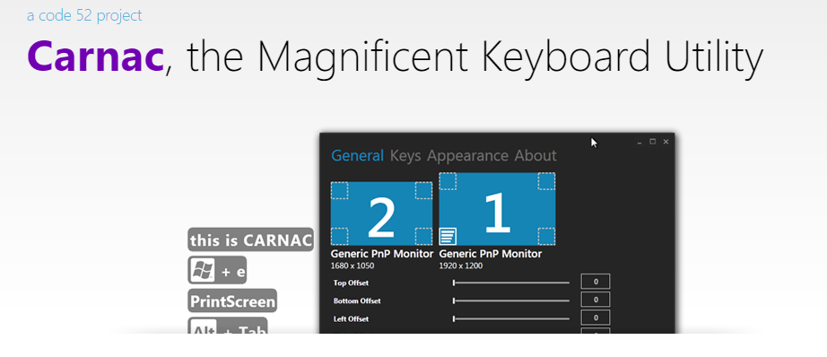
4. Always display keystrokes
Demo: Showing keystrokes with Carnac
Download (Windows) at http://code52.org/carnac/

Slide 9
5. Embed workbooks
Demo: Creating and embedding a workbook to use for asynchronous instruction
This feature works easier on a personal Office account; to do for Business see https://bit.ly/3mlZAWL

Slide 10
Chat me up…
What tips are you excited to try?
What tips can you share?
Notes:
OK so now you will see R’s equivalent to some of those features you saw with Python. I think that for different reasons Python seems to be taking the lead on Excel automation, but R has some pretty robust features and in some ways are richer than Python’s.

Slide 11
Conclusion/Next steps

Slide 12
Event survey: https://forms.office.com/r/0ZnD0LxpZy

Slide 13
Questions?

Slide 14
THANK YOU
george@stringfestanalytics.com
linkedin.com/in/gjmount
stringfestanalytics.com/contact

