Slide 1



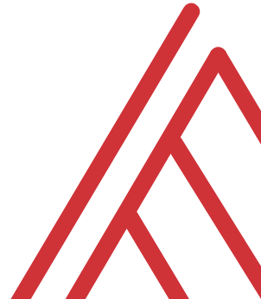
My top
Week 1 Bootcamp

Slide 2
Follow along with today
Download resources: https://github.com/stringfestdata/five-tips-virtual-excel-instruction
Code > Download ZIP
Follow along: demo-notes.docx

Slide 3

Chat me up…
What do you find most difficult about virtual Excel instruction (synchronous or asynchronous)?
What do you like and dislike about it?

Slide 4
Learning objectives
Identify and alleviate pain points of virtual Excel instruction
Share tips for online Excel instruction

Slide 5

1. Draw attention to the spreadsheet
Demo: Zoom in/out of workbook
Set font of formula bar
Highlight with Logitech Spotlight
Open a blank worksheet and follow with demo notes…
Notes:
I suppose this first one can apply to live in-person training too, but because there’s often such a communication lag or gap in a virtual setting it’s important to stay on top of. We want to make easy for audience to follow along with what we’re doing.
Open a blank worksheet and follow with demo notes…

Slide 6
2. Get help with your functions
Demo: The Insert Function menu
Generating qualitative data with CHOOSE() and conditional counting with COUNTIF()

Slide 7
3. Show off your formulas
Demo: Combining IFERROR() with FORMULATEXT() for dynamically visible references

Slide 8
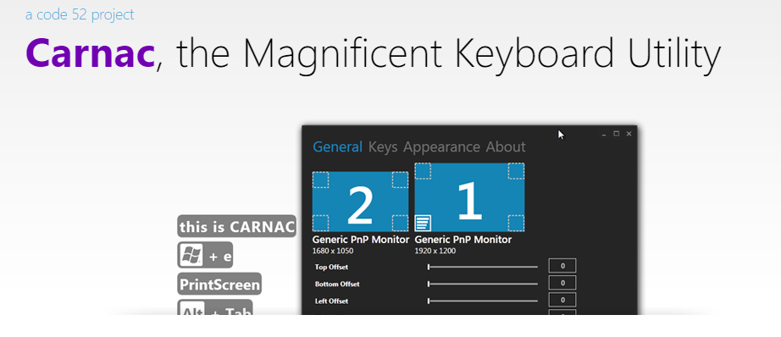
4. Always display keystrokes
Demo: Showing keystrokes with Carnac
Download (Windows) at http://code52.org/carnac/

Slide 9
5. Embed workbooks
Demo: Creating and embedding a workbook to use for asynchronous instruction
This feature works easier on a personal Office account; to do for Business see https://bit.ly/3mlZAWL

Slide 10
Chat me up…
When could you use these tip?
What tips do you have?
Notes:
OK so now you will see R’s equivalent to some of those features you saw with Python. I think that for different reasons Python seems to be taking the lead on Excel automation, but R has some pretty robust features and in some ways are richer than Python’s.

Slide 11
Conclusion/Next steps

Slide 12
Resource library: https://stringfestanalytics.com/subscribe/
Free data literacy audit call:
https://stringfestanalytics.com/contact/
Notes:
Please subscribe to my newsletter and you’ll get access to my analytics education resource library.
If you’d like to discuss your current upsklling strategy, you can book a free data literacy audit.

Slide 13
Event survey: https://forms.office.com/r/0ZnD0LxpZy

Slide 14
Questions?

Slide 15
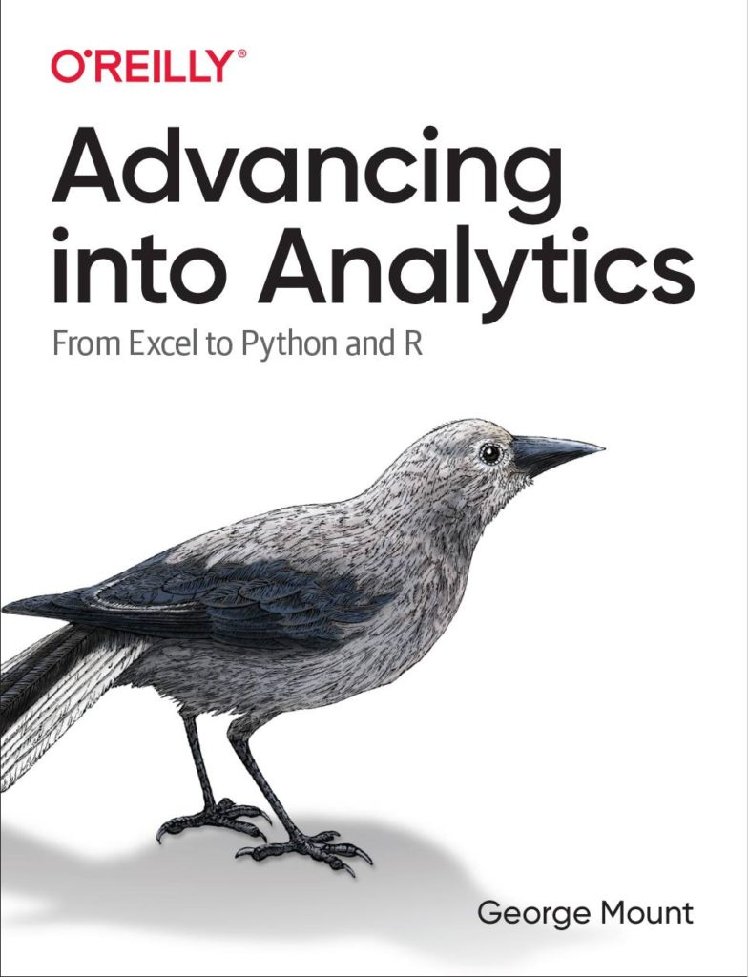
Questions?
Who wants to win a book?

Slide 16
THANK YOU
george@stringfestanalytics.com
linkedin.com/in/gjmount
stringfestanalytics.com/contact

