Slide 1


Python-Powered Excel for Finance

Slide 2

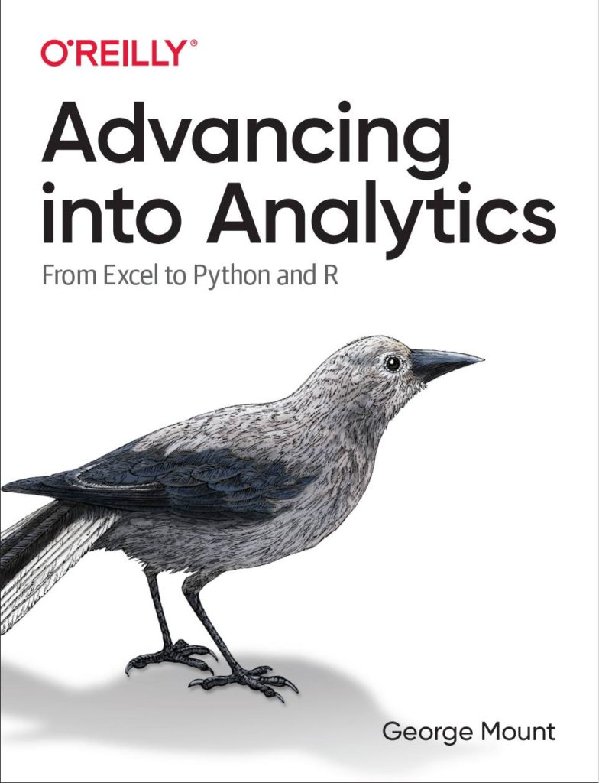

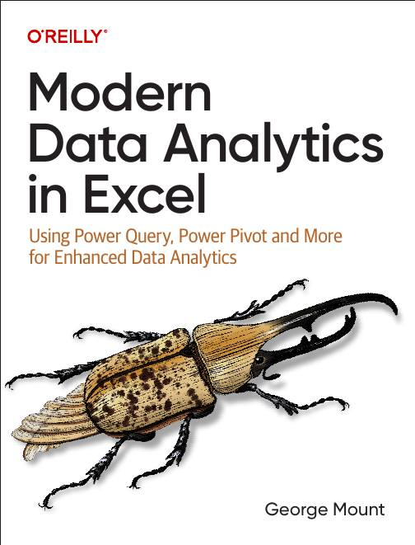


Hi, I’m George

Slide 3
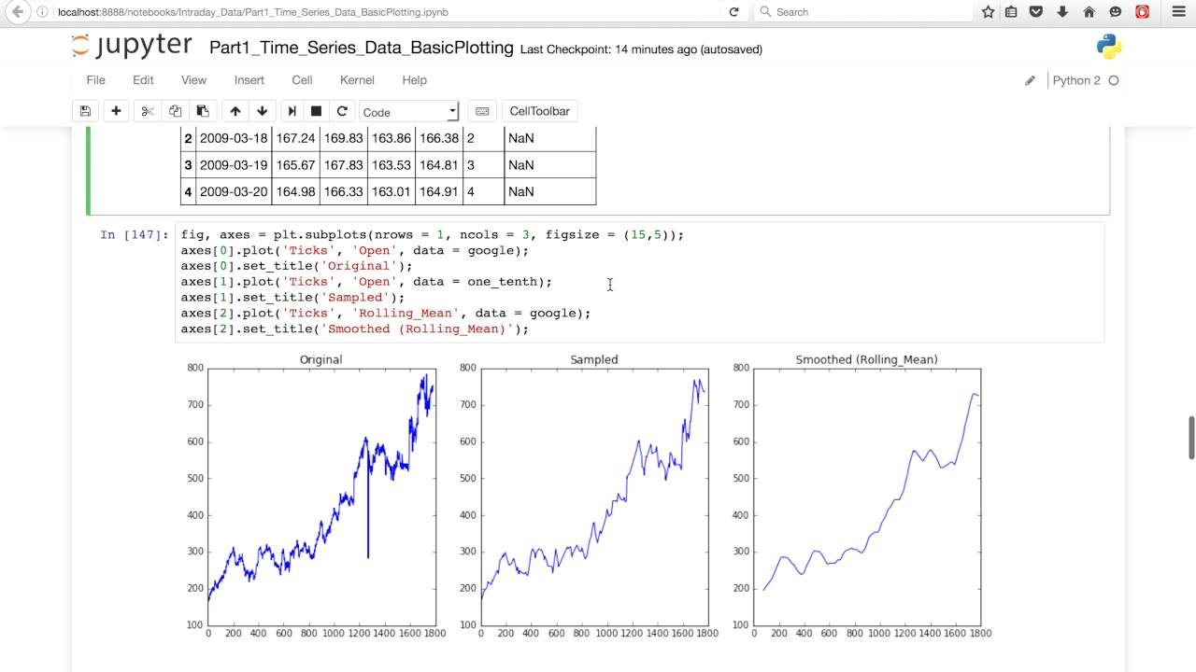

Where can Python in Excel help financial modelers?
Time series analysis & forecasting (pandas = “panel data”)
https://youtu.be/OwnaUVt6VVE?si=2dU0o_DVcXad36Mv

Slide 4
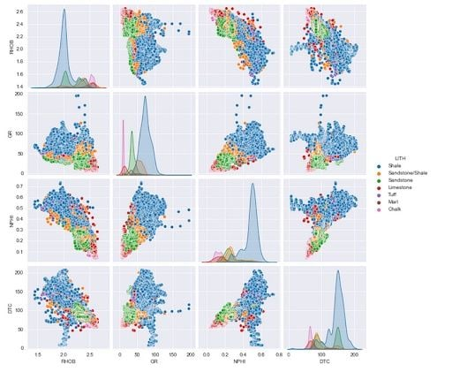
Where can Python in Excel help financial modelers?
Groupwise analysis & visualization (small multiples, group-by-group descriptive analytics)
https://builtin.com/articles/seaborn-pairplot

Slide 5
Use case: Create a moving average chart
Create a user-driven N-period moving average
Plot actuals vs smoothed on the same plot
File: python-excel-moving-average-demo.xlsx
Notes:
False!
Function, Formula, Function
Argument

Slide 6
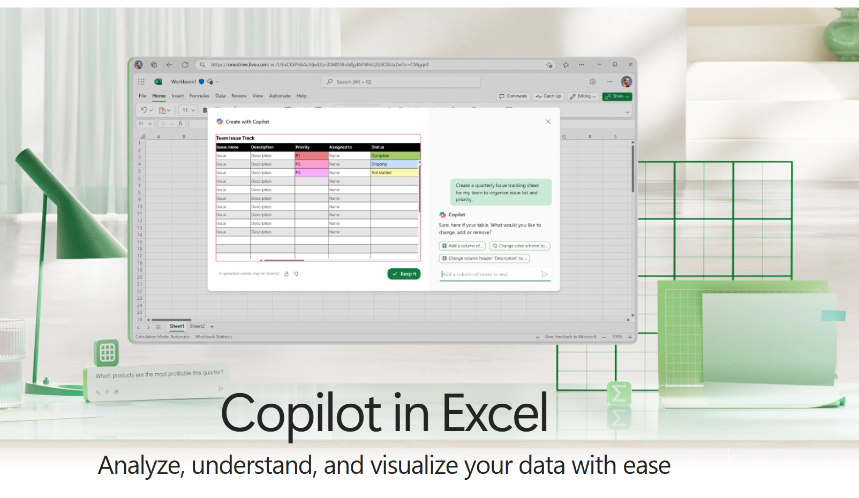
Where can Copilot in Excel help financial modelers?
Basic summary statistics & visualization
Basic financial calculations & metrics
https://support.microsoft.com/en-us/copilot-excel

Slide 7
Use case: Get help with financial functions from Copilot
Find present, future values
Calculated pro-rated depreciations
File: copilot-financial-functions.xlsx
Notes:
False!
Function, Formula, Function
Argument

Slide 8



The most ambitious crossover event in (financial modeling) history?

Slide 9
Use case: IRR simulation
Provide Copilot a detailed simulation prompt
Copilot will translate into Python
The script will be executed and editable within Excel
File: Blank workbook and copilot-irr-monte-carlo-prompt.md
Notes:
False!
Function, Formula, Function
Argument

Slide 10
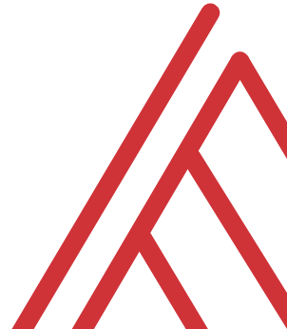
Questions?

Slide 11
THANK YOU
linkedin.com/in/gjmount
george@stringfestanalytics.com

