Slide 1
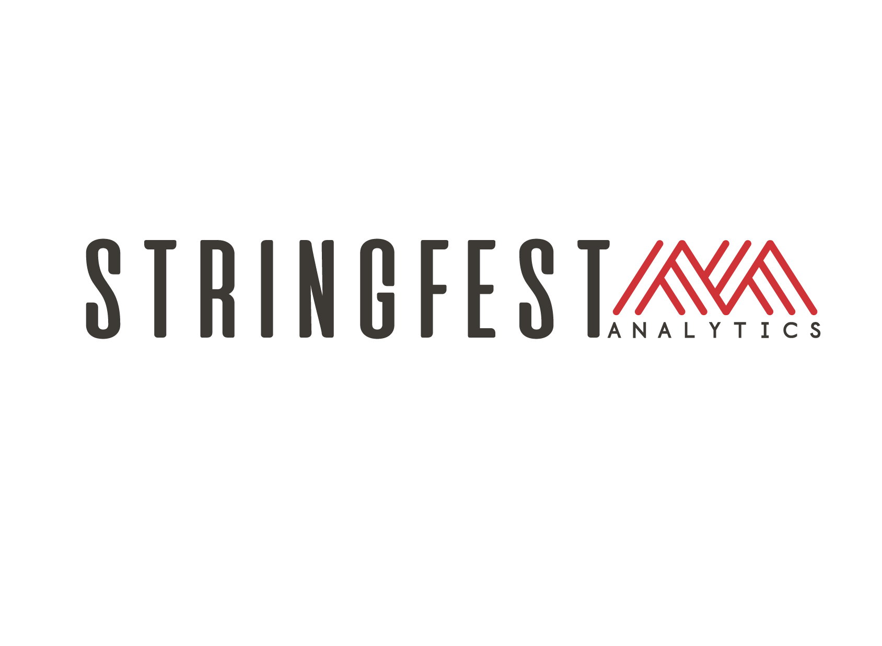
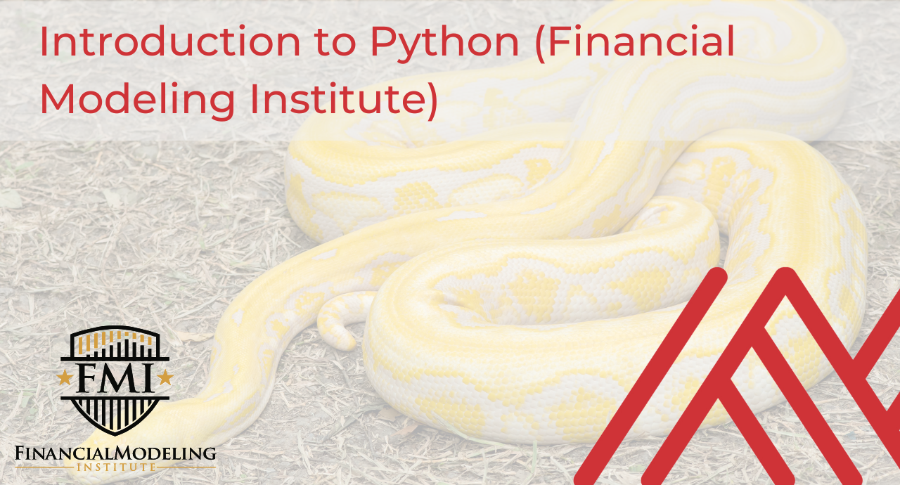
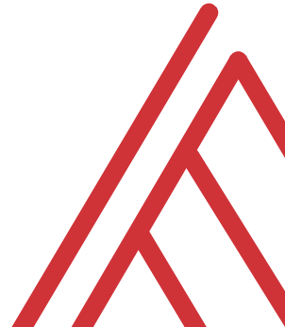
Advancing into Analytics: From Excel to R and Python
Notes:
Welcome everyone to the presentation, I am looking forward to it.

Slide 2
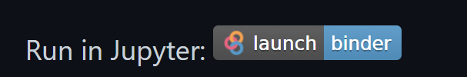
Follow along
Download resources: https://github.com/stringfestdata/fmi-intro-to-python/
Click through this link now to run during presentation:
(this could take some time so feel free to ask questions now)…

Slide 3


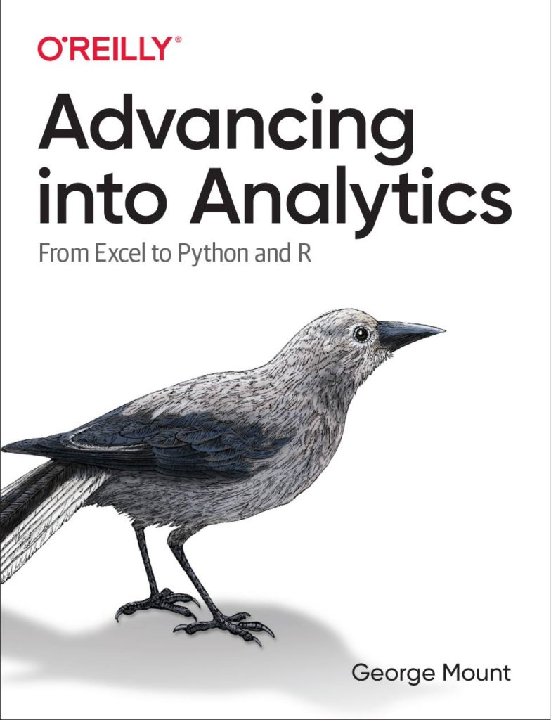
Hi, I’m George

Slide 4

Hi, I’m George

Slide 5
Learning objectives
Situate Excel <> Python in the data analytics stack
Chart a clear learning path from Excel to Python
Demonstrate tangible use cases for combining these tools

Slide 6
Unofficial learning objective
Having fun with data & computers
Win a book… maybe?
Read for free, either way!

Slide 7
1. Open source means a license to build and distribute
Notes:
This is different coming from Microsoft, proprietary technology
Python is open source what does that mean?

Slide 8

What is open source?
“… code that is designed to be publicly accessible—anyone can see, modify, and distribute the code as they see fit.”
- Red Hat, “What is open source?”
https://cloudblogs.microsoft.com/windowsserver/2015/05/06/microsoft-loves-linux/

Slide 9



Python+ Anaconda + Jupyter
The (open) source code
python.org
The distribution of code & apps
anaconda.com
The browser-based app
jupyter.org
Notes:
OK now remember that being open source means anyone is free to repackage and redistribute code. In the case of Python the official source code lives with the Python foundation and can be found there. It’s more common however to download from the Anaconda _distribution_ of that code. One of the reasons why is Anaconda comes with some goodies that don’t come with the raw Pyhon installation. One of those is the Jupyter notebook, which is a browser-based app we’ll be using to work with Python.

Slide 10
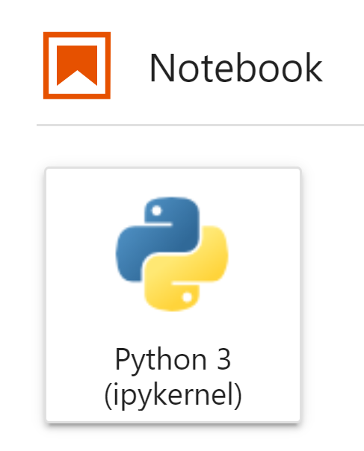

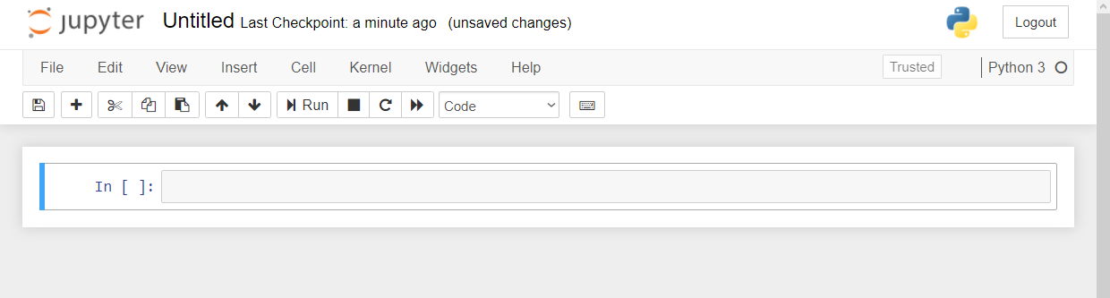

Demo
Navigate Jupyter, starting with 1 + 1
File: Open a new .ipynb notebook…
Menu bar
Toolbar
Code cell
Notes:
OK again, what I want to do here is just show you the basics of working with Jupyter. You will see in the repo there is an option to launch an interactive session, so do that and let’s navigate the four sections of Jupyter and get comfortable working there.
In the demo you’ll get a tour of the notebook and how to work a bit with functions and objects.
Possibly come up with some demo notes for this

Slide 11
2. It’s finnicky… or maybe logical?

Slide 12
Demo
File: thing-2.ipynb
How does Python handle
Case sensitivity?
Indexing?
Whitespace?
Notes:
OK so what we are going to do here is go back to your session or open a new one. Go to the diamonds.r dataset. And let’s actually conduct the analysis that was hinted at earlier.

Slide 13
3. There’s a package for that!

Slide 14
You won’t get far without these…
Package | Description
numpy | Designed for numerical computing
pandas | Designed to work with panel data and other tabular data structures (think rows and columns. This package leverages code from numpy.
matplotlib | a popular package for data visualization
seaborn | another package for data visualization, built on top of matplotlib and designed to work well with pandas.

Slide 15

The package two-step…
Install the package if needed
conda install packagename
pip install packagename
Open the package
import packagename
More: https://stringfestanalytics.com/sourcing-python-packages/
Notes:
Now another thing unique to open source programs is this idea of packages. You can kind of think of this as like add-ins for Excel – the analogy I like to use is as apps on a phone.

Slide 16
Demo
File: thing-3.ipynb
Import from the Standard Library
Confirm packages available to you
Import and alias pandas
Notes:
OK again, what I want to do here is just show you the basics of working with Jupyter. You will see in the repo there is an option to launch an interactive session, so do that and let’s navigate the four sections of Jupyter and get comfortable working there.
Possibly come up with some demo notes for this

Slide 17
Questions?
Notes:
Any questions so far about using R?
Again I just want to show you how easy it is to get up and running there as an Excel user and what to expect when working with open source programs.
Now I guess one of the questions I might have in your shoes is what’s the big deal, we can do the same kind of stuff with Power Query. So I want to acknowledge that.

Slide 18
4. It can augment and automate Excel

Slide 19
So many choices, so many use cases…
Package | Pros | Cons
xlsxwriter | Write almost anything from Excel from Python (data, formats, workbook settings, etc.) | Writes to Excel only/no reading
xlwings | Feature-rich: write data/UDFs, call VBA procedures, robust debugging tools | Local Python/Excel downloads needed
openpyxl | Read and write .xlsx, .xlsm Excel files | Limited ability to edit files
pyxlsb | Read and write .xlsb files | Limited features
xlrd, xlwt, xlutils | Can work with .xls files | Limited features
Notes:
Now another thing unique to open source programs is this idea of packages. You can kind of think of this as like add-ins for Excel – the analogy I like to use is as apps on a phone.

Slide 20
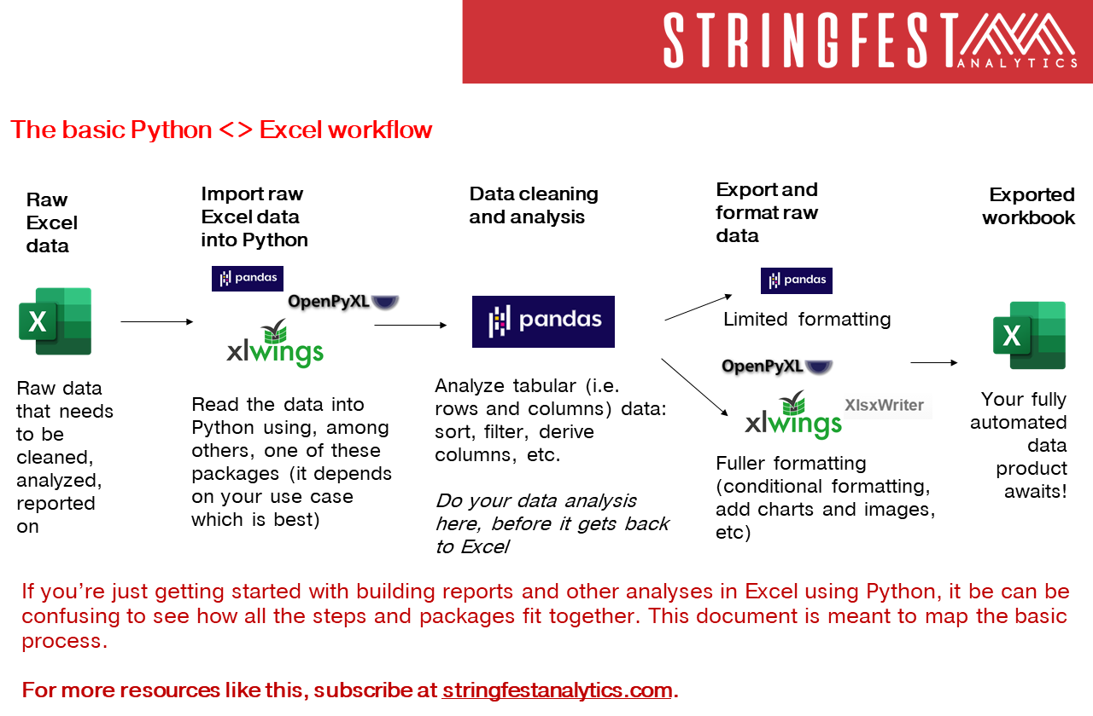
Notes:
Now another thing unique to open source programs is this idea of packages. You can kind of think of this as like add-ins for Excel – the analogy I like to use is as apps on a phone.

Slide 21
Demo
File: thing-4.ipynb
What can “Python-Powered Excel” do that “Pandas-Powered Excel” cannot?
Notes:
OK so what we are going to do here is go back to your session or open a new one. Go to the diamonds.r dataset. And let’s actually conduct the analysis that was hinted at earlier.

Slide 22
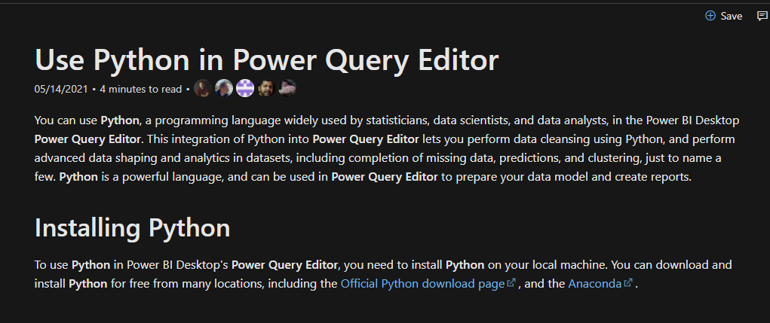
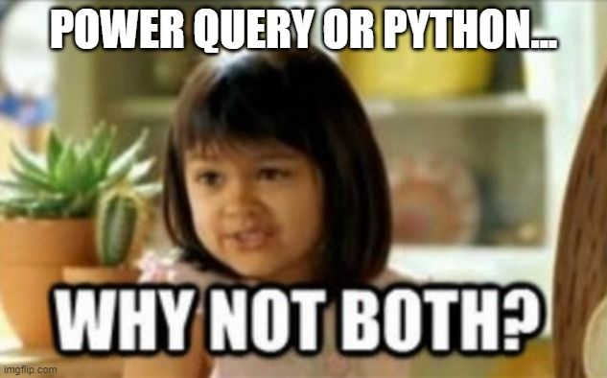
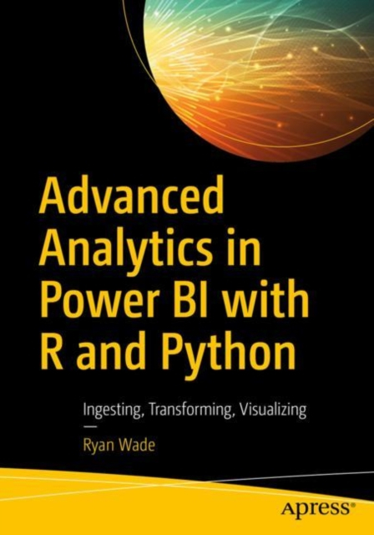
You’re not leaving the stack…
Notes:
One of the things that people get confused about is why learn Python if you’re getting into Power Query… or which to focus on.
You’re not leaving Microsoft’s stack. I have some documentation and a great book here. Now of course these are more about PowerBI but there’s every indication there’s more to come with Excel.

Slide 23
5. It’s not worth panicking over
Notes:
Now this is scary, it’s literally learning another language!

Slide 24
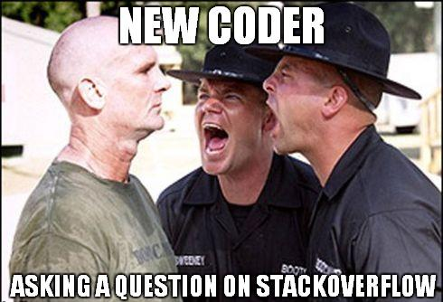
5 ways to get help…
0. Web search it
Help documentation: ? or help()
Read package’s documentation
Visualize your code with PythonTutor
Compose an MRE
And then…
5. Hit the forums for help
More: https://stringfestanalytics.com/five-ways-to-get-help-in-python/
Notes:
Now the Excel community is sooo welcoming that is can be jarring when you get elsewhere. The forums can be pretty brutal. So take some time to learn for yourself.

Slide 25

5 ways to get help…
0. Web search it
Help documentation: ? or help()
Read package’s documentation
Visualize your code with PythonTutor
Compose an MRE
And then…
5. Hit the forums for help
More: https://stringfestanalytics.com/five-ways-to-get-help-in-python/
Notes:
Now the Excel community is sooo welcoming that is can be jarring when you get elsewhere. The forums can be pretty brutal. So take some time to learn for yourself.

Slide 26
Questions?
Notes:
Any questions so far about using R?
Again I just want to show you how easy it is to get up and running there as an Excel user and what to expect when working with open source programs.
Now I guess one of the questions I might have in your shoes is what’s the big deal, we can do the same kind of stuff with Power Query. So I want to acknowledge that.

Slide 27
Conclusion/Resources

Slide 28
Recommended reading
Advancing into Analytics by George Mount
More info about http://stringfestanalytics.com/book/ , including how to read for free!
“By the end of this book, you should be able to conduct exploratory data analysis and
hypothesis testing using a programming language.”
Notes:
By the end of this book, you should be able to conduct exploratory data analysis and
hypothesis testing using a programming language.

Slide 29
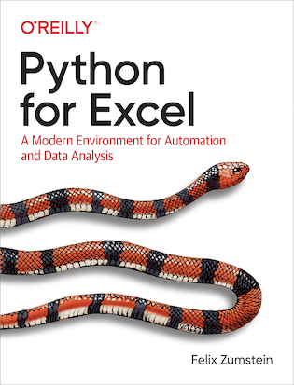
Recommended reading
Python for Excel by Felix Zumstein
https://www.xlwings.org/book
Notes:
By the end of this book, you should be able to conduct exploratory data analysis and
hypothesis testing using a programming language.

Slide 30
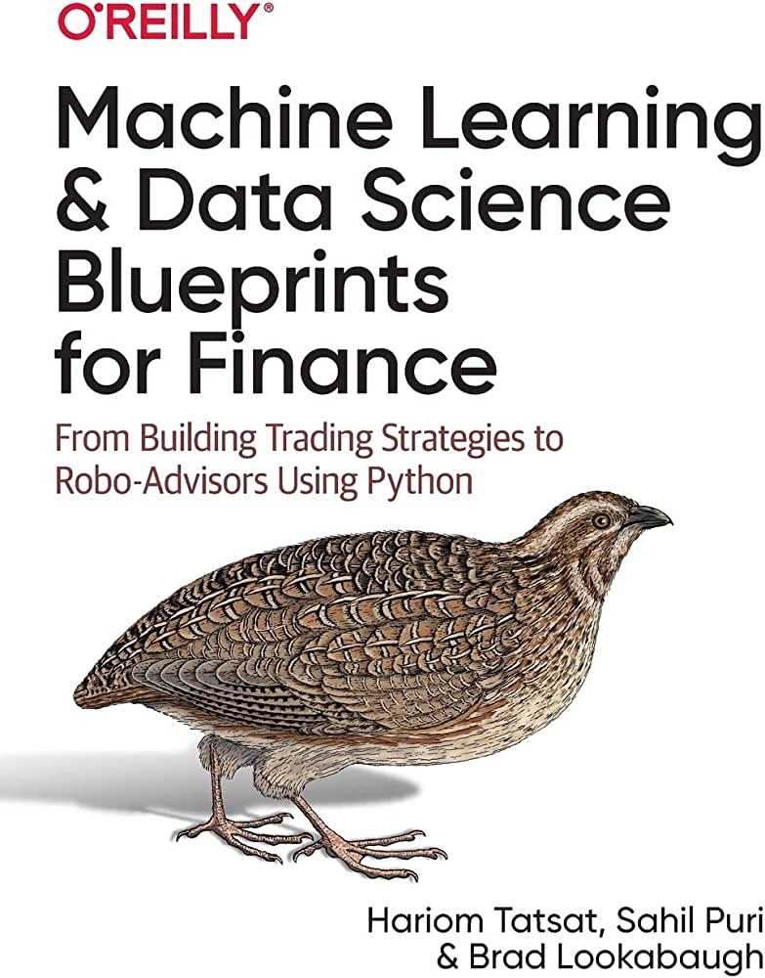
Recommended reading
Machine Learning and Data Science Blueprints for Finance by Hariom Tatasat et al.
Notes:
By the end of this book, you should be able to conduct exploratory data analysis and
hypothesis testing using a programming language.

Slide 31
Get in touch
george@stringfestanalytics.com
stringfestanalytics.com/book
linkedin.com/in/gjmount

Slide 32
Questions?
Who wants to win a book?

Slide 33
FEEBACK PLEASE
Email to George@stringfestanalytics.com
What did you learn?
What did you enjoy?
What else would you like?
Provide your mailing address for Stringfest swag!
(I may use testimonials for marketing)

