Slide 2
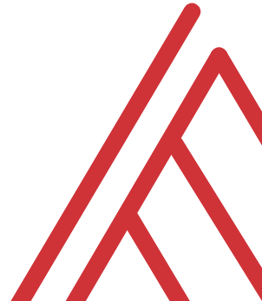
Lesson objectives
Load data from Excel workbooks and csv files into Power Query
Perform common data wrangling and cleaning tasks
Combine data from multiple sources
Notes:
So this means anyone is free to build on it or redistribute it… and that’s how we’ll get our code

Slide 3
Following along
Each section is a sub-folder
Demos = follow along with me
Drills = try it yourself
Refresh your memory with the demo notes
Notes:
So this means anyone is free to build on it or redistribute it… and that’s how we’ll get our code

Slide 4
1. Power Query as Excel’s ETL Tool
Notes:
Onto the five things now…

Slide 5

What the @%#! is ETL?
“A properly designed ETL system extracts data from the source systems, enforces data quality and consistency standards, conforms data so that separate sources can be used together, and finally delivers data in a presentation-ready format so that application developers can build applications and end users can make decisions.”
-- (where else but) Wikipedia
Notes:
So this means anyone is free to build on it or redistribute it… and that’s how we’ll get our code

Slide 6



Extract + Transform + Load
Notes:
OK now remember that being open source means anyone is free to repackage and redistribute code. In the case of Python the official source code lives with the Python foundation and can be found there. It’s more common however to download from the Anaconda _distribution_ of that code. One of the reasons why is Anaconda comes with some goodies that don’t come with the raw Pyhon installation. One of those is the Jupyter notebook, which is a browser-based app we’ll be using to work with Python.

Slide 7

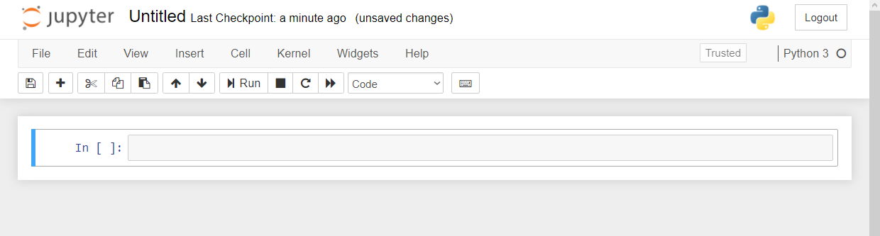

Demo
File: downloading-anaconda.docx
Download Anaconda (or click “launch binder”…)
Start with Jupyter at 1+1…
Menu bar
Toolbar
Code cell
Notes:
OK again, what I want to do here is just show you the basics of working with Jupyter. You will see in the repo there is an option to launch an interactive session, so do that and let’s navigate the four sections of Jupyter and get comfortable working there.
In the demo you’ll get a tour of the notebook and how to work a bit with functions and objects.
Possibly come up with some demo notes for this

Slide 8
2. It’s finnicky… or maybe logical?

Slide 9
Demo
File: thing-2.ipynb
How does Python handle
Case sensitivity?
Indexing?
Whitespace?
Notes:
OK so what we are going to do here is go back to your session or open a new one. Go to the diamonds.r dataset. And let’s actually conduct the analysis that was hinted at earlier.

