Slide 1



Introduction to Python for Excel

Slide 2
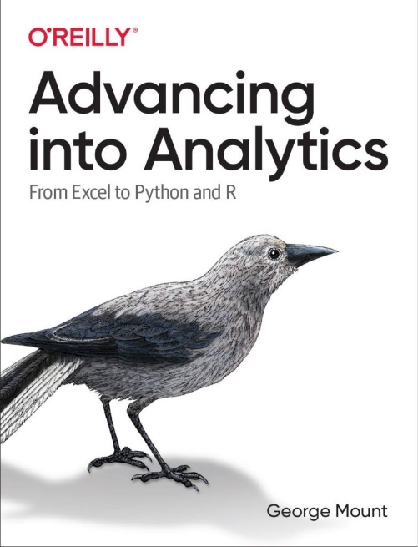
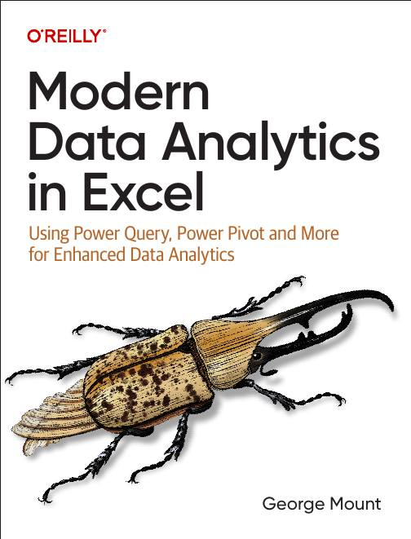



Hi, I’m George

Slide 3

Objectives for this session
Why Python & Excel for financial modelers?
Time series analysis
Data visualization
Report automation

Slide 4
Following along
Download the resources:
https://swiy.co/pie

Slide 5
1. Understanding the Python in Excel environment

Slide 6
Understanding the Python in Excel environment
What packages are available and why?
Loading Excel data into Python
Crossing between Python objects and Excel values
File: pie-environment.xlsx
Notes:
False!
Function, Formula, Function
Argument

Slide 7
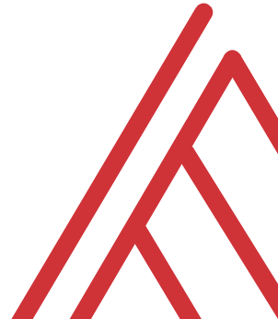
Questions?

Slide 8
2. From “that’s hard in Excel” to “that’s easy in Python”

Slide 9
From “that’s hard in Excel” to “that’s easy in Python”
Data profiling: What is the shape, size, completeness?
Time series: pandas for panel data
Visualizations: What are the distributions and relationships in this data?
File: hard-excel-easy-python.xlsx
Notes:
False!
Function, Formula, Function
Argument

Slide 10
Questions?

Slide 11
3. There’s more to Python and Excel than Python in Excel

Slide 12
There’s more to Python and Excel than Python in Excel
Python in Excel is all about data analysis, visualization, statistics & ML
It lacks Excel automation capabilities
You can automate an entire Excel workbook from Python… without opening Excel!
File: pae-pie.ipynb
Notes:
False!
Function, Formula, Function
Argument

Slide 13
Questions?

Slide 14
4. Conclusion

Slide 15
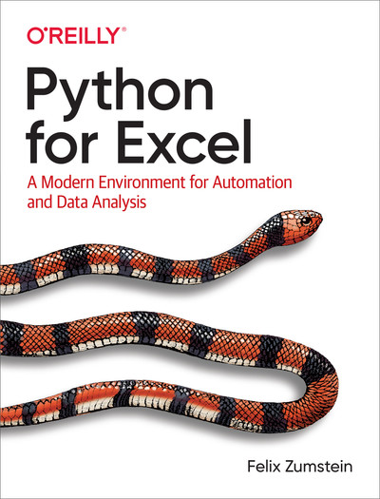
Resource: Python for Excel
Available on O’Reilly Online Learning: https://learning.oreilly.com/library/view/python-for-excel/9781492080992/
Notes:
False!
Function, Formula, Function
Argument

Slide 16
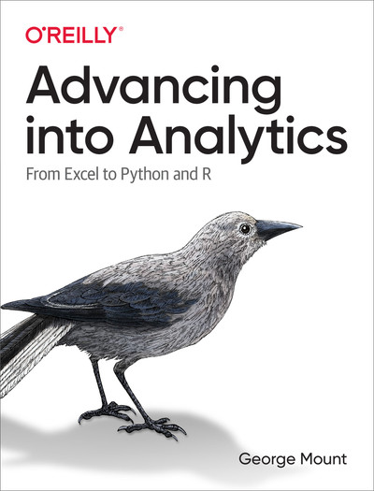
Resource: Advancing into Analytics
Available on O’Reilly Online Learning: https://learning.oreilly.com/library/view/advancing-into-analytics/9781492094333/
Notes:
False!
Function, Formula, Function
Argument

Slide 17
Resource: stringfestanalytics.com
Subscribe for updates & access to my data analytics learning resource library
Notes:
False!
Function, Formula, Function
Argument

Slide 18





Thank you!
George Mount
Owner, Stringfest Analytics
stringfestanalytics.com
George Mount
@gjmount

