Slide 1


Generative AI for Excel foundations

Slide 2
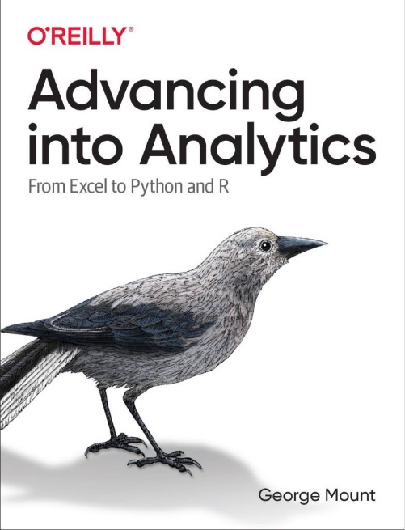
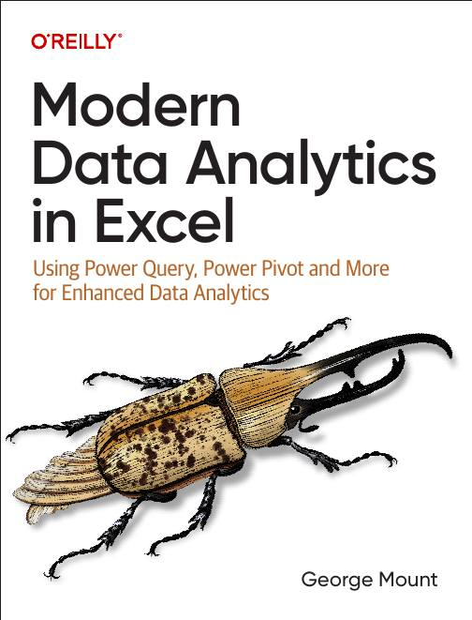



Hi, I’m George

Slide 3

Objectives for this session
Master data structuring with Markdown and Power Query for AI analysis.
Select suitable AI tools and craft prompts for enhanced data visualization.
Integrate AI tools into Excel, improving productivity and error management.
Engage in hands-on challenges to optimize and troubleshoot generative AI tasks for Excel.

Slide 4
1. Preparing data with Power Query and Markdown

Slide 5
Before we get started
Tables for enhanced AI, analytics & automation in Excel
Avoid “garbage in, garbage out” with Power Query
Do not upload proprietary/sensitive data to free/unapproved generative AI
Notes:
False!
Function, Formula, Function
Argument

Slide 6
Do not upload proprietary/sensitive data to free/unapproved generative AI

Slide 7
Reshaping data with Power Query
FILL THIS IN – I THINK I WANT TO SHOW THE COLUMN SPLIT AND THE FILL DOWN AS WELL
Notes:
False!
Function, Formula, Function
Argument

Slide 8
Structuring data inputs with Markdown
Fill this in later
Notes:
False!
Function, Formula, Function
Argument

Slide 9
Exercises
Unpivot the data in Power Query so all product categories are combined into a single column.
Convert the unpivoted data into Markdown format.
Use tools like Dropbox Paper or a generative AI tool for the conversion.
Use ChatGPT or another generative AI tool to analyze the data and return the results in Markdown format.
Paste the Markdown text into Google Docs or another tool to view the output.
Notes:
False!
Function, Formula, Function
Argument

Slide 10
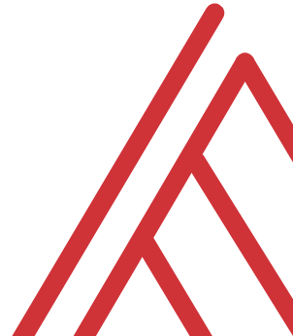
Questions?

Slide 11
2. Analyzing data with free generative AI tools

Slide 12
Choosing the right (free) tools for AI-powered Excel
Built-in Excel features (i.e., Analyze Data)
ChatGPT
Microsoft Copilot
Claude AI
Resource: https://stringfestanalytics.com/how-to-choose-the-right-free-tools-for-ai-powered-excel-tasks/
Notes:
Summary on the next slide

Slide 13
Tool | Strengths | Weaknesses | Use Cases
Excel Built-In AI | Integrated directly into Excel, offering seamless and familiar user experience | Limited to Excel’s built-in functionalities, limited generative AI capabilities | Automatically identify trends, patterns, and correlations with Analyze Data, gain insights quickly
ChatGPT | Excellent at generating text-based content, offering theoretical guidance, and explaining concepts | Cannot upload Excel workbooks in the free version, requires careful handling of sensitive data | Creating complex formulas, explaining Excel features, and offering tips on Excel best practices
Microsoft Copilot | Provides assistance with formulas and feature explanations through theoretical examples | Free version lacks direct data upload and customization with personal documents | Suggesting improvements to public datasets, content generation, explaining insights using public data
Claude AI | Sophisticated conversational AI, excels in offering high-level analytical strategies | Requires careful crafting of prompts to get the best results, cannot handle data uploads directly | Explaining data insights, communicating complex ideas to non-technical audiences, providing contextual explanations

Slide 14
Framing analytics problems with AI
SMART goals
CRISP-DM
Current state – Future state
Issue trees
Root cause analysis
Resource: https://stringfestanalytics.com/how-to-frame-a-data-analytics-problem-using-copilot-for-microsoft-365/
Notes:
False!
Function, Formula, Function
Argument

Slide 15
Creating effective AI prompts for data visualization
Resource: https://stringfestanalytics.com/how-to-choose-the-right-free-tools-for-ai-powered-excel-tasks/
Notes:
False!
Function, Formula, Function
Argument

Slide 16
Generating synthetic datasets
Resource: https://stringfestanalytics.com/how-to-generate-datasets-with-copilot-for-microsoft-365/
Notes:
False!
Function, Formula, Function
Argument

Slide 17
Exercises
Scenario: Prepare creation of retail sales dashboard & related strategy
Step 1: Generate synthetic data with Copilot
Step 2: Plan visualizations
Step 3: Frame the problem
Step 4: Compare AI Tools
More instructions/hints: ai-assisted-dashboard.pdf
Notes:
Step 1: Generate Synthetic Data
Use Copilot to create 1,000 records: Transaction ID, Date, Product Category, Sales, Store Type, and Age Group.
Ensure realistic patterns (e.g., higher weekend sales, age-group preferences).
Run Python script with Faker for reproducibility.
Step 2: Plan Visualizations
Ask ChatGPT how to best compare sales (online vs. physical, age group vs. product preferences).
Select chart types based on AI suggestions.
Step 3: Frame the Problem
Use Claude AI to identify key sales drivers and frame a SMART goal (e.g., “Increase online sales by 15% in 3 months”).
Step 4: Compare AI Tools
Reflect on how Copilot, ChatGPT, and Claude contributed to data creation, visualization, and framing.
Evaluate their strengths and limitations for future projects.

Slide 18
3. Advanced AI applications and troubleshooting

Slide 19
Debugging Excel formulas
https://stringfestanalytics.com/how-to-understand-console-log-in-office-scripts-for-excel/
Notes:
False!
Function, Formula, Function
Argument

Slide 20
Integrating AI within Excel with Analyze Data
Sharing within a workbook
Sharing with other users in an organization
Sharing outside your organization
File: sharing-office-scripts.xlsx
Resource: https://stringfestanalytics.com/office-scripts-for-excel-how-to-share-your-scripts/
Notes:
False!
Function, Formula, Function
Argument

Slide 21
Challenge
Sharing within a workbook
Sharing with other users in an organization
Sharing outside your organization
File: sharing-office-scripts.xlsx
Resource: https://stringfestanalytics.com/office-scripts-for-excel-how-to-share-your-scripts/
Notes:
False!
Function, Formula, Function
Argument

Slide 22
Questions?

Slide 23
Thank you

