Slide 1





Course Name Goes Here
Course Description or Chapter Name
Instructor Name
Instructor Role or Company.

Slide 2

Agenda
List Item
List Item
Item Description...
Item Description...
List Item
List Item
Item Description...
Item Description...
List Item
List Item
Item Description...
Item Description...
List Item
List Item
Item Description...
Item Description...
List Item
List Item
Item Description...
Item Description...

Slide 3


Let’s Recap
Sagittis et eu at elementum, quis in. Proin praesent volutpat egestas sociis sit lorem nunc nunc sit. Eget diam curabitur mi ac. Auctor rutrum lacus malesuada massa ornare et.
List Item
Item Description...
List Item
Item Description...
List Item
Item Description...

Slide 4

Break / Q&A Time
Supporting Text Goes Here.

Slide 5


Before next session...
Sagittis et eu at elementum, quis in. Proin praesent volutpat egestas sociis sit lorem nunc nunc sit. Eget diam curabitur mi ac. Auctor rutrum lacus malesuada massa ornare et.
Assignment 1
Sagittis et eu at elementum, quis in. Proin praesent volutpat egestas sociis sit lorem nunc nunc sit.
Assignment 2
Sagittis et eu at elementum, quis in. Proin praesent volutpat egestas sociis sit lorem nunc nunc sit.
Assignment 3
Sagittis et eu at elementum, quis in. Proin praesent volutpat egestas sociis sit lorem nunc nunc sit.

Slide 6
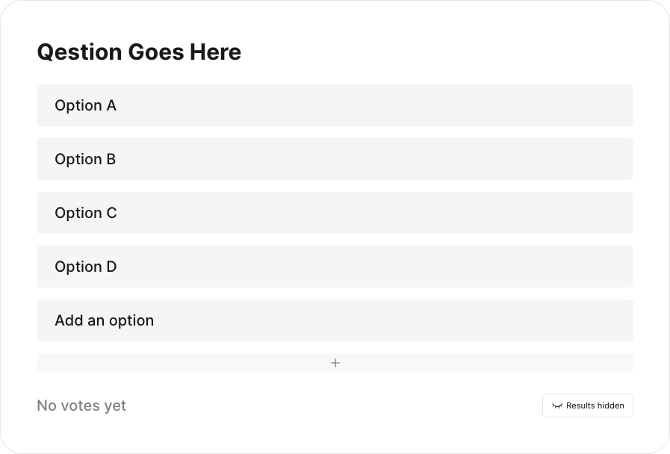
Poll / Vote Question
Sagittis et eu at elementum, quis in. Proin praesent volutpat egestas sociis sit lorem nunc nunc sit. Eget diam curabitur mi ac. Auctor rutrum lacus malesuada massa ornare et.

Slide 7


Key Takeaway(s)
Sagittis et eu at elementum, quis in. Proin praesent volutpat egestas sociis sit lorem nunc nunc sit. Eget diam curabitur mi ac. Auctor rutrum lacus malesuada massa ornare et.
Assignment 1
Sagittis et eu at elementum, quis in. Proin praesent volutpat egestas sociis sit lorem nunc nunc sit.
Assignment 2
Sagittis et eu at elementum, quis in. Proin praesent volutpat egestas sociis sit lorem nunc nunc sit.
Assignment 3
Sagittis et eu at elementum, quis in. Proin praesent volutpat egestas sociis sit lorem nunc nunc sit.

Slide 8


Live Demo / Coding
Supporting Text Goes Here.

Slide 9

Graph & Chart Placeholders
Sagittis et eu at elementum, quis in. Proin praesent volutpat egestas sociis sit lorem nunc nunc sit.
APAC
EMEA
27%
Location
41%
29.8% Central & South Asia
32%
32%
North America
27.4% North America
25.5% Europe
26%
9%
Software Developer
4.7% East & Southeast Asia
6%
Founder
4.7% Latam & Caribbean
4%
Executive Director
3.8% Middle East & North Africa
4%
Salesperson
2.6% Oceana
4%
Technology Manager
1.6% Sub-Saharan

Slide 10



Until Next Session! 👋🏻
Next session will be held on April 12th 2026 11am PST.
Instructor Name
Channel Link
Instructor Role or Company.
Support@academy.genai.works

