Slide 1


Getting started with GROUPBY() and PIVOTBY() in Excel

Slide 2





Hi, I’m George

Slide 3

Objectives for this session
Understand and apply the GROUPBY() function to aggregate and summarize data dynamically.
Utilize the PIVOTBY() function to flexibly display data across both rows and columns for comprehensive analysis.
Transition between using traditional PivotTables to these more powerful, formula-driven alternatives for faster and more responsive data insights.

Slide 4
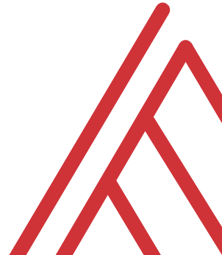
Questions?

Slide 5
Thank you

