Slide 1


Python in Excel for Enhanced Data Analytics
George Mount

Slide 2

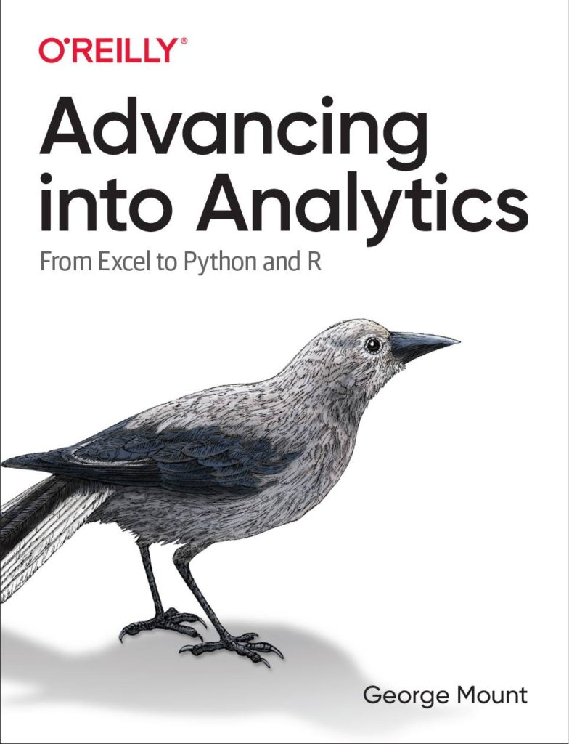

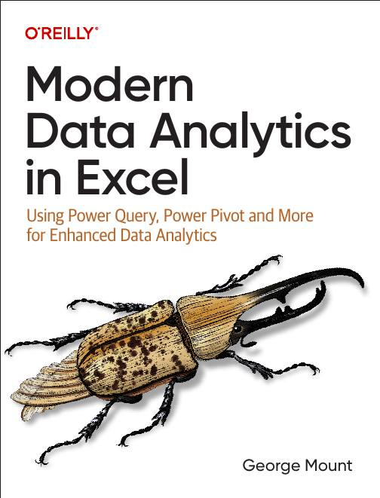


Hi, I’m George

Slide 3

Objectives for this session
Learn core Python integration techniques in Excel.
Apply Python for complex data analysis and visualization techniques.
Harness generative AI and Copilot for assistance with Python tasks.
Master Python-driven Excel report automation.

Slide 4
1. Python in Excel: First Steps

Slide 5
Python in Excel: First steps
Understanding the Python in Excel environment
Loading Excel data into Python
Converting Python objects to Excel values
File: python-excel-first-steps.xlsx
Notes:
False!
Function, Formula, Function
Argument

Slide 6
Python in Excel: First steps EXERCISE
Load the penguins dataset into a DataFrame called penguins_df
Check the resulting dataset’s columns: run penguins_df.columns. Swith the output to display in Excel
Visualize relationship b/w bill length and body mass: run sns.scatterplot(x='bill_length_mm', y='body_mass_g', data=penguins_df). Practice resizing this plot.
File: python-excel-first-steps-exercise.xlsx
Notes:
False!
Function, Formula, Function
Argument

Slide 7
Must-know features for Python in Excel
Data import with Power Query
Data preview with linked data types
Structured references with Excel tables
Mixing Python and Excel operations with dynamic arrays
Creating, resizing, and referencing Python plots with images in cells
File: python-excel-first-steps.xlsx
Notes:
False!
Function, Formula, Function
Argument

Slide 8
Must-know features for Python in Excel
Import into Excel via Power Query (Get Data > From File > From Text/CSV)
Unpivot the Fresh through Delicassen [sic] columns
Load as connection into Python in Excel
Preview the data with a linked data type
Count the number of nonblank cells in the preview area with a spill operator
File: wholesale-customers.csv
Notes:
False!
Function, Formula, Function
Argument

Slide 9

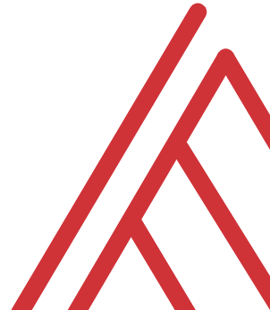

Questions?

Slide 10
2. Analyzing data with Python in Excel

Slide 11
Analyzing data with Python in Excel
Data profiling: What is the shape, size, completeness?
Time series: pandas for panel data
Descriptive statistics/EDA: What stories might be told in this data?
File: analyzing-data-with-python-in-excel.xlsx
Notes:
False!
Function, Formula, Function
Argument

Slide 12
Analyzing data with Python in Excel exercises
Explore relationship between sales, temperature, customer count over time
Fill in the blanks to complete the code
File: analyzing-data-with-python-in-excel-exercise.xlsx
Notes:
False!
Function, Formula, Function
Argument

Slide 13
Questions?

Slide 14
2. Visualizing data with Python in Excel

Slide 15
Visualizing data with Python in Excel
Inserting and resizing Python plots in the workbook
Building plots in Python that would be difficult in Excel
Customizing the results of seaborn plots
File: visualizing-data-with-python-in-excel.xlsx
Notes:
False!
Function, Formula, Function
Argument

Slide 16
Visualizing data with Python in Excel EXERCISE
Visualize this data to analyze sales, customer ratings, and more
Fill in the blanks to complete the code
File: visualizing-data-with-python-in-excel-exercise.xlsx
Notes:
False!
Function, Formula, Function
Argument

Slide 17
Questions?

Slide 18
4. Advanced Analysis with Copilot

Slide 19



The new trinity for data analysis

Slide 20
The new trinity for data analysis…
if you know what you’re doing!!!

Slide 21
Getting started with Advanced Analysis
Load & begin iterative analysis process with Copilot and Python
Become an active participant and learner for best results
Worksheet: penguins
Resource: https://stringfestanalytics.com/how-to-get-started-with-advanced-analysis-with-python-for-copilot-in-excel/
Notes:
False!
Function, Formula, Function
Argument

Slide 22
Additional use cases for Advanced Analytics (follow along!)
Data visualizations
Time series
Text
Notes:
False!
Function, Formula, Function
Argument

Slide 23
Advanced Analytics exercises
Workbook: copilot-dashboard-start.xlsx
Use Advanced Analysis to create visualizations for a dashboard
Check mpg-dashboard-prompt.txt for a sample input prompt
We’ll walk through assembling the dashboard together
Your results will vary from mine… embrace it!
Notes:
False!
Function, Formula, Function
Argument

Slide 24
Questions?

Slide 25
5. There’s more to Python and Excel than Python in Excel

Slide 26
There’s more to Python and Excel than Python in Excel
Python in Excel is all about data analysis, visualization, statistics & ML
It lacks Excel automation capabilities
Let’s automate an entire Excel workbook from Python… without opening Excel!
File: pae-pie.ipynb
Notes:
False!
Function, Formula, Function
Argument

Slide 27
There’s more to Python and Excel than Python in Excel EXERCISE
Automate production of a workbook comparing website visitors versus rating
Fill in the blanks to create the script
File: pae-pie-exercise.ipynb
Notes:
False!
Function, Formula, Function
Argument

Slide 28
Questions?

Slide 29
6. Combined use cases for Python in Excel

Slide 30
Building a moving average chart
Develop an interactive moving average chart using Python within an Excel workbook
Combine Python backend processing with Excel frontend capabilities to build user-driven data analyses
File: moving-average.xlsx User-defined resample period: dynamic-moving-average.xlsx
Notes:
False!
Function, Formula, Function
Argument

Slide 31
Dynamic measures
Create dynamic measures a la Power BI/Tableau
Integrate Python backend processing with Excel’s visualization capabilities to build responsive and customizable bar charts
Utilize Python’s getattr() function to dynamically handle user-driven inputs for flexible data aggregation
File: dynamic-measures.xlsx
Notes:
False!
Function, Formula, Function
Argument

Slide 32
Practical use cases EXERCISE
Fill in the blanks to do the following:
Create user inputs for start date, end date, and cumulative type (sum or mean)
Use the expanding() method
Build line chart of cumulative total over filtered date range
Don’t forget about getattr()!
File: combine-use-cases-challenge.xlsx
Notes:
False!
Function, Formula, Function
Argument

Slide 33
Questions?

Slide 34
7. Quick wins with Python in Excel

Slide 35
Quick wins with Python in Excel
Python is NOT inherently harder than Excel...
15 top use cases, ~1 line apiece!
Notes:
False!
Function, Formula, Function
Argument

Slide 36
Conclusion

Slide 37

Resource: Advancing into Analytics
stringfestanalytics.com/book
Notes:
False!
Function, Formula, Function
Argument

Slide 38
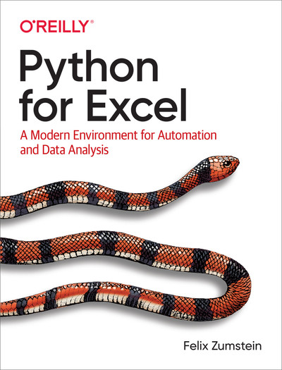
Resource: Python for Excel
xlwings.org/book
Notes:
False!
Function, Formula, Function
Argument

Slide 39
Resource: Modern Data Analytics in Excel
stringfestanalytics.com/maxl/
Notes:
False!
Function, Formula, Function
Argument

Slide 40
THANK YOU
Linkedin.com/in/gjmount
Twitter: @gjmount
george@stringfestanalytics.com

Slide 41
Python in Excel for Enhanced Data Analytics
George Mount

