Slide 1

Notes:
https://swiy.co/musopen

Slide 2





HI, I’M GEORGE
Data cleaning in Power Query

Slide 3
OBJECTIVES
Split & fill rows and columns
Create calculated fields
Unpivot a dataset
Data cleaning in Power Query

Slide 4
FOLLOWING ALONG
Download resources on Patreon:
https://www.patreon.com/user?u=80541000
Data cleaning in Power Query
Notes:
https://swiy.co/amx

Slide 5
TERMS OF ENGAGEMENT
Feel free to share the download link with latecomers ☺
Participation is welcome via the chat (or please ask to be unmuted!)
Demos work best with 365 on Windows, I cannot guarantee other systems
Recording goes out later today and is up for two days, then moves to Patreon

Slide 6

QUESTIONS?

Slide 7
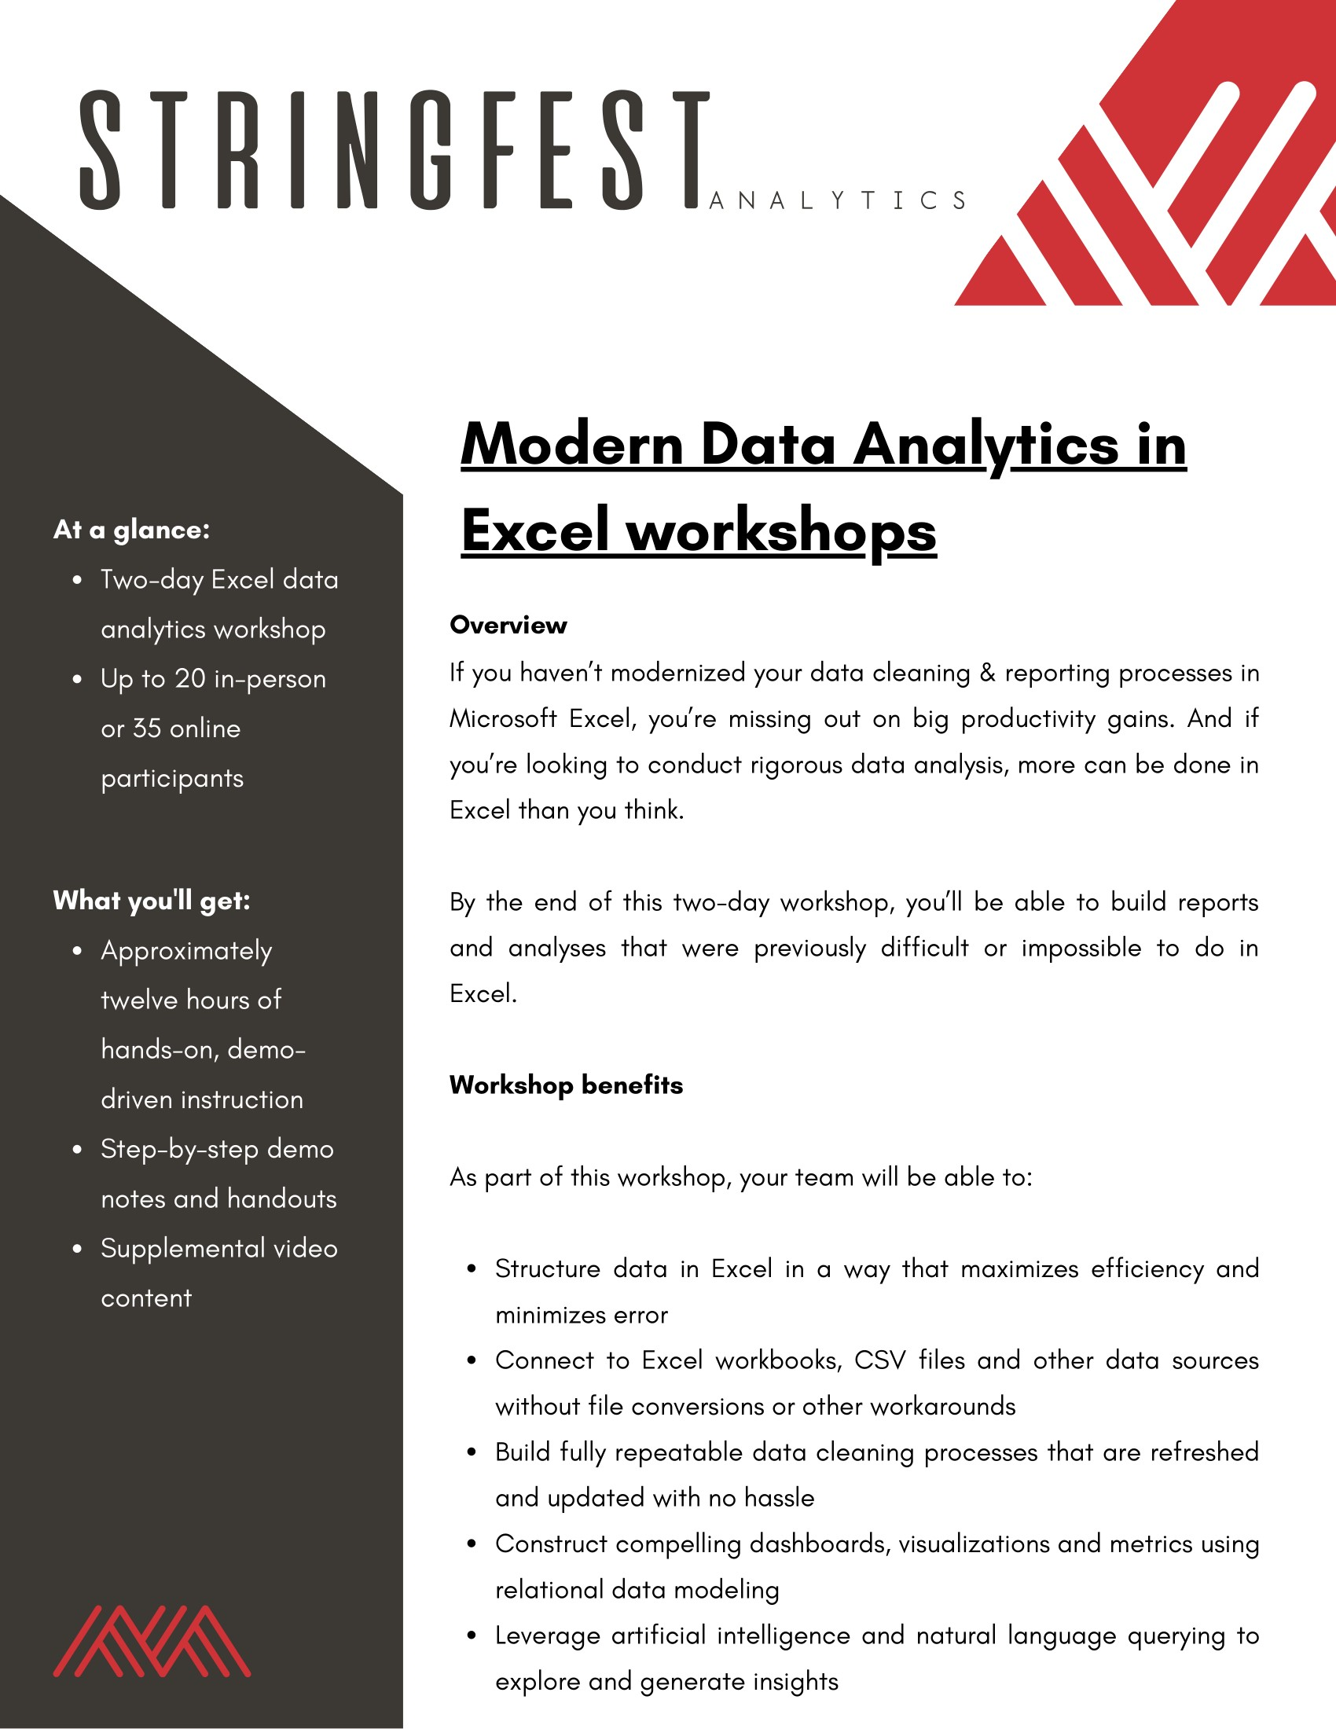
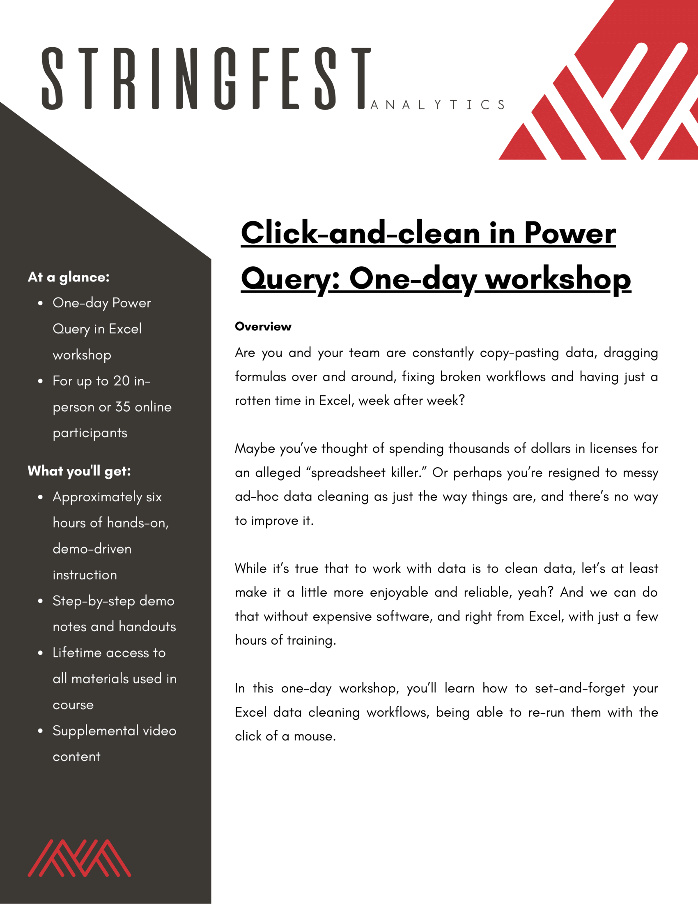
Modern Analytics in Excel workshops
Learn more and connect at https://stringfestanalytics.com/modern-data-analytics-in-excel-workshops/
Human Centered Design • MDLS 2020
Notes:
If you are looking to individually take a Power Query class I have a surprise here at the end…

Slide 8

THANK YOU
LINKEDIN
linkedin.com/in/gjmount
EMAIL ADDRESS
george@stringfestanalytics.com
WEBSITE
stringfestanalytics.com
TWITTER
twitter.com/gjmount
Notes:
Thanks for coming! Feel free to contact me anytime, find me on LinkedIn, I also write frequently on this stuff so check out my website too.

Slide 9


Modern Data Analytics in Excel
Available in early release: https://stringfestanalytics.com/maxl/

Slide 10
Join my Patreon
https://social.stringfestanalytics.com/patreon
Get lifetime access to all past webinar recordings & downloads

Slide 11
FINAL QUESTIONS?
Thanks for joining!
A recap email with recording, survey and more will be coming…
The recording stays up for 48 hours, then moves to my Patreon
I appreciate your reviews & referrals.
Notes:
Any questions on descriptive statistics?

Slide 12

TAKE THE SURVEY
How did I do today? Testimonials or other data welcome!
https://social.stringfestanalytics.com/event-feedback
Notes:
I’m a data analyst give me data on how I did
Testimonials also VERY helpful.

