Slide 1


Custom Copilot with Copilot Studio: Building AI Assistants for Excel
George Mount

Slide 2
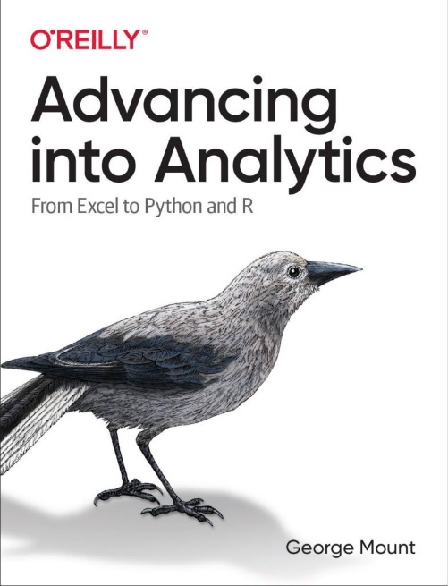
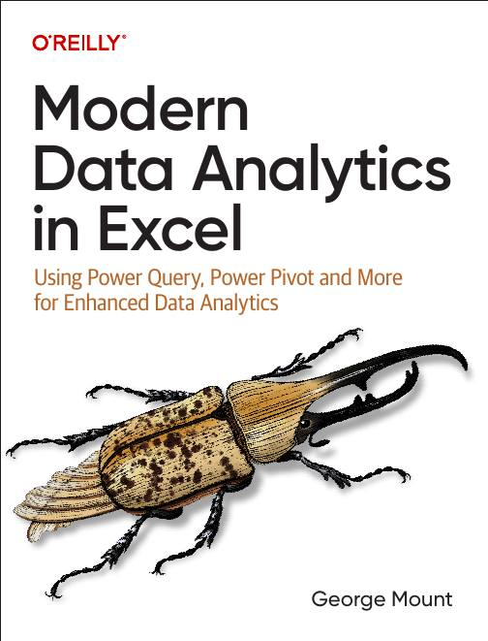

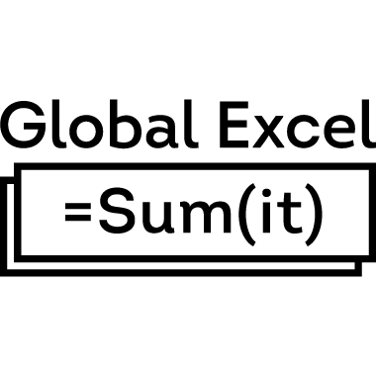


About me
I help Excel users move from fragile spreadsheets
to confident, scalable analysis.

Slide 3

Objectives for this session
How to build your own Copilots for Excel in Copilot Studio
How to create focused, task-specific assistants that actually help with classification, reporting, and data cleanup
How to use the newer custom 365 Agents, which are easier to provision and deploy inside Microsoft 365
How to structure prompts and workflows so your AI outputs are reliable and usable inside Excel

Slide 4
Resources
Download at https://github.com/stringfestdata/gxls-copilot-studio-excel/archive/refs/heads/main.zip

Slide 5
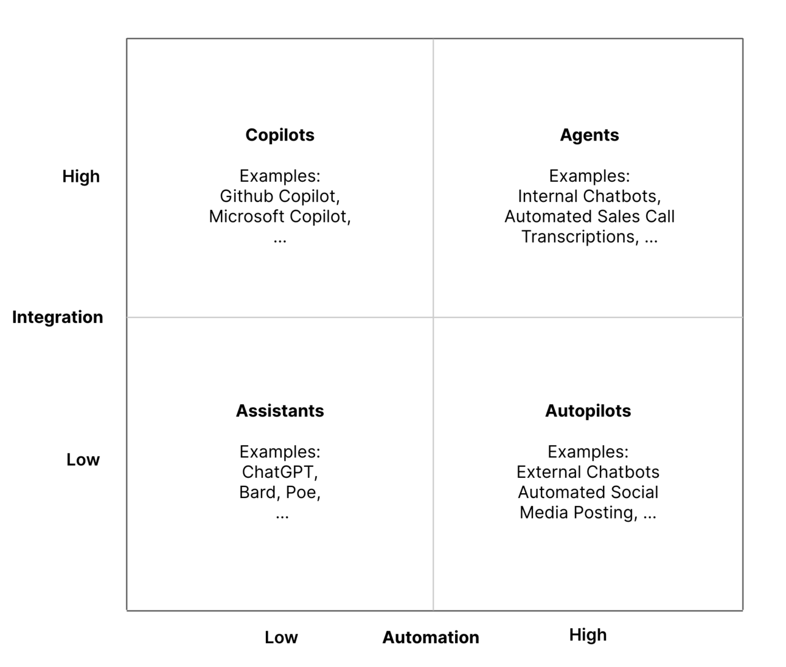
The integration-automation AI framework
https://blog.tobiaszwingmann.com/p/integration-automation-ai-framework
Notes:
This framework helps make sense of all the vocabulary we’ve been talking about. Instead of treating “copilots” and “agents” as fuzzy marketing terms, it breaks things down by two dimensions: how integrated the tool is with your systems, and how much automation it can actually perform.
In the top left, you have copilots. They’re highly integrated because they sit inside your existing apps, but they still rely on you to drive the workflow. They improve your work, but they don’t take it over.
On the right, you have agents. They combine that same level of integration with the ability to take multi-step actions on their own. So they’re not just responding to you, they’re actually completing tasks across systems.
Below that, you have assistants and autopilots. These are less connected to your internal data and tools, even if some of them can automate quite a bit.
The main idea here is that Excel is moving from the “copilot” box toward the “agent” box. That’s why everything suddenly feels like it’s changing. It isn’t just giving you answers anymore — it’s starting to orchestrate real work.

Slide 6
Demo 1: MVP knowledge base
Create Excel MVP knowledge base with Copilot Studio
Set custom knowledge sources & instructions
Add custom goodbye message
Notes:
False!
Function, Formula, Function
Argument

Slide 7
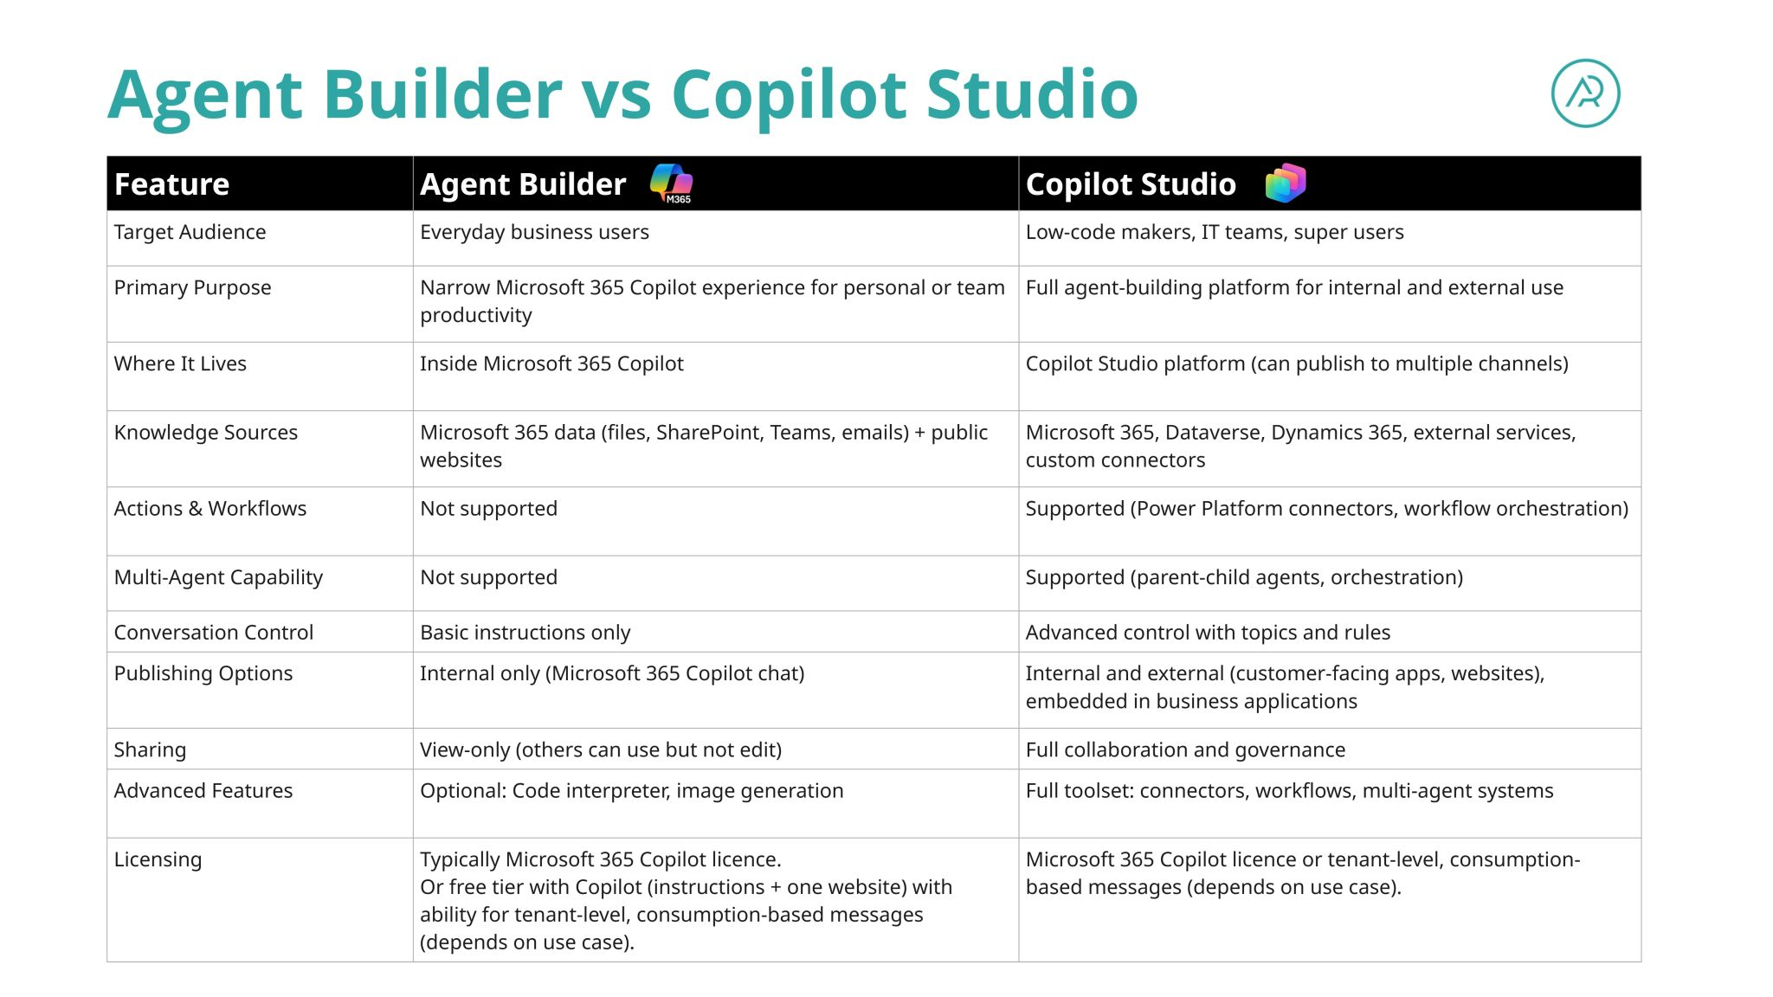
https://www.linkedin.com/posts/hamishsheild_recently-ive-been-working-with-teams-who-activity-7432532796482695168-gTbp?utm_source=share&utm_medium=member_desktop&rcm=ACoAAATCK8AB8LEMRRQ353gE1bukLsTb6mY_Zbg
Notes:
This framework helps make sense of all the vocabulary we’ve been talking about. Instead of treating “copilots” and “agents” as fuzzy marketing terms, it breaks things down by two dimensions: how integrated the tool is with your systems, and how much automation it can actually perform.
In the top left, you have copilots. They’re highly integrated because they sit inside your existing apps, but they still rely on you to drive the workflow. They improve your work, but they don’t take it over.
On the right, you have agents. They combine that same level of integration with the ability to take multi-step actions on their own. So they’re not just responding to you, they’re actually completing tasks across systems.
Below that, you have assistants and autopilots. These are less connected to your internal data and tools, even if some of them can automate quite a bit.
The main idea here is that Excel is moving from the “copilot” box toward the “agent” box. That’s why everything suddenly feels like it’s changing. It isn’t just giving you answers anymore — it’s starting to orchestrate real work.

Slide 8
Demo 2: Excel keyboard shortcut agent
Create Excel MVP knowledge base with Agent Builder
Set custom knowledge sources & instructions
Compare and contrast Copilot Studio vs 365 Custom Agents
Notes:
False!
Function, Formula, Function
Argument

Slide 9
Demo 3: Expense account agent
Build PDF receipt to Excel expense report agent (a la Shoeboxed)
Use 365 Custom Agents for ease of build
Notes:
False!
Function, Formula, Function
Argument

Slide 10
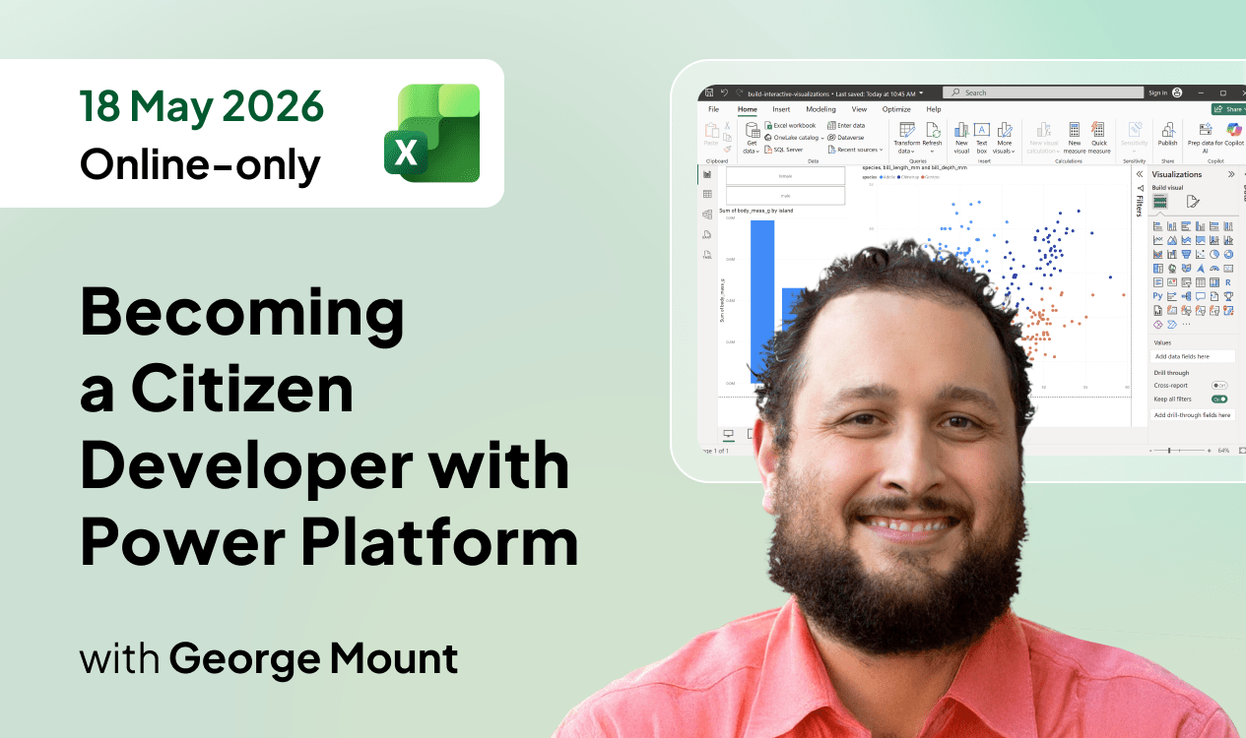
See you in May?
10% off with GEORGE10 at checkout
https://globalexcelsummit.com/product/becoming-a-citizen-developer-with-power-platform

Slide 11

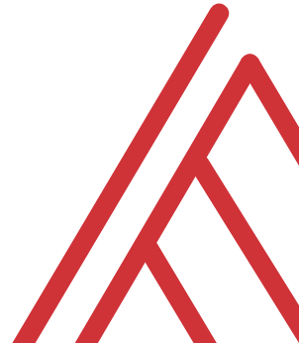

Questions?

Slide 12
Thank you

