Slide 1


AI comes to Excel: Building your first Excel agent

Slide 2
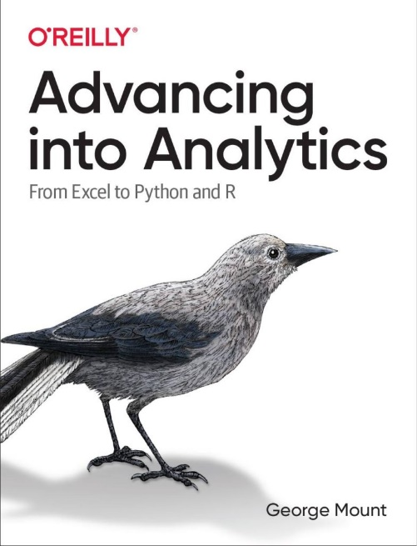

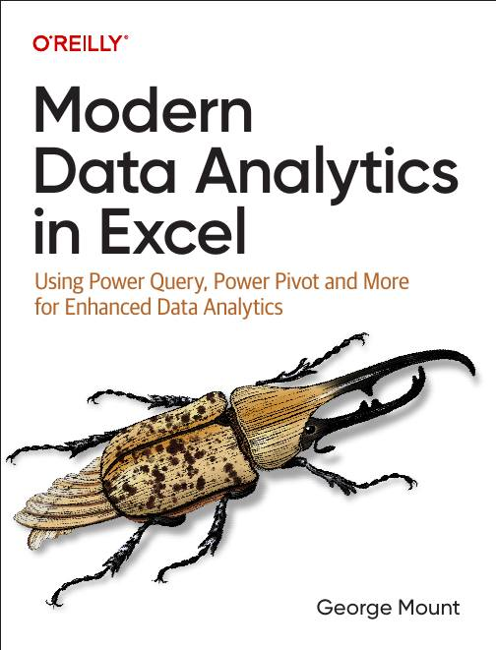

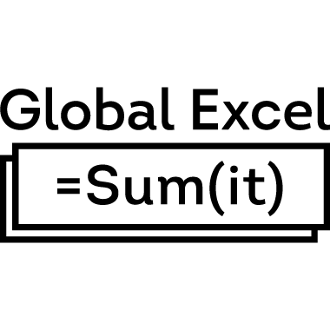

About me

Slide 3

Objectives for this session
Explore the difference between Copilot and Agent Mode in Excel
Build your first Agent Mode tool in Excel using natural language prompts
Understand how Excel Agents fit into the Microsoft AI ecosystem (Copilot Studio, Power Platform, etc.)

Slide 4
Remember when Excel got…
Formulas
PivotTables
Power Query
Copilot

Slide 5
Remember when Excel got…
Now it’s getting AI agents!
Formulas
PivotTables
Power Query
Copilot

Slide 6
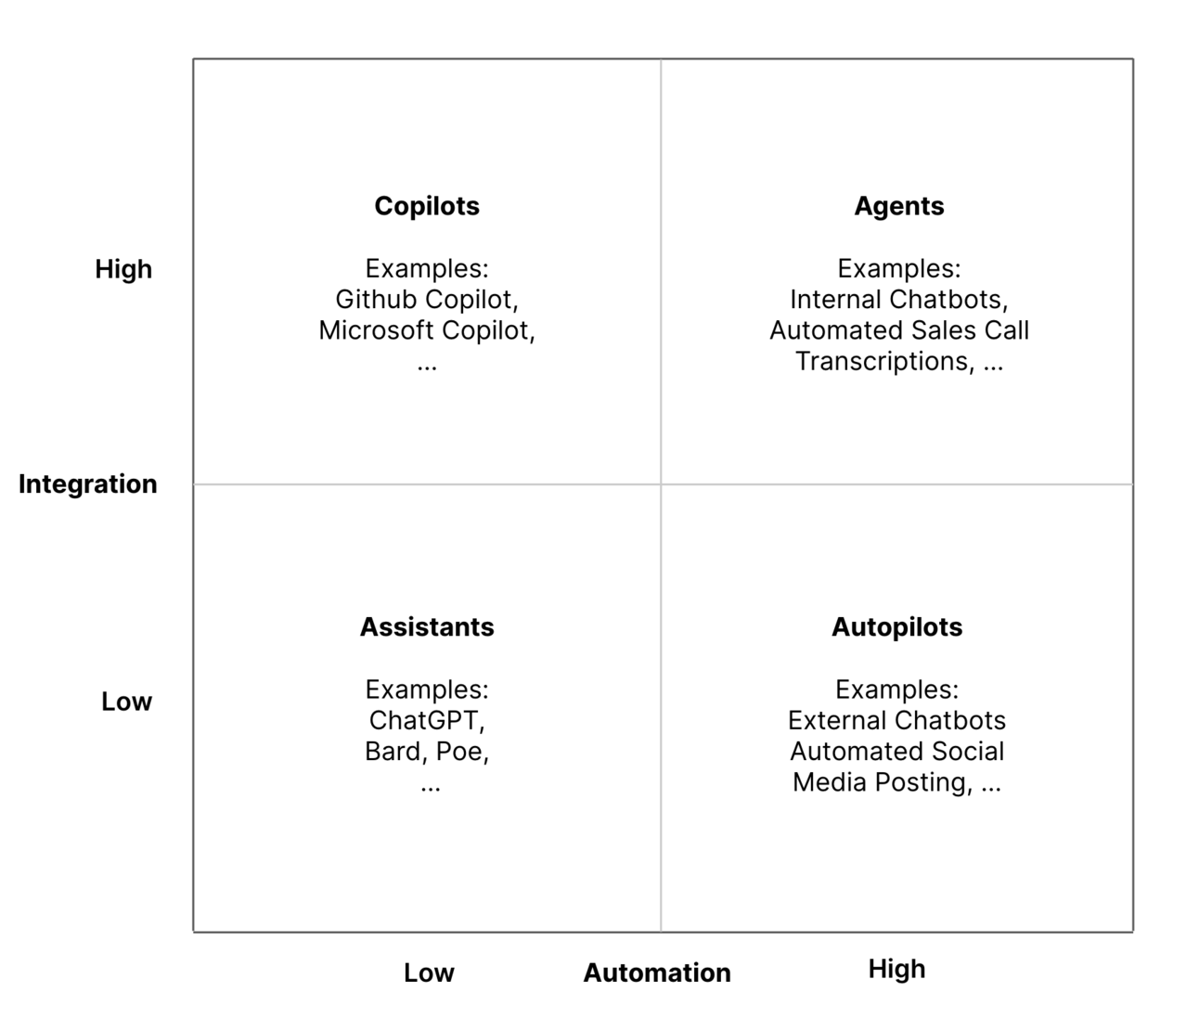
The integration-automation AI framework
https://blog.tobiaszwingmann.com/p/integration-automation-ai-framework

Slide 7
Excel Copilot vs Excel Agent Mode
Feature | Excel Copilot | Agent Mode
Interaction | One-shot prompts | Iterative, self-guided workflow
Task Scope | Single actions (formulas, charts, summaries) | Multi-step processes across sheets
Error Handling | User re-prompts or fixes | Agent reviews, retries, self-corrects
User Role | You do, Copilot helps | You manage, Agent executes
Output Quality | Fast but shallow | Verified and repeatable
Best For | Quick wins, ad-hoc tasks | Structured, high-stakes workflows
Analogy | Smart assistant | Junior analyst
Notes:
When people hear Copilot and Agent Mode, they often assume they are the same thing, but they represent very different stages in how AI works inside Excel.
Copilot is what most of us have used so far. It is a great assistant when you need to generate a formula, summarize some data, or clean up a quick report. You ask it a question, it gives an answer, and then it is up to you to decide what to do next. It is reactive. It waits for your prompt each time.
Agent Mode takes this a step further. Instead of a single prompt and response, the agent can plan, execute, and evaluate multiple steps on its own. It does not just answer you, it actually works with you, refining its approach until it gets the result right. Think of it as the difference between giving someone an instruction versus giving them a project.
That also changes your role as the analyst. With Copilot, you are still the one doing the work, just faster. With Agent Mode, you become more of a manager or reviewer, someone who guides, oversees, and checks the agent’s work. The focus shifts from “Can I get this formula right?” to “Can I structure and verify the workflow my agent is running?”
In terms of output, Copilot is great for speed. You will get something usable right away. Agent Mode is built for reliability. It double checks itself, validates formulas, and produces outputs that are more auditable and refreshable. That is what makes it better suited for more complex or higher stakes workflows like financial models, reconciliations, or recurring dashboards.
So the short version is: Copilot accelerates your work. Agent Mode begins to do the work. The real opportunity for Excel professionals is learning how to manage and guide these new digital teammates effectively.

Slide 8

https://stringfestanalytics.com/how-to-understand-the-modern-excel-ai-stack/
Notes:
When people hear Copilot and Agent Mode, they often assume they are the same thing, but they represent very different stages in how AI works inside Excel.
Copilot is what most of us have used so far. It is a great assistant when you need to generate a formula, summarize some data, or clean up a quick report. You ask it a question, it gives an answer, and then it is up to you to decide what to do next. It is reactive. It waits for your prompt each time.
Agent Mode takes this a step further. Instead of a single prompt and response, the agent can plan, execute, and evaluate multiple steps on its own. It does not just answer you, it actually works with you, refining its approach until it gets the result right. Think of it as the difference between giving someone an instruction versus giving them a project.
That also changes your role as the analyst. With Copilot, you are still the one doing the work, just faster. With Agent Mode, you become more of a manager or reviewer, someone who guides, oversees, and checks the agent’s work. The focus shifts from “Can I get this formula right?” to “Can I structure and verify the workflow my agent is running?”
In terms of output, Copilot is great for speed. You will get something usable right away. Agent Mode is built for reliability. It double checks itself, validates formulas, and produces outputs that are more auditable and refreshable. That is what makes it better suited for more complex or higher stakes workflows like financial models, reconciliations, or recurring dashboards.
So the short version is: Copilot accelerates your work. Agent Mode begins to do the work. The real opportunity for Excel professionals is learning how to manage and guide these new digital teammates effectively.

Slide 9
Demo: Agent Mode in action
Loan calculator
Variance analysis
Monthly close pack
What does Agent Mode do well, poorly, or not at all?
How does this relate to other tools in the Excel AI stack?
Notes:
False!
Function, Formula, Function
Argument

Slide 10
The emerging Excel AI stack
Stage | Purpose | Tools
1. Data Foundation | Store, structure, and retrieve data | Power BI, Dataverse
2. Data Preparation | Clean, shape, and combine data | Power Query/Dataflows
3. Analysis & Intelligence | Explore data and get insights | Excel (with Copilot, Python, Agent Mode)
4. Automation & Extension | Repeat, scale, and connect processes | Office Scripts, Power Automate
5. Customization & Governance | Control, deploy, and monitor AI agents | Copilot Studio
Notes:
This table shows how the tools in the Excel AI stack fit together and build on one another. It follows the natural flow of how data moves through a modern analytics process — from storage, to preparation, to analysis, to automation, and finally to customization and governance.
At the foundation are Power BI and Dataverse, which serve as the data backbone. They provide the structured, secure, and governed data sources that every other layer depends on. This is where the organization’s single source of truth lives.
Just above that are Power Query and Dataflows, which handle data preparation. Power Query is built into Excel and Power BI, allowing users to clean, reshape, and combine data within a workbook or report. Dataflows take those same transformation steps and run them in the cloud, making them reusable across different files and apps. Together, they form the data preparation layer that ensures agents and copilots are working from high-quality, consistent information.
Then we reach the Excel layer, which is where most users spend their time. Inside Excel we now have three main AI tools: Copilot in Excel, Python in Excel, and Agent Mode.
Copilot helps with quick insights and formula generation through natural language.
Python in Excel brings advanced analytics, modeling, and visualization right inside the workbook.
And Agent Mode takes it further by allowing AI to plan, act, and refine multi-step tasks on its own. These three tools make Excel both a familiar workspace and a full-fledged AI analysis platform.
Above that come Office Scripts and Power Automate, which handle logic and automation. Office Scripts define repeatable workflows that can be triggered inside Excel, while Power Automate connects those workflows across Microsoft 365 and beyond. They turn your Excel agents into active participants in larger business processes.
At the top is Copilot Studio, which provides customization and governance. This is where organizations build, deploy, and manage their own copilots and agents, deciding what they can do, how they behave, and what data they can access.
Altogether, this stack shows how Excel has evolved from a standalone spreadsheet into a connected, intelligent platform. Power Query and Dataflows prepare the data, Excel tools like Copilot, Python, and Agent Mode turn that data into insight, and automation layers like Office Scripts and Power Automate put it into action — all governed and managed through Copilot Studio.

Slide 11
Takeaways
Excel’s AI stack is expanding fast but still coming together
Copilots assist; Agents act and reason across steps
Agent Mode shifts your role from doing work to managing AI
Excel is becoming the front end for Microsoft’s data and automation stack
Power Query, Dataflows, and Python are the glue that make AI useful
Winning teams think in systems, not just features.

Slide 12
Next steps
Audit your team’s data and automation skills
Start small with Office Scripts and Power Automate
Experiment safely with Copilot and Agent Mode
Build a roadmap for AI adoption and governance
Book a discovery call to plan your next moves
Notes:
When I say audit your team’s data and automation skills, I mean really take stock of what you already have. Who knows Power Query? Who can write a bit of Python or create a simple flow in Power Automate? Before you chase shiny new AI tools, get a baseline of your current capabilities.
Next, start small with Office Scripts and Power Automate. These are great low-risk ways to build repeatable logic and connect Excel to other systems. Once you understand how those pieces work, Agent Mode and Copilot will make a lot more sense.
Then, experiment safely with Copilot and Agent Mode. Try them in sandboxed files or low-stakes tasks. Learn how they interpret prompts, where they struggle, and how they can support your workflows. The goal is to build trust with the tools before relying on them in production.
From there, build a roadmap for AI adoption and governance. This is where system thinking comes in. Decide which processes to automate, who owns the workflows, and how you will review and audit results. This ensures the technology actually scales.
Finally, book a discovery call to plan your next moves. Every organization is at a different stage with these tools, and having a plan makes all the difference. I can help you map the skills, systems, and priorities that will make this stack work for you.

Slide 13

Questions?

Slide 14
Thank you

