Slide 1


Modern Data Analytics in Excel
George Mount

Slide 2
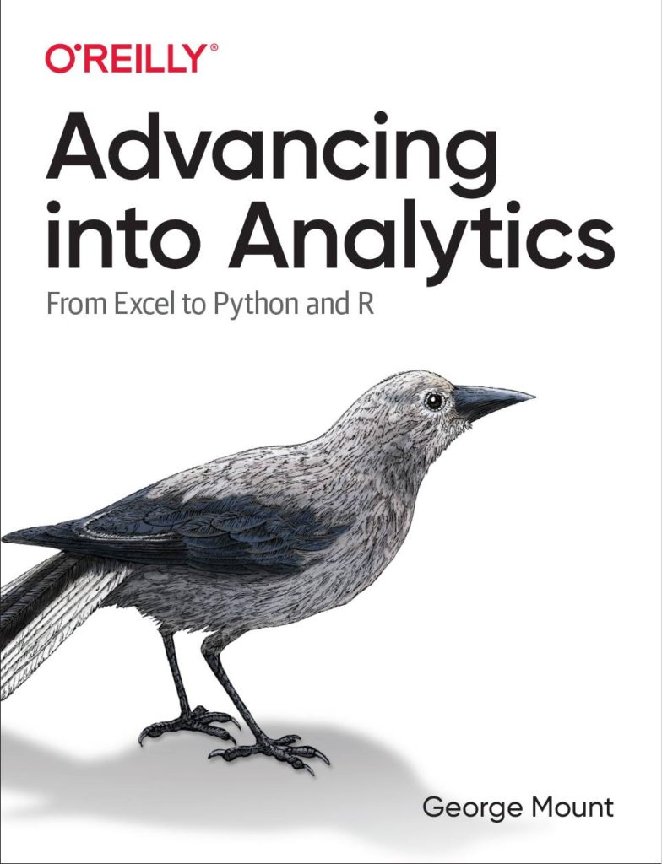

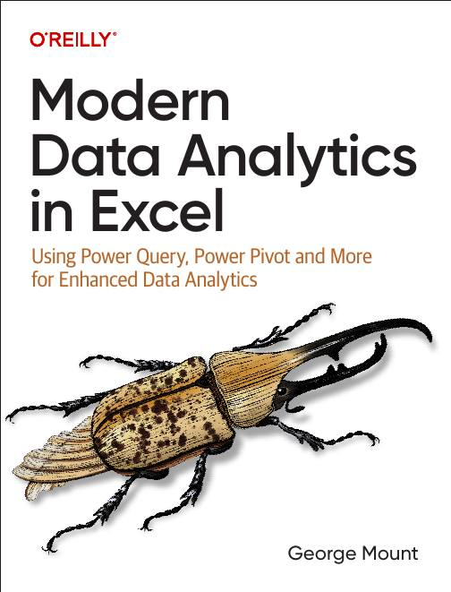


Hi, I’m George

Slide 3

Objectives for today
Build repeatable data cleaning workflows with Power Query
Build relational data models and dashboards straight from Excel with Power Pivot
Use new Excel features like dynamic array functions, AI-powered insights, and Python integration
Notes:
https://globalexcelsummit.com/product/modern-data-analytics-in-excel

Slide 4
Following along
Download the resources: https://swiy.co/xlgs-sep-24

Slide 5
Data Cleaning with Power Query

Slide 6
1.
Build repeatable data cleaning workflows with Power Query
Build relational data models and dashboards straight from Excel with Power Pivot
Use new Excel features like dynamic array functions, AI-powered insights, and Python integration
Notes:
https://globalexcelsummit.com/product/modern-data-analytics-in-excel

Slide 7
AI-Powered Excel

Slide 8
1. AI-Powered Data Manipulation

Slide 9
AI-powered data manipulation
Automating data entry with Flash Fill
Creating a Column by Example in Power Query
Creating a Formula by Example in Excel Online
Joining tables with Fuzzy Matching
File: ai-powered-data-manipulation.xlsx
Notes:
False!
Function, Formula, Function
Argument

Slide 10
AI-powered data manipulation EXERCISE
Using either Flash Fill or Column from Example:
Find the city name from each column (Houston, Atlanta, Los Angeles, etc)
Find the initials for each time (HA, AB, LAD, etc)
File: ai-powered-data-manipulation-exercise.xlsx
Notes:
False!
Function, Formula, Function
Argument

Slide 11

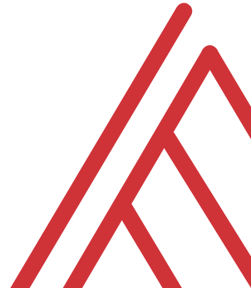

Questions?

Slide 12
2. AI-Powered Data Entry and Forecasting

Slide 13
AI-powered data entry and forecasting
Importing data from picture
Creating forecasts with Forecast Sheet
Enhancing insights with linked data types
File: ai-powered-data-entry-forecasting.xlsx
Notes:
False!
Function, Formula, Function
Argument

Slide 14
AI-powered data entry and forecasting EXERCISE
Create a population forecast for the selected European countries
Enhance your data with linked data types
File: ai-powered-data-manipulation-exercise.xlsx
Notes:
False!
Function, Formula, Function
Argument

Slide 15
Questions?

Slide 16
3. AI-Powered Data Analysis and Visualization

Slide 17
AI-powered data analysis and visualization
Preparing data for Analyze Data
Basics of natural language querying & prompt engineering
File: ai-powered-data-analysis-visualization.xlsx
Notes:
False!
Function, Formula, Function
Argument

Slide 18
AI-powered data analysis and visualization EXERCISE
Prepare data for optimal Analyze Data use
Visualize total state population over time
File: ai-powered-data-analysis-visualization-exercise.xlsx
Notes:
False!
Function, Formula, Function
Argument

Slide 19
Questions?

Slide 20
AI-Powered Excel RECAP
AI in Excel learns over time – try adding more data
When one algorithm doesn’t work, try another
AI isn’t worth much without normalized, “tidy” datasets
Notes:
False!
Function, Formula, Function
Argument

Slide 21
Python in Excel

Slide 22
1. Python in Excel: First Steps

Slide 23
Python in Excel: First steps
Understanding the Python in Excel environment
Loading Excel data into Python
Converting Python objects to Excel values
File: python-excel-first-steps.xlsx
Notes:
False!
Function, Formula, Function
Argument

Slide 24
Python in Excel: First steps EXERCISE
Load the penguins dataset into a DataFrame called penguins_df
Check the resulting dataset’s columns: run penguins_df.columns. Swith the output to display in Excel
Visualize relationship b/w bill length and body mass: run sns.scatterplot(x='bill_length_mm', y='body_mass_g', data=penguins_df). Practice resizing this plot.
File: python-excel-first-steps-exercise.xlsx
Notes:
False!
Function, Formula, Function
Argument

Slide 25
Questions?

Slide 26
2. From “that’s hard in Excel” to “that’s easy in Python”

Slide 27
From “that’s hard in Excel” to “that’s easy in Python” analysis
Data profiling: What is the shape, size, completeness?
Time series: pandas for panel data
Descriptive statistics/EDA: What stories might be told in this data?
File: hard-excel-easy-python-analysis.xlsx
Notes:
False!
Function, Formula, Function
Argument

Slide 28
From “that’s hard in Excel” to “that’s easy in Python” analysis EXERCISE
Explore relationship between sales, temperature, customer count over time
Fill in the blanks to complete the code
File: hard-excel-easy-python-analysis-exercise.xlsx
Notes:
False!
Function, Formula, Function
Argument

Slide 29
Questions?

Slide 30
3. There’s more to Python and Excel than Python in Excel

Slide 31
There’s more to Python and Excel than Python in Excel
Python in Excel is all about data analysis, visualization, statistics & ML
It lacks Excel automation capabilities
Let’s automate an entire Excel workbook from Python… without opening Excel!
File: pae-pie.ipynb
Notes:
False!
Function, Formula, Function
Argument

Slide 32
There’s more to Python and Excel than Python in Excel EXERCISE
Automate production of a workbook comparing website visitors versus rating
Fill in the blanks to create the script
File: pae-pie-exercise.ipynb
Notes:
False!
Function, Formula, Function
Argument

Slide 33
Questions?

Slide 34
Python in Excel RECAP
Python can do some things easier – there’s a reason it’s in Excel now!
Python in Excel for analysis & visualization; openpyxl for everything else
What about AI-powered, Python-powered Excel? Try Anaconda Toolbox
Notes:
False!
Function, Formula, Function
Argument

Slide 35




Thank you!
George Mount
Owner, Stringfest Analytics
stringfestanalytics.com
George Mount
@gjmount

