Slide 1


Modern Data Analytics in Excel
George Mount

Slide 2
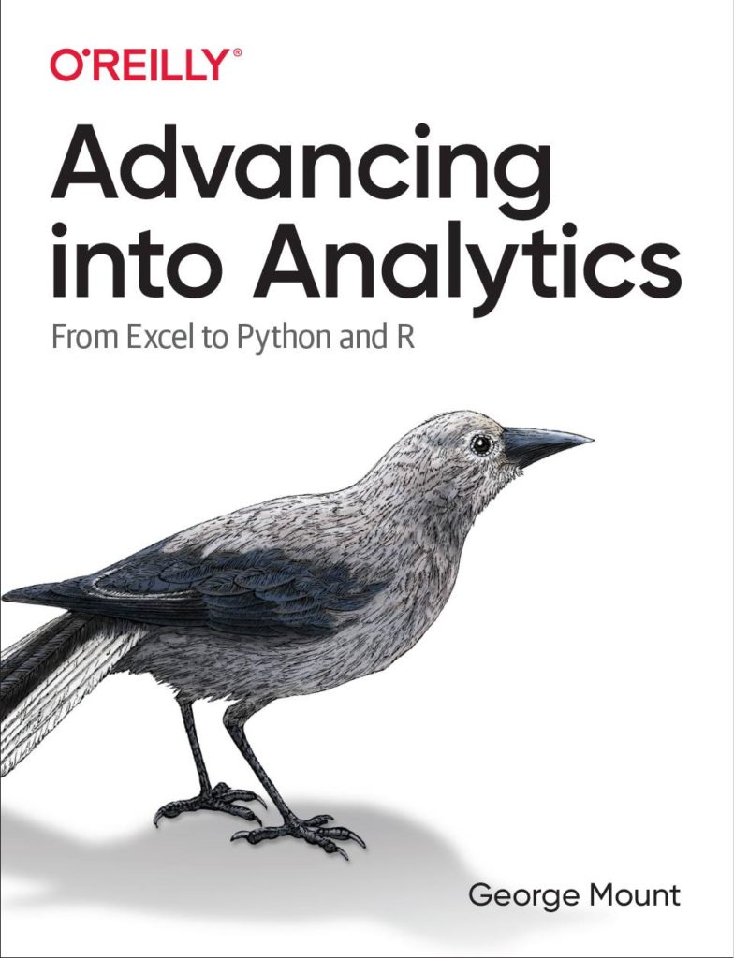

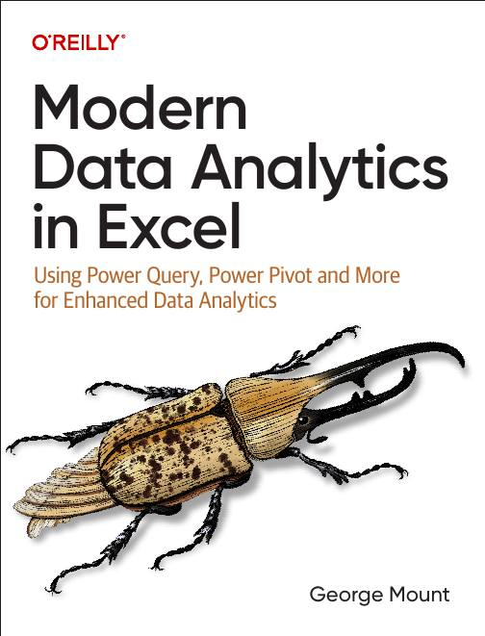


Hi, I’m George

Slide 3

Objectives for today
Build repeatable data cleaning workflows with Power Query
Build relational data models and dashboards straight from Excel with Power Pivot
Use new Excel features like dynamic array functions, AI-powered insights, and Python integration
Notes:
https://globalexcelsummit.com/product/modern-data-analytics-in-excel

Slide 4
Following along
Download the resources: https://swiy.co/xlgs-sep-24

Slide 5



Questions?

Slide 6
Data Cleaning with Power Query

Slide 7
1. First Steps in Power Query
Power Query as Excel’s ETL tool
A tour of Power Query
Data profiling in Power Query
File: first-steps-power-query.xlsx
Notes:
https://globalexcelsummit.com/product/modern-data-analytics-in-excel

Slide 8
First steps in Excel Power Query Exercises
Load the data into Power Query as a table. Name the query computers.
Add an index column starting from 1 to the data.
Rename the previous step in the Applied Steps list as “Added unique identifier.”
Drag-and-drop the Index column so that it is the first column in the dataset.
Use Power Query’s data profiling features to address the following questions. Be sure to adjust column profiling to work on the entire dataset.
What is the range of prices for the computers in the dataset?
What is the average amount of RAM in the dataset?
Are there any missing values in this dataset? If so, where?
Load the query results into an Excel PivotTable.
File: first-steps-power-query-exercises.xlsx

Slide 9
2. Transforming rows in Power Query
Cleaning a roster
Loading & refreshing the results
Splitting data by row
File: transforming-rows-power-query.xlsx
Notes:
https://globalexcelsummit.com/product/modern-data-analytics-in-excel

Slide 10
Transforming rows in Power Query Exercises
On the states worksheet:
Remove the United States row from the data.
Fill down blanks on the region and division columns.
Sort by population from high to low.
Load results into a PivotTable.
On the midwest_cities worksheet:
Load this data into a table where each city is in its own row
File: transforming-rows-power-query-exercises.xlsx

Slide 11
3. Transforming columns in Power Query
Cleaning text
Changing data types
Creating calculated columns
Reshaping data
File: transforming-columns-power-query.xlsx
Notes:
https://globalexcelsummit.com/product/modern-data-analytics-in-excel

Slide 12
Transforming columns in Power Query Exercises
Transform the date column to a month format, such as changing 1/1/2023 to January.
Transform the owner column to proper case.
Split the location column into two separate columns: zip and state.
Reshape the dataset so that subscription_cost, support_cost, and services_cost are consolidated into two columns: category and cost.
Introduce a new column named tax that calculates 7% of the values in the cost column.
Convert the zip variable to the Text data type, and update both cost and tax columns to Currency.
Load the results to a table.
File: transforming-columns-power-query.xlsx

Slide 13
4. Appending and merging in Power Query
Appending multiple sources
Understanding relational joins
Managing & auditing queries
File: Start with a blank Excel workbook
Notes:
https://globalexcelsummit.com/product/modern-data-analytics-in-excel

Slide 14
Appending and merging in Power Query Exercises
Append the ewr-flights.csv, jfk-flights.csv, and lga-flights.csv files, consisting of the flight records from Newark Liberty, John F. Kennedy, and LaGuardia airports, respectively. Name this query flights. (Hint: Select “Three or more tables” from the Append menu in Power Query to expedite this process.)
Merge this query with planes.xlsx using a left outer join, and then an inner join. Call the queries flights_left and flights_inner, respectively. How many records are returned for each? (Hint: Merge the tables based on tailnum).
File: Multiple workbooks

Slide 15
Questions?

Slide 16
Data Modeling and Analysis with Power Pivot

Slide 17
5. First steps with Power Pivot
Power Pivot and the Data Model
A brief tour of the Power Pivot add-in
Power Query vs Power Pivot
File: first-steps-power-pivot.xlsx
Notes:
https://globalexcelsummit.com/product/modern-data-analytics-in-excel

Slide 18
First Steps in Power Pivot Exercises
What is the purpose of the Power Pivot add-in, and what can it enable you to do?
Explain the role of the Data Model in Power Pivot and its significance in data analysis.
What is the basic role of DAX measures and key performance indicators in Power Pivot?
Compare Power Query joins with Power Pivot relationships in terms of combining data sources.
What are the drawbacks of using lookup functions like VLOOKUP() or XLOOKUP() to merge tables in Excel?
File: n/a

Slide 19
6. Creating relational models in Power Pivot
Creating and managing relationships
Understanding cardinality and filter direction
Creating calculated columns with DAX
File: creating-relational-models-power-pivot.xlsx
Notes:
https://globalexcelsummit.com/product/modern-data-analytics-in-excel

Slide 20
Creating Relational Models in Power Pivot Exercises
Load the tables into Power Pivot via Power Query and establish relationships in the Power Pivot Data Model.
Identify fact and dimension tables in the Data Model and organize the model in Diagram View accordingly.
What is the cardinality of the relationships between these tables?
Use the SWITCH() function to generate an is_player column in the hof table. Assign Yes if the category column indicates Player, otherwise assign No.
Create a hierarchy among the birthCountry, birthState, and birthCity fields in the people table.
Load the Data Model results into an Excel PivotTable. Count the number of players. You can do this by totaling the number of playerIDs that have Yes in the is_player column
File: creating-relational-models-power-pivot-exercises.xlsx

Slide 21
7. Creating measures and KPIs in Power Pivot
Creating measures with DAX
Implicit vs explicit measures
Creating KPIs
File: creating-measures-kpis-power-pivot.xlsx
Notes:
https://globalexcelsummit.com/product/modern-data-analytics-in-excel

Slide 22
Creating Measures and KPIs in Power Pivot Exercises
Create a PivotTable to present the total number of home runs (HR) by birth state (birthState) using an implicit measure.
Remove the implicit measure created in step 1 and establish a new explicit measure named hr_total that computes the sum of home runs, formatted as a whole number in thousands. Add this measure to the PivotTable.
Generate another explicit measure named hr_pct that calculates the percentage of total home runs (HR) out of total at bats (AB) from the batting table. Format the result as a percentage. Feel free to create an additional total at bats measure to assist with this.
Develop a KPI based on the metric hr_pct aiming for a target absolute value of 1. Use the following status thresholds:
Less than 2%: Red status
Between 2% and 3%: Yellow status
Greater than 3%: Green status
Apply the KPI to a PivotTable that displays teamID along the Rows and yearID along the Columns.
File: creating-measures-kpis-power-pivot-exercises.xlsx

Slide 23
8. Intermediate DAX for Power Pivot
Modified filter context with CALCULATE()
Time intelligence functions
File: intermediate-dax-power-pivot.xlsx
Notes:
https://globalexcelsummit.com/product/modern-data-analytics-in-excel

Slide 24
Intermediate DAX for Power Pivot Exercises
Load the data into Power Pivot via Power Query and create the following measures:
accessories_rev: Returns the total revenue when product_category is set to Accessories.
accessories_rev_aus: Returns the total revenue when both product_category is Accessories and country is Australia.
aov_all: Calculates the total revenue divided by the total order quantity across the entire dataset, irrespective of applied filters.
profit_margin_ytd: Returns the year-to-date profit margin.
profit_margin_ly_ytd: Returns the year-to-date profit margin for the previous year
File: intermediate-dax-power-pivot-exercises.csv

Slide 25
Questions?

Slide 26
The Excel Analytics Toolkit

Slide 27
9. Introducing dynamic array functions
Arrays, dynamic arrays, and dynamic array functions
Finding unique and distinct values with UNIQUE()
Filtering records with FILTER()
Sorting records with SORTBY()
Creating modern lookups with XLOOKUP()
File: introducing-dynamic-array-functions.xlsx
Notes:
https://globalexcelsummit.com/product/modern-data-analytics-in-excel

Slide 28
Introducing dynamic array functions Exercises
Find the distinct and truly unique values in the make column of the vehicles dataset. How many are there of each?
Display only the vehicles with city mileage greater than 30.
Display only the vehicles where either the city mileage is greater than 30, or where both cylinders are less than 6 and fuel is Regular.
Sort the vehicles dataset in descending order based on the highway mileage.
Sort just the model column of the common dataset based on the years column, descending.
Add the years column from the common dataset to the vehicles dataset. Return Not reported if a match is not found.
File: introducing-dynamic-array-functions-exercises.xlsx

Slide 29
10. Augmented analytics and the future of Excel
Analyze Data for AI-powered insights
OCR with Data from Image
Sentiment analysis with Azure Machine Learning
File: augmented-analytics-future-excel.xlsx
Notes:
https://globalexcelsummit.com/product/modern-data-analytics-in-excel

Slide 30
Augmented analytics and the future of Excel Exercises
Perform sentiment analysis on a dataset of movie reviews located in the imdb worksheet using the Azure Machine Learning add-in. Afterwards, apply the XLMiner add-in to generate descriptive statistics for the obtained scores.
Import the life_expectancy.png image into Excel. Use the Analyze Data feature to produce a line chart that illustrates the average life expectancy over time. It might be necessary to adjust the data format to achieve this.
File: augmented-analytics-future-excel-exercises.xlsx

Slide 31
11. Python with Excel
Understanding the Python in Excel environment
Loading Excel data into Python
Converting Python objects to Excel values
File: python-with-excel.xlsx
Notes:
https://globalexcelsummit.com/product/modern-data-analytics-in-excel

Slide 32
Python with Excel exercises
Load the penguins dataset into a DataFrame called penguins_df
Check the resulting dataset’s columns: run penguins_df.columns. Switch the output to display in Excel
Visualize relationship b/w bill length and body mass: run sns.scatterplot(x='bill_length_mm', y='body_mass_g', data=penguins_df). Practice resizing this plot.
File: python-with-excel-exercises.xlsx
Notes:
False!
Function, Formula, Function
Argument

Slide 33
Questions?

Slide 34




Thank you!
George Mount
Owner, Stringfest Analytics
stringfestanalytics.com
George Mount
@gjmount

