Slide 1

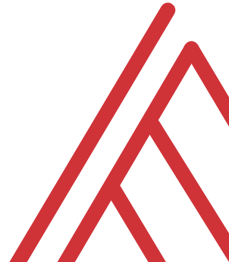

Building Practical AI Agents and Workflows for Excel

Slide 2
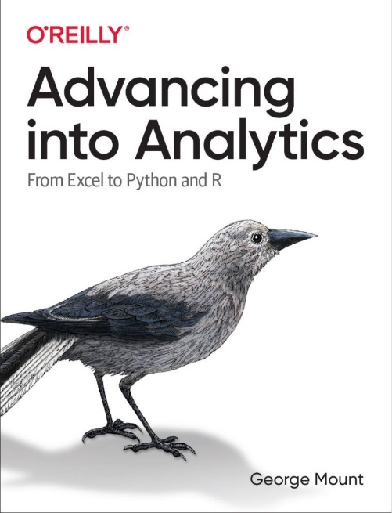
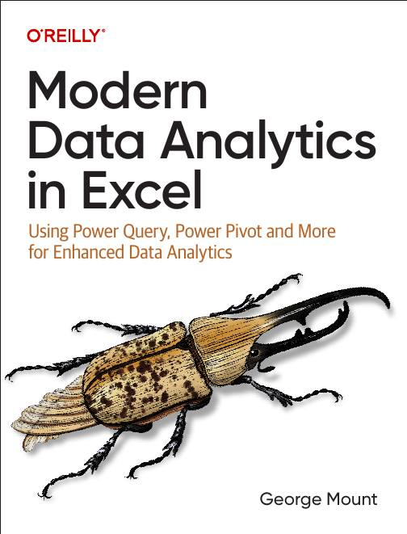

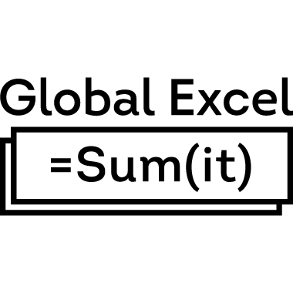


About me
I help Excel users move from fragile spreadsheets
to confident, scalable analysis.

Slide 3

Objectives for this session
Evaluate where AI agents meaningfully improve structured Excel reporting workflows
Build an expense report agent that classifies receipt data directly into Excel
Automate a monthly variance deck with Copilot and Power Automate, including executive-ready commentary
Implement validation steps with Office Scripts to improve trust and auditability of AI outputs

Slide 4
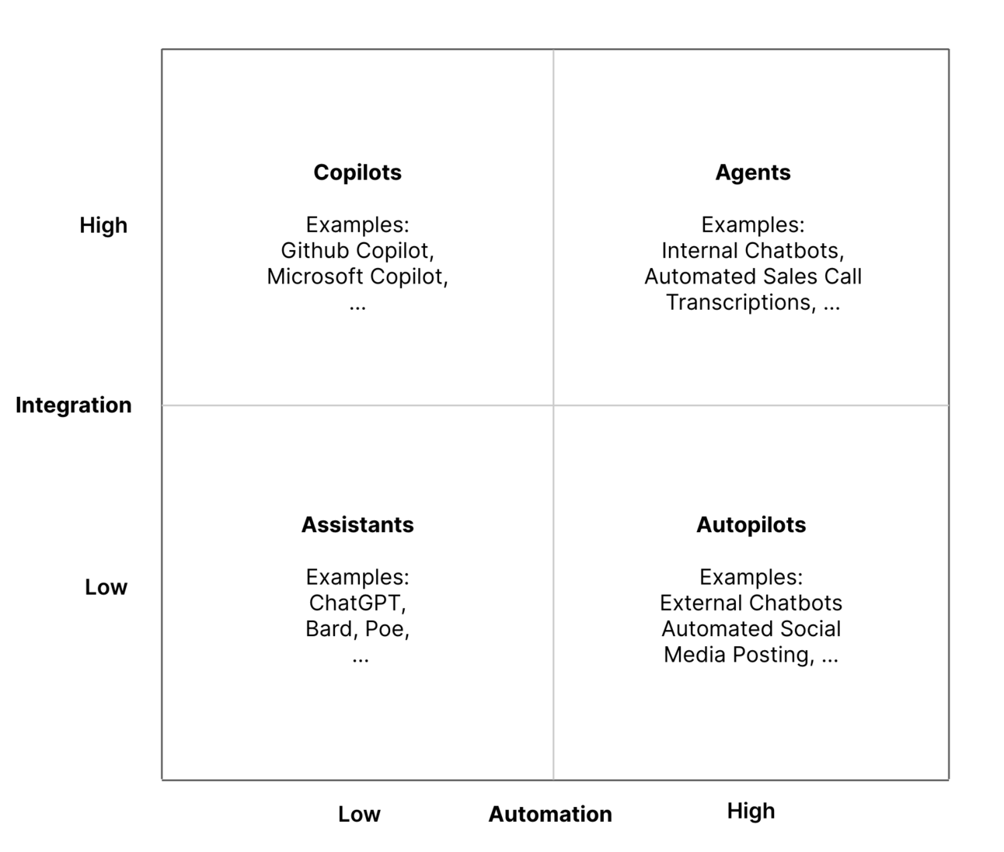
The integration-automation AI framework
https://blog.tobiaszwingmann.com/p/integration-automation-ai-framework
Notes:
This framework helps make sense of all the vocabulary we’ve been talking about. Instead of treating “copilots” and “agents” as fuzzy marketing terms, it breaks things down by two dimensions: how integrated the tool is with your systems, and how much automation it can actually perform.
In the top left, you have copilots. They’re highly integrated because they sit inside your existing apps, but they still rely on you to drive the workflow. They improve your work, but they don’t take it over.
On the right, you have agents. They combine that same level of integration with the ability to take multi-step actions on their own. So they’re not just responding to you, they’re actually completing tasks across systems.
Below that, you have assistants and autopilots. These are less connected to your internal data and tools, even if some of them can automate quite a bit.
The main idea here is that Excel is moving from the “copilot” box toward the “agent” box. That’s why everything suddenly feels like it’s changing. It isn’t just giving you answers anymore — it’s starting to orchestrate real work.

Slide 5
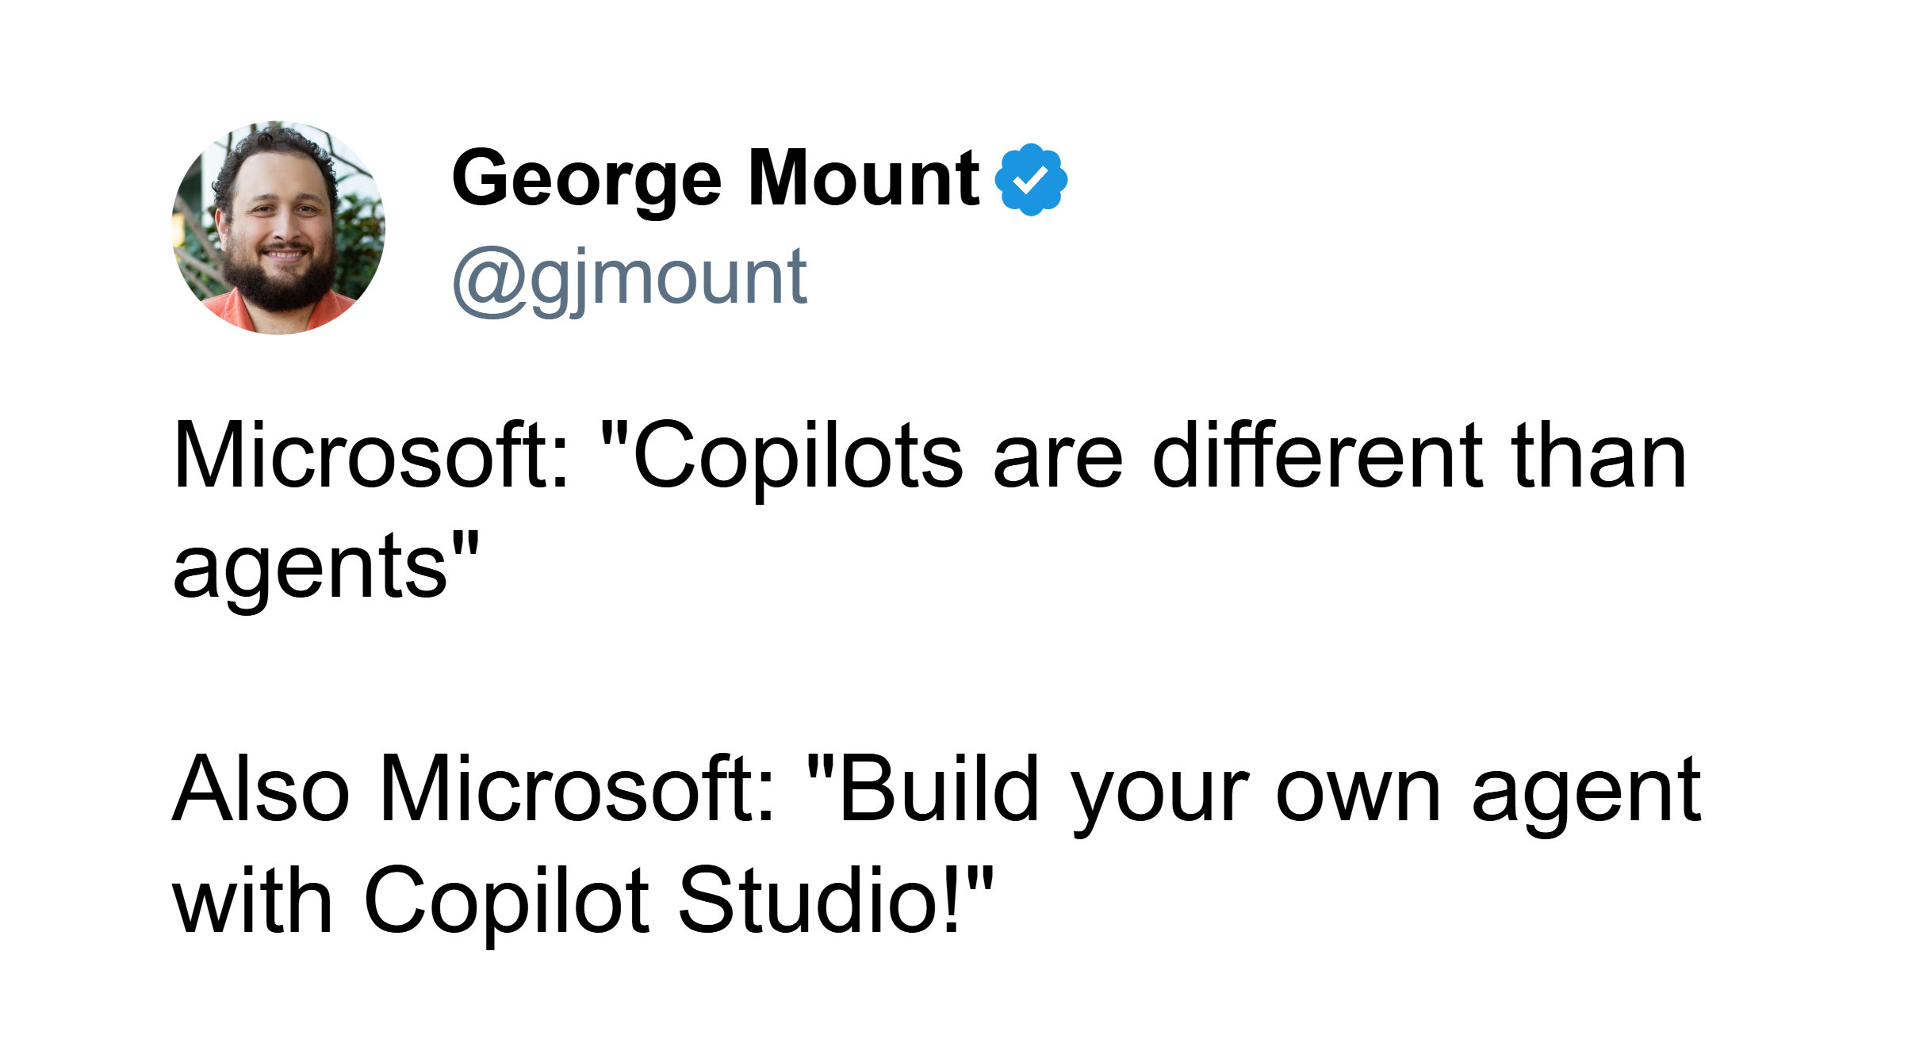
Copilots, agents, apps… oh my!

Slide 6
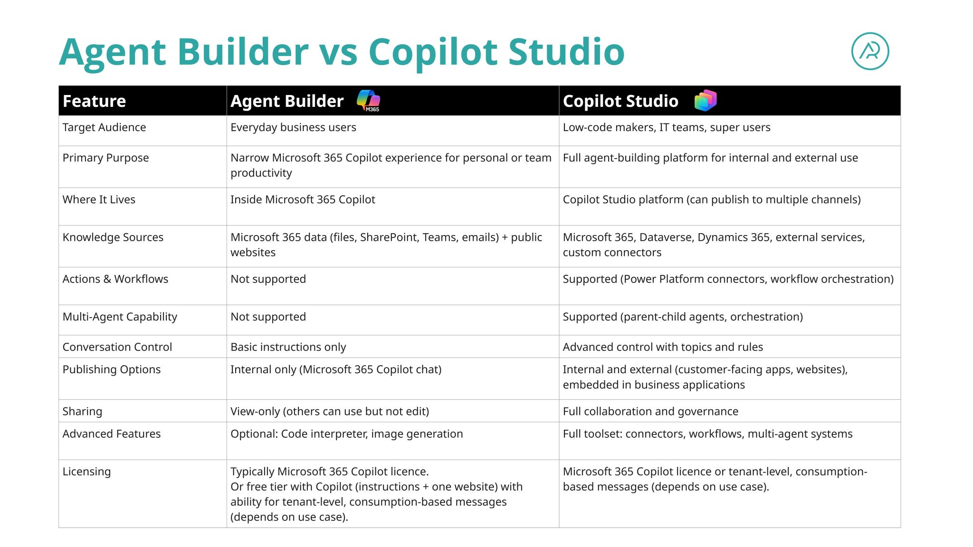
https://www.linkedin.com/posts/hamishsheild_recently-ive-been-working-with-teams-who-activity-7432532796482695168-gTbp?utm_source=share&utm_medium=member_desktop&rcm=ACoAAATCK8AB8LEMRRQ353gE1bukLsTb6mY_Zbg
Notes:
This framework helps make sense of all the vocabulary we’ve been talking about. Instead of treating “copilots” and “agents” as fuzzy marketing terms, it breaks things down by two dimensions: how integrated the tool is with your systems, and how much automation it can actually perform.
In the top left, you have copilots. They’re highly integrated because they sit inside your existing apps, but they still rely on you to drive the workflow. They improve your work, but they don’t take it over.
On the right, you have agents. They combine that same level of integration with the ability to take multi-step actions on their own. So they’re not just responding to you, they’re actually completing tasks across systems.
Below that, you have assistants and autopilots. These are less connected to your internal data and tools, even if some of them can automate quite a bit.
The main idea here is that Excel is moving from the “copilot” box toward the “agent” box. That’s why everything suddenly feels like it’s changing. It isn’t just giving you answers anymore — it’s starting to orchestrate real work.

Slide 7
Demo 1: Expense account agent
Build a Copilot agent that converts PDF receipts into a structured Excel expense report
Write clear, rule-based instructions to control AI behavior and output format
Use a restricted knowledge source to ensure consistent expense classification
Generate a properly structured Excel table automatically.
Resource: https://stringfestanalytics.com/how-to-create-an-expense-report-agent-with-copilot-365/
Notes:
While we can run a prompt in Power Automate to extract receipt data and push it into Excel, that approach starts to break down pretty quickly. It works fine if the inputs are clean and consistent, but receipts aren’t. The formats vary, the fields aren’t always obvious, and the classification piece especially requires some interpretation.
An agent is better here because this isn’t just extraction, it’s decision-making. We need something that can look at messy input, apply rules, and make consistent calls about how to categorize and structure the data. That’s hard to lock down in a simple workflow without a lot of brittle logic.
The other big reason is consistency. With a workflow prompt, you might get slightly different outputs each time. An agent, especially with a restricted knowledge source like a chart of accounts, keeps everything aligned. It’s operating within defined boundaries, not just generating answers.
So this is a good example of where a workflow can technically do the job, but an agent does it reliably—because it combines rules, context, and structure in a way a one-off prompt just doesn’t.

Slide 8
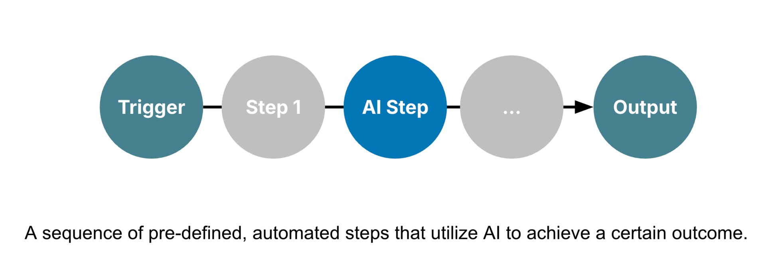
Automated AI workflows with Power Automate + Copilot
Source: https://blog.tobiaszwingmann.com/p/ai-workflows-vs-ai-agents-vs-everything-in-between
Notes:
This diagram shows what an automated AI workflow looks like — a sequence of predefined steps that move from a trigger to a final output. You can think of it as a chain reaction: something starts the process, different actions happen automatically, and along the way, AI steps in to add intelligence or decision-making.
It all begins with a trigger — something that tells the workflow to start. In Excel or Power Automate, that could be a new row added to a table, a file uploaded to OneDrive, or even a scheduled time like “every Monday morning.” The trigger is what kicks everything off without you having to manually do anything.
Then we have Step 1, which is often a preparation step. Maybe it’s collecting the data, formatting it, or sending it into Excel. This could be where Power Automate connects to a SharePoint list, a form submission, or a Teams message and feeds that data into your workbook.
Next comes the AI Step — this is where Copilot or another AI model gets involved. This could be an AI Builder action inside Power Automate that summarizes text, classifies feedback, or extracts key details from a document. Or it might be Copilot inside Excel generating a formula, building a chart, or explaining data patterns automatically. The AI step takes what used to be manual analysis and turns it into an automated, intelligent action.
After that, there can be more steps — maybe sending results back to Excel, notifying someone in Teams, or updating a dashboard. Each step builds on the last, flowing seamlessly without human intervention.
Finally, we reach the output, which is the end goal of the automation. That might be a refreshed Excel report, an email summary, or a new dataset ready for review. The beauty of it is that the whole process runs automatically once it’s designed — no constant copying, pasting, or checking formulas.
So, in short, this kind of workflow connects automation tools like Power Automate with AI capabilities from Copilot or AI Builder to take everyday Excel tasks — things like reporting, data cleaning, or summarizing — and turn them into intelligent, repeatable processes.

Slide 9
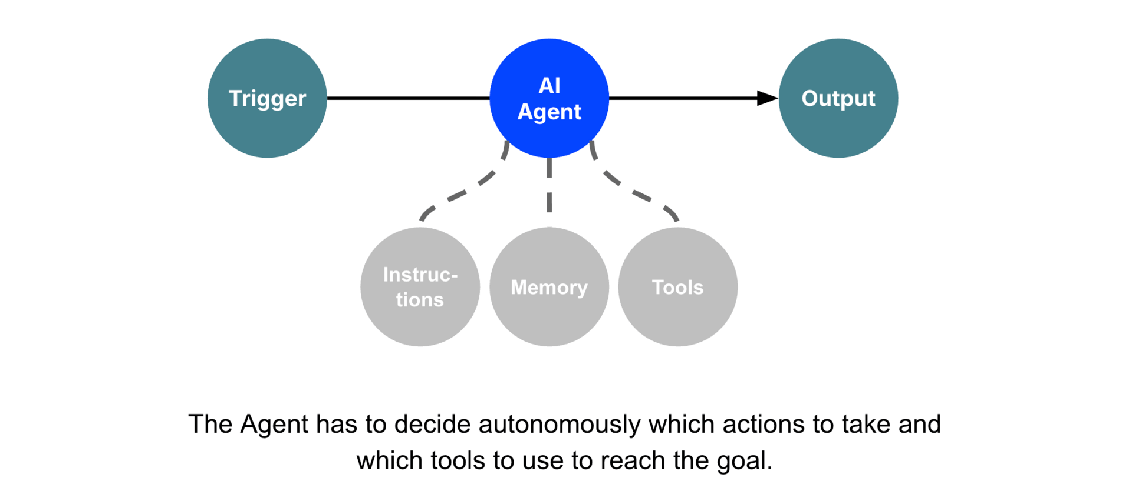
Agentic workflows with Copilot Studio + Agent Flows
Source: https://blog.tobiaszwingmann.com/p/ai-workflows-vs-ai-agents-vs-everything-in-between
Notes:
This diagram shows the core idea behind an agentic workflow. Everything starts with a trigger. That could be a scheduled time, a user action, an event in another system, or even a message. Once the trigger fires, control passes to the AI agent.The agent’s job is to figure out the steps needed to reach the goal. And the important part is that the agent isn’t just following a script. It can draw on three things: the instructions you gave it, the memory it has access to, and the tools it’s allowed to use. Those might include connectors, APIs, retrieval sources, or actions in Power Automate.From there, the agent decides which actions to take and in what order. It keeps adjusting based on the context it sees, and it keeps working until it produces an output. That output might be a document, a dataset, a message, an update in a system, or something else entirely.So even though we’re building this in Copilot Studio, the workflow here is very agent-like. It’s not just a single prompt. It’s a goal-directed system that figures out the how on its own.

Slide 10
Demo 2: Month-end variance deck flow
Build a Power Automate flow that connects Excel data to a PowerPoint reporting template
Write a structured Copilot prompt to calculate variance metrics and generate executive-ready commentary
Pass files dynamically into prompts using Base64 encoding and Power Fx expressions
Automatically generate and save an updated variance deck for month-end reporting.
Resource: https://stringfestanalytics.com/how-to-automate-a-monthly-variance-deck-with-power-automate-and-copilot/
Notes:
False!
Function, Formula, Function
Argument

Slide 11
Demo 3: Validate AI-generated sales report with Office Scripts
Build an Office Script that retrieves and returns a control total from a named range
Configure a Power Automate flow to compare AI-generated KPIs against independently calculated results
Implement a conditional checkpoint that halts reporting if totals do not match
Deliver validated results to Teams using structured JSON and Adaptive Cards for executive-ready presentation
Resource: https://stringfestanalytics.com/how-to-validate-ai-generated-excel-reports-with-office-scripts/
Notes:
False!
Function, Formula, Function
Argument

Slide 12

Learn more with the AI-Powered Excel Blueprint
Get it for free:
https://stringfestanalytics.com/subscribe/

Slide 13
Questions?

Slide 14
Thank you

