Slide 1


Becoming a Citizen Developer with the Power Platform
George Mount

Slide 2
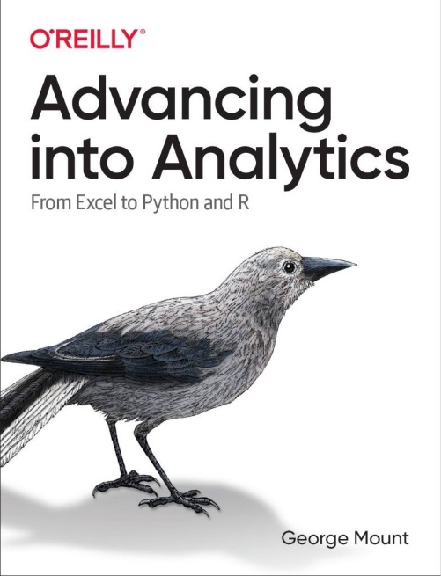
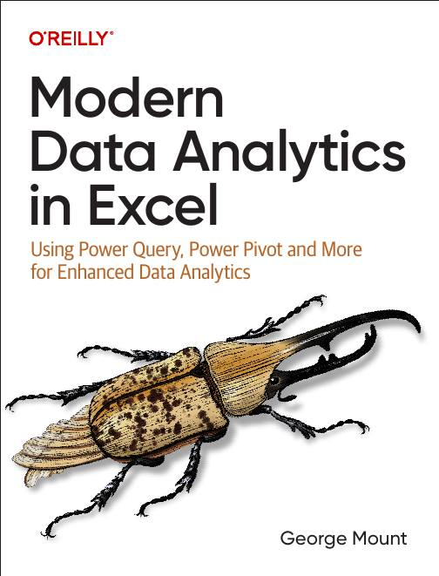



Hi, I’m George

Slide 3

Objectives for this course
Understand how Excel connects with Power Automate, Power Apps, Power BI, and Copilot Studio to create end-to-end workflows
Build trigger-based flows to automate common Excel tasks and send real-time notifications through Teams or Outlook
Create low-code dashboards and apps that update automatically and streamline reporting
Use Copilot Studio and Power Fx to add natural language automation and chatbot capabilities
Notes:
So here's what we're going to cover today. The goal is to show you how your existing Excel skills connect directly to four tools in the Power Platform. We'll build real workflows, real dashboards, a real app, and even a chatbot — all starting from Excel data. By the end, you should feel confident picking up any of these tools on your own and applying them at work.

Slide 4
Resources
Download at https://github.com/stringfestdata/gxls-power-platform/archive/refs/heads/main.zip
Notes:
Before we get started, go ahead and download the course files from this link if you haven't already. It's a ZIP file from GitHub. Unzip it and upload the folder to your OneDrive or SharePoint — we'll be connecting to those files throughout the day.

Slide 5
Automating tasks with Power Automate

Slide 6
First steps with Power Automate

Slide 7
First flow with Power Automate
Use Power Automate templates for Excel
Create clock in/clock out workflow
File: first-flow.xlsx
Notes:
We're going to start with something simple — building our first flow using a Power Automate template. Templates are pre-built flows you can customize. We'll set up a clock in, clock out workflow that reads from an Excel table. Open the first-flow workbook and let's walk through this together.

Slide 8
Customizing outputs with Power Fx
Continue with the previous example
How can we improve appearance of outputs in Excel?
Resource: https://stringfestanalytics.com/power-automate-for-excel-how-to-understand-the-power-fx-programming-language/
Notes:
Now that we have a working flow, let's make the output look better. Power Fx is the formula language behind Power Platform — think of it like Excel formulas but for flows and apps. We'll use it to format dates, combine text, and clean up the messages our flow sends. If you've written an IF or CONCATENATE in Excel, you already know the basics.

Slide 9
Building flows with Copilot
Get AI assistance to build a flow
Create a monthly email/post to Teams based on data in a workbook
File: power-automate-copilot.xlsx
Resource: https://stringfestanalytics.com/power-automate-for-excel-how-to-build-flows-with-copilot/
Notes:
Here's where things get interesting. We're going to use Copilot inside Power Automate to build a flow using plain English. You describe what you want, and Copilot generates the flow for you. We'll create a monthly flow that pulls data from a workbook and posts a summary to Teams. It won't be perfect on the first try, but it gets you eighty percent of the way there — and then you fine-tune.

Slide 10
Exercises
Build on the clock in/clock out workflow
Task: Modify the flow to prompt users for comments when clocking in or out
Add the comment prompt where the in/out criteria is built with a yes/no checkbox
Save the clock in/out data, including comments, to the worksheet
Post an update to Teams with details (who clocked in/out, time, and comments)
File: first-steps-exercises.xlsx
Notes:
Alright, time for you to try it. Take the clock in, clock out flow we just built and extend it. You're going to add a comment prompt so users can add notes when they clock in or out. Save that data back to the worksheet, and post an update to Teams with all the details. Take about ten minutes on this. I'll be walking around if you get stuck.

Slide 11

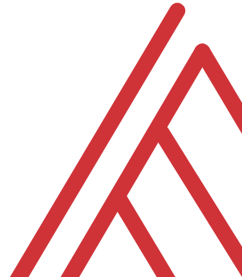

Questions?

Slide 12
Building and managing Excel-related flows

Slide 13
Automating Excel entry with Power Automate
Add summary of all incoming manager’s emails into a workbook
File: automate-excel-entry.xlsx
Resource: https://stringfestanalytics.com/how-to-track-incoming-emails-in-excel-with-power-automate/
Notes:
Let's look at a really common use case — automatically logging incoming emails into an Excel workbook. We'll set up a flow that triggers whenever a new email arrives from a specific sender, extracts the key details, and adds a row to our tracking spreadsheet. This is the kind of thing that saves you twenty minutes a day if you're doing it manually.

Slide 14
Creating conditional flows
Create emails only when project is delayed
Test flow and put on schedule
File: conditional-logic.xlsx
Resource: https://stringfestanalytics.com/power-automate-for-excel-how-to-understand-conditional-flows/
Notes:
Not every email needs the same response, right? So now we're adding conditional logic. We'll create a flow that only sends notifications when a project status is delayed. We'll test it, then put it on a schedule so it runs automatically. This is where Power Automate starts feeling really powerful — you set it and forget it.

Slide 15
Office Scripts + Power Automate, part 1
Run a TOC updater script on schedule
Files: power-automate-office-scripts.xlsx, add-toc.txt
Resource: https://stringfestanalytics.com/how-to-get-started-with-power-automate-for-excel/
Notes:
Now we're combining two tools — Office Scripts and Power Automate. Office Scripts let you write small TypeScript programs that run inside Excel. We'll use one that automatically builds a table of contents for any workbook, and then schedule it with Power Automate so it runs on its own. Open the power-automate-office-scripts workbook and the add-toc text file.

Slide 16
Office Scripts + Power Automate, part 2
How can we apply the same script to multiple workbooks?
Use conditional logic to validate filetype
Folder: multiple-workbooks
Resource: https://stringfestanalytics.com/how-to-run-an-office-script-on-all-excel-workbooks-in-a-folder-with-power-automate/
Notes:
What if you need to run that same script on multiple workbooks? That's what we're tackling here. We'll loop through a folder of Excel files and apply our TOC script to each one. We'll also add a check to make sure we're only processing Excel files and skipping anything else in the folder. Open the multiple-workbooks folder.

Slide 17
Exercises
Folder: pa-challenge
Task: Create a log in file-log.xlsx every time a workbook is uploaded to incoming-files folder
Trigger: When a file is created (properties only)
Use conditional logic for file type
Consider using Power Fx to format upload date
Notes:
Here's your next exercise. In the pa-challenge folder, you'll find a file-log workbook and an incoming-files folder. Your job is to create a flow that logs every new workbook uploaded to that folder. Use the 'when a file is created' trigger, add conditional logic to check the file type, and consider using Power Fx to format the upload date. Take about ten minutes.

Slide 18
Advanced Flow Configuration

Slide 19
Creating an expense approval process
Create and track expense approval process using Forms, Excel and Power Automate
File: expense-approval.xlsx
Resource: https://stringfestanalytics.com/power-automate-for-excel-how-to-create-an-approval-process-with-microsoft-forms/
Notes:
Approval workflows are one of the most popular uses for Power Automate in organizations. We're going to build one that connects Microsoft Forms to Excel and Power Automate. When someone submits an expense, the flow sends an approval request. The response gets logged back into the workbook. This is a complete end-to-end process.

Slide 20
Retrieving data from external sources
How can we check and collect data from outside sources, e.g. RSS feeds?
Power Automate vs Power Query for data collection
Fils: get-rss.xlsx, bbc-rss.txt
Resource: https://stringfestanalytics.com/power-automate-for-excel-how-to-work-with-rss-feeds/
Notes:
Power Automate can also pull data from outside sources. We'll use an RSS feed from the BBC as an example — the flow checks for new articles and logs them into an Excel workbook. This is a good comparison point with Power Query: Power Query is great for scheduled data pulls, but Power Automate can react in real time and do things like send notifications when new data arrives.

Slide 21
Exercises
Create a customer feedback review process
Start with: “When a new response is submitted > Get response details”
Add a conditional operation: if the "Overall Experience" score is 4 stars and up, email the recipient thanking them for their business. If it's less, email the recipient apologizing and also send an email notification to a manager.
Use Power Automate to convert feedback score to text with INT() function
Feel free to use Copilot for help!
Notes:
Last exercise for the Power Automate section. You're going to build a customer feedback review process. Start with a Forms trigger, add conditional logic based on the experience score, and send different emails depending on whether the feedback is positive or negative. Feel free to use Copilot to help you build this one — that's what it's there for.

Slide 22
Questions?

Slide 23
Building interactive dashboards with Power BI

Slide 24
Loading, profiling and transforming data
Using Power Query in Power BI:
Read in workbook data
Profile, explore and transform the data via
Folder: 1-load-worksheet-to-power-bi
Notes:
Alright, switching gears to Power BI. If you've used Power Query in Excel, this is going to feel familiar. We'll load a worksheet into Power BI Desktop, profile the data to check for quality issues, and do some basic transformations. The Power Query experience in Power BI is almost identical to Excel — same interface, same M language under the hood.

Slide 25
Load Excel data model to Power BI
Port a Power Pivot data model into Power BI
Strengths, weaknesses, limitations
Folder: 2-load-data-model-to-power-bi
Notes:
If you've already built a data model in Excel with Power Pivot, you don't have to start from scratch in Power BI. We can import your existing data model directly. I'll show you how, and we'll talk about the strengths and limitations of this approach — it works well for getting started quickly, but there are some things that don't carry over perfectly.

Slide 26
Creating interactive dashboards and reports
Continue with penguins dataset
Creating interactive reports with Power BI
Slicers/Timelines
Cross filter functionality
Additional plot functionality vs Excel
Folder: 3-creating-interactive-visuals
Notes:
Now for the fun part — building interactive visuals. We'll use the penguins dataset to create charts, add slicers and timelines, and see how cross-filtering works — where clicking on one chart filters all the others automatically. This is where Power BI really shines compared to Excel — the interactivity is built in.

Slide 27
Exercises
For all data since 1970:
Create stolen base percentage measure: SUM(SB) / (SUM(SB) + SUM(SC))
Compare SBP over time by league
Compare relationship between runs (R) and wins (W)
Add a timeline-based slicer to the report
Folder: 4-power-bi-challenge
Notes:
Time for the Power BI exercise. You're working with baseball data here. For all records since 1970, create a stolen base percentage measure using DAX, compare that metric over time by league, look at the relationship between runs and wins, and add a timeline slicer. The solution file is in the folder if you need it.

Slide 28
Questions?

Slide 29
Designing simple business apps with Power Apps

Slide 30
Creating a Power App from Excel
Upload Excel table to Power Apps
Create basic three-screen app
Add and edit records
Preview app in development
File: first-power-app.xlsx
Notes:
Power Apps lets you turn an Excel table into a working mobile app in minutes. We'll upload our Excel data, and Power Apps will automatically generate a three-screen app — a browse screen, a detail screen, and an edit screen. You can add records, edit them, and preview everything right in the browser.

Slide 31
Modifying your Power App
Continuing with our example:
Adding required fields
Creating data validation dropdowns
Creating data validation on date ranges
Notes:
The auto-generated app is a good start, but you'll want to customize it. We'll add required fields so users can't submit incomplete data, create dropdown menus for data validation, and add date range validation to prevent impossible entries. These small touches make the difference between a prototype and something people actually use.

Slide 32
Deploying your Power App
Continuing with our example:
Preparing Excel workbook for external use
Migrating our app from development to production via ZIP folder
Notes:
Once your app works in development, you need to deploy it. We'll prepare the Excel workbook for external use — making sure it's stored in the right place — and then export the app as a ZIP file for migration. This is the process you'd follow to move an app from a test environment to production.

Slide 33
Creating a Power App with images
Folder: power-apps-challenge
Turn this into an app with photos!
Use image URLs to populate values
Notes:
For this challenge, you're going to build an app that includes images. The power-apps-challenge folder has an Excel file with image URLs and some photos. Your job is to create an app where users can see the photos alongside the data. This is common for things like maintenance tracking, inventory, or inspection apps.

Slide 34
Questions?

Slide 35
Creating chatbots with Copilot Studio

Slide 36
Creating an Excel MVP chatbot
Create a custom Copilot agent in Copilot Studio tailored for specific Excel-related use cases
Add and manage trusted knowledge sources (like MVP websites) to ensure high-quality, domain-specific responses
Test and publish the agent with simple topics added
File: mvp-knowledge-base-instructions.docx
Notes:
Our last tool is Copilot Studio, which lets you build custom AI chatbots. We'll create a chatbot that answers Excel questions using MVP websites as its knowledge base. You'll add trusted sources, set up the agent's instructions, and test it with some real questions. Open the mvp-knowledge-base-instructions document for the setup details.

Slide 37
Exercise: Create an Excel keyboard shortcut chatbot for Teams
Create a chatbot that helps users find Excel keyboard shortcuts, using only the provided “Excel keyboard shortcuts” cheat sheet as its knowledge base
Edit the “goodbye” topic to replace the default response (“okay, goodbye”) with a more engaging sign-off like “Keep on excelling,” then save and test
Publish the chatbot and launch it in Microsoft Teams to see it running inside an external app
Folder: copilot-studio-exercise
Notes:
For the exercise, you'll build a chatbot that helps people find Excel keyboard shortcuts. The knowledge base is just a simple Excel workbook with shortcut data. You'll also customize the goodbye topic to give it some personality, and then publish it to Microsoft Teams so you can see it running inside a real app. The instructions are in the copilot-studio-exercise folder.

Slide 38
Questions?

Slide 39
Pulling it all together
Power Platform extends Excel into automation, dashboards, apps, and AI — start with the tool that solves your biggest pain point
Combine components for end-to-end workflows: collect data in Power Apps, automate with Power Automate, visualize in Power BI
Use governance and sharing best practices when deploying flows, apps, and reports across your organization
Keep experimenting with free trials and Copilot to grow into a Power Platform champion in your organization
Notes:
Let's step back and look at the big picture. Today you've used four different Power Platform tools, all connected to Excel data. The key takeaway is you don't need to learn everything at once. Pick the tool that solves your biggest headache right now — maybe that's automating a repetitive task with Power Automate, or replacing a static report with a live Power BI dashboard. Start there, get comfortable, and then branch out. And remember, governance matters — share your flows and apps responsibly, use proper naming conventions, and document what you build so your team can maintain it. You're all well on your way to being Power Platform champions. Thanks for a great session.

Slide 40
THANK YOU

