Slide 2
Write Python code in a .py script
Python compiles the source code into bytecode .pyc files
Python virtual machine converts bytecode into machine code
Machine code is executed on computer and program produces output

Slide 3
Real dataset
Real samples
Discriminator
Generator loss
Random input
Synthetic data generator
Synthetic samples
Discriminator loss

Slide 4
Input
Output
Latent space
Encoder
Decoder

Slide 5




Slide 6


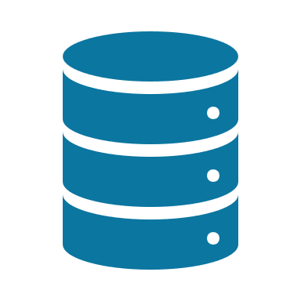

up.sql
down.sql
Migrate up
Old schema New schema
Migrate down

Slide 7
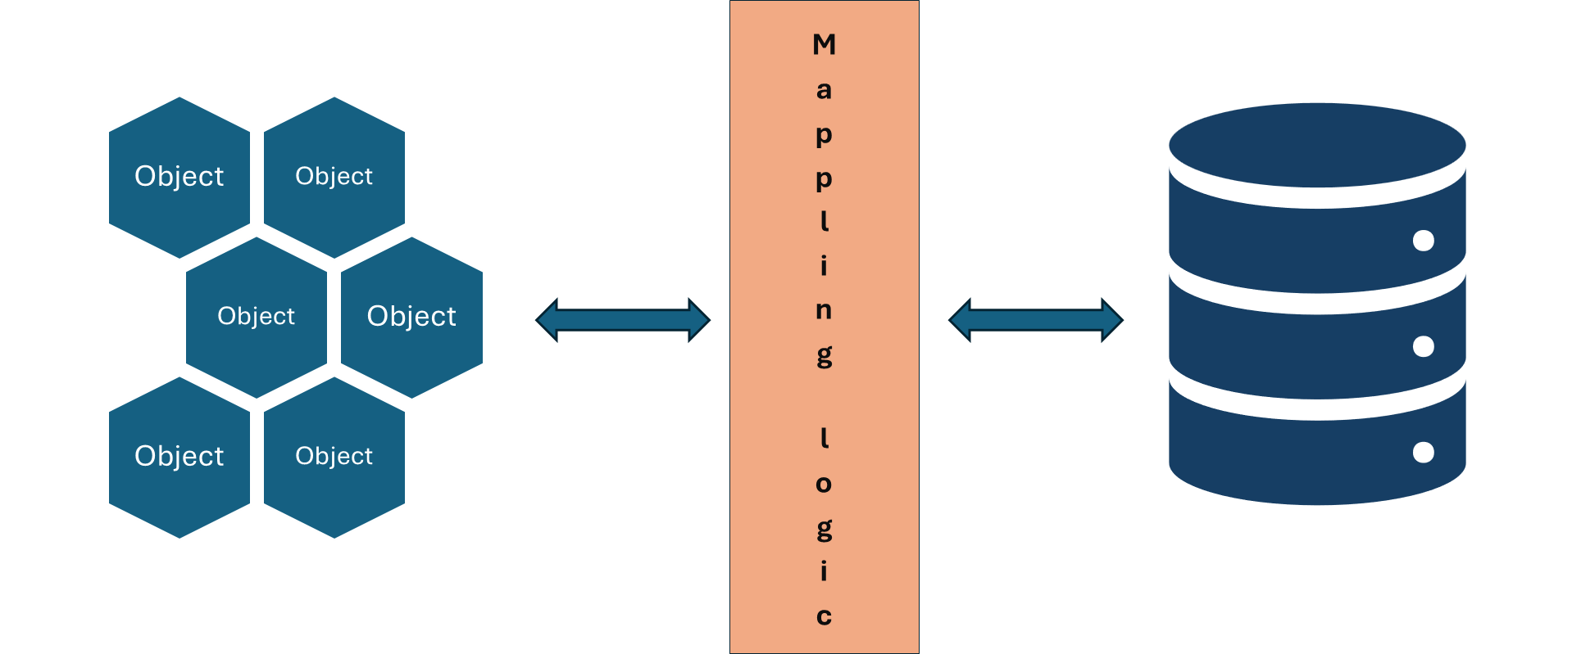

Object
Object
Object
Object
Object
Object
Mappling logic

Slide 8
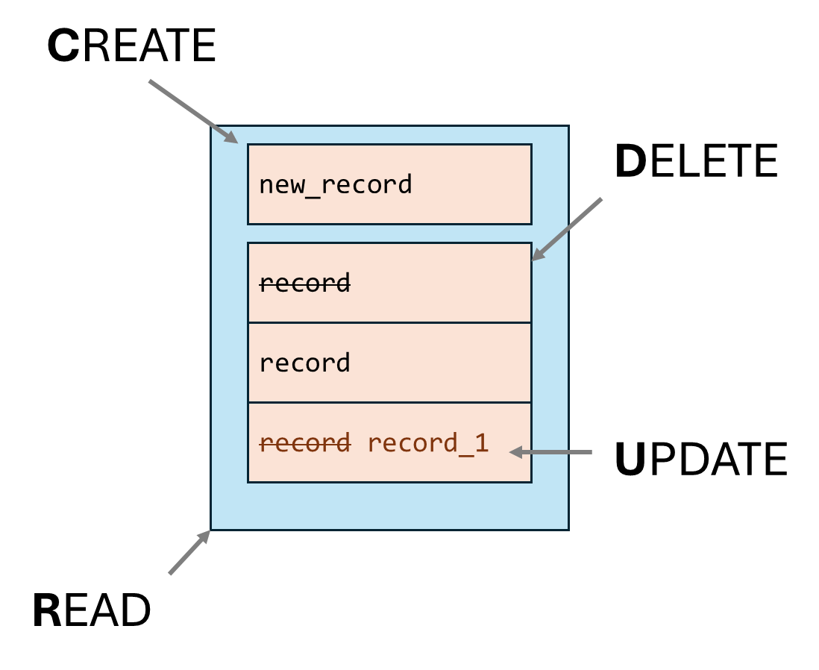
CREATE
DELETE
UPDATE
new_record
record
record
record record_1
READ

Slide 9
X₁
W₁
Summation and bias
Activation function
X₂
W₂
Y
X₃
W₃
Output
.
.
.
W₄
X_{n}
Weights
Inputs

Slide 10
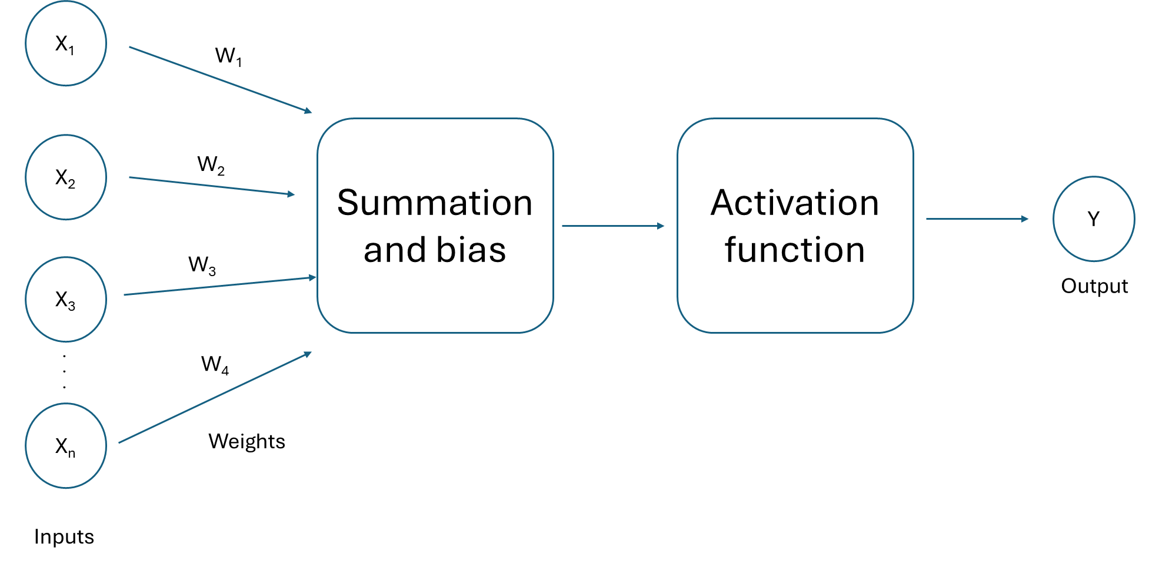

Slide 11
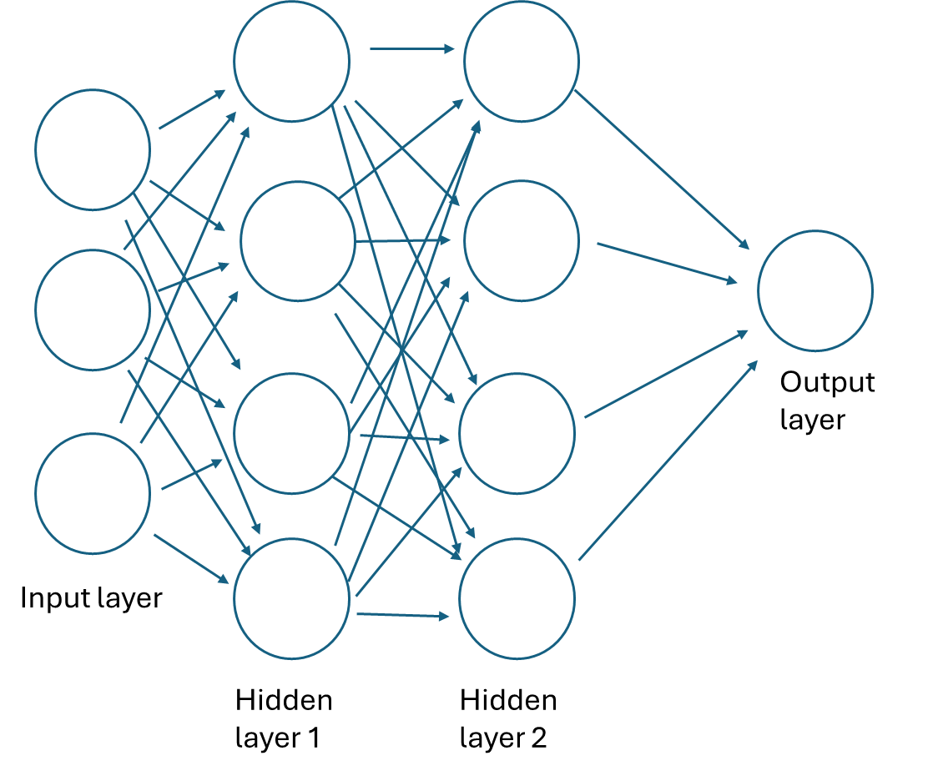
Output layer
Input layer
Hidden layer 1
Hidden layer 2

