Slide 1

Notes:
https://swiy.co/musopen

Slide 2
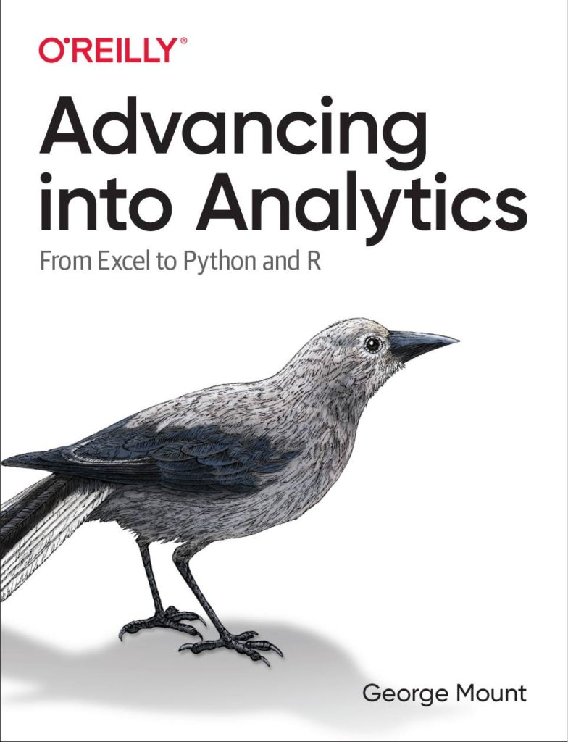




HI, I’M GEORGE
AI-Powered Excel

Slide 3
OBJECTIVES
Calculated columns versus measures
Basic DAX aggregations
Implicit versus explicit measures
DAX for Power Pivot 101

Slide 4
FOLLOWING ALONG
Download resources:
https://swiy.co/pp-dax-101-dl
DAX for Power Pivot 101
Notes:
https://swiy.co/amx

Slide 5
TERMS OF ENGAGEMENT
Feel free to share the download link with latecomers ☺
Participation is welcome via the chat (or please ask to be unmuted!)
Demos work best with 365 on Windows, I cannot guarantee other systems
Recording goes out later today and is up for one week
AI-Powered Excel

Slide 6

QUESTIONS?

Slide 7
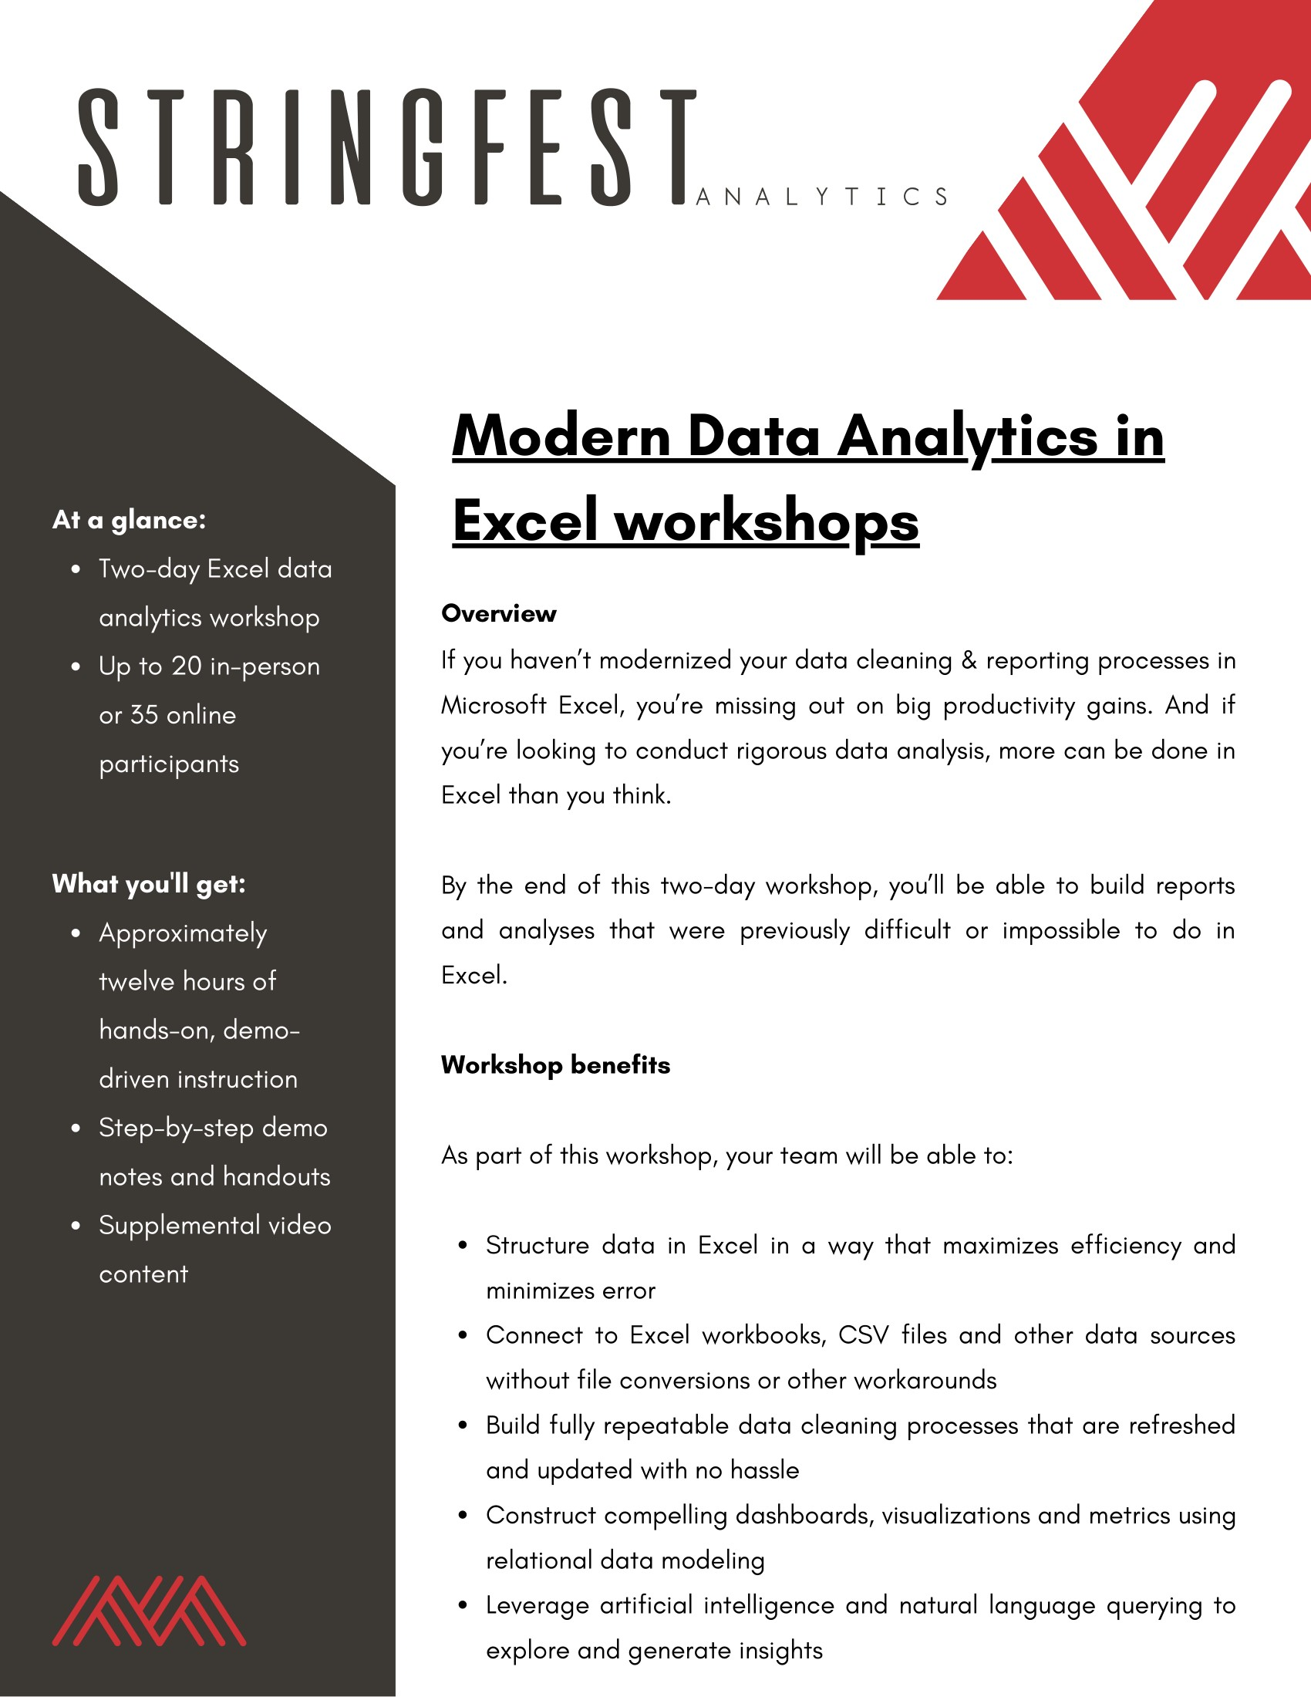

Modern Analytics in Excel workshops
Learn more and connect at https://stringfestanalytics.com/modern-data-analytics-in-excel-workshops/
Human Centered Design • MDLS 2020
Notes:
If you are looking to individually take a Power Query class I have a surprise here at the end…

Slide 8
Advancing into Analytics
Learn more and where to get it: stringfestanalytics.com/book
Human Centered Design • MDLS 2020
Notes:
If you are looking to individually take a Power Query class I have a surprise here at the end…

Slide 9
REFERRAL PROGRAM
Refer me to a training client & get
Two 45-minute coaching sessions
Signed copies of Advancing into Analytics and Modern Data Analytics in Excel (when available)
Get in touch: https://stringfestanalytics.com/contact/
Notes:
There’s also let and lambda

Slide 10

THANK YOU
LINKEDIN
linkedin.com/in/gjmount
EMAIL ADDRESS
george@stringfestanalytics.com
WEBSITE
stringfestanalytics.com
TWITTER
twitter.com/gjmount
Notes:
Thanks for coming! Feel free to contact me anytime, find me on LinkedIn, I also write frequently on this stuff so check out my website too.

Slide 11
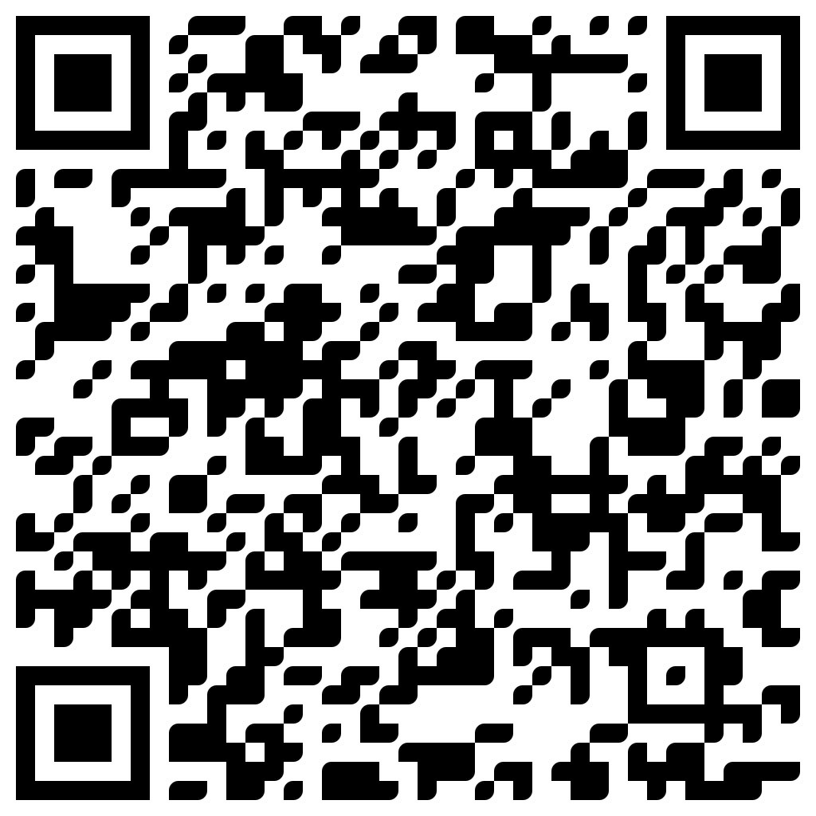
TAKE THE SURVEY
How did I do today? Testimonials or other data welcome!
https://social.stringfestanalytics.com/event-feedback
Notes:
I’m a data analyst give me data on how I did
Testimonials also VERY helpful.

Slide 12
FINAL QUESTIONS?
Thanks for joining!
A recap email with recording, survey and more will be coming…
The recording stays up for seven days.
I appreciate your reviews & referrals.
Notes:
Any questions on descriptive statistics?

