Slide 1



AI in Excel for Finance & Accounting Teams
A practical, hands-on session. Copilot in the grid, the new AI functions, and the guardrails that keep them audit-ready.
George Mount · Stringfest Analytics
IOFM Webinar · August 10, 2026 · 2:00 PM ET
Notes:
Welcome, everyone. Thanks for spending the next hour with me. Here's the plan for today. We're going to use AI in the place where finance and accounting actually do the work, which is the spreadsheet. And we're going to do it without giving up the controls your controller and your auditors expect. I have about forty-five minutes of material, and then we'll save time for your questions. Everything I show you today is yours to keep. That includes these slides, the sample files, and a set of take-home guides. If you'd like to follow along, open the sample workbook and find the InvoiceRegister and ExpenseMemos tabs.

Slide 2
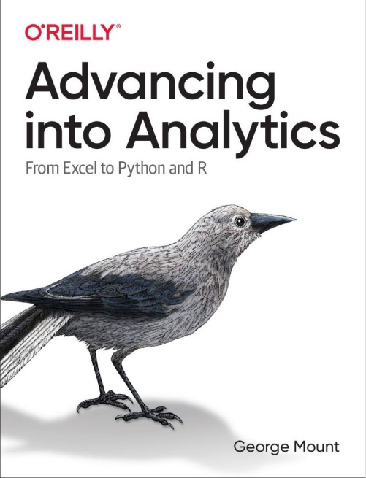
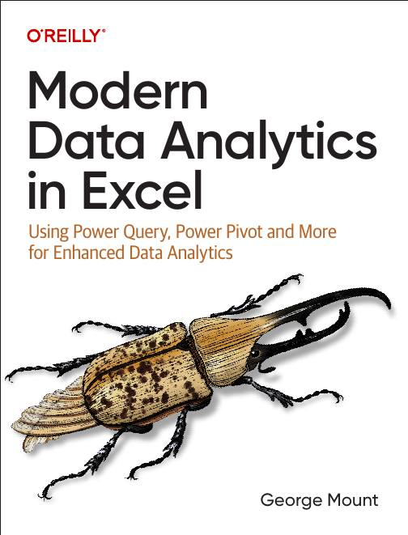


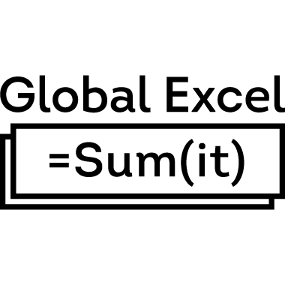

About me
I help finance and Excel teams move from fragile spreadsheets to confident, scalable analysis.
Author of Modern Data Analytics in Excel and Advancing into Analytics.
Microsoft MVP, LinkedIn Learning instructor, and founder of Stringfest Analytics.
Notes:
A quick word about me, and then we'll dive in. I help finance and Excel teams move from fragile spreadsheets to analysis they can actually trust. I've written a couple of books on analytics in Excel, I'm a Microsoft MVP, and I teach on LinkedIn Learning. Here's the one idea that runs through all of my work. The goal is not to replace the spreadsheet. The goal is to make the spreadsheet more reliable. Keep that in mind, because it's the lens for everything we're about to do.

Slide 3
What we'll do in the next 45 minutes
1
Where AI actually fits in a finance workflow
5 min
2
Copilot in Excel, live
12 min
3
The new AI functions: =COPILOT() and friends
12 min
4
Guardrails for accounting work
10 min
5
A practical starting point
6 min
+
Bonus: make Copilot work like your team
if time
Slides, sample files, and take-home guides are yours to keep.
Notes:
Here's where we're headed. We start with judgment, meaning where AI actually fits in your workflow. Then we roll up our sleeves for two hands-on blocks. First, Copilot right inside the grid. Then the brand-new AI functions. After that we'll talk about guardrails, which is the part that makes finance comfortable using any of this. And we'll finish with a short, concrete starting point. Notice the time budget on the right. The two demo blocks are the heart of the session, so that's where we'll spend most of our time.

Slide 4

Part 1
Where AI actually fits in a finance workflow
5 minutes
Notes:
Before we touch a single demo, let's get the framing right. Most of the confusion about AI in Excel comes from people living at one of two extremes. Let me show you what I mean.

Slide 5
The AI sweet spot
AI without structure
= risk
AI + Excel's controls
= leverage
Structure without AI
= slow
Pasting messy data into a chat box. No validation, no audit trail, no repeatability.
AI layered on tables, Power Query steps, version history, and review workflows. Speed without losing control.
Careful, controlled, all-manual. People copy, check, and reformat instead of thinking.
The middle is where you get leverage without giving up control. AI becomes an assistant inside a workflow you already trust.
Notes:
Think of AI in Excel as a spectrum. On the left end, you have AI with no structure. That's when someone pastes messy data into a chat box and just hopes for the best. There's no validation, no audit trail, and no way to repeat it. In finance, that isn't innovation. That's risk. On the right end, you have structure with no AI. Everything is careful and controlled, but it's also slow and manual. People spend their days copying, checking, and reformatting instead of thinking. The sweet spot is right in the middle. It's AI layered on top of the controls Excel already gives you. Your tables, your formulas, your Power Query steps, your version history, your review workflows. In that middle, AI is an assistant that respects your structure instead of bypassing it. Everything I show you today lives in that middle.

Slide 6
Two kinds of tools: know which one you're holding
Deterministic
Probabilistic (AI)
Same input, same output. Trust the number.
Same input, output can vary. Review the output.
SUM, XLOOKUP, PivotTables
Power Query steps
Office Scripts & Power Automate
Copilot in Excel
The =COPILOT() function
Analyst Agent & Agent Mode
Use for: totals, reconciliations, anything that must tie out.
Use for: drafting, classifying, summarizing, extracting from text.
Rule of thumb: let the deterministic tools do the math, and let AI do the reading and the writing.
Notes:
This one slide will save you the most trouble, so let's slow down for it. There are two kinds of tools in Excel, and you want to know which one you're holding. On the left are the deterministic tools. Formulas, Power Query, Office Scripts. Same input, same output, every single time. That's exactly what you want for anything that has to foot and tie. On the right are the probabilistic tools. These are the AI ones. Because there's a model in the loop, the output can vary a little when you run it again. And that's perfectly fine for reading and writing tasks. Classifying a memo. Drafting a narrative. Summarizing a table. The trap to avoid is using a probabilistic tool for a deterministic job. In other words, don't ask the AI to be your calculator. Here's the rule of thumb. Let the math go to your formulas. Let the reading and writing go to AI. We'll come right back to this idea in the guardrails section.

Slide 7
Part 2
Copilot in Excel, live
12 minutes
Notes:
Alright, let's get into Excel. Go ahead and open the InvoiceRegister tab in the sample workbook. I'm going to show you three quick moves with Copilot.

Slide 8
Copilot in Excel, live
1. Clean a messy AP export. Ask Copilot to spot data-quality issues before you fix anything.
2. Build formulas from plain language. Describe the result, and let Copilot write it.
3. Summarize a dataset without leaving the grid. Trends and outliers, right in the sidebar.
Worksheet: InvoiceRegister
Prompts are in the Prompt Cheat-Sheet. Copilot proposes; you apply and keep the Power Query steps as your audit trail.
Notes:
Here's our first demo. We're in the InvoiceRegister tab, and I'll show you three quick moves. The first one matters most, so watch closely. Before I fix anything, I'm going to ask Copilot to review the data for problems. My prompt tells it to describe what it notices, but not to change anything yet. So I'll paste that in now. Look at everything it caught. The same vendor spelled three different ways. Dates in different formats. A duplicate invoice. A missing amount. Even a credit memo tucked in there. Notice the order. I looked first, and I fixed second. For the second move, I'll build a formula just by describing what I want in plain English. I want to flag any invoice that's due within fifteen days. Copilot writes the formula, I paste it in, and I still check one row to be sure. I'll say that part out loud, because it matters. I always check what it wrote. For the third move, I'll ask Copilot to summarize the whole table without leaving the grid. Totals by cost center, and any vendors that might have duplicate invoices. Here's the point to land. Copilot proposes, but your Power Query steps and formulas are what actually run. And those are your audit trail. If the demo ever hangs, don't wait on it. Just switch to the cleaned version in your solutions file and talk it through.

Slide 9
Part 3
The new AI functions: =COPILOT() and friends
12 minutes
Notes:
Now for my favorite part, and it's the newest. Let's switch over to the ExpenseMemos tab. This is the capability most people in the room probably haven't seen yet.

Slide 10
The new AI functions: =COPILOT()
1. Pull structure out of unstructured text. Categorize free-text expense memos into clean labels.
2. Extract the vendor and the dollar amount from each memo into their own columns.
3. Flag possible policy concerns for a human to review, not to auto-enforce.
Worksheet: ExpenseMemos
Requires a Microsoft 365 Copilot license · in rollout, general availability expected end of 2026.
Notes:
We're in the ExpenseMemos tab, and each row is a messy, real-sounding expense note. Here's the big idea. The new COPILOT function puts a model right inside a formula. You give it a prompt and a cell, and it returns an answer into the grid. It recalculates like any other function, and it can fill a whole column at once. Let me build a few columns live. First, I'll categorize each memo. Watch that I give it a fixed list of categories to choose from. That one constraint is what makes the answers consistent. Next, I'll pull out the vendor. Then the dollar amount. Then I'll flag any policy concerns. And here is a key point: because this function is vanilla, it only knows what is in the prompt, so I actually type our limits right into it, the seventy-five dollar meal cap, the hundred dollar gift cap, and so on. If I want it to know a rule, the rule goes in the prompt. While these run, let me be honest about the limits. This is a probabilistic tool, so the answers can shift a little when you run it again. It needs the Copilot license. And it is not a calculator, so the amount column especially needs a human to check it against the receipt. Notice that this is exactly the deterministic versus probabilistic idea from earlier, made real. If it hangs, open the extracted version in your solutions file and read a few of the tricky ones out loud.

Slide 11
Part 4
Guardrails for accounting work
10 minutes
Notes:
Let's slow down for a minute. This next part is what makes finance comfortable using everything we just saw.

Slide 12
Keep it audit-ready
Review before you rely AI output is a draft, not a determination. A person approves every number that leaves the sheet.
Know when to trust it Text tasks like classifying, extracting, and summarizing are fine. Math and totals get verified against formulas in the grid.
Keep an audit trail Capture the prompt, the source range, who reviewed it, and when. The Power Query steps document themselves.
Mind the boundary No data outside your compliance perimeter. Confirm the license and tenant before pasting anything sensitive.
Name a human owner Every AI-assisted figure still has a person's name on it. Ownership doesn't transfer to the model.
Notes:
Here are five guardrails. If you adopt only these, you can use everything else safely. First, review before you rely. The AI gives you a draft, and a person approves the final number. Second, know when to trust it. Text tasks are fine. Math and totals get verified against your formulas. That's the same idea from earlier. Third, keep an audit trail. Your Power Query steps document themselves, and for a COPILOT cell, just capture the prompt and who reviewed it. Fourth, mind the boundary. Watch your license and your tenant, and don't paste anything sensitive outside your compliance perimeter. Fifth, name a human owner. Every AI-assisted number still has a person's name on it. That never transfers to the model.

Slide 13
Part 5
A practical starting point
6 minutes
Notes:
Let's bring it home. I'll give you three things worth trying on Monday, and one clear list of what to leave alone for now.

Slide 14
Start here Monday
1
2
3
Clean & document an export
Extract structure from text
Draft the close narrative
Copilot spots the issues; Power Query enforces the fix and keeps the steps.
=COPILOT() turns memos, vendor notes, and line descriptions into clean columns.
Summarize variances into a first draft. You edit, verify, and approve.
Leave alone for now: anything that must tie to the penny, journal entries posted straight from AI, and client or PII data outside your tenant.
Notes:
Here are the three workflows I'd start with. All three are low-risk, they pay off right away, and they're things you already do every month. First, clean and document an export. Second, extract structure from text, the way we just did with those memos. Third, draft your close narrative and then edit it. Now here's the part people skip, and it's just as important. Be clear about what to leave alone for now. Anything that has to tie to the penny. Journal entries posted straight from AI. And any client or personal data that lives outside your tenant. Knowing what not to automate is exactly what earns you the room to use the rest. And remember, all of this is in your take-home guides. The prompt cheat sheet, the which-tool-when guide, the guardrails checklist, and the first-three-workflows quickstart.

Slide 15
Bonus
Make Copilot work like your team
If we have time
Notes:
This part is a bonus, and it's here on purpose. If the demos ran quickly and we have time, this is where we spend it. If we're tight, I'll point you to the take-home guide and jump straight to your questions. The topic is how you make Copilot behave like a member of your team instead of a generic assistant. There are three levers, and people mix them up all the time. Let me untangle them.

Slide 16
Three ways to make Copilot yours
Custom instructions
Skills
Reference files
Your house style, set once.
Saved workflows you reuse.
Point it at your other data.
Standing preferences Copilot applies across workbooks: formats, naming, labels. A .Rules sheet does the same inside one file.
Package a repeatable task, then invoke it by name so the whole team runs it the same way.
Ground Copilot in other workbooks or files through the file picker: OneDrive, SharePoint, or your PC.
e.g. “Format currency as $#,##0, label variances Favorable or Unfavorable, never overwrite source.”
e.g. a “Monthly variance review” skill everyone can call.
e.g. last month’s close file, or your chart-of-accounts mapping.
Heads up: these shape the Copilot chat and agents, not the =COPILOT() worksheet function. The function is vanilla: your prompt plus the cells you point at.
Notes:
Here are the three levers, and the trick is knowing which one you want. First, custom instructions, your house style, set once and applied across your workbooks. Second, Skills, saved workflows you package and then reuse by name. Third, reference files, where you point Copilot at other data so it grounds its answer in the real thing. Now here is the important caveat, and it is easy to miss. All three of these shape the Copilot chat and the agents, the conversational side. They do not feed the equals COPILOT worksheet function we used earlier. That function is vanilla. It sees your prompt and the cells you hand it, and nothing else. So for the function, you put your rules in the prompt. For the chat, you can set instructions and attach files. To show the chat side cleanly, I am switching to a completely different dataset, some regional sales numbers.

Slide 17
Custom instructions change how the answer arrives
Set once (Copilot chat): Format currency as $#,##0. Label year-over-year change as Growth or Decline. Give summaries as 3 bullets, lead with the number. One decimal on percentages.
Before
After
Revenue was 4,218,500.00 in the West, up 12.3 percent,
the Northeast came in at 3,860,200.00, down 3.0 percent,
the Southeast was 2,974,300.00…
(one paragraph, cents, no labels)
$4,218,500 West · 12.3% Growth
$3,860,200 Northeast · 3.0% Decline
$2,974,300 Southeast · 14.0% Growth
(bulleted, no cents, labeled)
Worksheet: RegionalSummary (Sales-by-Region.xlsx) · Copilot chat
A different dataset on purpose. Same prompt, same data. Only the standing instruction changed.
Notes:
Now the chat side, and notice I have switched to a completely different dataset, regional sales. That is deliberate, because these customization features are a chat thing, not a function thing. On the left is the default. A wordy paragraph, dollars with cents, percentages with no label. On the right is the same request, after I set one standing instruction in Copilot. Whole dollars, a Growth or Decline label on every change, and three number-first bullets. Same prompt, same data. I set the house style once, and now the answer arrives the way my team reads it.

Slide 18
A reference file changes the answer itself
Attach (Copilot chat): Reporting & Chart Style Guide.docx via the file picker, then ask Copilot to summarize and chart RegionalSummary.
Before
After
Summary: a generic paragraph, mixed formats
Chart: default blue columns, unsorted
(follows no house rules)
Summary: 3 number-first bullets, Growth or Decline
Chart: brand red, sorted high to low, labels
(follows your style guide)
Worksheet: RegionalSummary (Sales-by-Region.xlsx) · Copilot chat
A policy, a codebook, or a style guide: give Copilot the document with your rules, and its output follows them.
Notes:
And here is a reference file, still on the sales data, still in the chat. This time I am not setting a style, I am handing Copilot a document, our reporting and chart style guide. Watch the before. A generic summary and a plain blue chart. Then I attach the style guide through the file picker and ask again. Now the summary is three number-first bullets with Growth and Decline labels, and the chart uses our brand red, sorted high to low, with data labels, exactly what the guide specifies. A policy, a codebook, a style guide, whatever holds your rules, the chat can read it and follow it. The function cannot, and that is the whole reason we keep these two ideas separate.

Slide 19
If you want to go further
Python in Excel Forecasting and simulation, written for you by Copilot and run right in the grid.
Analyst Agent Scenario analysis and exception review that shows its work step by step.
Agent Mode A coordinated first draft across sheets: analysis, a chart, and a written summary.
Workbook Rules (.Rules) Bake your team’s standards into a file so every Copilot edit follows them.
Pick whichever the room is asking about. Each one is a session on its own.
Notes:
If there's still time and appetite, here are the natural next steps, and I'll follow the room on which one to open. Python in Excel is the one for forecasting and simulation, and the nice part is that Copilot can write the Python for you. Analyst Agent is great when you want the AI to show its work on a scenario or an exception review. Agent Mode goes further and assembles a coordinated first draft across several sheets, which you then review. And if your team cares about standards, a rules sheet bakes them right into the file. Any one of these could be its own hour, so I'll just take the one you're most curious about.

Slide 20
Questions?
George Mount
george@stringfestanalytics.com
stringfestanalytics.com
Notes:
That's the material, so let's open it up for questions. If it's quiet at first, I'll get us started. Think about this. What's the first workflow you'd try? And what's the one you're not sure is safe yet? And one more reminder. The slides, the sample files, and all four guides are yours to keep.

Slide 21
Thank you
george@stringfestanalytics.com
stringfestanalytics.com
Notes:
Thank you so much for your time today. I really enjoyed this. Before you go, grab the take-home bundle. You've got the slides, two sample workbooks, and four short guides. I hope you'll open one of them on Monday and try it on your own data. Thanks again, and I'll hand it back to the team at IOFM.

