Slide 1



The New AI in Excel Stack for Finance Professionals

Slide 2
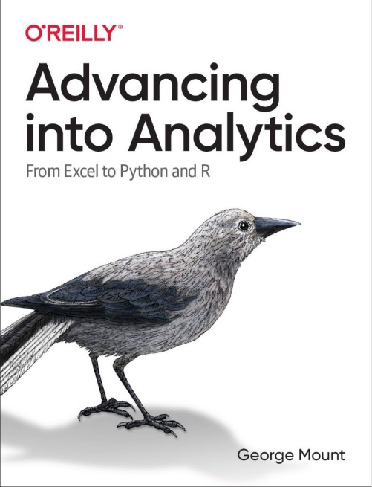
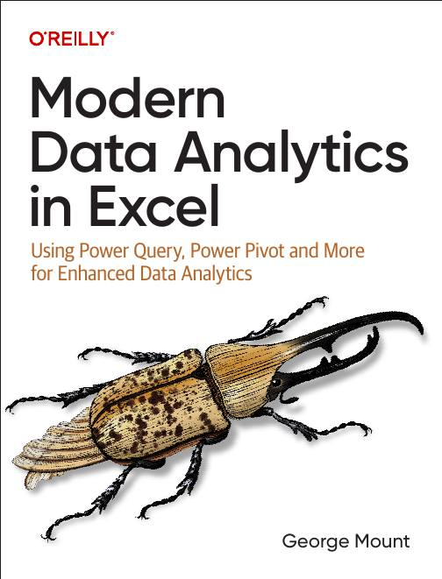

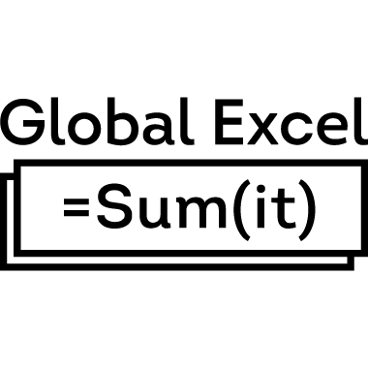


About me
I help Excel users move from fragile spreadsheets
to confident, scalable analysis.

Slide 3

Objectives for this session
Clean and prep data the modern, reliable way
Run forecasting and simulations in Python in Excel
Use Copilot for fast, defensible analysis
Understand where Office Scripts, Automate, and Agents actually fit
Build a practical modeling workflow you can use tomorrow

Slide 4
The AI sweet spot
AI + Excel’s existing controls = leverage
AI without structure = risk
Structure without AI = slow
Notes:
I like to frame AI in Excel as a spectrum, because most of the confusion comes from living at the extremes.
On one end, you have AI without structure. That’s when people paste messy data into a chat box and ask for answers. There’s no validation, no audit trail, no repeatability. In finance, that’s not innovation — that’s risk.
On the other end, you have structure without AI. Very controlled spreadsheets, very careful processes — but everything is slow, manual, and fragile. People spend their time copying, checking, reformatting, and explaining instead of thinking.
The sweet spot is right here in the middle. AI layered on top of Excel’s existing controls.
Excel already gives us things finance cares about: tables, formulas, Power Query steps, version history, review workflows. AI becomes useful when it respects that structure instead of bypassing it.
In this session, I’m not showing AI as a decision-maker. I’m showing it as an assistant that works inside a controlled Excel workflow: helping spot issues, draft explanations, and reduce repetitive effort — while humans still review, refresh, and approve.
That’s where you get leverage without giving up control.

Slide 5
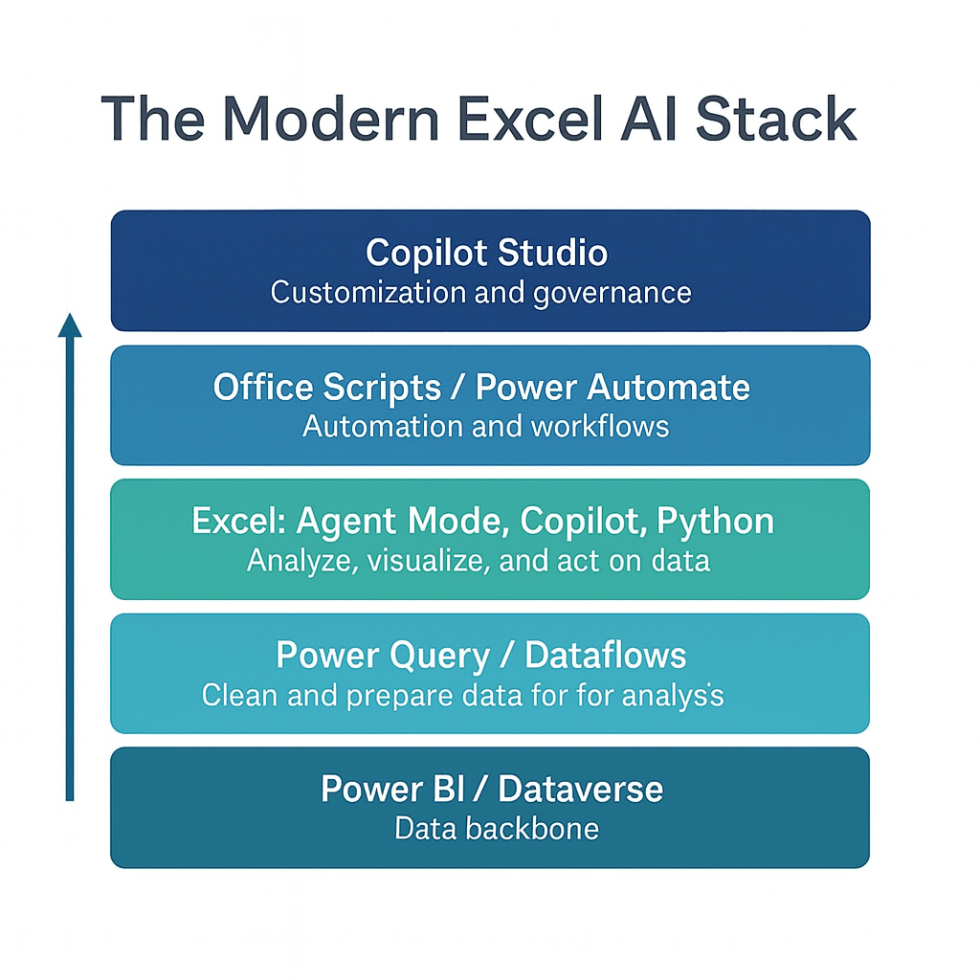

Slide 6
Auditable data cleaning with Power Query
Use Copilot to identify potential data quality issues
Enforce standardization and business rules with Power Query
Use Copilot to clarify and document transformation steps
Worksheet: InvoiceRegister
Notes:
\\

Slide 7
Scenario-based payment timing analysis with Analyst Agent
Specify uncertainty ranges using natural language
Run a reproducible scenario analysis
Worksheet: OpenInvoices
Notes:
False!
Function, Formula, Function
Argument

Slide 8
Exception review & variance explanation with Analyst Agent
Ask the agent to flag the biggest variances and unusual invoice volume shifts
Have it show its work (reasoning + intermediate steps) for review
Use the output to draft a concise, defensible close summary
Worksheet: APSummary
Notes:
False!
Function, Formula, Function
Argument

Slide 9
Controlled approval workflows with Power Automate & Excel
Use Power Automate to route requests and manage approvals
Record outcomes and comments in a structured Excel table
Reduce email-based manual work while preserving review and auditability
Reference example: Expense approval workflow (Forms → Power Automate → Excel)
https://stringfestanalytics.com/power-automate-for-excel-how-to-create-an-approval-process-with-microsoft-forms/
Notes:
False!
Function, Formula, Function
Argument

Slide 10
First-draft reporting workflows with Agent Mode
Use Agent Mode to assemble analyses, charts, and written summaries across Excel sheets
Treat agent output as a coordinated draft, not a final deliverable
Review, edit, and approve results to preserve accuracy and auditability
Worksheet: APMonthly
Notes:
False!
Function, Formula, Function
Argument

Slide 12
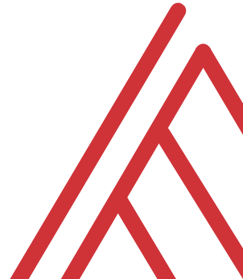
Questions?

Slide 13
Thank you

