Slide 1



Mastering Excel Formulas

Slide 2
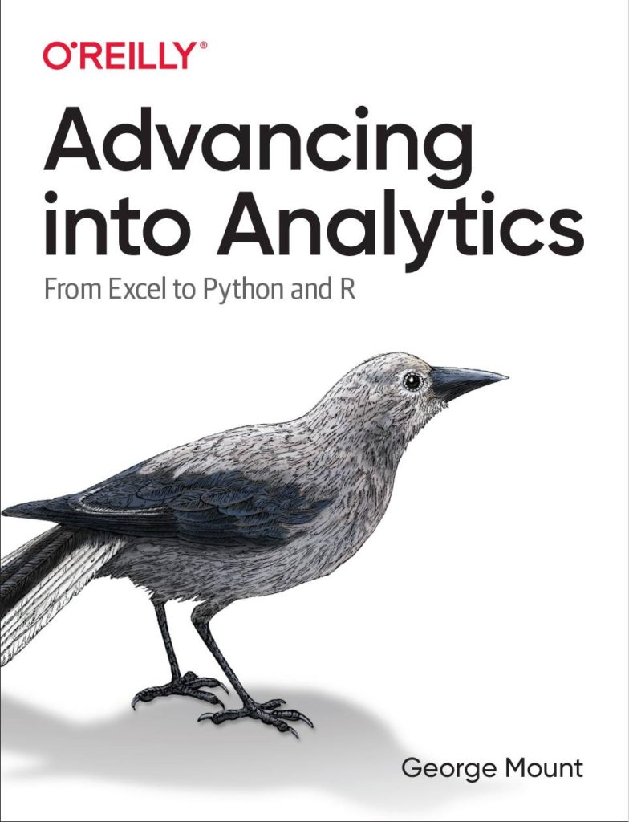


Hi, I’m George

Slide 3

Objectives for this session
Comfortably use formulas like SUMIFS and XLOOKUP
Design and audit complex, nested formulas
Look up data in an instant

Slide 4
Sections
Basics of formulas and functions
Formula design & audit
Conditional logic & formulas
Dynamic arrays
LET(), LAMBDA() and the future of Excel

Slide 5
Following along
Each section is a workbook
Solutions in separate workbooks
Follow along with demo notes

Slide 6

1. Basics of formulas and functions

Slide 7
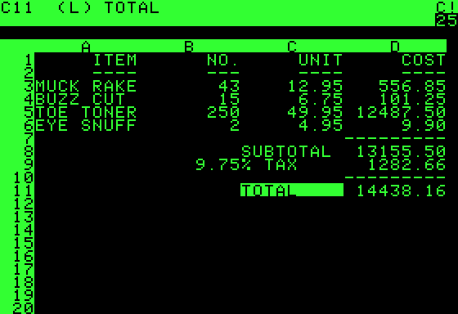
What is a formula?
User-designed equation
Usually starts with = (but doesn’t have to!)
https://en.wikipedia.org/wiki/VisiCalc
Notes:
Demonstrate in Excel how this works
Visi”Calc”

Slide 8
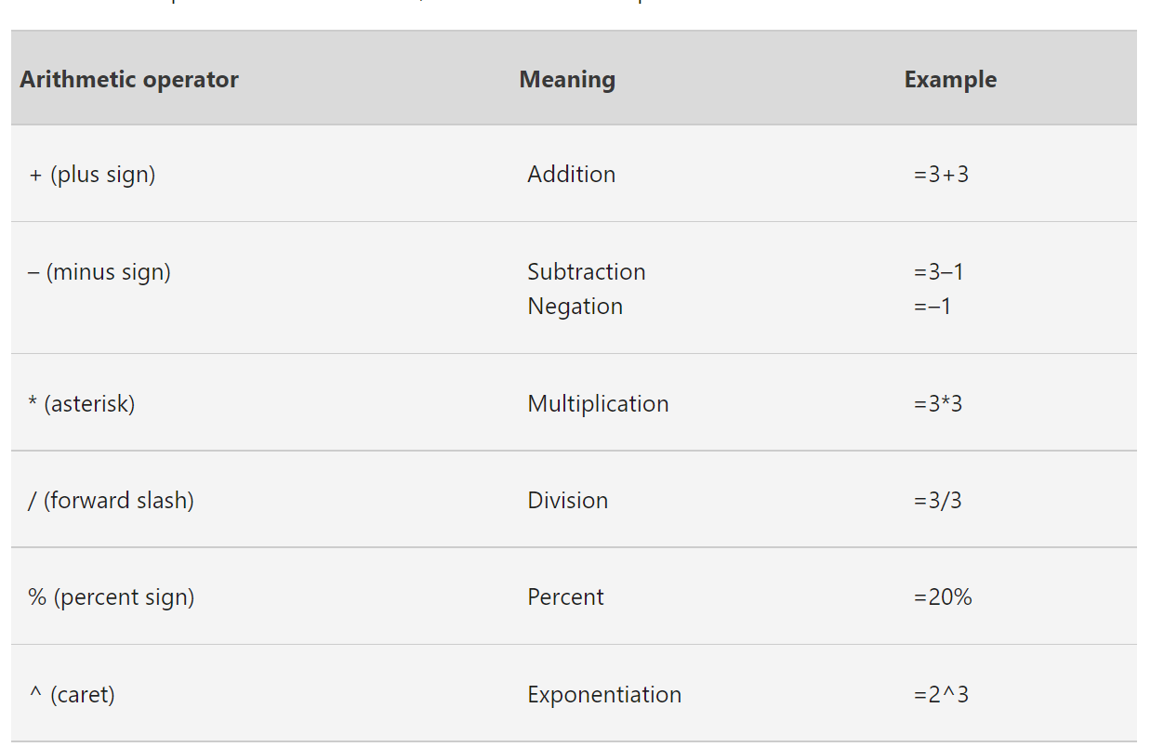
Numeric formulas
Follows the order of operations
https://support.microsoft.com/en-us/office/calculation-operators-and-precedence-in-excel-48be406d-4975-4d31-b2b8-7af9e0e2878a
Notes:
Demonstrate in Excel how this works
Visi”Calc”

Slide 9
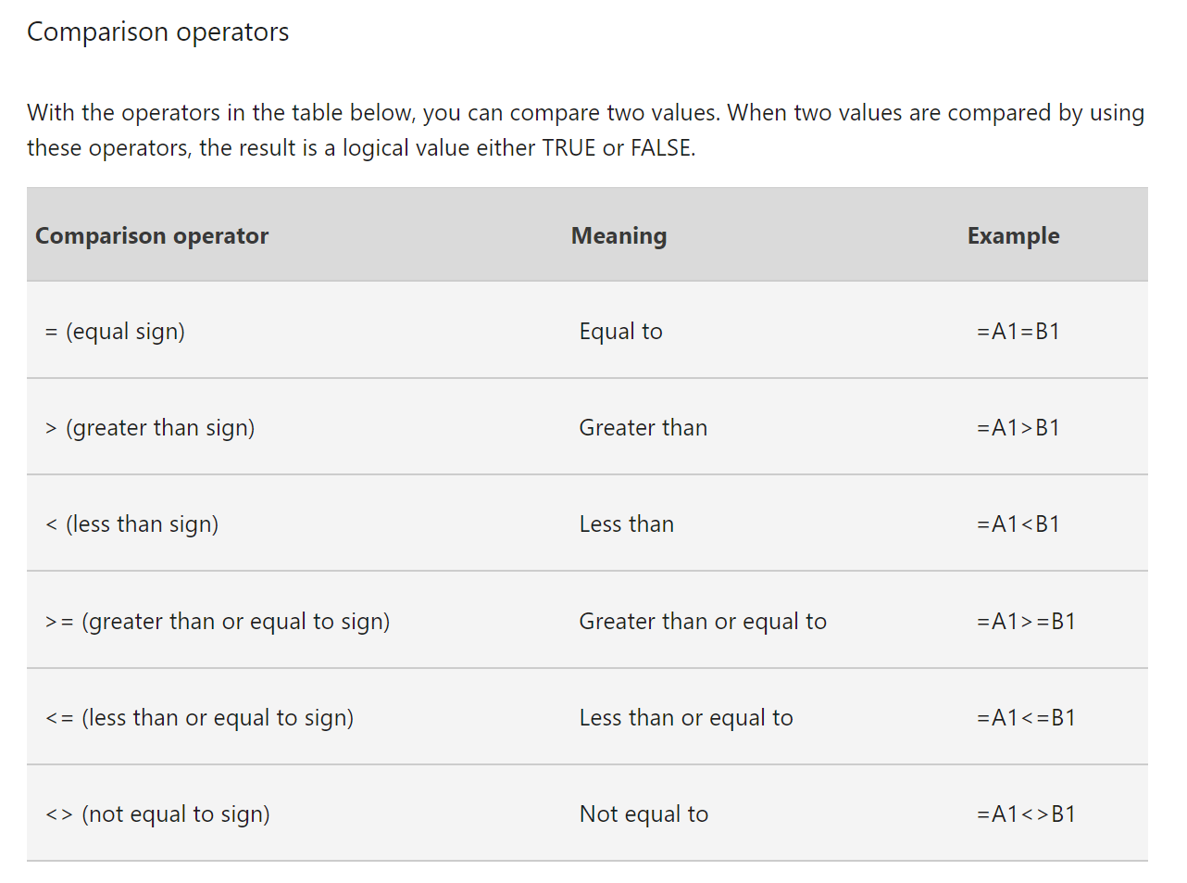
Comparison formulas
Useful for error-checking
https://support.microsoft.com/en-us/office/calculation-operators-and-precedence-in-excel-48be406d-4975-4d31-b2b8-7af9e0e2878a
Notes:
Demonstrate in Excel how this works
Visi”Calc”

Slide 10
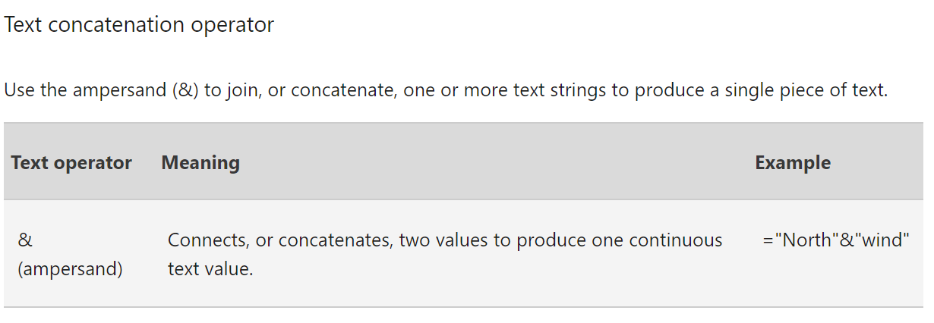
Text formulas
Small but mighty!
https://support.microsoft.com/en-us/office/calculation-operators-and-precedence-in-excel-48be406d-4975-4d31-b2b8-7af9e0e2878a
Notes:
Show how this works

Slide 11
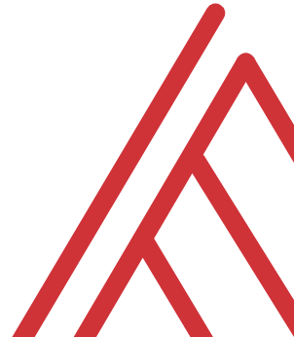
Questions?

Slide 12
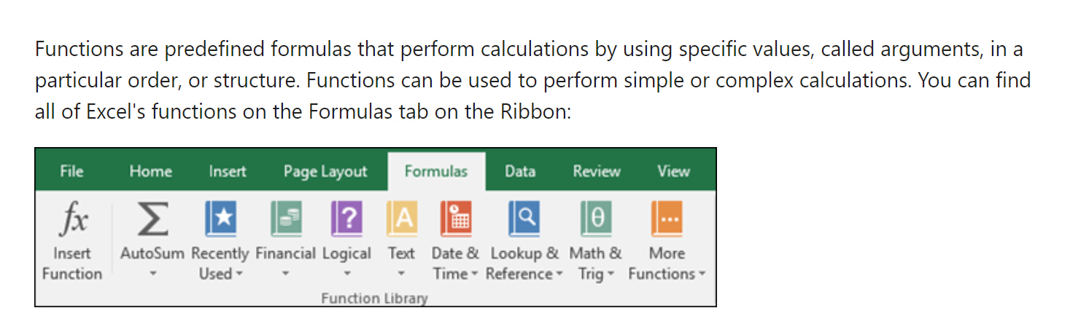
What is a function?
https://support.microsoft.com/en-us/office/using-functions-and-nested-functions-in-excel-formulas-3f4cf298-ded7-4f91-bc80-607533b65f02#:~:text=Functions%20are%20predefined%20formulas%20that,Excel%20function%20syntax
Notes:
Ask learner to name a few functions in the chat

Slide 13
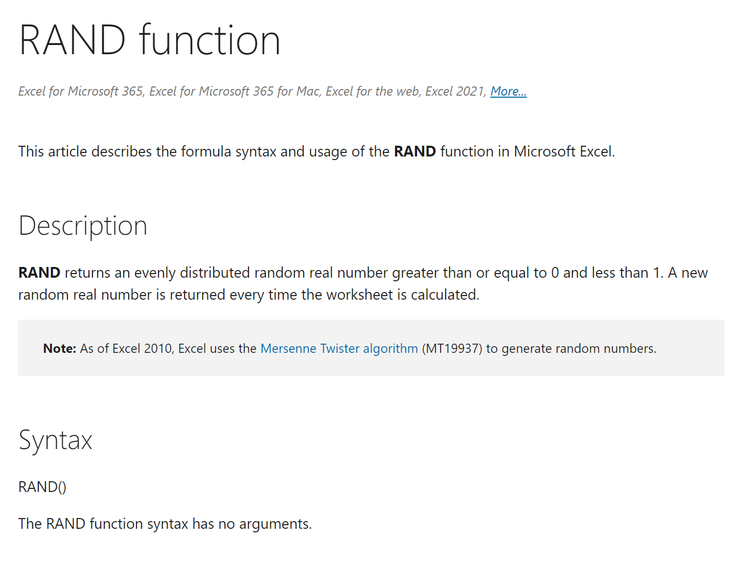
Not all functions are defined equal…
Some have no arguments
https://support.microsoft.com/en-us/office/rand-function-4cbfa695-8869-4788-8d90-021ea9f5be73
Notes:
Ask learner to name a few functions in the chat

Slide 14
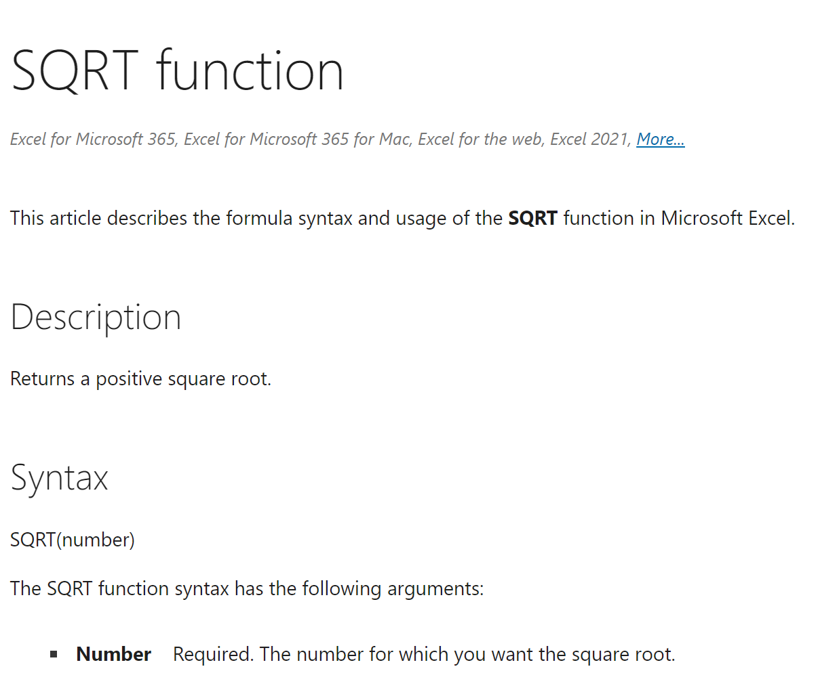
Not all functions are defined equal…
Some always have the same number
https://support.microsoft.com/en-us/office/sqrt-function-654975c2-05c4-4831-9a24-2c65e4040fdf
Notes:
Ask learner to name a few functions in the chat

Slide 15
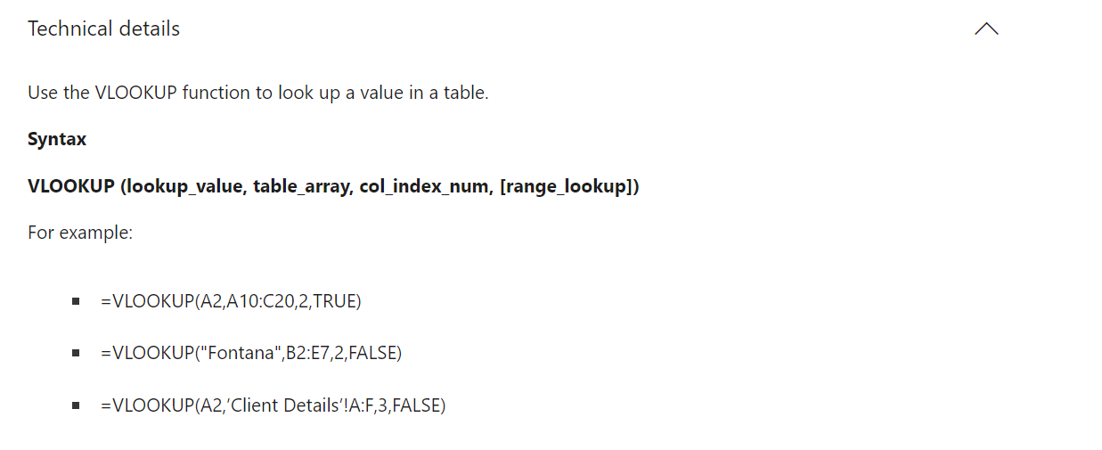
Not all functions are defined equal…
Some have optional and default arguments
https://support.microsoft.com/en-us/office/vlookup-function-0bbc8083-26fe-4963-8ab8-93a18ad188a1
Notes:
Ask learner to name a few functions in the chat

Slide 16
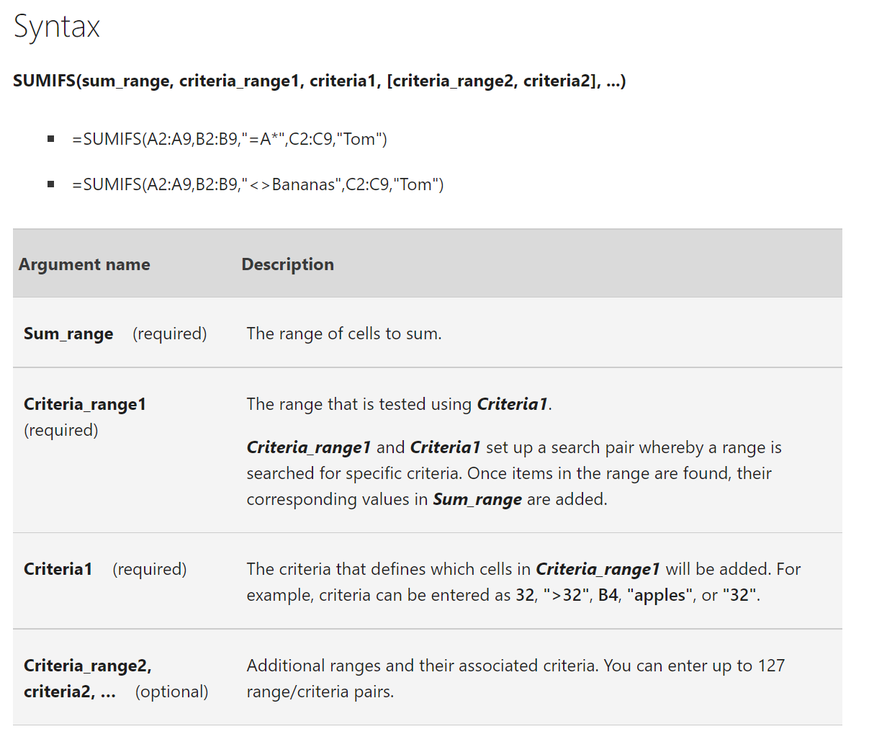
Not all functions are defined equal…
Some have an infinite number (which can be optional!)
https://support.microsoft.com/en-us/office/sumifs-function-c9e748f5-7ea7-455d-9406-611cebce642b
Notes:
Ask learner to name a few functions in the chat

Slide 17
Exercises
T/F: Every Excel formula/function must begin with an = sign.
Are the following formulas or functions:
ABS(-10)
B4<B3
SQRT(10*2)
What is the A4 in the following function called?
FORMULATEXT(A4)
Notes:
False!
Function, Formula, Function
Argument

Slide 18
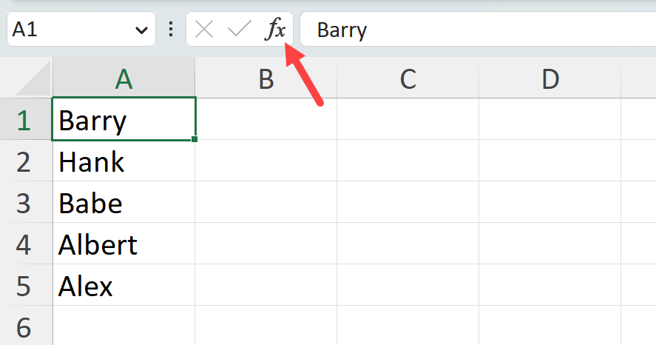
Demo
Worksheet: count-v-counta
Using the Insert Function menu:
Find the results of COUNT() vs COUNTA() for cells A1-A6

Slide 19
Exercise
Learn & teach a new function!
Peruse the Insert Function menu to find an unfamiliar function
Test, evaluate & demonstrate it to class
There are over 450 functions in Excel

Slide 20
Questions?

Slide 21
2. Named ranges and tables

Slide 22

How can we avoid this?
Notes:
Ask learner to name a few functions in the chat

Slide 23
Demo
Worksheet: references
Relative vs absolute references
Creating named ranges

Slide 24
Exercise
Worksheet: ranges-practice
Using named ranges:
Calculate tax * sales amount
Find the % to total NYC population for each borough in each year

Slide 25
Questions?

Slide 26
Ctrl + T is your superpower! Intro to Excel tables

Slide 27
Demo
Worksheet: table-time
Why use (and love) Excel tables?

Slide 28
Exercises
Worksheet: mpg
Convert the data to a table called mpg
Create a column which is the average of cty and hwy
Use the MATCH() function to find the position of the trans variable in the column headers
Add a total row to find the average mileage of the vehicles
Remove the header row
Notes:
Removing the header row means that #3 now gets an error, sad!

Slide 29
Questions?

Slide 30
3. Conditional logic & formulas

Slide 31
IF() statements can only go 2 ways…
Does this condition hold up?
Yes: TRUE
No: FALSE
Notes:
Ask learner to name a few functions in the chat

Slide 32
Demo
Worksheet: commissions
Which reps meet various criteria?
Combine IF() with AND(), OR(), NOT()

Slide 33
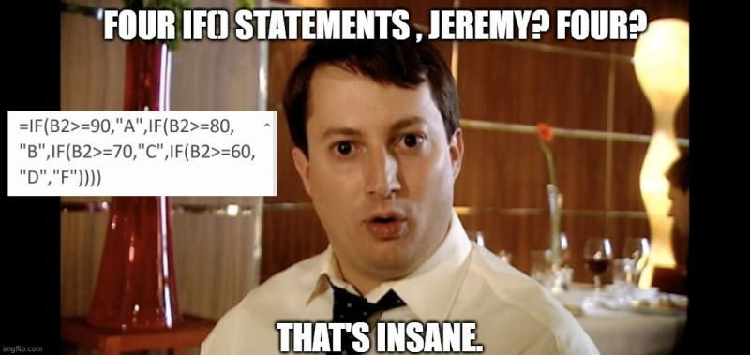
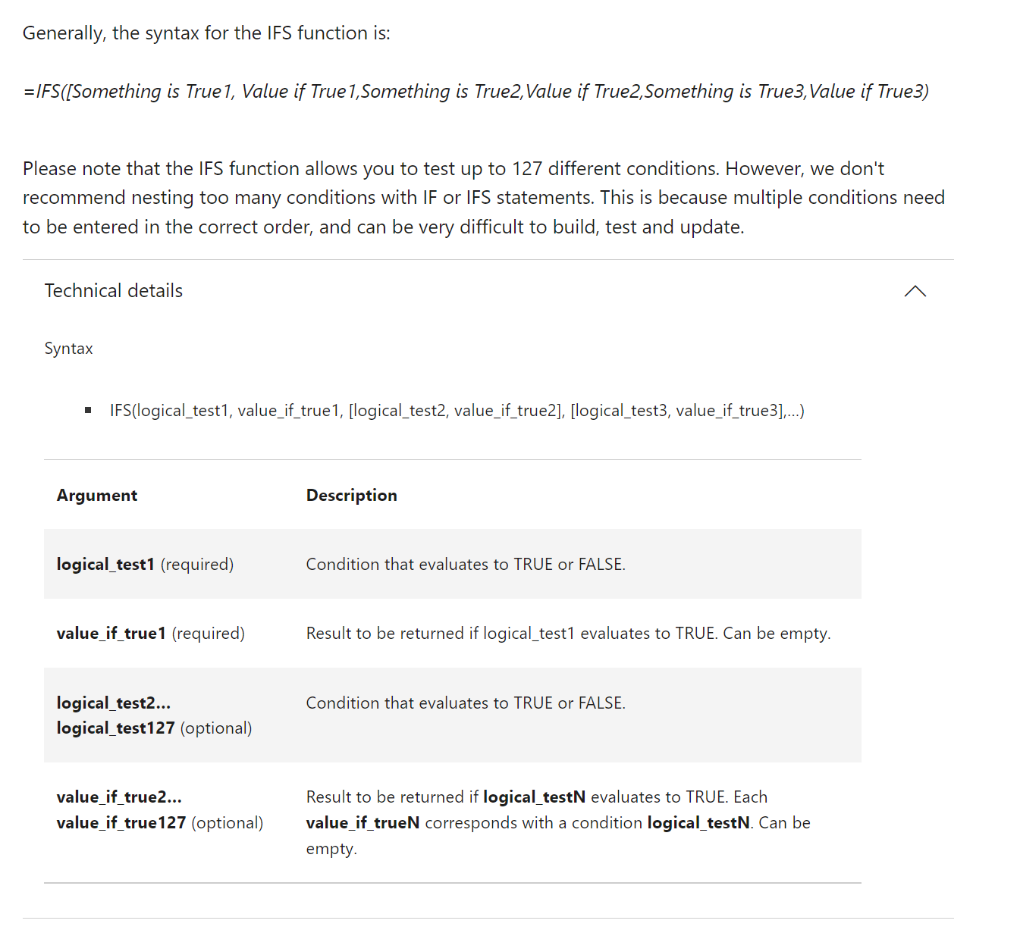
Avoiding nested IF()s with IFS()
https://support.microsoft.com/en-us/office/ifs-function-36329a26-37b2-467c-972b-4a39bd951d45
Notes:
Don’t worry too much about the building blocks right now – I have this in here to gauge everyone’s interest

Slide 34
Avoiding nested IF()s with IFS()
Score | Grade | Grade
89 | B | B
61 | D | D
72 | C | C
95 | A | A
67 | D | D
87 | B | B
62 | D | D
 | =IF(A2 >= 90, "A", IF(A2>=80, "B", IF(A2>=70, "C", IF(A2>=60, "D", "F")))) | =IFS(A2 >= 90,"A", A2 >= 80,"B", A2 >= 70,"C", A2 >= 60,"D", TRUE,"F")
Notes:
Don’t worry too much about the building blocks right now – I have this in here to gauge everyone’s interest

Slide 35
Demo
Worksheet: commissions
Calculate commission from multiple scenarios using IFS()

Slide 36
What’s wif all the IFS()?
What do we want to do with the data? | By how many conditions? | Formula to use
Add it | 1 | SUMIF()
Add it | More than 1 | SUMIFS()
Count it | 1 | COUNTIF()
Count it | More than 1 | COUNTIFS()
Average it | 1 | AVERAGEIF()
Average it | More than 1 | AVERAGEIFS()
Notes:
Don’t worry too much about the building blocks right now – I have this in here to gauge everyone’s interest

Slide 37
Demo
Worksheet: commissions
Conduct summary analysis on the data: which cells roll up to which summaries?

Slide 38
Exercises
Worksheet: pixar-dreamworks
Find the following with conditional logic:
Write the full studio name Pixar or Dreamworks from P or D
Get the letter grade using the typical grading system
Movies with >$500M gross and >90% rating are “Hits”
Movies with <$350M gross OR <50% rating are “Duds”
Also answer the questions at bottom of worksheet (Hint: Try COUNTIF() for last question!)

Slide 39
4. Dynamic arrays

Slide 40
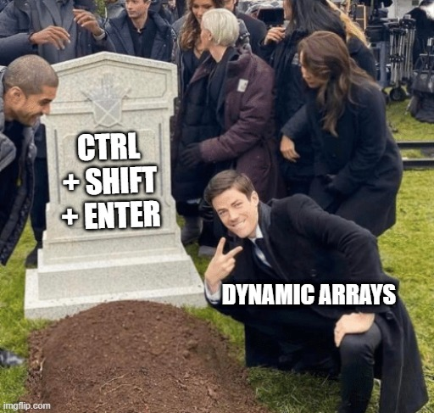
One formula, many cells
Function | What it does
UNIQUE() | Finds the unique items in an array
FILTER() | Filters an array
SORTBY() | Sorts an array
XLOOKUP() | Combines data from two sources
But wait, there’s more: https://support.microsoft.com/en-us/office/dynamic-array-formulas-and-spilled-array-behavior-205c6b06-03ba-4151-89a1-87a7eb36e531
Notes:
Don’t worry too much about the building blocks right now – I have this in here to gauge everyone’s interest

Slide 41
Demo
Worksheet: computers
Pull ad-hoc data quickly using dynamic arrays
Use table references to retrieve matching headers

Slide 42
Exercises
File: penguins.xlsx
How many unique species are in this dataset? What are they?
Pull only the records from the Biscoe island.
Pull only the records that are from Biscoe island and that have a body mass greater than average for that group.
Sort the data by body mass ascending, species ascending, sex descending.

Slide 43

Joining data sources with XLOOKUP()

Slide 44

Say bye-bye to VLOOKUP()
XLOOKUP() can:
Easily look up to the left
Handle errors
Search the lookup table in multiple directions
Notes:
Don’t worry too much about the building blocks right now – I have this in here to gauge everyone’s interest

Slide 45
Demo
Worksheet: office-employees
Combine data from outside tables with XLOOKUP()
Look up data to the left
Handle lookup errors

Slide 46
Demo
Worksheet: superstore
Determine which orders were returned as a “Yes/No” column
Find the salesperson responsible for each region

Slide 47
Dynamic visualizations with dynamic arrays

Slide 48
Demo
Worksheet: iris
How are dynamic arrays stored and referred to in Excel?
How can we manipulate this to make Excel more dynamic in general?

Slide 49
Questions?

Slide 50
5. LET(), LAMBDA() and the future of Excel

Slide 51
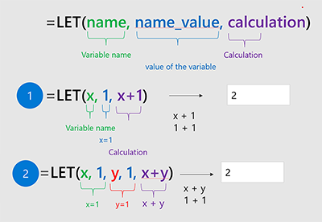
Do not LET() your code repeat!
“The LET function assigns names to calculation results. This allows storing intermediate calculations, values, or defining names inside a formula.”
https://www.microsoft.com/en-us/research/blog/lambda-the-ultimatae-excel-worksheet-function/
Notes:
Don’t worry too much about the building blocks right now – I have this in here to gauge everyone’s interest

Slide 52
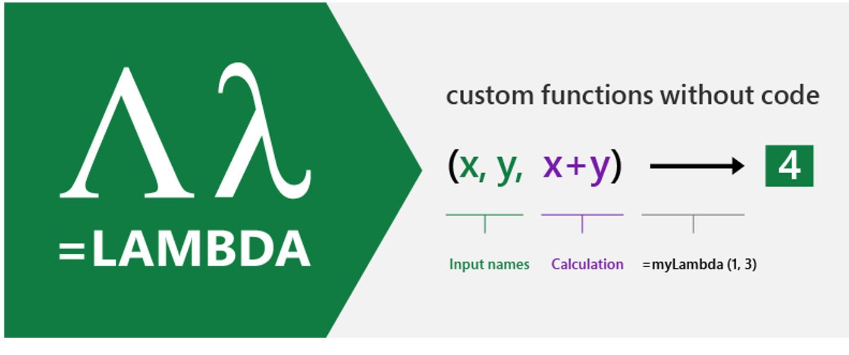
It’s official… Excel IS programming!
“With LAMBDA, Excel has become Turing-complete. You can now, in principle, write any computation in the Excel formula language.”
https://www.microsoft.com/en-us/research/blog/lambda-the-ultimatae-excel-worksheet-function/
Notes:
Don’t worry too much about the building blocks right now – I have this in here to gauge everyone’s interest

Slide 53
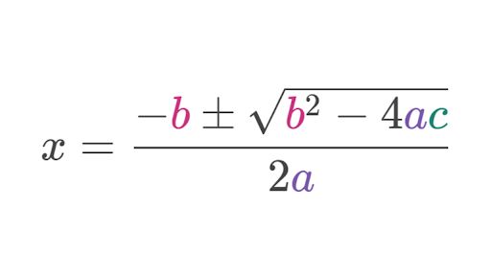
Demo
Worksheet: quadratic
Derive the quadratic formula for a=1, b=-5, c=6 using
LET()
LAMBDA()
LAMBDA() (Name Manager)

Slide 54
Recap: LET() vs LAMBDA()
Method | Pros | Cons
LET() | Easy to set up | Can only return one at a time, difficult to use across workbooks
LAMBDA() | Can reuse across workbook, can return multiple values | Clunky to set up
LAMBDA() (Name manager) | Can do it all! | Difficult to set up

Slide 55
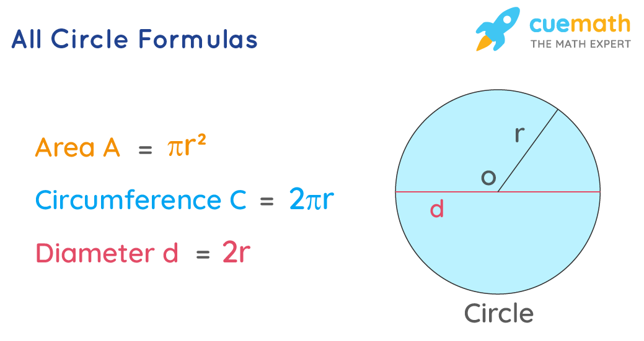
Exercise
Worksheet: circumference
Write a LAMBDA() function called circumference() to get the circumference of a circle
(Hint… use the PI() function!)
https://www.cuemath.com/all-circle-formulas/

Slide 56
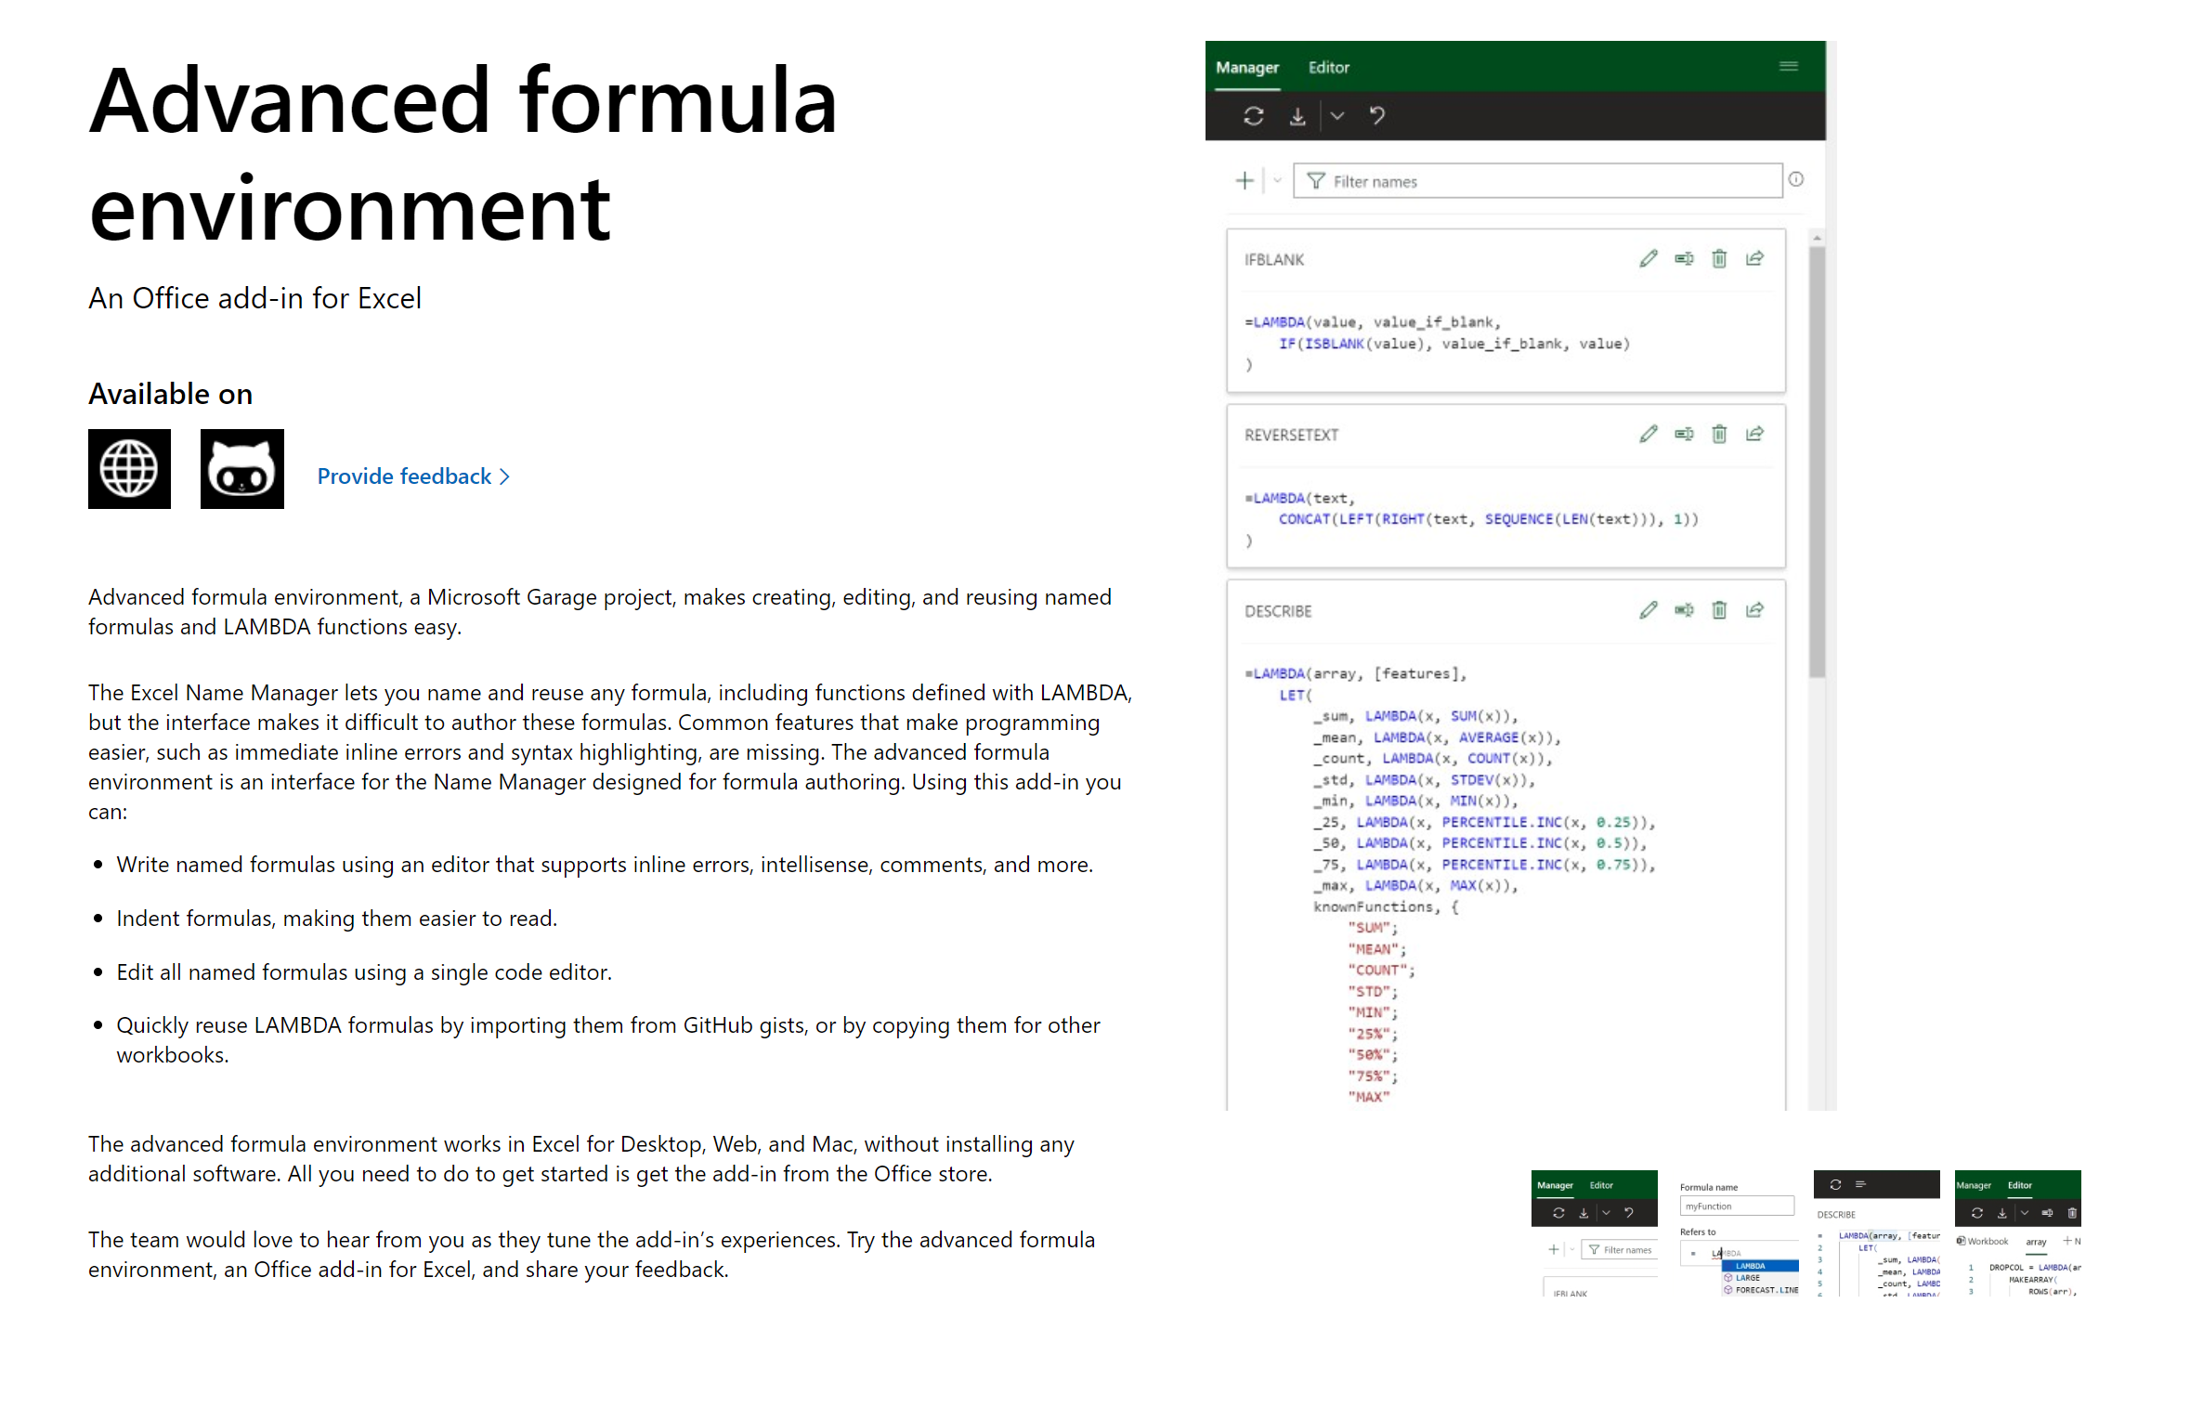
Yes, LAMBDA() can be reused
https://www.microsoft.com/en-us/garage/profiles/advanced-formula-environment-a-microsoft-garage-project/#:~:text=The%20advanced%20formula%20environment%20is,making%20them%20easier%20to%20read.

Slide 57
Questions?

Slide 58
4. Formula design & audit

Slide 59
Building readable functions
Add white space
Do not repeat yourself
Ditch nested IF()s
Don’t fear the helper column
No hard codes
Notes:
Ask learner if they would like to see any of these demonstrated.

Slide 60
Auditing formulas
Ctrl + `
FORMULATEXT()
Trace Dependents
F9 & calculation options
Notes:
Ask learners if they would like to see any of these

Slide 61
Questions?

Slide 62
Conclusion & resources

Slide 63
Course recap
What has changed your thinking about Excel formulas?
What are you looking forward to using?
What would you like more practice on?
What do you want to learn next?
Notes:
Ask learners if they would like to see any of these

Slide 64
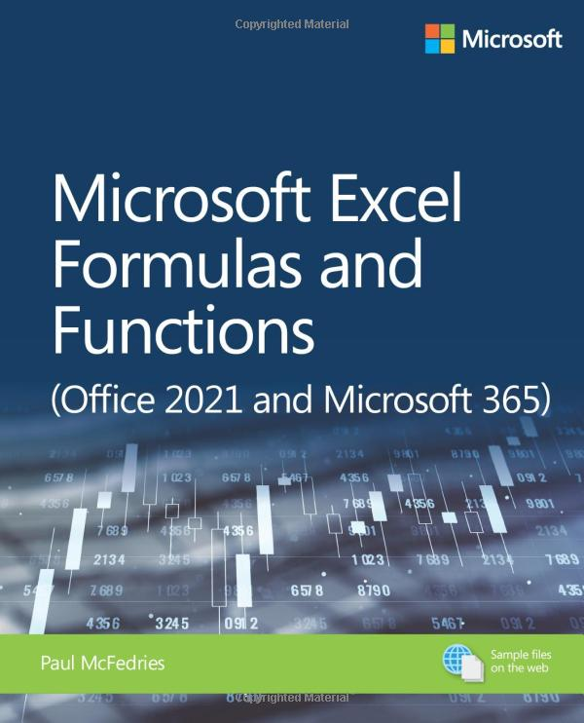
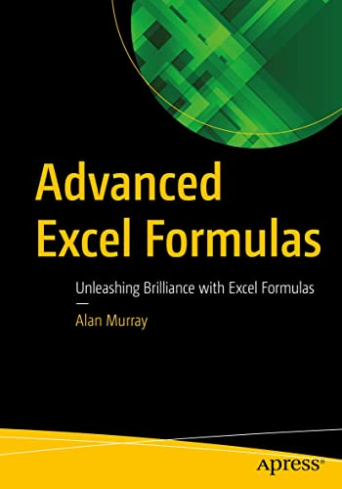
Reading list
Microsoft Excel Formulas and Functions (Office 2021 and Microsoft 365) by Paul McFedries
Advanced Excel Formulas: Unleashing Brilliance with Excel Formulas by Alan Murray

Slide 65
Stay tuned for other courses!
Data wrangling with Power Query
Mastering PivotTable dashboards & reports
Business statistics in Excel
Python analytics for Excel users

Slide 66
Questions?

Slide 67
Find me
georgejmount.com
@gjmount
github.com/stringfestdata

Slide 68
Thank you

