Slide 1

Notes:
https://swiy.co/musopen

Slide 2
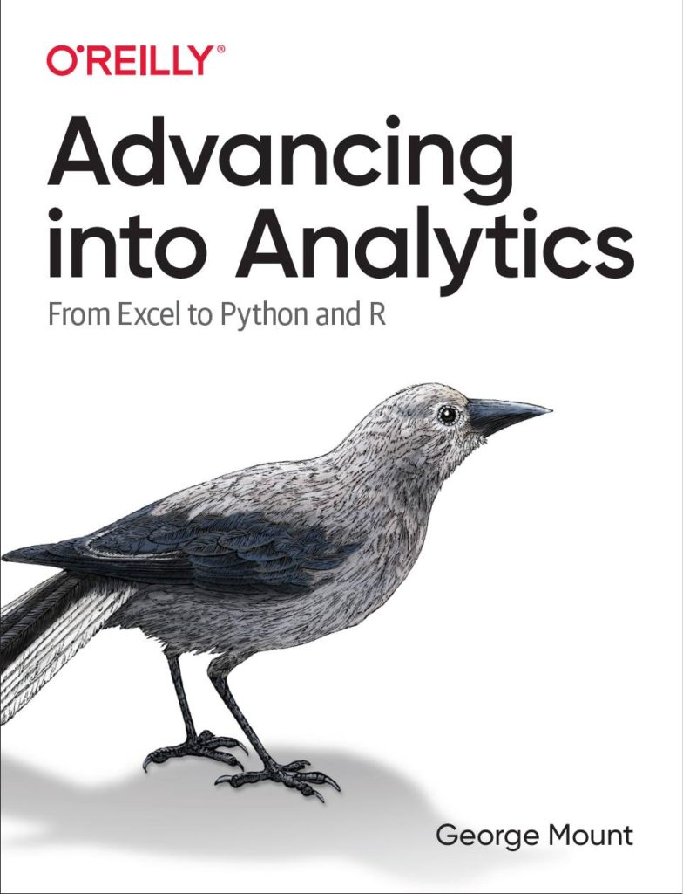



Hi, I’m George

Slide 3

OBJECTIVES
Make first impressions with the data using Power Query profiling
Conduct ad-hoc analysis with PivotTables
Pulling data fast with dynamic arrays
Analytics in Modern Excel

Slide 4
FOLLOWING ALONG
Download resources:
https://swiy.co/amx
Analytics in Modern Excel
Notes:
https://swiy.co/amx

Slide 5
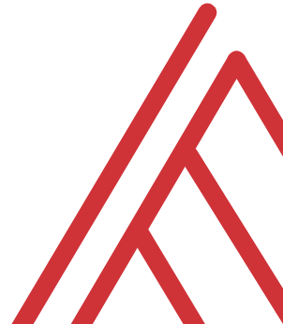
Terms of engagement
Feel free to share the download link with latecomers ☺
Participation is welcome via the chat/unmute
Demos work best with 365 for PC
Recording goes out later today, moves to Patreon after 2 days
I will do my best to answer your questions

Slide 6

QUESTIONS?

Slide 7
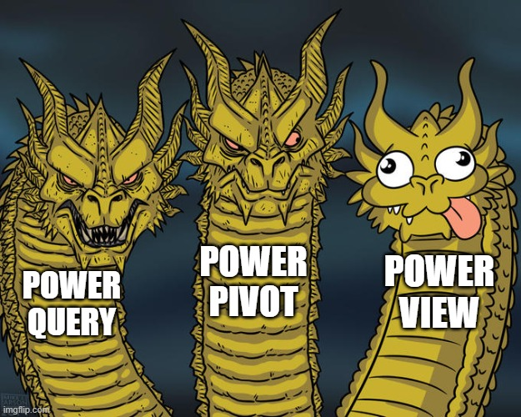
WHAT IS MODERN EXCEL?
Historically:
Power Query
Power Pivot
Power View
We’ll substitute
Dynamic arrays
Notes:
There’s also let and lambda

Slide 8
Data prep & profiling with Power Query
File: computers.xlsx
Profiling the data for potential issues
Adding an index column for slicing and dicing
Notes:
Now you are hyped up Power Query, I think you are going to love it and it will be hard for you to remember the days when you didn’t have it. So let’s think about what we would do without Power Query.

Slide 9
Ad-hoc analyzing with PivotCharts
Continue computers.xlsx
Compare distribution of computer price by category
We want to reshape without aggregating!
Notes:
Now you are hyped up Power Query, I think you are going to love it and it will be hard for you to remember the days when you didn’t have it. So let’s think about what we would do without Power Query.

Slide 10
Pulling data fast with dynamic arrays
Continue computers.xlsx
Sort, filter and de-duplicate right from the spreadsheet
Notes:
Now you are hyped up Power Query, I think you are going to love it and it will be hard for you to remember the days when you didn’t have it. So let’s think about what we would do without Power Query.

Slide 11


Find me
stringfestanalytics.com
Linkedin.com/in/gjmount
Twitter.com/gjmount

Slide 12
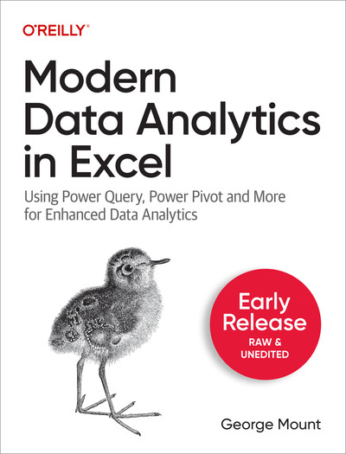
Modern Data Analytics in Excel
Available in early release: https://stringfestanalytics.com/maxl/

Slide 13
Join my Patreon
https://social.stringfestanalytics.com/patreon
Get lifetime access to all past webinar recordings & downloads

Slide 14

TAKE THE SURVEY
How did I do today? Testimonials or other data welcome.
https://social.stringfestanalytics.com/event-feedback
Notes:
I’m a data analyst give me data on how I did
Testimonials also VERY helpful.

Slide 15
FINAL QUESTIONS?
Thanks for joining!
A recap email with recording, survey and more will be coming…
The recording stays up for 48 hours, then moves to my Patreon
I appreciate your reviews & referrals.
Notes:
Any questions on descriptive statistics?

