Slide 1

Notes:
https://swiy.co/musopen

Slide 2
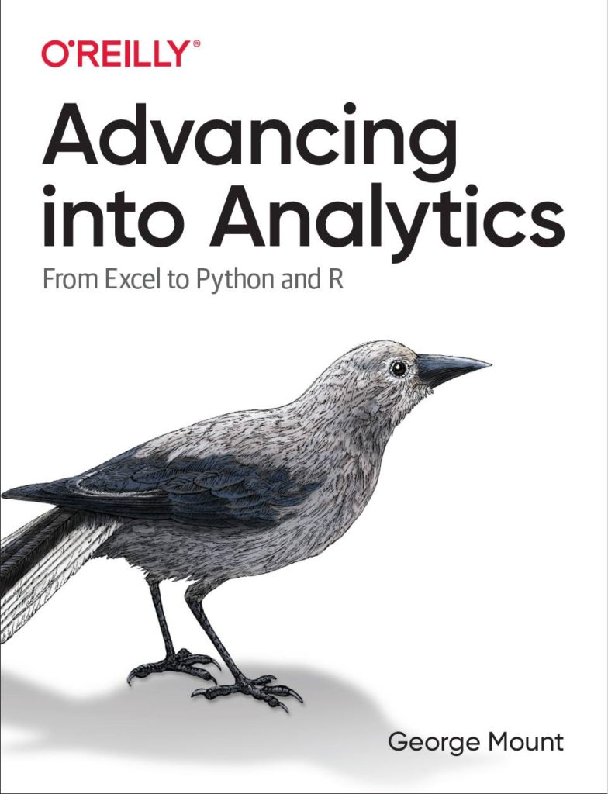




HI, I’M GEORGE
AI-Powered Excel

Slide 3
OBJECTIVES
U﻿se Analyze Data to generate AI-powered insights
Properly structure your data to get the most of these features
G﻿et the most of ChatGPT for troubleshooting and exploring your data
AI-Powered Excel

Slide 4
FOLLOWING ALONG
Download resources:
https://swiy.co/aixld
AI-Powered Excel
Notes:
https://swiy.co/amx

Slide 5
FOLLOWING ALONG
Start with a Slido:
https://app.sli.do/event/iTwXfWSvua2rmGDQxEmich
AI-Powered Excel
Notes:
https://swiy.co/amx

Slide 6
TERMS OF ENGAGEMENT
Feel free to share the download link with latecomers ☺
Participation is welcome via the chat (or please ask to be unmuted!)
Demos work best with 365 on Windows, I cannot guarantee other systems
Recording goes out later today and is up for one week
AI-Powered Excel

Slide 7

QUESTIONS?

Slide 8
Natural language queries with Analyze Data
File: wholesale-customers.xlsx
What PivotTables and charts can we create with this feature?
Where does it fall short?
Notes:
Now you are hyped up Power Query, I think you are going to love it and it will be hard for you to remember the days when you didn’t have it. So let’s think about what we would do without Power Query.

Slide 9
Preparing data for AI with Power Query
Getting data to “tidy” → Every variable is in one and only one column
Unpivoting
Notes:
Now you are hyped up Power Query, I think you are going to love it and it will be hard for you to remember the days when you didn’t have it. So let’s think about what we would do without Power Query.

Slide 10
QUESTIONS?

Slide 11

Exercise
File: life-expectancy.png
Together: Read in this data from an image!
On your own: Use Analyze Data to visualize average life expectancy over time
You might need to reshape ☺

Slide 12
Getting the most of Excel with ChatGPT
Open ChatGPT and let’s try it out:
Using familiar datasets
Loading data as Markdown or CSV
Generating new data via Python
Share your tips and tricks!

Slide 13
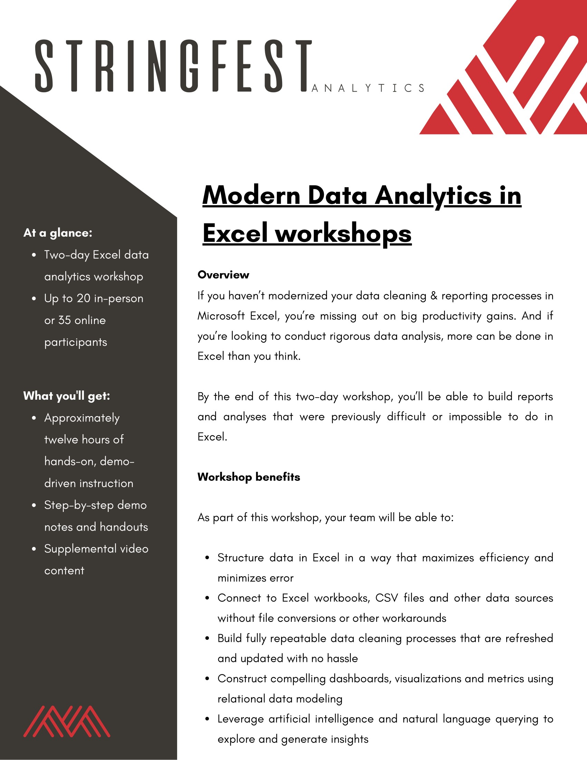
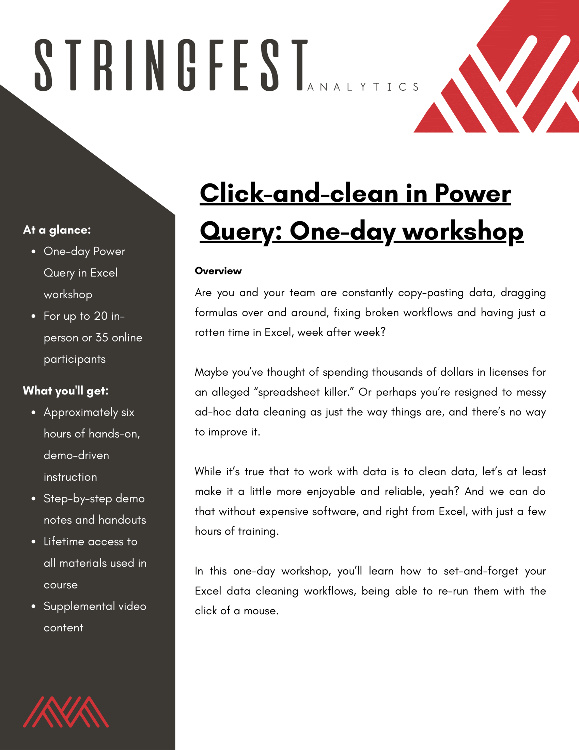
Modern Analytics in Excel workshops
Learn more and connect at https://stringfestanalytics.com/modern-data-analytics-in-excel-workshops/
Human Centered Design • MDLS 2020
Notes:
If you are looking to individually take a Power Query class I have a surprise here at the end…

Slide 14
Advancing into Analytics
Learn more and where to get it: stringfestanalytics.com/book
Human Centered Design • MDLS 2020
Notes:
If you are looking to individually take a Power Query class I have a surprise here at the end…

Slide 15
REFERRAL PROGRAM
Refer me to a training client & get
Two 45-minute coaching sessions
Signed copies of Advancing into Analytics and Modern Data Analytics in Excel (when available)
Get in touch: https://stringfestanalytics.com/contact/
Notes:
There’s also let and lambda

Slide 16

THANK YOU
LINKEDIN
linkedin.com/in/gjmount
EMAIL ADDRESS
george@stringfestanalytics.com
WEBSITE
stringfestanalytics.com
TWITTER
twitter.com/gjmount
Notes:
Thanks for coming! Feel free to contact me anytime, find me on LinkedIn, I also write frequently on this stuff so check out my website too.

Slide 17
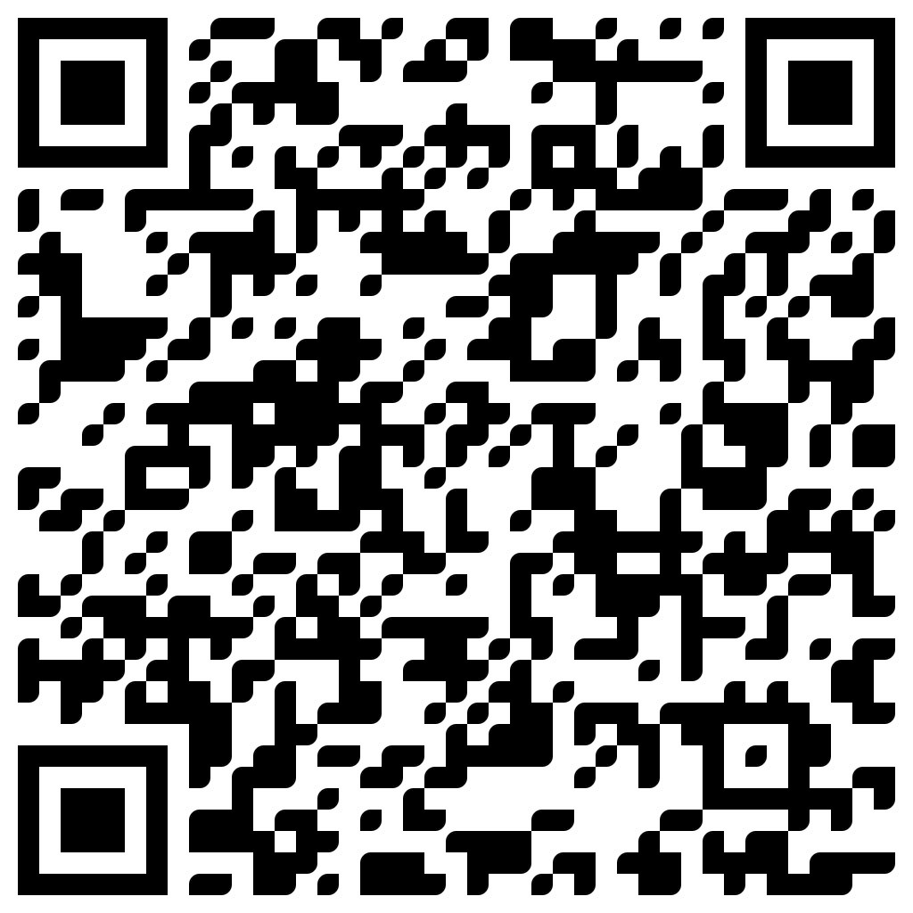
TAKE THE SURVEY
How did I do today? Testimonials or other data welcome!
https://social.stringfestanalytics.com/event-feedback
Notes:
I’m a data analyst give me data on how I did
Testimonials also VERY helpful.

Slide 18
FINAL QUESTIONS?
Thanks for joining!
A recap email with recording, survey and more will be coming…
The recording stays up for seven days.
I appreciate your reviews & referrals.
Notes:
Any questions on descriptive statistics?

