Slide 1

Notes:
https://swiy.co/musopen

Slide 2
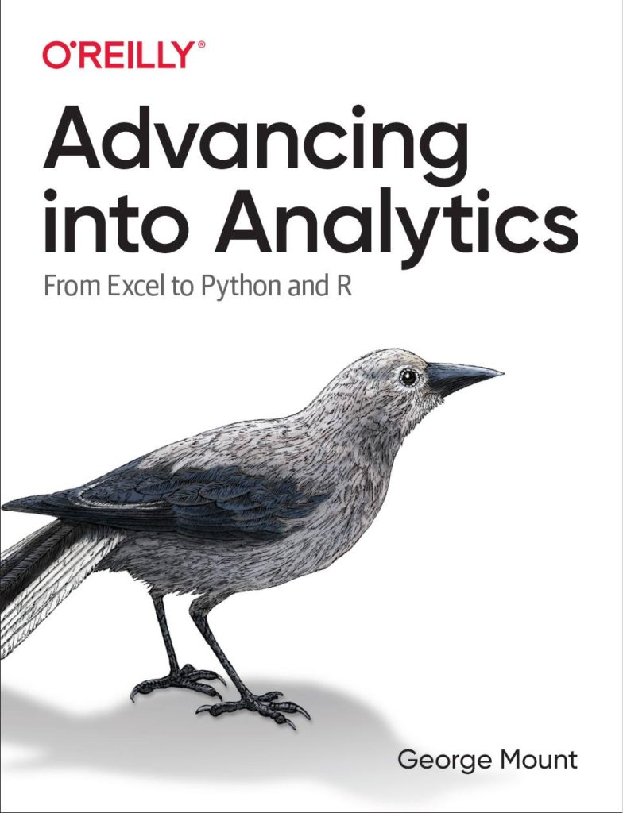



Hi, I’m George

Slide 3

OBJECTIVES
Make first impressions with the data using Power Query profiling
Conduct ad-hoc analysis with PivotTables
Pull data fast with dynamic array functions
Prepare for AI-Powered Excel
Analytics in Modern Excel

Slide 4
FOLLOWING ALONG
Download resources:
https://swiy.co/I7aT
Analytics in Modern Excel
Notes:
https://swiy.co/amx

Slide 5
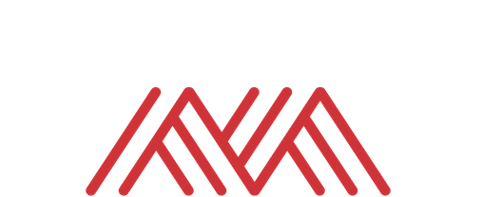
QUESTIONS?

Slide 6
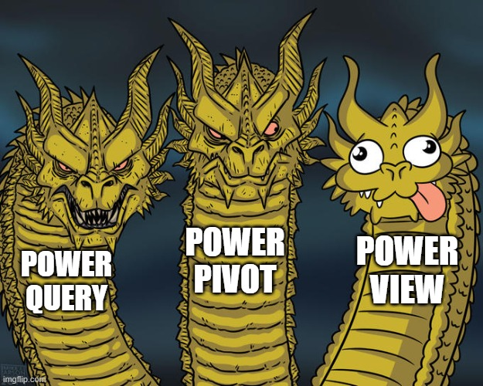
WHAT IS MODERN EXCEL?
Historically:
Power Query
Power Pivot
Power View
We’ll substitute
Dynamic arrays
Notes:
There’s also let and lambda

Slide 7
Data prep & profiling with Power Query
File: computers.xlsx
Profiling the data for potential issues
Adding an index column for slicing and dicing
Notes:
Now you are hyped up Power Query, I think you are going to love it and it will be hard for you to remember the days when you didn’t have it. So let’s think about what we would do without Power Query.

Slide 8
Ad-hoc analyzing with PivotCharts
Continue computers.xlsx
Compare distribution of computer price by category
We want to reshape without aggregating!
Notes:
Now you are hyped up Power Query, I think you are going to love it and it will be hard for you to remember the days when you didn’t have it. So let’s think about what we would do without Power Query.

Slide 9
Pulling data fast with dynamic arrays
Continue computers.xlsx
Sort, filter and de-duplicate right from the spreadsheet
Notes:
Now you are hyped up Power Query, I think you are going to love it and it will be hard for you to remember the days when you didn’t have it. So let’s think about what we would do without Power Query.

Slide 10
AI-Powered Excel
Continue computers.xlsx
Sort, filter and de-duplicate right from the spreadsheet
Notes:
Now you are hyped up Power Query, I think you are going to love it and it will be hard for you to remember the days when you didn’t have it. So let’s think about what we would do without Power Query.

Slide 11
Analyze Data & Preparing for Generative AI
computers.xlsx
Sort, filter and de-duplicate right from the spreadsheet
Notes:
Now you are hyped up Power Query, I think you are going to love it and it will be hard for you to remember the days when you didn’t have it. So let’s think about what we would do without Power Query.

Slide 12


Find me
stringfestanalytics.com
Linkedin.com/in/gjmount
Twitter.com/gjmount

Slide 13
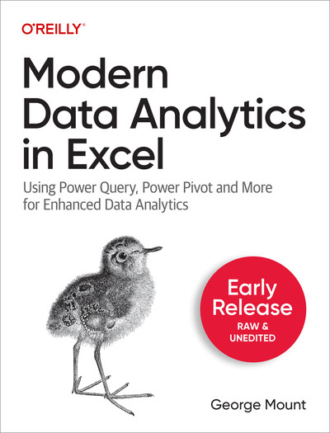
Modern Data Analytics in Excel – the book!
Available in early release: https://stringfestanalytics.com/maxl/

Slide 14
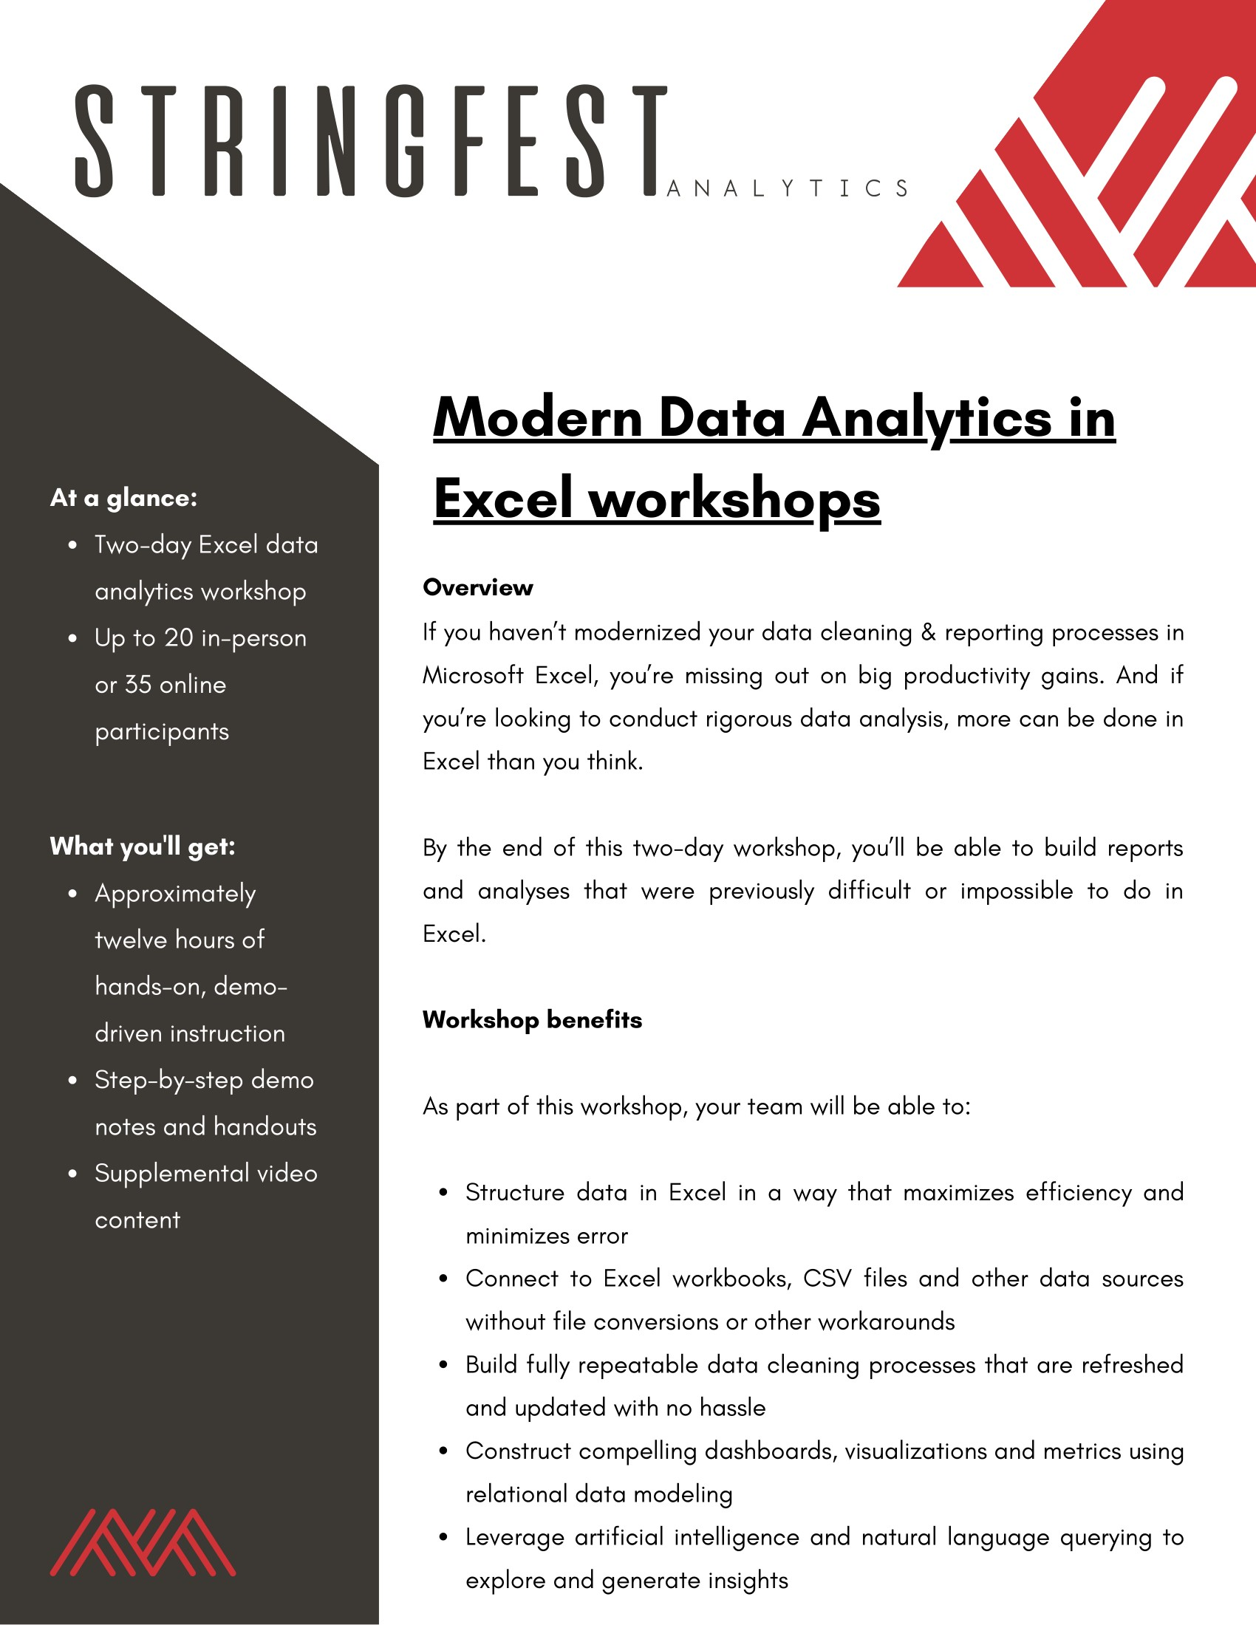
Modern Data Analytics in Excel – the workshops!
Get in touch: https://stringfestanalytics.com/modern-data-analytics-in-excel-workshops/

Slide 15

TAKE THE SURVEY
How did I do today? Testimonials or other data welcome.
https://social.stringfestanalytics.com/event-feedback
Notes:
I’m a data analyst give me data on how I did
Testimonials also VERY helpful.

